Slide 1
TCP Westwood(+) Protocol Implementation in ns-3
Authors: Siddharth Fangadhar, Truc Anh N. Nguyenm Greeshma Umapathi, and James P.G. Sterbenz
CS577
Brett Levasseur

Slide 2
Outline
Introduction
TCP Variations
ns-3 TCP Implementation
ns-3 Westwood Implementation
Evaluation
Conclusions
Remarks
Questions

Slide 3
Introduction
ns-3 is a packet network simulator
Successor to ns-2
Improved design, better wireless support
Used by researchers around the world
Has TCP implementation
Lacks modern TCP variants
Tahoe, Reno, NewReno
Authors present Westwood(+) for ns-3

Slide 4
TCP Tahoe
Terms
cwnd: Congestion Window
ssthresh: Slow Start Threshold
TCP States
Slow-start: cwnd exponential increase
Congestion Avoidance: cwnd linear increase
Fast Retransmit: Half ssthresh, reset cwnd to 1
Timeouts and duplicate ACKs (DUPACK) considered congestion

Slide 5
TCP Tahoe
Congestion avoidance
Timeout or 3 DUPACK
ssthresh
Slow start

Slide 6
TCP Reno
Tahoe vs Reno
Tahoe: 3 DUPACKs move to fast retransmit
Reno: 3 DUPACKs half ssthresh and cwnd, move to fast recovery
Fast Recovery
Retransmit missing packet
Wait for ACK before congestion avoidance

Slide 7
TCP Reno
Timeout or 3 DUPACK
Congestion avoidance
ssthresh
Slow start

Slide 8
TCP NewReno
Adds partial and full ACKs
Partial ACK remain in fast recovery
Full ACK continues congestion avoidance
Transmission Window
1
2
3
4
5
6
7
8
9
Partial ACK = 4, 6, 8
Full ACK = 9

Slide 9
TCP Packet Corruption
Lost packets considered congestion
Wireless has bursty errors
High wireless bit error rate confused as congestion
TCP lowers cwnd needlessly
Wireless loss

Slide 10
TCP Westwood
Made for wireless networks
Estimates bandwidth
Set cwnd based on estimate
Set ssthresh based on estimate
Rate of ACK and DUPACK arrivals used
BWE | ˆb
BWA | b
Weight | a = 0.9
Time | k

Slide 11
TCP Westwood+
ACK compression hurts Westwood estimation
Westwood+ compensates
Samples every RTT instead of every ACK
ACK
Flow 1
ACK
ACK
Data
ACK
Data
ACK
ACK
Data
Flow 2

Slide 12
TCP in ns-3
Object oriented design
Generic TCP defined
TCP variants are extended from base
TCP headers and buffers provided
Contribution

Slide 13
Global Variables
m_cWnd | Congestion window
m_ssThresh | Slow start threshold
m_initialCWnd | Initial value of m_cWnd
m_inFastRec | Fast recovery flag
m_prevAckNo | Last received ACK
m_accountedFor | Track number of DUPACKs during loss
m_lastAck | Arrival time of previous ACK
m_currentBW | Current bandwidth estimate
m_minRTT | Minimum round trip time
m_lastBW | Last bandwidth estimate
m_lastSampleBW | Total measured bandwidth
m_ackedSegments | Total ACKed segments for current RTT
m_IsCount | Flag to count for m_ackedSegments
m_bwEstimateEvent | Bandwidth sampling event

Slide 14
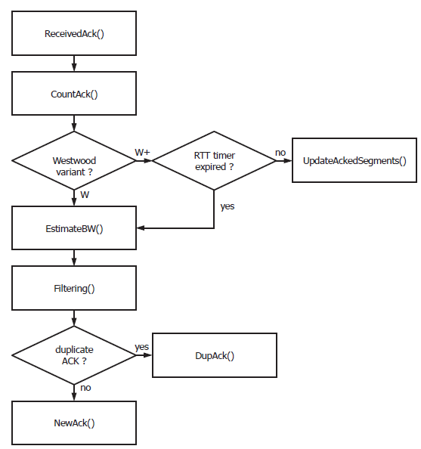
Execution
ACK arrives at sender
ACKs counted
Bandwidth is estimated
Immediate in Westwood
After RTT timeout in +
Optional use of Tustin filter (user choice)
Off: Measured BW
On: Estimate BW

Slide 15
Count ACK
Need total number of bytes sent
Count TCP segments received
cumul_ack = Current ACK number – m_prevAckNo
m_prevAckNo = 6
cumul_ack = 10 - 6
4 Packets received
ACK = 10

Slide 16
Count ACK
Take DUPACKs into account
If cumul_ack = 0 then current ACK is a duplicate
Else check m_accountedFor for number of DUPACKs
m_prevAckNo = 6
cumul_ack = 6 - 6
DUPACK
ACK = 6
m_prevAckNo = 6
cumul_ack = 9 - 6
m_accountedFor = 1
ACKed 3 > 1 DUPACK
3 – 1 = 2 received
m_prevAckNo = 6
cumul_ack = 7 - 6
m_accountedFor = 2
ACKed 1 < 2 DUPACK
cumul_ack = 1
ACK = 9
ACK = 7

Slide 17
Estimate Bandwidth
Westwood
Westwood+
Bytes since last ACK
Time since last ACK
Last known RTT

Slide 18
Tustin Filtering
Off – Measure bandwidth assumed current
On – Estimate current bandwidth
w1
w2

Slide 19
Tustin Filtering
?
w1
w2
From ns-3 source code (version 3.18):
(alpha * m_lastBW) + ((1 - alpha) * ((sample_bwe + m_lastSampleBW) / 2));
w1
w2
Source code and Westwood equation use addition
Equation 4 uses multiplication so probably a typo

Slide 20
Westwood Cont
For new ACK adjust variables same as Reno
After receiving set number of DUPACKs
Adjust slow start threshold
If retransmit timeout
Adjust slow start threshold the same as previous
Cwnd set to one TCP segment size
If m_cWnd > m_ssThresh Then m_cWnd = m_ssThresh

Slide 21
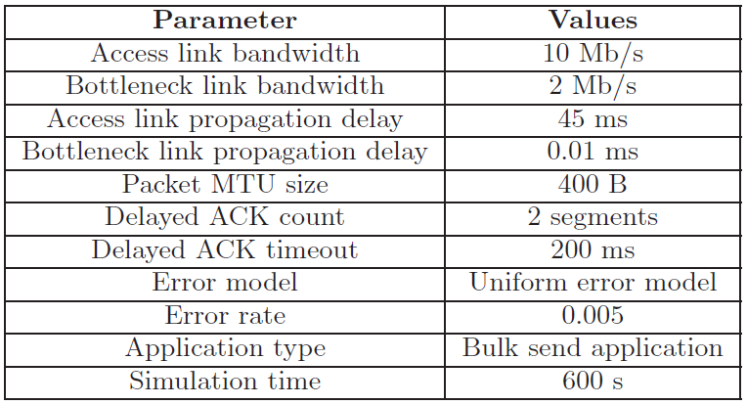
Westwood Evaluation
Simulate original TCP Westwood study
Wireless Link

Slide 22
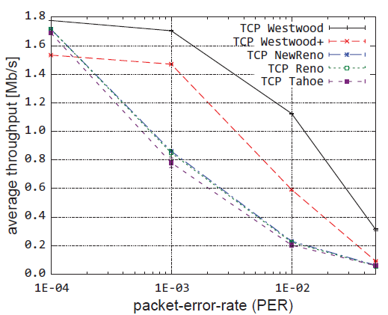
Packet Error Rate
Westwood samples bandwidth on every ACK
Westwood+ samples every RTT
Westwood+ takes longer to stabilize
As error rate increases Westwood+ performs worse

Slide 23
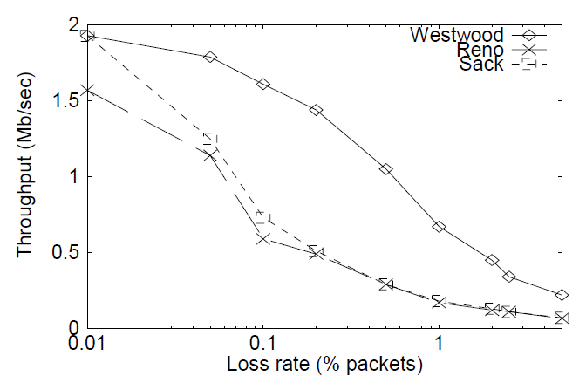
Packet Error Rate
ns-3 Simulation
Westwood Paper
Authors claim this is validation of their work

Slide 24
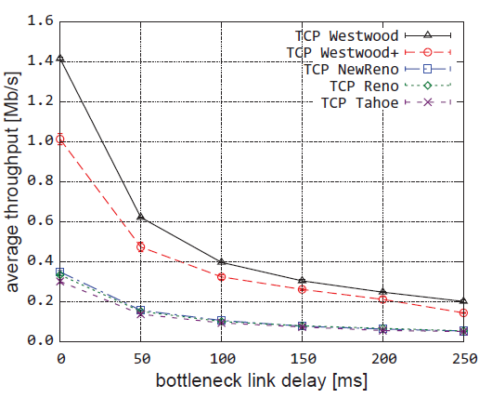
Bottleneck Delay
PER = 0.005
Westwood(+) attempt to fill the pipe
Other variants conservative

Slide 25
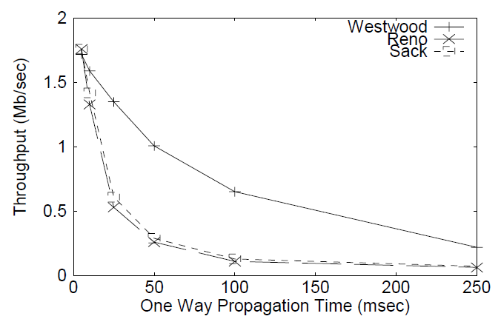
Bottleneck Delay
ns-3 Simulation
Westwood Paper
TCP Reno appears to behave differently in ns-3 vs ns-2

Slide 26
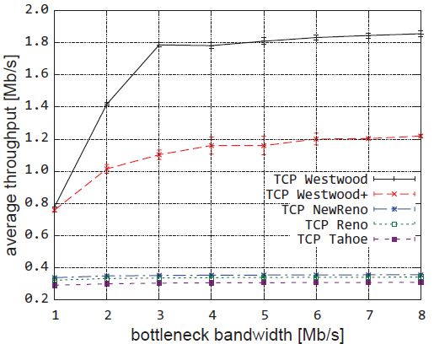
Bottleneck Bandwidth
PER = 0.005
Delay = 0.01ms
Westwood(+) attempt to fill the pipe
Other variants conservative

Slide 27
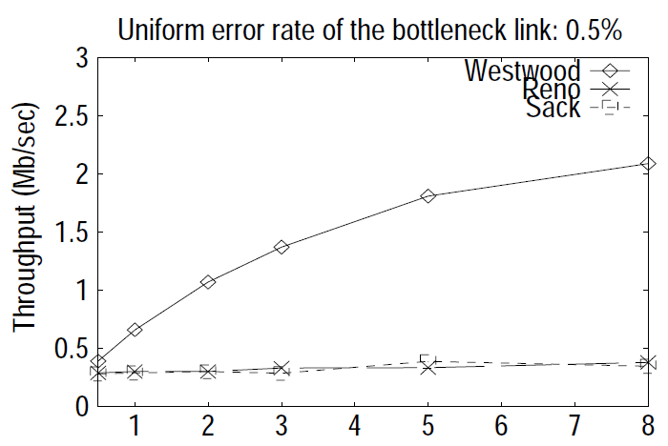
Bottleneck Bandwidth
ns-3 Simulation
Westwood Paper

Slide 28
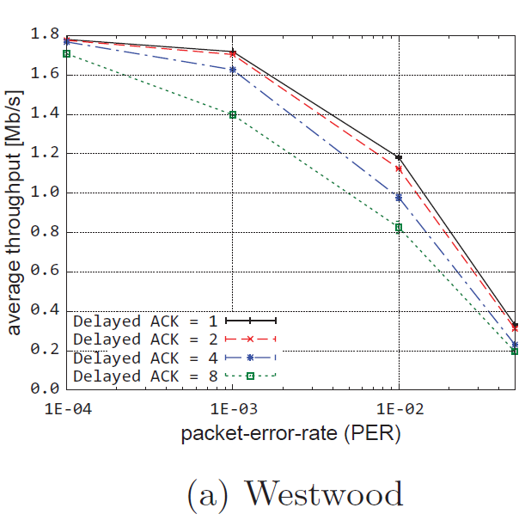
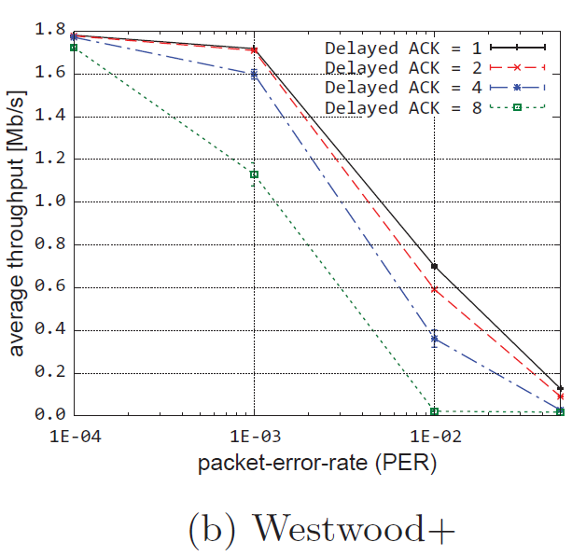
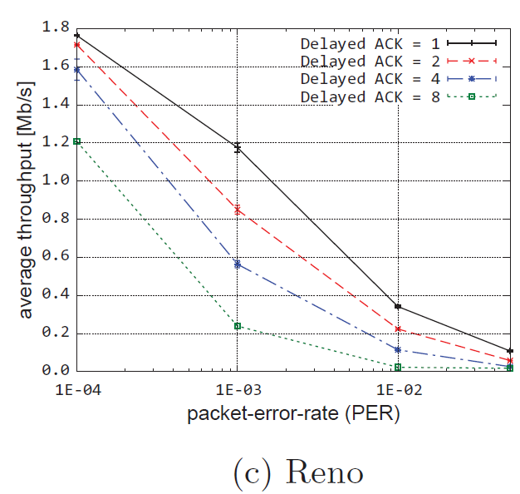
Delayed ACK
Delayed ACK Timeout = 200ms
Notes:
Westwood and Westwood+ perform better than Reno when ACKs are delayed. They have a higher average throughput and less variance than Reno.

Slide 29
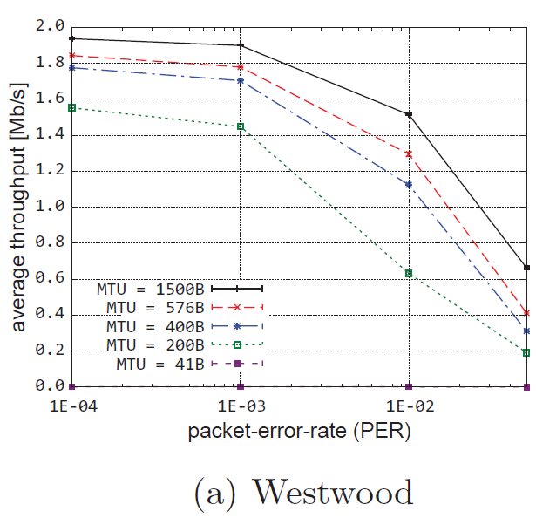
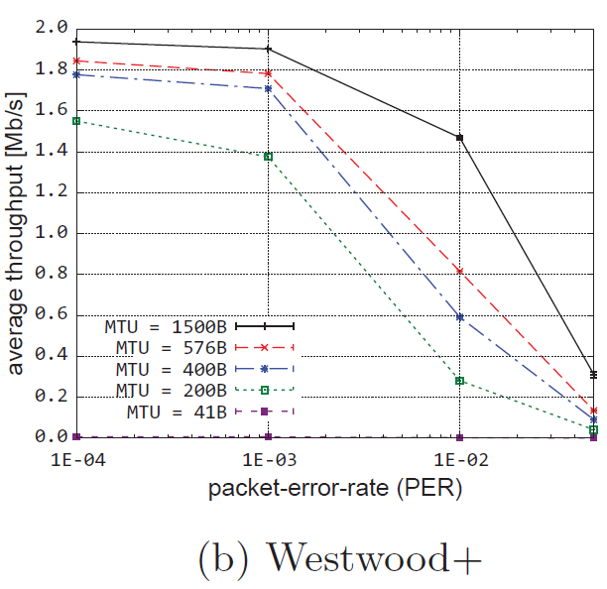
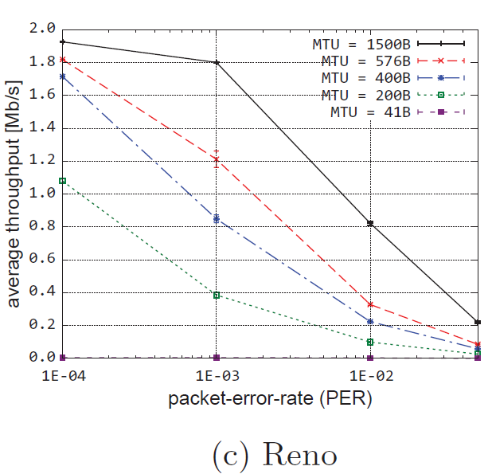
MTU Size
Notes:
Larger MTU sizes perform better.
Westwood and Westwood+ outperform Reno being able to handle higher error rates with less variability.

Slide 30
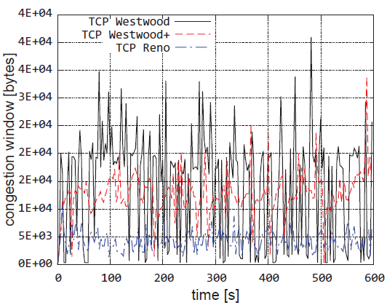
Cwnd Size
PER = 0.005
Samples every 3sec

Slide 31
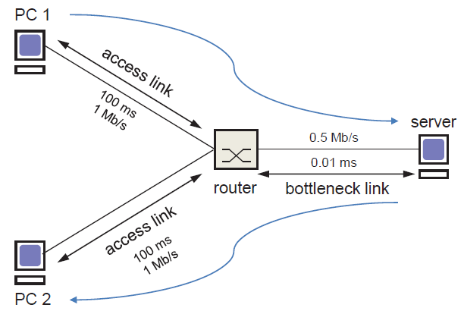
Westwood+ Evaluation
Simulation designed to create ACK compression

Slide 32
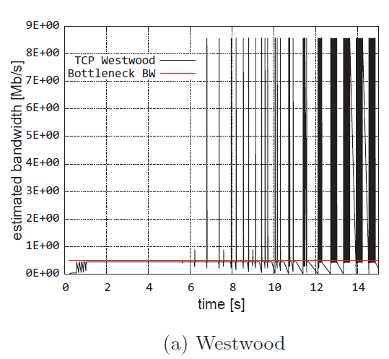
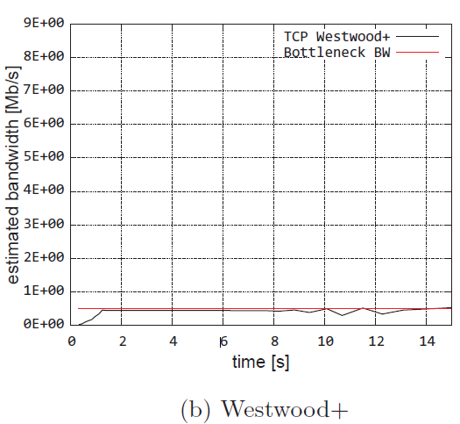
ACK Compression
Westwood overestimates bandwidth
Notes:
Westwood vastly overestimates bandwidth

Slide 33
Conclusions
Created Westwood(+) for ns-3
Validated similar to original Westwood work
Westwood+ better when ACK compression present
Working on TCP SACK and Vegas implementations

Slide 34
Remarks
Inconsistency in Reno implementation
Tests did not emphasize Westwood+ strengths
Comparison to original Westwood work is not as conclusive as author’s suggest
Typo in the Westwood equation

Slide 35
Questions

Slide 36
References
S. Gangadhar, T. Nguyen, G. Umapathi, and J. Sterbenz. TCP Westwood(+) protocol implementation in ns-3. In ICST 2013, pages 167-175.
S. Mascolo, C. Casetti, M. Gerla, M. Sanadidi, and R. Wang. TCP westwood: Bandwidth estimation for enhanced transport over wireless links. In MOBICOM 2001, pages 287–297.

