Slide 1
A Close Examination of Performance and Power Characteristics of 4G LTE Network
Junxian Huang Feng Qian Alexandre Gerber
Z. Morley Mao Subhabrata Sen Oliver Spatscheck
University of Michigan AT&T Labs - Research
Presented by Tianxiong Yang
Advanced Computer Networks
Fall 2014

Slide 2
CATALOGUE
Introduction
Background
Methodology
LTE network characterization
LTE power model construction
User trace based tradeoff analysis
Application performance impact
Conclusion

Slide 3
INTRODUCTION
The nomenclature of the generations generally refers to:
a change in the fundamental nature of the service
non-backwards-compatible transmission technology
higher peak bit rates
new frequency bands
wider channel frequency bandwidth in Hertz
higher capacity for many simultaneous data transfers.

Slide 4
INTRODUCTION
New mobile generations have appeared about every ten years since the first move
1G: 1981 ----------------14.4 Kbps (peak)
2G: 1992 ----------------56 Kbps to 115 Kbps
3G: 2001 ----------------up to 21Mbps
4G: 2011 ----------------up to 128 Mbps
The targeted user throughput of 4G is 100Mbps for downlink and 50Mbps for uplink with less than 5ms user-plane latency.

Slide 5
INTRODUCTION
Contributions:
This paper is one of the first studies on commercial LTE networks
Researchers develop the first empirically derived comprehensive power model of a commercial LTE network, considering both uplink and downlink data rates in addition to state transitions and Discontinuous reception (DRX).
Researchers build a trace-driven LTE analysis modeling framework, which breaks down the total energy consumption into different components, to identify the key contributor for energy usage.
Researchers perform case studies of several popular applications on Android to understand the impact of improved LTE network performance and enhanced user equipment (UE) processing power on applications.

Slide 6
CATALOGUE
Introduction
Background
Methodology
LTE network characterization
LTE power model construction
User trace based tradeoff analysis
Application performance impact
Conclusion

Slide 7
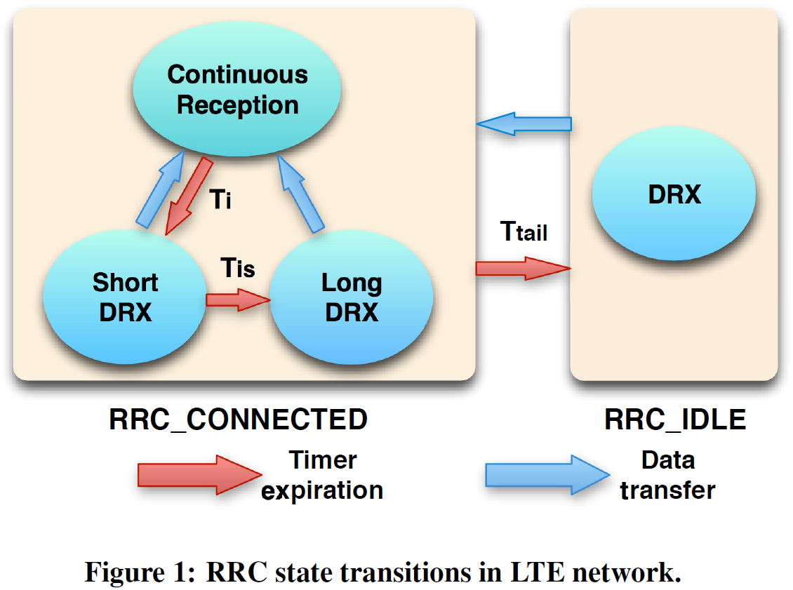
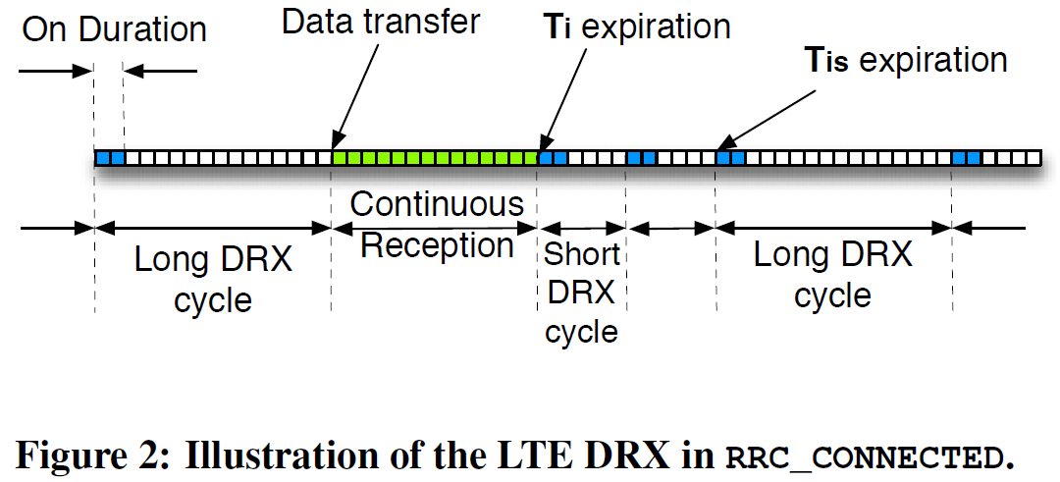
BACKGROUND
Radio Resource Control (RRC) and Discontinuous Reception (DRX) in LTE
RRC_CONNECTED state has three modes:
Continuous Reception, Short DRX and Long DRX.
RRC_IDLE state has only one mode:
DRX mode.

Slide 8
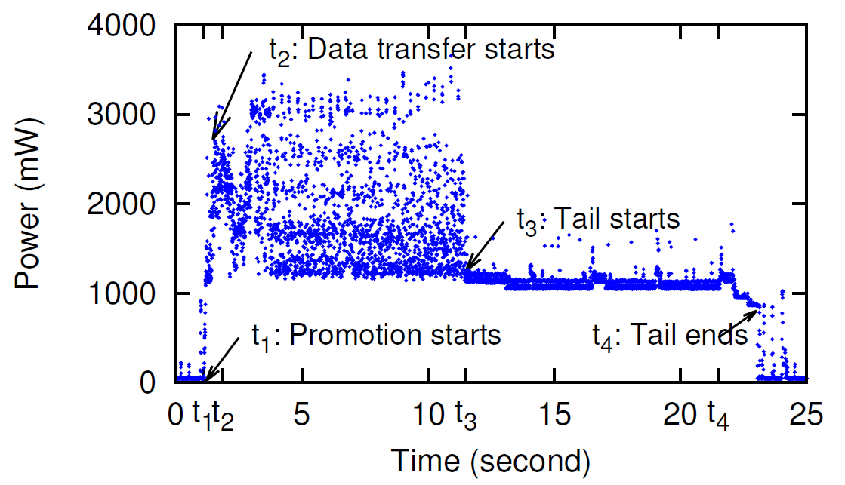
BACKGROUND
Smartphone power model for LTE
T₁: a TCP SYN packet is sent to trigger RRC_IDLE to RRC_CONNECTED. Power level rises.
T₂: T_{pro} (promotion time) seconds after t₁, data transfer starts. Power level fluctuates depending on instant data rate.
T₃: Data transfer ends; UE remains in RRC_CONNECTED for T_{tail}. Power level remains stable for UE to start data activity at any time.
T₄: t_{tail} expires, UE goes back to RRC_IDLE. Power level is low to save energy.

Slide 9
CATALOGUE
Introduction
Background
Methodology
LTE network characterization
LTE power model construction
User trace based tradeoff analysis
Application performance impact
Conclusion

Slide 10
METHODOLOGY
Present methodology for:
Network
Power measurement
Trace-driven simulation analysis
Real application case studies

Slide 11
METHODOLOGY—NETWORK MEASUREMENT
The design of 4GTest
4GTest is improved from 3GTest, which is designed by researchers of this paper.
4GTest is able to test different network types: 3G, WiFi and LTE
Measurement methodology is improved to leverage the M-Lab support, which is an open, distributed server platform.

Slide 12
METHODOLOGY—NETWORK MEASUREMENT
The design of 4GTest--RTT and variation test
In 4GTest, a nearest M-Lab node is selected for a user based on current GPS location or IP address or both.
To measure RTT and variation, 4GTest repeatedly establishes a new TCP connection with the server and measures the delay between SYN and SYN-ACK packet. Both the median of these RTT measurements and variation are reported to our central server.

Slide 13
METHODOLOGY—NETWORK MEASUREMENT
The design of 4GTest--Throughput test
Since single-threaded TCP measurement is more sensitive to packet loss and hence less accurate, multi-threaded TCP measurement in 4GTest to estimate the peak channel capacity: three nearest server nodes in M-Lab are selected for throughput test.
A throughput test lasts for 20 seconds.
Initial 5 seconds are ignored due to TCP slow start.
Remaining 15 seconds are separated into 15 1-second bins; Median of throughput of all bins is the measured throughput.

Slide 14
METHODOLOGY—POWER MEASUREMENT
Local network measurement
Devices for accessing LTE networks:
LTE Phone: an HTC phone.
LTE Laptop: a laptop equipped with LTE USB Modem running Mac OS X 10.7.2
Packet and CPU trace collection
To capture CPU usage history, researchers write a simple C program to read /proc/stat in Android system every 25ms.
Impact of packet size on one-way delay (OWD)
To understand ~~, uplink and downlink is measured with varying packet size between LTE Laptop and a server.
Comparison between LTE with 3G and WiFi
Researchers compare LTE with 3G and WiFi by local experiments on LTE Phone.

Slide 15
METHODOLOGY—POWER MEASUREMENT
Researchers use Monsoon power monitor as power input for LTE Phone and measuring power traces at the same time, in which Monsoon Solutions, Inc. is an engineering services and consulting company.
For minimizing power noise caused by screen, for all measurement, researchers keep the application running in the background with screen completely off.

Slide 16
METHODOLOGY—APPLLICATION PERFORMANCE
To compare energy consumption for different networks using real user traces and evaluate the impact of setting LTE parameters, researchers devise a systematic methodology for trace-driven analysis, which is applied to a comprehensive user trace data set, named UMICH.
UMICH data set for analysis
UMICH data set is collected from 20 smartphone users for five months totaling 118 GB.
Trace-driven modeling methodology
Researchers build up their own network simulator, whose output is an array of packets with timestamps, in ascending order, RRC and DRX and UE at any time.
They takes the output of network model simulator and calculates the energy consumption.

Slide 17
METHODOLOGY—APPLLICATION PERFORMANCE
Researchers select a few smartphone applications and collect both network and CPU traces on LTE Phone.
Researchers select default browser, YouTube, NPR News and Android Market as sampled applications given their popularity.
Especially for default browser, researchers choose two different usage scenarios visiting:
google.com representing a simple website and
yahoo.com representing a content-rich website
These two websites are named G and Y, respectively.

Slide 18
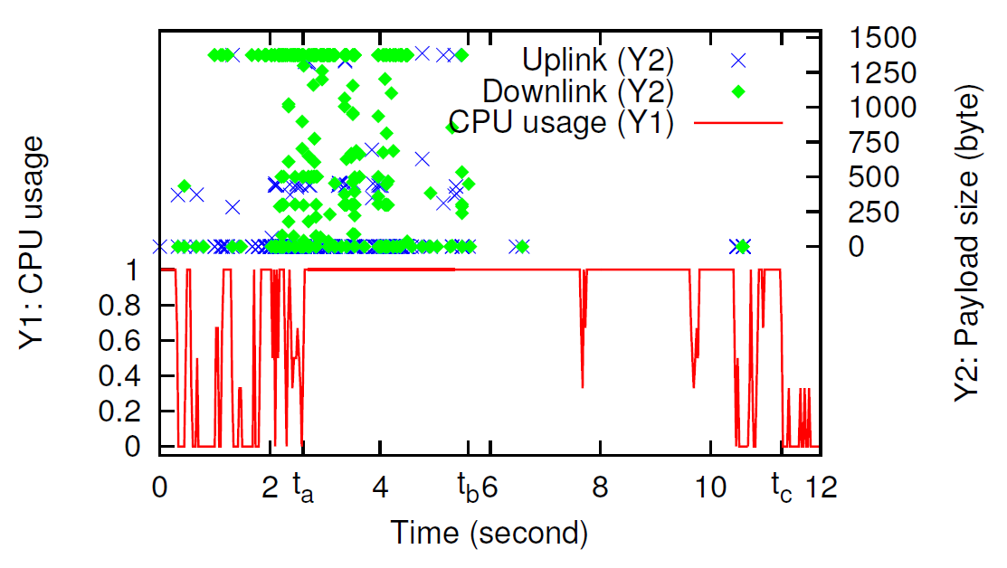
METHODOLOGY—APPLLICATION PERFORMANCE
Figure 4 shows co-located network and CPU trace of Website Y.
Average usage is defined between time 0 and t_{c} to be the CPU usage for this application.
At time 0, Go button is clicked, loading starts.
From 0 to t_{a}, CPU usage stays low most of the time given that UE has not finished downloading the HTML or JavaScript objects.
Starting from t_{a} to t_{b}, CPU jumps up to 100% because UE is downloading web objects and meanwhile rendering HTML pages or JavaScript objects.
From t_{b} to t_{c}, CPU remains 100% because UE has finished downloading but still rendering HTML pages or JavaScript objects.
t_{c} is defined as application loading time.

Slide 19
CATALOGUE
Introduction
Background
Methodology
LTE network characterization
LTE power model construction
User trace based tradeoff analysis
Application performance impact
Conclusion

Slide 20
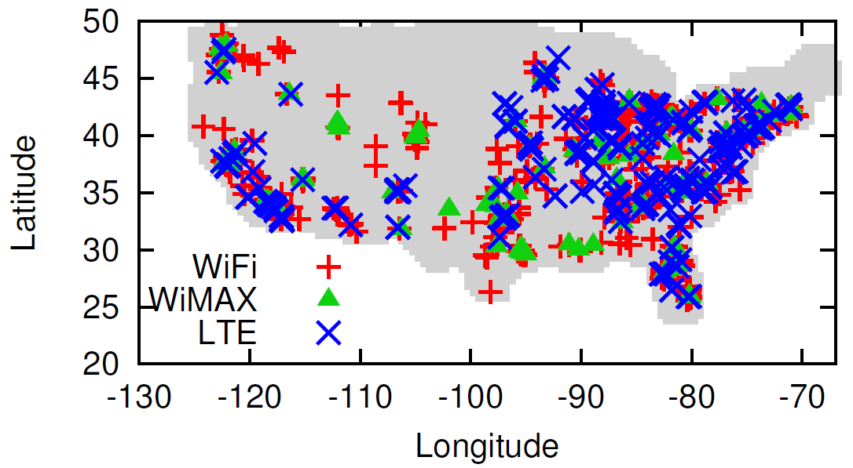
LTE NETWORK CHARACTERIZATIOIN
Comparing LTE to other mobile networks
Figure 6 shows distribution of coverage of LTE, WiMAX and WiFi used by 4G LTE users who download 4GTest.
The coverage of LTE, WiMAX, and WiFi are mostly similar, covering 39, 37 and 44 states in the U.S., respectively.
This indicates that 4GTest data set enables fair comparison on the distribution of performance metrics for different mobile networks in the U.S.

Slide 21
LTE NETWORK CHARACTERIZATIOIN
Comparing LTE to other mobile networks
Figure 5 summarizes performance comparison among various mobile networks.
We can observe that LTE network has a higher downlink and uplink throughput and shorter RTT and RTT jitter.
LTE significantly improves network throughput as well as RTT and RTT jitters.

Slide 22
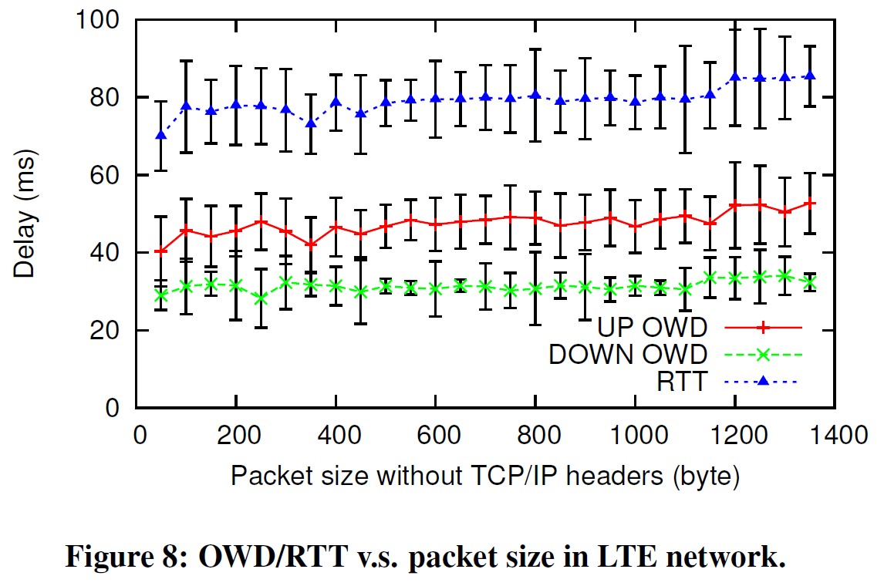
LTE NETWORK CHARACTERIZATIOIN
One-way delay (OWD) and impact of packet size
WiFi:
Both uplink and downlink OWD are around 30ms with little correlation with packet size
RTT is stable around 60ms.
LTE
Uplink OWD is clearly larger than downlink OWD
Uplink OWD slightly increases as packet size grows
Median RTT ranges from 70ms to 86ms as packet size increases.
In summary, RTT in LTE is more sensitive to packet size than WiFi mainly due to uplink OWD.

Slide 23
LTE NETWORK CHARACTERIZATIOIN
Mobility
Researchers measure RTT and downlink/uplink throughput with 4GTest at three different mobile speed: stationary, 35mph and 70mps.
It’s observed that
RTT remains stable at different speeds, with small variation.
Uplink and downlink throughput both have high variation of 3~8Mbps at each of the different speed.
Experiments show that at least at researchers test location, there is no major performance downgrade at high speed for LTE.

Slide 24
LTE NETWORK CHARACTERIZATIOIN
Researchers also study the correlation between LTE performance and time of day.
It’s observed that:
RTT’s median value remain stable at 68ms across different hours
Downlink and uplink throughput variant across different hours but there’s no strong relation with time of day.
Conclusion of section:
LTE has significantly improved network performance over 3G.

Slide 25
CATALOGUE
Introduction
Background
Methodology
LTE network characterization
LTE power model construction
User trace based tradeoff analysis
Application performance impact
Conclusion

Slide 26
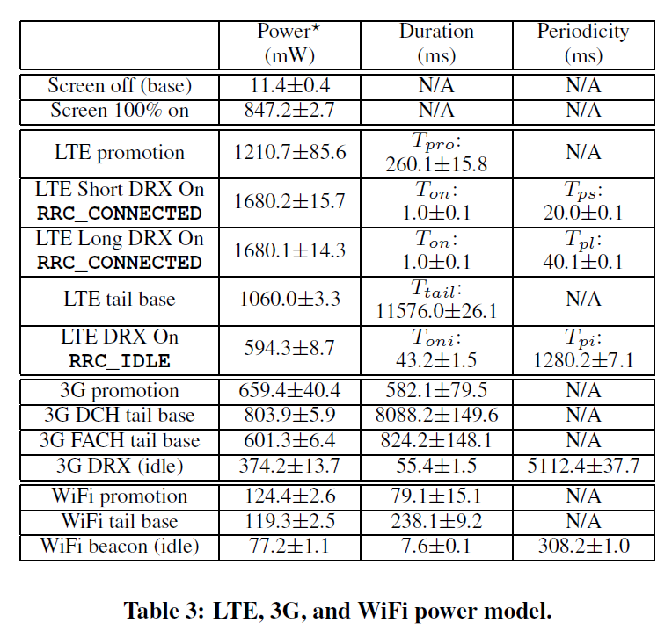
LTE POWER MODEL CONSTRUCTION
Power model for RRC and DRX
Promotion delay (T_{pro})
LTE reduces promotion delay from 3G’s 582.06ms to 260.13ms
Power level of LTE is almost doubled that of 3G, 1210.74mW v.s. 659.43mW
WiFi has most small promotion delay and power level.

Slide 27
LTE POWER MODEL CONSTRUCTION
Power model for RRC and DRX
Tail length
LTE has longest tail (11.576 seconds) with highest tail base power (1060.04 mW).
Summing up DCH and FACH tail, 3G’s total tail time is 8.9 seconds, which is smaller than LTE’s.
WiFi has much shorter tail and lower base power.

Slide 28
LTE POWER MODEL CONSTRUCTION
Power model for RRC and DRX
IDLE mode
LTE has highest power and slightly smaller On Duration than 3G.
WiFi has smallest on power and on duration.
The cycle of LTE (1.28 seconds) is in between 3G and WiFi.

Slide 29
LTE POWER MODEL CONSTRUCTION
Power model for RRC and DRX
Conclusion: LTE is less energy efficient during idle state and for transferring smaller amount of data.
For example: if only one packet is transferred, energy usage considering both promotion and tail energy for LTE, 3G, WiFi is 12.76J, 7.38J and 0.04J, respectively.
*
+
*

Slide 30
LTE POWER MODEL CONSTRUCTION
Power model for data transfer
Linear model is made for uplink throughput t_{u} and downlink throughput t_{d}:
Power level for uplink: P_{u}=α_{u}t_{u}+β
Power level for downlink: P_{d}= α_{d}t_{d}+β
Formula are combined as P= α_{u}t_{u}+α_{d}t_{d}+β
Uplink power increases faster than downlink for all three network types because sending data requires more power than receiving data.

Slide 31
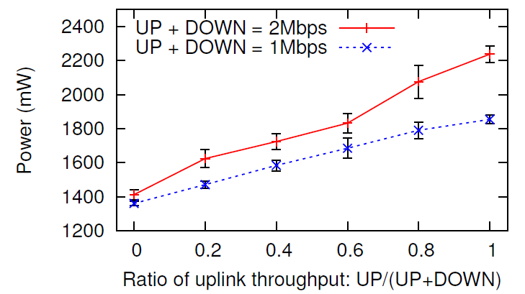
LTE POWER MODEL CONSTRUCTION
Power model for data transfer
Assume total throughput t=t_{u}+t_{d} and the ratio of uplink throughput ε=t_{u}/t
P= α_{u}t_{u} +α_{d}t_{d}+β=(α_{u}- α_{d})tε+α_{d}t+β
When t is a constant, P grows linearly with ε and the slope is (α_{u}- α_{d})t.

Slide 32
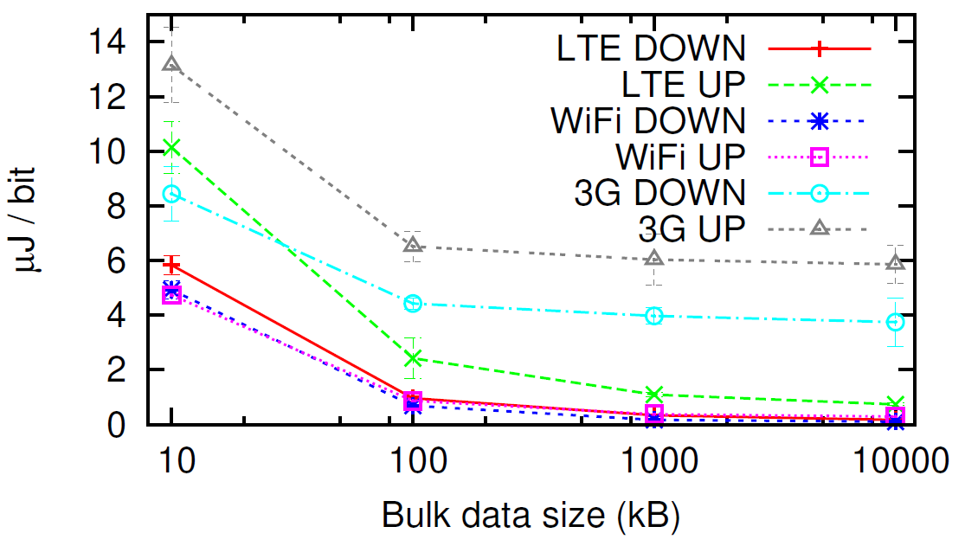
LTE POWER MODEL CONSTRUCTION
Energy efficiency for bulk data transfer
Figure 12 shows energy cost per bit in transmission as bulk data size increases.
Energy per bit decreases as bulk data size increases.
LTE’s energy per bit in downlink is comparable with WiFi
With bulk data size of 10MB, LTE consumes 1.62 times the energy of WiFi for downlink and 2.53 for uplink
3G has the worst energy efficiency for large data transfer

Slide 33
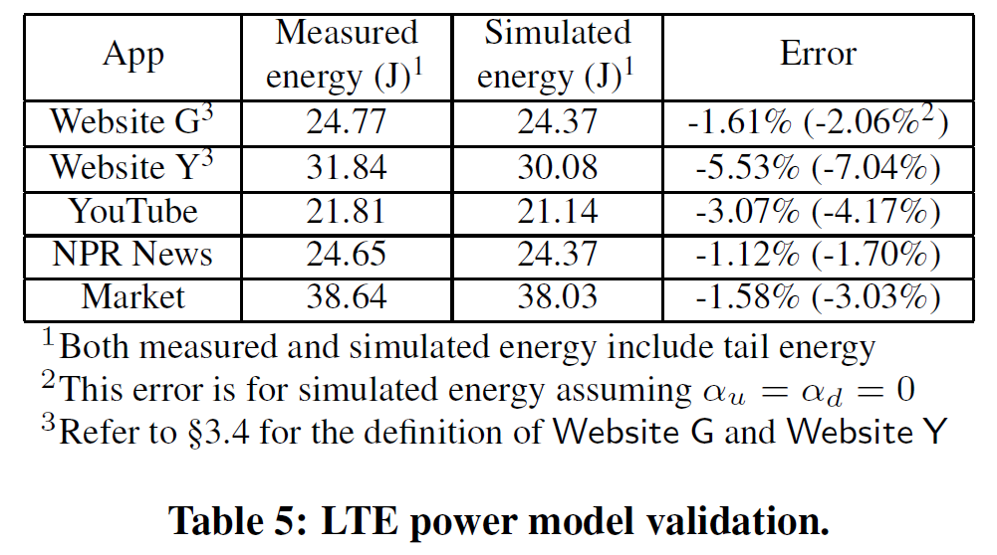
LTE POWER MODEL CONSTRUCTION
Power model validation
To validate the LTE power model and the trace-driven simulation, researchers compare measured energy with simulated energy for case study applications.
The error rate is consistently less than 6%, with the largest error rate from Website Y.

Slide 34
CATALOGUE
Introduction
Background
Methodology
LTE network characterization
LTE power model construction
User trace based tradeoff analysis
Application performance impact
Conclusion

Slide 35
USER TRACE BASED TRADEOFF ANALYSIS
Researchers apply the LTE power model to UMICH data set and compare energy efficiency with 3G and WiFi. In addition, they study the tradeoff of configuring different LTE parameters via analysis framework.

Slide 36
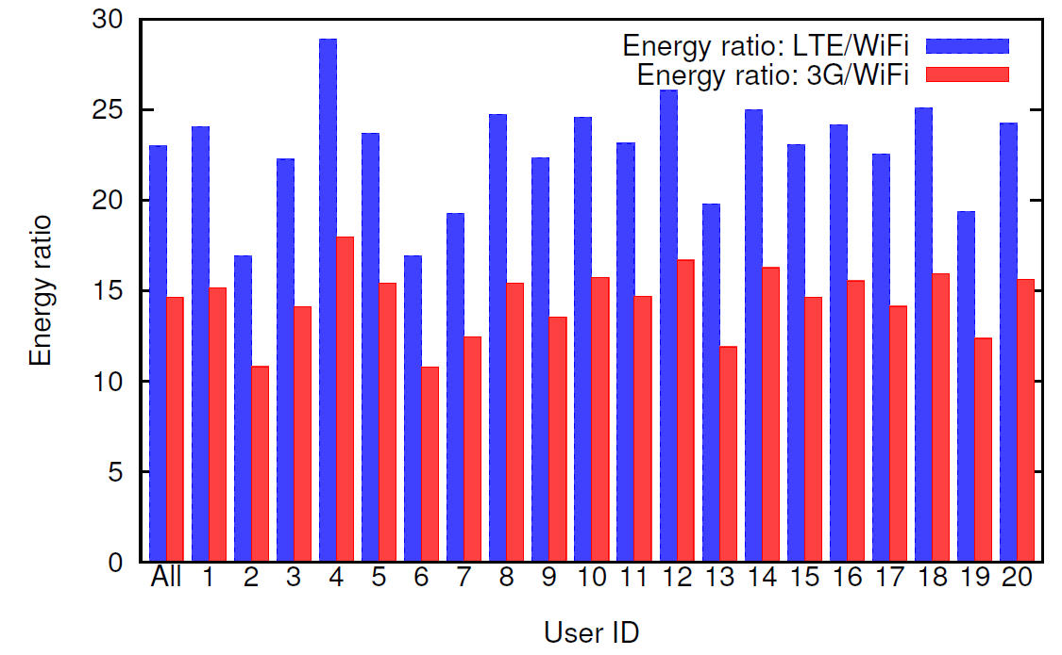
USER TRACE BASED TRADEOFF ANALYSIS
Energy efficiency comparisons
Assume that the simulated energy usage for LTE, WiFi and 3G power model is E_{lte}, E_{wifi} and E_{3g}, respectively.
The energy ratio of LTE/WiFi is E_{lte}/E_{wifi}.
The energy ratio of 3G/WiFi is E_{3g}/E_{wifi}.
Figure 13 shows the two ratio among 20 users.
E_{lte}/E_{wifi} ranges from 16.9 to 28.9 and the aggregate ratio for all users is 23.0.
E_{3g}/E_{wifi} ranges from 10.8 to 18.0 and the aggregate ratio for all users is 14.6, lower than LTE.
In summary, the energy efficiency for LTE is lower than 3G, with WiFi having a much higher energy efficiency.

Slide 37
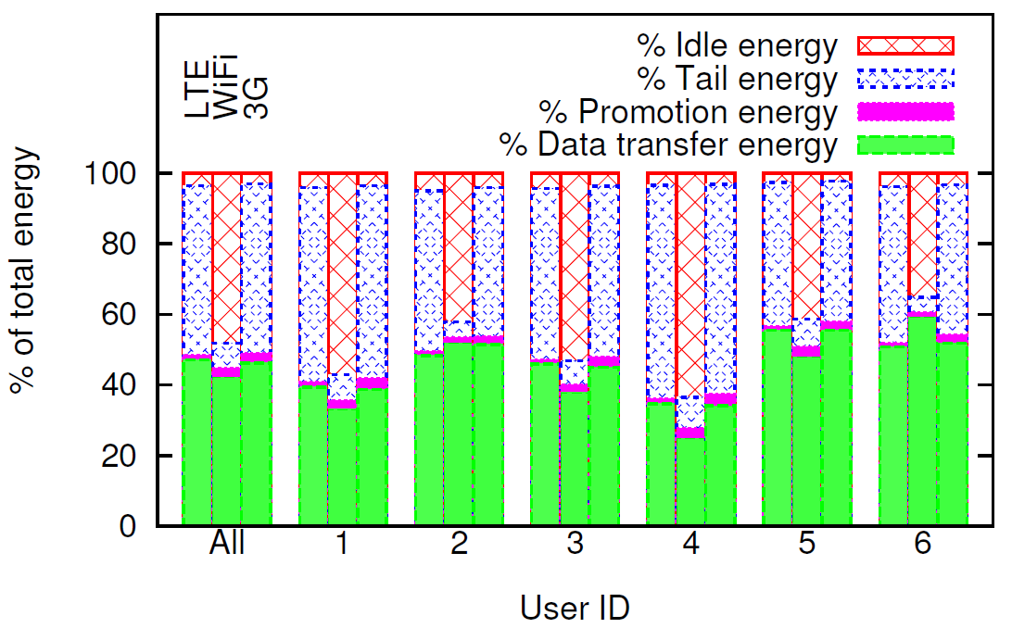
USER TRACE BASED TRADEOFF ANALYSIS
Energy efficiency comparisons
Energy consumption is decomposed into
promotion energy
data transfer energy
tail energy
idle energy
Promotion energy contributes to a small portion.
WiFi has significantly higher percentage of idle energy than LTE and 3G, which can be explained by WiFi’s smaller total energy, making its idle energy contribution relatively higher.
LTE has high variation on aggregate data transfer energy from 22% to 62.3%, due to traffic pattern differences across users.
Surprisingly, the biggest energy component for LTE and 3G network is tail, rather than data transfer, which lowers the energy efficiency of LTE and 3G compared to WiFi.

Slide 38
USER TRACE BASED TRADEOFF ANALYSIS
Impact of LTE parameters
Researchers use WiFi traces in the UMICH data set to study the impact of LTE parameter configuration on radio energy E, channel scheduling delay D and signaling overhead S.
E is the simulated total energy consumed by UE.
D is the sum of scheduling delay for all packets.
S is the overhead of the LTE network for serving this UE.

Slide 39
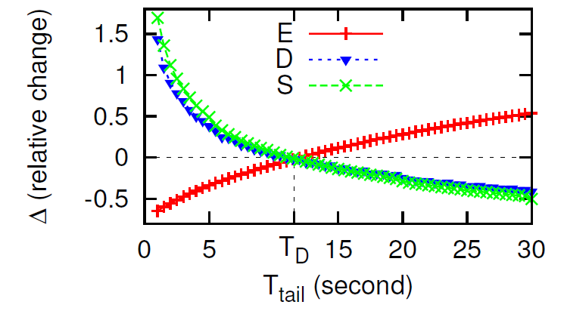
USER TRACE BASED TRADEOFF ANALYSIS
Impact of LTE parameters--LTE tail timer T_{tail}
S id defined to be the total number of RRC_IDLE to RRC_CONNECTED promotions.
T_{tail} varies from 1 second to 30 seconds.
T_{D} is the default configuration of 11.58 seconds for T_{tail}.
∆(E)=(E’-E_{D­})/E_{D}, similar for ∆(D) and ∆(S).
As show in Figure 15, a larger T_{tail} value reduces both ∆(D) and ∆(S) while increases ∆(E).

Slide 40
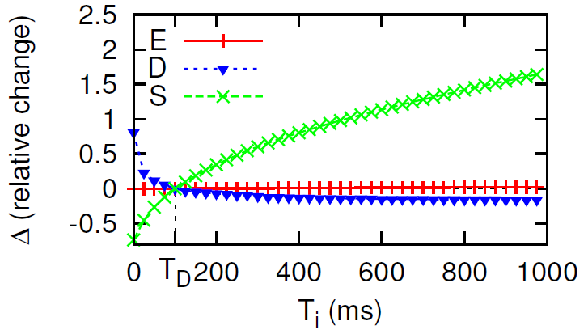
USER TRACE BASED TRADEOFF ANALYSIS
Impact of LTE parameters--DRX inactivity timer T_{i}
In this measurement, Signaling overhead S is defined as the sum of the continuous reception time and DRX On durations in RRC_CONNECTED.
Figure 16 shows that a larger T_{i} keeps UE in continuous reception longer and reduces the scheduling delay for downlink packets, while has negligible impact on E.

Slide 41
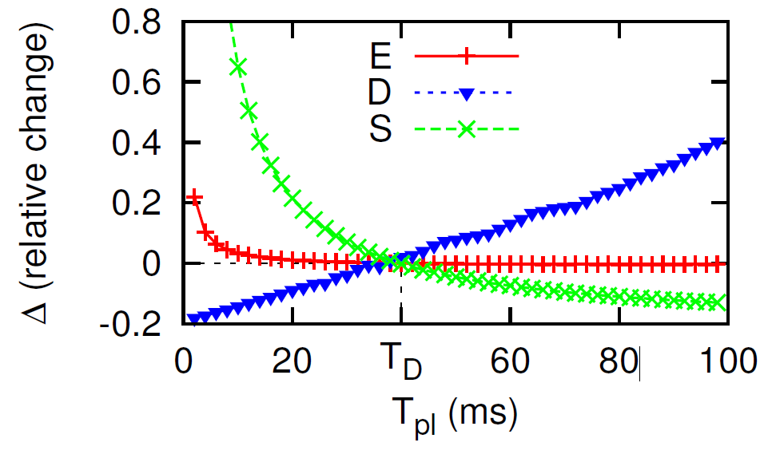
USER TRACE BASED TRADEOFF ANALYSIS
Impact of LTE parameters-- DRX cycle (T_{pl}) in RRC_CONNECTED
S is defined as the sum of the continuous reception time and DRX On durations.
When T_{pl} is set to a very small value, S significantly increases. So T_{pl} is not recommend to be set to too small value.

Slide 42
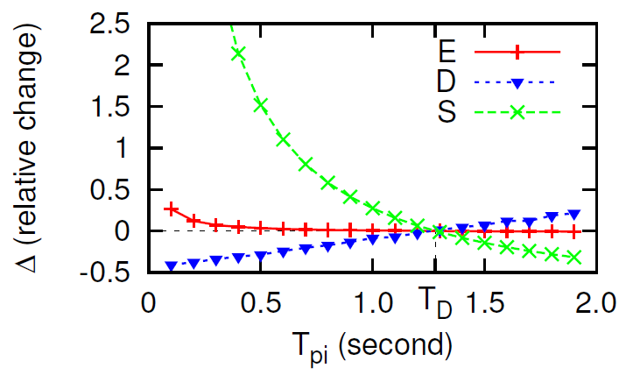
USER TRACE BASED TRADEOFF ANALYSIS
Impact of LTE parameters-- DRX cycle in RRC_IDLE
Similar to T_{pl}, T_{pi­} causes significant signaling overhead when set to be too small.
So T_{pi} is also not recommend to be set to too small value.

Slide 43
CATALOGUE
Introduction
Background
Methodology
LTE network characterization
LTE power model construction
User trace based tradeoff analysis
Application performance impact
Conclusion

Slide 44
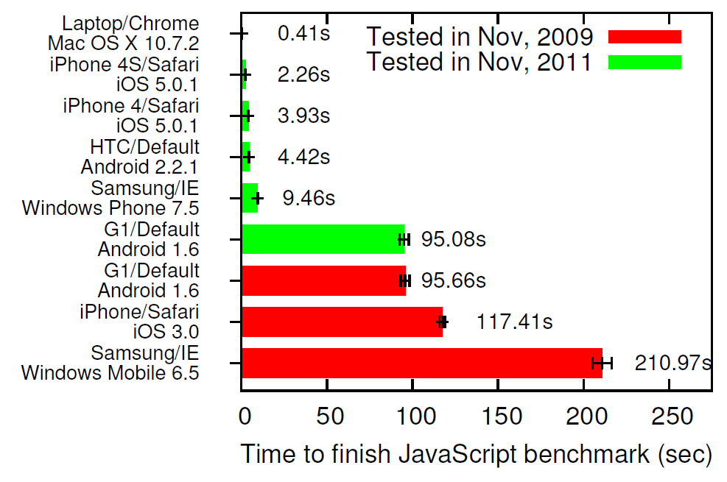
APPLICATION PERFORMANCE IMPACT
JavaScript execution
Although contemporary smartphones have reduced gap with desktop computers in terms of processing power, performance bottleneck is still at the UE processing side.
In 2009, researchers found that JavaScript execution speed for smartphone browsers could be up to 20~80 times slower than desktop browsers.
From 2009 to 2011, iOS has a speedup of 29.88 for iPhone 4 and 51.95 for iPhone 4S. while 21.64 for Android and 22.30 for Windows Phone.
Possible reasons for this improvement include fast CPU, larger memory and better OS and application software for smartphones.

Slide 45
APPLICATION PERFORMANCE IMPACT
Application case study
Loading time:
3G lags behind with 50%~200% larger response time
LTE slightly lags behind WiFi

Slide 46
APPLICATION PERFORMANCE IMPACT
Application case study
Average CPU usage:
3G: ranging from 35.5% to 70.8%, with an average of 57.7%
LTE: ranging from 68.8% to 84.3%, with an average of 79.3%
WiFi: ranging from 78.2% to 93.0%, with an average of 87.1%
This comparison implies that the gap between WiFi and cellular network has narrowed because of LTE’s better network performance.

Slide 47
APPLICATION PERFORMANCE IMPACT
Application case study
Energy usage:
WiFi has significantly higher efficiency
LTE has lowest efficiency, but closer to 3G.

Slide 48
CATALOGUE
Introduction
Background
Methodology
LTE network characterization
LTE power model construction
User trace based tradeoff analysis
Application performance impact
Conclusion

Slide 49
CONCLUSION
Application case study
LTE has significantly higher downlink and uplink throughput, compared with 3G and even WiFi.
LTE is much less power efficient than WiFi, and the key contributor is the tail energy.
UE processing to be the new bottleneck for web-based applications in LTE networks.

