Slide 1
Core-Stateless Fair Queueing: A Scalable Architecture to Approximate Fair Bandwidth Allocations in High Speed Networks
Ion Stoica, Scott Shenker, and Hui Zhang
SIGCOMM’98, Vancouver, August 1998
subsequently
IEEE/ACM Transactions on Networking 11(1), 2003, pp. 33-46.
Presented by Bob Kinicki

Slide 2
Outline
Introduction
Core-Stateless Fair Queueing (CSFQ)
Fluid Model Algorithm
Packet Algorithm
Flow Arrival Rate
Link Fair Share Rate Estimation
NS Simulations
Conclusions

Slide 3
Introduction
This paper brings forward the concept of “fair” allocation.
The claim is that fair allocation inherently requires routers to maintain state and perform operations on a per flow basis.
The authors present an architecture and a set of algorithms that is “approximately” fair while using FIFO queueing at internal routers.

Slide 4
An “Island” of Routers
Destination
Source
Edge
Router
Core
Router
Destination

Slide 5
Outline
Introduction
Core-Stateless Fair Queueing (CSFQ)
Fluid Model Algorithm
Packet Algorithm
Flow Arrival Rate
Link Fair Share Rate Estimation
NS Simulations
Conclusions

Slide 6
Core-Stateless Fair Queueing
Ingress edge routers compute per-flow rate estimates and insert these estimates as labels into each packet header.
Only edge routers maintain per flow state.
Labels are updated at each router based only on aggregate information.
FIFO queuing with probabilistic dropping of packets on input is employed at the core routers.

Slide 7
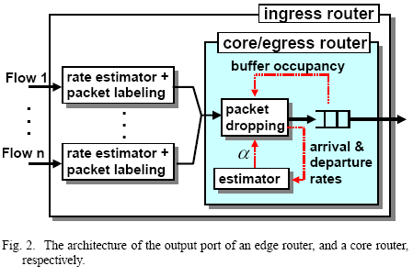
Edge – Core Router Architecture

Slide 8
Fluid Model Algorithm
Assume the bottleneck router has an output link with capacity C.
Assume each flow’s arrival rate, r_{i} (t) , is known precisely.
The main idea is that max-min fair bandwidth allocations are characterized such that all flows that are bottlenecked by a router have the same output rate.
This rate is called the fair share rate of the link.
Let α(t) be the fair share rate at time t.

Slide 9
Fluid Model Algorithm
If max-min bandwidth allocations are achieved, each flow receives service at a rate given by
min (r_{i} (t), α(t))
Let A(t) denote the total arrival rate:
If A(t) > C , then the fair share is the unique solution to

Slide 10
Fluid Model Algorithm
Thus, the probabilistic fluid forwarding algorithm that achieves fair bandwidth allocation is:
Each incoming bit of flow i is dropped with probability
max (0,1-α(t)/r_{i}(t)) (2)
These dropping probabilities yield fair share arrival rates at the next hop.

Slide 11
Packet Algorithm
Moving from a bit-level, bufferless fluid model to a packet-based, buffer model with unknown arrival rates leaves two challenges:
Estimate the flow arrival rates r_{i}(t)
Estimate the fair share α(t)
This is possible because the rate estimator incorporates the packet size.

Slide 12
Flow Arrival Rate
At each edge router, use exponential averaging to estimate the rate of a flow. For flow i, let
l_{i}^{k} be the length of the k^{th} packet.
t_{i}^{k} be the arrival time of the k^{th} packet.
Then the estimated rate of flow i, r_{i} is updated every time a new packet is received:
r_{i}^{new} = (1-e^{-T/K}) L / T + (e^{-T/K})r_{i}^{old} (3)
where
T = T_{i}^{k} = t_{i}^{k} – t_{i}^{k-1}
L = l_{i}^{k} and K is a constant

Slide 13
Link Fair Rate Estimation
If we denote the estimate of the fair share by and the acceptance rate by , we have
Note – if we know r_{i}(t), then can be determined by finding the unique solution to F(x) = C.
However, this requires per-flow state !
Instead, aggregate measurements of F and A are used to compute .

Slide 14
Heuristic Algorithm
The heuristic algorithm needs three aggregate state variables:
, , where is the estimated aggregate arrival rate and is the estimated accepted traffic rate .
When a packet arrives, the router computes:
(5)
where T is the interarrival time between the current and previous packet.
and similarly computes .

Slide 15
CSFQ Algorithm
When a packet arrives, is updated using exponential averaging (equation 5).
If the packet is dropped, remains the same.
If the packet is not dropped, is updated using exponential averaging.
At the end of an epoch (defined by K_{c} ), if the link is congested during the whole epoch, update :

Slide 16
CSFQ Algorithm (cont.)
If the link is not congested, is set to the largest rate of any active flow seen during the last K_{c} time units.
feeds into the calculation of drop probability, p, for the next arriving packet as α in
p = max (0 , 1 – α / label)

Slide 17
CSFQ Algorithm (cont.)
Estimation inaccuracies may cause to exceed link capacity.
Thus, to limit the effect of Drop Tail buffer overflows, every time the buffer overflows is decreased by 1% in the simulations.
If link becomes uncongested, algorithm assumes it remains uncongested until buffer occupancy reached 50% or higher.

Slide 18
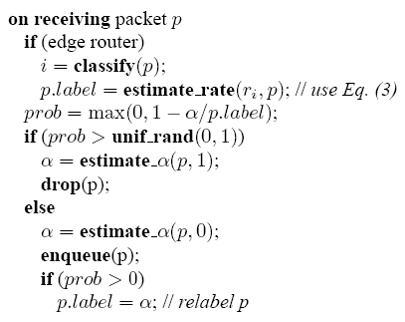
CSFQ Pseudo Code
Figure 3

Slide 19
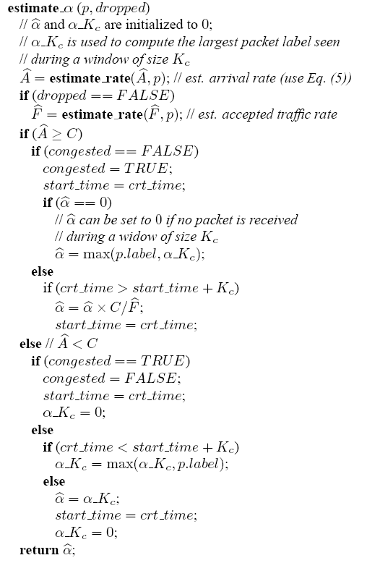
CSFQ Pseudo Code

Slide 20
Label Rewriting
At core routers, outgoing rate is merely the minimum between the incoming rate and the fair rate, α .
Hence, the packet label L can be rewritten by
L _{new} = min (L _{old} , α )

Slide 21
Outline
Introduction
Core-Stateless Fair Queueing (CSFQ)
Fluid Model Algorithm
Packet Algorithm
Flow Arrival Rate
Link Fair Share Rate Estimation
NS Simulations
Conclusions

Slide 22
Simulations
A major effort of the paper is to compare CSFQ to four algorithms via ns-2 simulations.
FIFO
RED
FRED (Flow Random Early Drop)
DRR (Deficit Round Robin)

Slide 23
FRED (Flow Random Early Drop)
Maintains per flow state in router.
FRED preferentially drops a packet of a flow that has either:
Had many packets dropped in the past
A queue larger than the average queue size
Main goal : Fairness
FRED-2 guarantees a minimum number of buffers for each flow .

Slide 24
DRR (Deficit Round Robin)
Represents an efficient implementation of WFQ.
A sophisticated per-flow queueing algorithm.
Scheme assumes that when router buffer is full, the packet from the longest queue is dropped.
Can be viewed as the “best case” algorithm with respect to fairness.

Slide 25
ns-2 Simulation Details
Use TCP, UDP, RLM (Receiver-driven Layered Multicast) and On-Off traffic sources in separate simulations.
Bottleneck link: 10 Mbps, 1ms latency, 64KB buffer
CSFQ threshold is 16KB.
RED, FRED (min, max) thresholds: (16KB, 32KB)
K and K_{c} = 100 ms. = 200ms.
K_{α}

Slide 26
A Single Congested Link
First Experiment : 32 UDP CBR flows
Each UDP flow is indexed from 0 to 31 with flow 0 sending at 0.3125 Mbps and each of the i subsequent flows sending (i+ 1) times its fair share of 0.3125 Mbps.
Second Experiment : 1 UDP CBR flow, 31 TCP flows
UDP flow sends at 10 Mbps
31 TCP flows share a single 10 Mbps link.

Slide 27
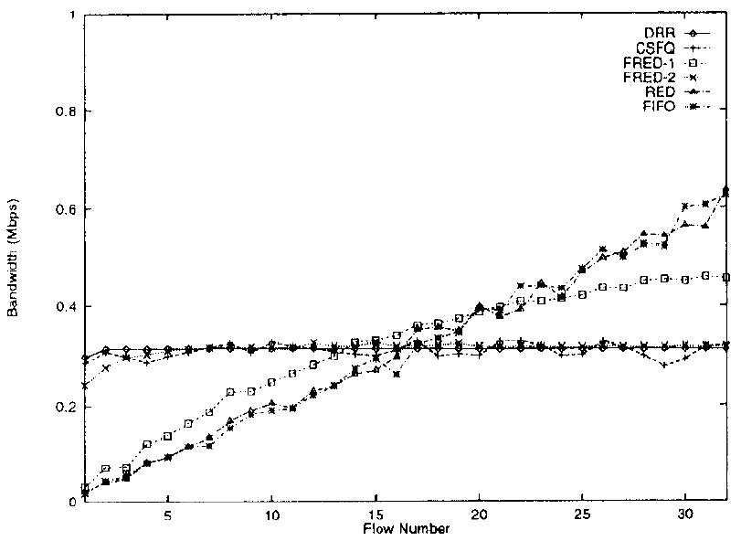
Figure 5b: 32 UDP Flows
Only CSFQ, DRR
and FRED-2 can
contain UDP flows!!

Slide 28
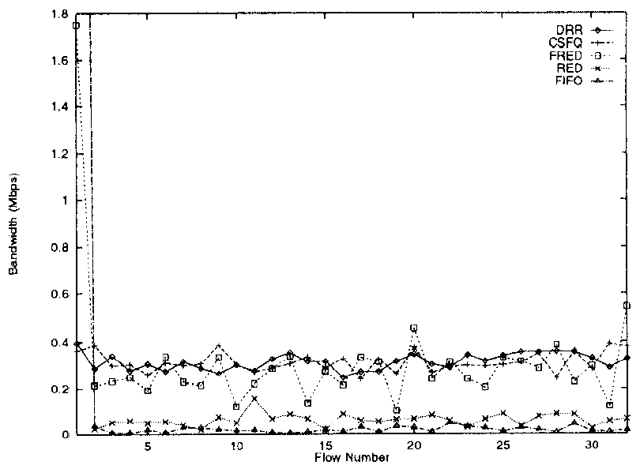
Figure 6a : One UDP Flow, 31 TCP Flows
Only CSFQ and
DRR can contain
Flow 0 – the only
UDP flow!

Slide 29
A Single Congested Link
Third Experiment Set : 31 simulations
Each simulation has a different N,
N = 2 … 32.
One TCP and N-1 UDP flows with each UDP flow sending at twice the fair share rate of 10/(N +1) Mbps.

Slide 30
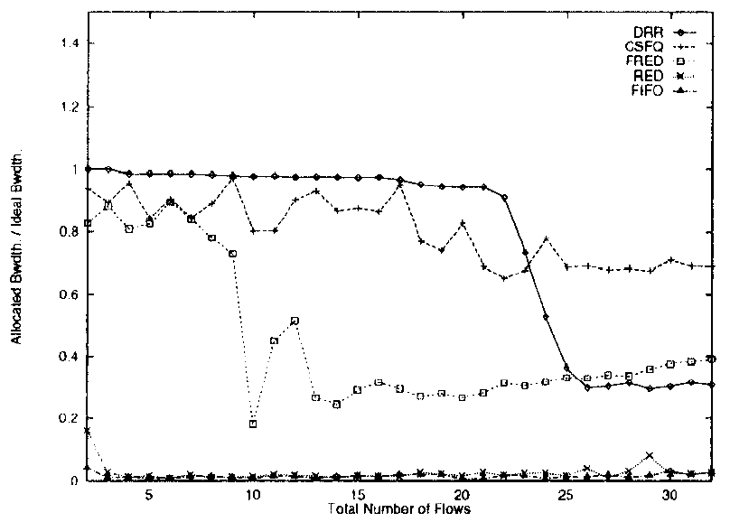
Figure 6b : One TCP Flow, N-1 UDP Flows
Normalized fair share
throughput for one TCP source
DRR good for less
than 22 flows.
CSFQ better than
DRR when a large
number of flows.
CSFQ beats FRED.

Slide 31
Multiple Congested Links
1-10
K1-K10
UDP
Sinks
TCP/ UDP-0
Source
Router
Router
Router K
Router K+1
TCP/ UDP-0
Sink
UDP
Sources
1
10
11
20
K1
K10

Slide 32
Multiple Congested Links
First experiment : CBR UDP flow 0 sends at its fair share rate, 0.909 Mbps while the other ten “crossing” UDP flows send at 2 Mbps.
Second experiment: Replace the UDP flow with one TCP flow and leave the ten crossing UDP flows.

Slide 33
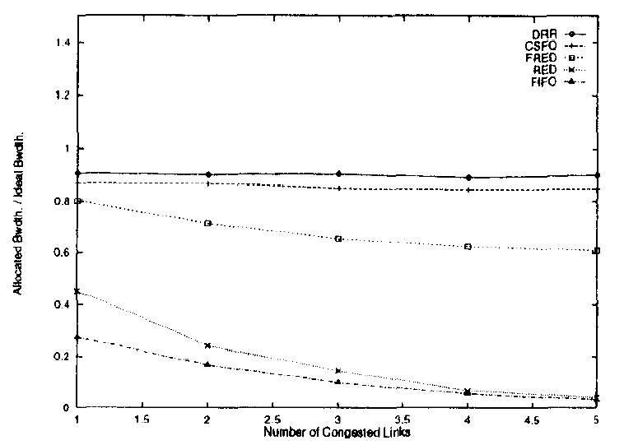
Figure 8a : UDP source
Fraction of UDP-0 traffic forwarded
versus the number of congested links

Slide 34
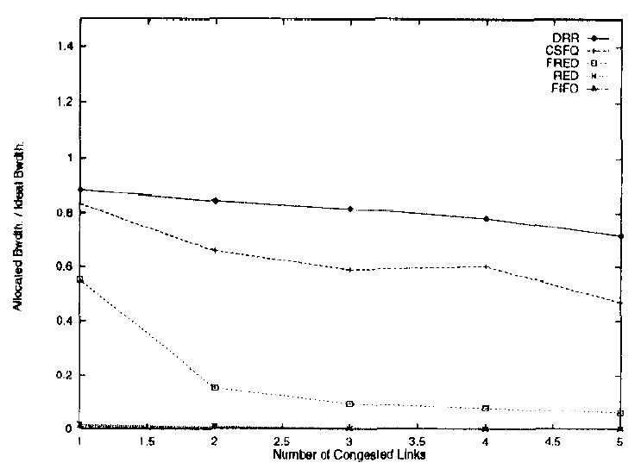
Figure 8b : TCP Source
Fraction of TCP-0 traffic forwarded
versus the number of congested links

Slide 35
Receiver-driven Layered Multicast (RLM)
RLM is an adaptive scheme in which the source sends the information encoded in a number of layers.
Each layer represents a different multicast group.
Receivers join and leave multicast groups based on packet drops experienced.

Slide 36
Receiver-driven Layered Multicast (RLM)
Simulation of three RLM flows and one TCP flow with a 4 Mbps link.
Fair share for each is 1 Mbps.
Since router buffer set to 64 KB, K, K_{c}, and are set to 250 ms.
Each RLM layer I sends 2^{i+4} Kbps with each receiver subscribing to the first five layers.
K_{α}

Slide 37
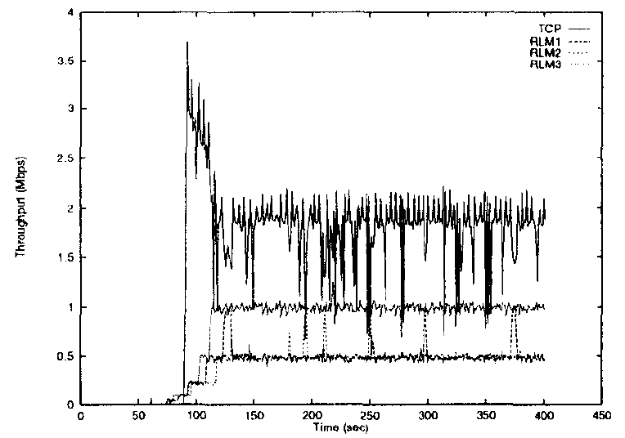
Figure 9b : FRED

Slide 38
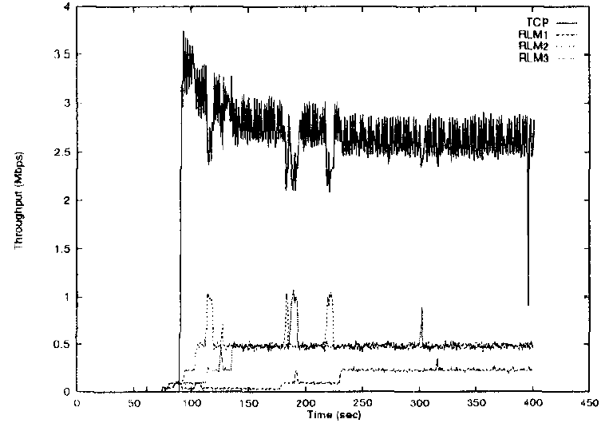
Figure 9e : RED

Slide 39
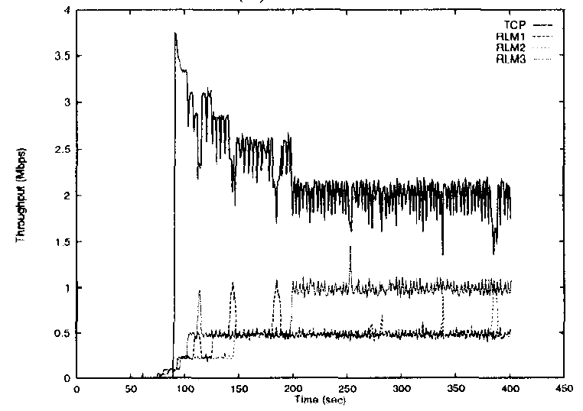
Figure 9f : FIFO

Slide 40
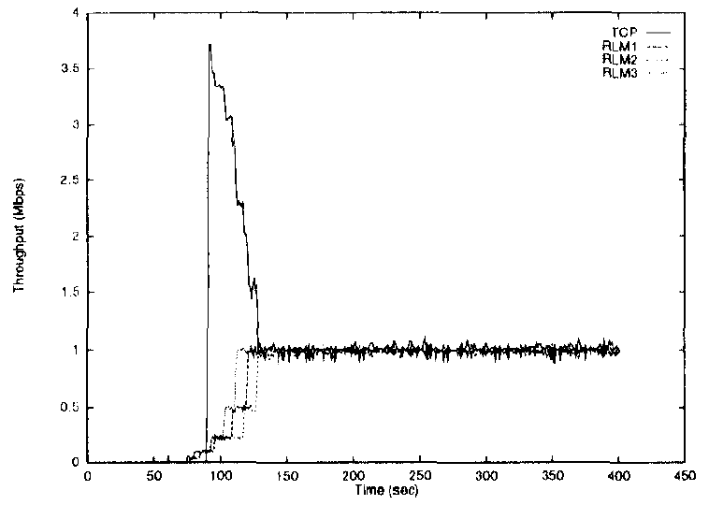
Figure 9a : DRR

Slide 41
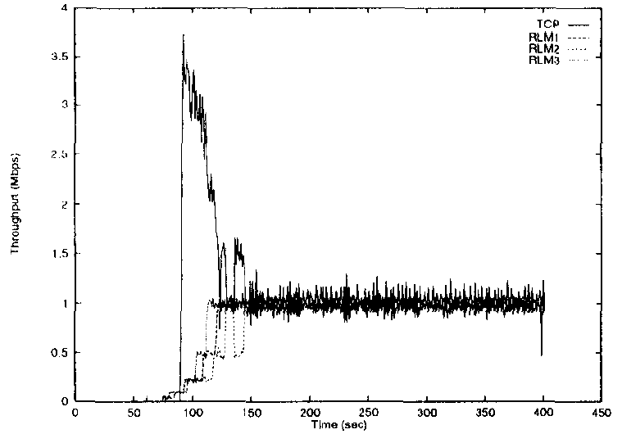
Conference Figure : CSFQ
K,= Kc = Kα = 250 ms.

Slide 42
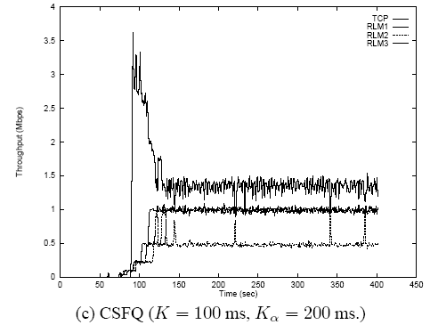
Figure 9c: CSFQ

Slide 43
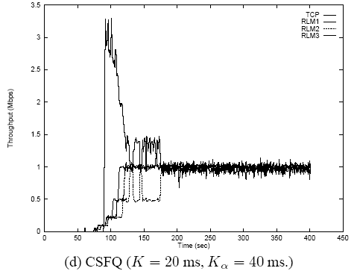
Figure 9d: CSFQ

Slide 44
On-Off Flow Model
One approach to modeling interactive, Web traffic :: OFF represents “think time”.
ON and OFF times are drawn from exponential distribution with means of 200 ms and 3800 ms respectively ( K set to 200 ms).
During ON period source sends at 10 Mbps.
19 CBR flows sending at 0.5Mbps

Slide 45
Table I One On-Off Flow, 19 CBR Flows
Algorithm | Delivered | Dropped
DRR | 1080 | 3819
CSFQ | 1000 | 3889
FRED | 1064 | 3825
RED | 2819 | 2080
FIFO | 3771 | 1128
4899 packets sent!

Slide 46
Web Traffic
A second approach to modeling Web traffic uses Pareto Distribution to model the length of a TCP connection.
In this simulation 60 TCP flows whose interarrivals are exponentially distributed with mean 0.1 ms and Pareto distribution with shaping parameter 1.06 that yields a mean connection length of 40,1 KB packets.
One CBR flow sending at 10 Mbps.

Slide 47
Table II 60 Short TCP Flows, One CBR Flow
Algorithm | Mean Transfer Time (ms) | Standard Deviation (ms)
DRR | 46.38 | 197.35
CSFQ | 88.21 | 230.29
FRED | 73.48 | 272.25
RED | 790.28 | 1651.38
FIFO | 1736.93 | 1826.74

Slide 48
Table III : 19 TCP Flows, One CBR Flow with propagation delay of 100 ms
Algorithm | Mean Packets forwarded in 100 s. | Standard Deviation
DRR | 5857.89 | 192.86
CSFQ | 5135.05 | 175.76
FRED | 4967.05 | 261.23
RED | 628.10 | 80.46
FIFO | 379.42 | 68.72

Slide 49
Figure 10 Packet Relabeling
Sources
10 Mbps
Flow 1
Router 1
Link 1
10 Mbps
10 Mbps
Link 2
10 Mbps
Flow 2
Router 2
Sink
10 Mbps
Flow 3

Slide 50
Table IV UDP and TCP with CSFQ Packet Relabeling
Traffic | Flow 1 | Flow 2 | Flow 3
CBR | 3.267 | 3.262 | 3.458
TCP | 3.232 | 3.336 | 3.358
Link 2 Throughput

Slide 51
Unfriendly Flows
Using TCP congestion control requires cooperation from other flows.
Three types cooperation violators:
Unresponsive flows (e.g., Real Audio)
Not TCP-friendly flows (e.g., RLM)
Flows that lie to cheat.
This paper deals with unfriendly flows!!

Slide 52
Outline
Introduction
Core-Stateless Fair Queueing (CSFQ)
Fluid Model Algorithm
Packet Algorithm
Flow Arrival Rate
Link Fair Share Rate Estimation
NS Simulations
Conclusions

Slide 53
Conclusions
This paper presents Core Stateless Fair Queueing and offers many simulations to show how CSFQ provides better fairness than RED or FIFO.
They mention issue of “large latencies”. This is the robust versus fragile flow issue from FRED paper.
CSFQ ‘clobbers’ UDP flows!

Slide 54
Significance
First paper to use hints from the edge of the subnet.
Deals with UDP as CBR flows. Many AQM algorithms ignore UDP.
Makes a reasonable attempt to look at a variety of traffic types.

Slide 55
Problems/ Weaknesses
“Epoch” is related to three K constants in a way that can produce different results.
How does one set the three K constants for a variety of situations?
There is no discussion of algorithm “stability”.

Slide 56
Acknowledgments
Figures extracted from presentation by Nagaraj Shirali and Choong-Soo Lee in Spring 2002 and modified for annotations.

