Slide 1
Understanding Bufferbloat in Cellular Networks
Haiqing Jiang, Zeyu Liu, Yaogong Wang, Kyunghan Lee, and Injong Rhee
Published in 2012 in the ACM SIGCOMM CellNet workshop on cellular networks
Presented by Vasilios Mitrokostas [my side comments in blue]
Graph images taken from paper
Notes:
This PowerPoint Template includes a series of slide masters with predefined layouts and color schemes for formatting slides
Slide Masters are displayed when you right click on a slide and select Layout from menu
1

Slide 2
Introduction to bufferbloat
Authors' observations on bufferbloat in cellular networks
Bufferbloat analysis
Analysis of the involvement of TCP
Existing and suggested solutions
Some quick thoughts on this paper
2
Notes:
2

Slide 3
Why study bufferbloat?
In measuring TCP across four major US cellular networks, authors found performance degradation issues:
Increased delay
Low throughput
One proposed major cause: bufferbloat
The claim: these major carriers are “over-buffered”
3
Notes:
3

Slide 4
Bufferbloat
An issue where the buffering of packets actually increases delay, increases jitter, and decreases throughput
The original intention of increased buffer size was to improve Internet performance
If the size is too large, the interaction between the buffer and TCP congestion control degrades overall network performance
4
Notes:
4

Slide 5
How bufferbloat causes issues
Large packet buffers cause loss-based TCP congestion control algorithms to overestimate packets to queue
Leads to longer queuing delays
Results in packet delay variation (jitter)
Essentially, packets are buffered when they instead should be dropped
If this occurs on a bottlenecked link with a large packet buffer (e.g., on a newer router), packets will not be dropped until the buffer is full, causing TCP congestion avoidance to react slowly
5
Notes:
5

Slide 6
Why would buffers be large?
Large packet buffers help . . .
. . . deal with bursty traffic
. . . support user fairness
. . . promote channel variability
Not as simple as merely reducing buffer sizes
6
Notes:
6

Slide 7
Introduction to bufferbloat
Authors' observations on bufferbloat in cellular networks
Bufferbloat analysis
Analysis of the involvement of TCP
Existing and suggested solutions
Some quick thoughts on this paper
7
Notes:
7

Slide 8
The authors' “untold story”
Large buffers are causing issues
Making them small isn't an elegant solution
A trick employed by smartphone vendors today: set maximum TCP receive buffer size to a small value
Advertised window can't exceed this value
Sending window is the lesser of the congestion window and advertised window
As a result, this limitation keeps buffers from overfilling and mitigates end-to-end delay
The problem: what's the right value?
8
Notes:
8

Slide 9
The paper's goals
Establish the prevalence of the bufferbloat problem in cellular networks
Show that high-speed TCP aggravates the performance degradation of bufferbloated networks
Discuss practical solutions
9
Notes:
9

Slide 10
Introduction to bufferbloat
Authors' observations on bufferbloat in cellular networks
Bufferbloat analysis
Analysis of the involvement of TCP
Existing and suggested solutions
Some quick thoughts on this paper
10
Notes:
10

Slide 11
Setting up the test
Bulk-data transfer between laptop (receiver) and server (sender) over 3G networks; laptop access 3G mobile data across multiple US carriers
Both sender and receiver use TCP CUBIC and Linux (Ubuntu 10.04)
Ubuntu, by default, sets maximum receive buffer size and maximum send buffer size to a large value
This way, flow is not limited by buffer size
Detailed queue size is unknown, so the first test (the following chart) attempts to estimate this
11
Notes:
11

Slide 12
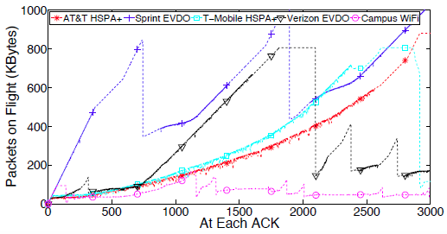
Estimating network buffer space
12
Notes:
12

Slide 13
Estimating network buffer space
Campus WiFi: baseline choice
Despite long link distance and high bandwidth, WiFi experiment yields smaller results than cellular networks
The cellular networks use buffer sizes beyond reasonable ranges; for example, Sprint supports over 1000 KB of in-flight packets, but its EVDO network does not support it [source?]
How do we know this bufferbloat is occurring within the cellular network?
13
Notes:
13

Slide 14
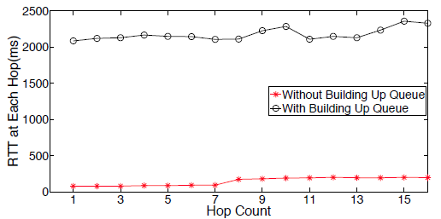
Queue build-up experiment
14
Notes:
14

Slide 15
Queue build-up experiment
Authors' observation: queuing delay begins at the very first IP hop which contains the cellular link
What about other hops? Authors suggest packets are buffered on the way back as well due to the long queue already built-up
15
Notes:
15

Slide 16
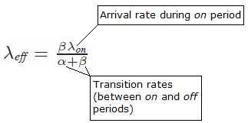
Simulating 3G network traffic
Cellular network traffic:
Heavy traffic periods (e.g., video streaming or file transfer)
Inactive periods (e.g., not in use)
In order to simulate the bursty nature of cellular network traffic, experiment employs an interrupted Poisson process with on-off periods
16
Notes:
16

Slide 17
Formula: expected delay
Expectation of delay
Takeaway: when bottleneck processor is nearly fully utilized, as the buffer size K increases, the expected delay increases at a faster rate [how does one relate buffer size and delay time?]
17
Notes:
17

Slide 18
Formula: expected throughput
Expectation of throughput
Takeaway: as the buffer size K increases, the expected throughput approaches a limit, so there are diminishing returns on performance
18
Notes:
18

Slide 19
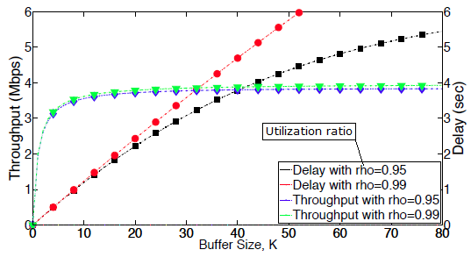
Delay and throughput analysis
19
Notes:
19

Slide 20
Introduction to bufferbloat
Authors' observations on bufferbloat in cellular networks
Bufferbloat analysis
Analysis of the involvement of TCP
Existing and suggested solutions
Some quick thoughts on this paper
20
Notes:
20

Slide 21
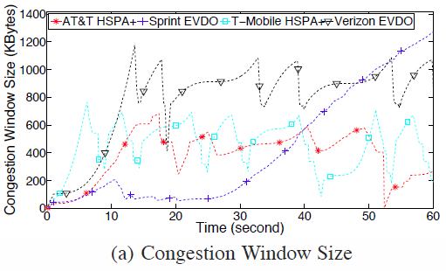
TCP CUBIC behavior: cwnd
21
Notes:
21

Slide 22
TCP CUBIC behavior: cwnd
Why CUBIC? Paper source suggests the widespread use of “high-speed TCP variants such as BIC, CUBIC, and CTCP”
Chart shows that the congestion window (cwnd) keeps increasing even if the size is beyond the bandwidth-delay product (BDP) of the underlying network
Example: EVDO BDP is approximately 58 KB, but cwnd increases far beyond that limit
22
Notes:
22

Slide 23
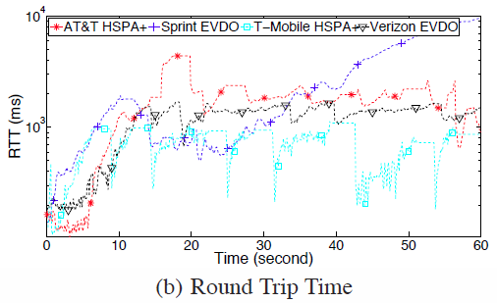
TCP CUBIC behavior: delay
23
Notes:
23

Slide 24
TCP CUBIC behavior: delay
The lengthy delays shown in the chart (up to 10 seconds) support the expected delay formula
24
Notes:
24

Slide 25
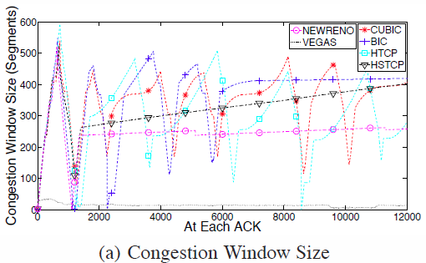
The behavior of TCP variants
25
Notes:
25

Slide 26
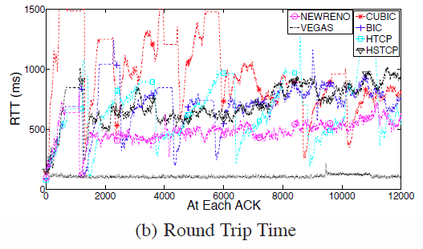
The behavior of TCP variants
26
Notes:
26

Slide 27
The behavior of TCP variants
The aggressive nature of high-speed TCP variants, combined with bufferbloat, results in “severe congestion window overshooting”
TCP Vegas appears resistant to bufferbloat; this is because its congestion control algorithm is delay-based, not loss-based
27
Notes:
27

Slide 28
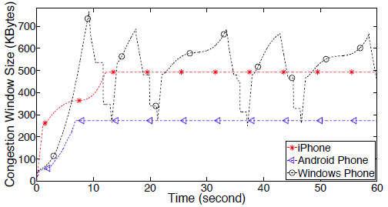
The data behind the “untold story”
28
Notes:
28

Slide 29
The data behind the “untold story”
The Android and iPhone trials show a “flat TCP” pattern
cwnd hits a ceiling and remains flat until session ends
The Windows Phone trials show a “fat TCP” pattern
This is characteristic of bufferbloat
29
Notes:
29

Slide 30
Introduction to bufferbloat
Authors' observations on bufferbloat in cellular networks
Bufferbloat analysis
Analysis of the involvement of TCP
Existing and suggested solutions
Some quick thoughts on this paper
30
Notes:
30

Slide 31
Existing solutions
1) The “untold story”
2) What the heck, let's just reduce buffer size
Aside from previously mentioned issues, reducing size would impact link layer retransmission and deep packet inspection
3) Incorporate Active Queue Management (AQM) schemes which involve randomly dropping or marking packets before the buffer fills (similar to RED) [this paper will never stop being referenced]
This carries the same challenges we've already seen (e.g., the complexity of parameter tuning or the purported limited performance gains in trying AQM)
31
Notes:
31

Slide 32
Suggested solution
Inspired by RED, modifying the TCP protocol itself has advantages:
More feasible than modifying routers
Easier and cheaper to deploy
More flexible; it may be server-based, client-based, or both
Another factor to consider:
Delay-based TCP such as Vegas suffer from throughput degradation in cellular networks, replacing one demon with another
32
Notes:
32

Slide 33
Suggested solution
The authors suggest a TCP protocol that combines the favorable properties of both loss-based and delay-based congestion control while maintaining good performance across multiple network types (wired, WiFi, and cellular)
Dynamic Receive Window Adjustment (DRWA)
The solution is not presented in this paper; the authors forward the reader to another reference
33
Notes:
33

Slide 34
Introduction to bufferbloat
Authors' observations on bufferbloat in cellular networks
Bufferbloat analysis
Analysis of the involvement of TCP
Existing and suggested solutions
Some quick thoughts on this paper
34
Notes:
34

Slide 35
Review Notes
Strengths
Interesting and prevalent topic
Establishes concern and highlights the issues behind bufferbloat
Provides good analysis of bufferbloat as it relates to major carriers
Weaknesses
Riddled with grammar and spelling mistakes
35
Notes:
35

