Slide 1
The Impact of Channel Bonding on 802.11n Network Management
Lara Deek, Eduard Garcia-Villegas, Elizabeth Belding, Sung-Ju Lee, Kevin Almeroth
Presenter – Li Lening
lli4@wpi.edu
ACM CoNEXT December 2011
Notes:
Today, Prof Bob Kinicki and I are going to present our paper “Application, Network, and Linklayer measurements of Streaming video over a wireless Campus Network”.
Before I start the presentation, I want to introduce the people from WPI Wireless streaming research group.
They are our group members.
Prof Claypool, prof Kiniki, Mingzhe,Huahui, and Ashishi

Slide 2
Outline
1.Introduction
2.Background and related work
3.Test environment
4.Empirical study of channel bonding
5.Identifying channel bonding opportunities
6.Evaluation of intelligent channel bonding
7.Conclusion

Slide 3
Introduction
There are many drawbacks in 802.11 a/b/g.
802.11n : two 20MHz -> 40 Mhz.
802.11n with MIMO can achieve higher data rates, but no guidelines.
Previous studies focus on features.
Goal: Effectively characterizing channel bonding in real-world setting.

Slide 4
1. Introduction
Evaluate the impact of different channel bonding choices
Set up a configurable testbed to evaluate channel bonding, and restrict to 5GHz frequency range.
Most of the naïve decisions degrade performance.
Co-channel and adjacent channel interference would be mitigated to perform intelligent decisions.

Slide 5
1. Introduction
As result of experiments, some discoveries are found.
Identify a metric called normalized throughput(ratio) to alert us to interference patterns.
Are able to improve network throughput by a factor of more than 80%.

Slide 6
Outline
1.Introduction
2.Background and related work
3.Test environment
4.Empirical study of channel bonding
5.Identifying channel bonding opportunities
6.Evaluation of intelligent channel bonding
7.Conclusion

Slide 7
2.Background and related work
The 5GHz frequency range: traditional 2.4GHz is harmful. 5GHz could exploit channel bonding well, and less interference.
MIMO: utilize multiple discrete antennas to transmit multiple data streams along the same channel. Solve the problem that transmission range decrease. Using: spatial diversity and spatial multiplexing

Slide 8
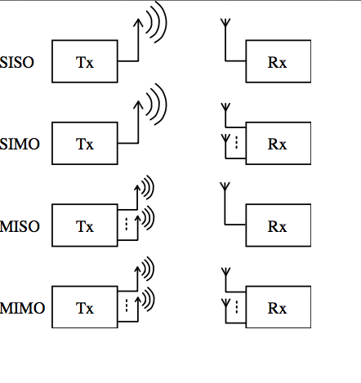
Radio communication models

Slide 9
2. Background and related work
Channel management: Distribute the load more flexibly. First, understand the behavior in order to make intelligent decisions.
Experimental studies of 802.11n: primarily focused on features. One reasons: performed on busy 2.4GHz.another: using only standard metrics.

Slide 10
Outline
1.Introduction
2.Background and related work
3.Test environment
4.Empirical study of channel bonding
5.Identifying channel bonding opportunities
6.Evaluation of intelligent channel bonding
7.Conclusion

Slide 11
3. Test environment
3.1 Node configuration: in semi-open environment. 12 laptops running Ubuntu10.04. The AR5133 provides three dual-band radios(both 2.4GHz and 5GHz). AR5416 allows MCS indices 0 to 15.(Table 1) spatial diversity is achieved by the MRC, whereas MCS 8 to 15 exploit spatial multiplexing by transmitting two simultaneous streams.
Vary the locations.

Slide 12
Test environment
3.1 Node configuration: Vary the locations of transmitter and receiver pairs to obtain a rich set of link coadunations. Maintain the transmit power at the maximum allowable limit. The goal is to select the transmitter and receiver setting that yield the highest physical(PHY) data rates.

Slide 13
3. Test environment
3.2 Measurement environment: generate constant bit-rate UDP in order to avoid accounting for transport layer parameters. Monitor UDP flows, evaluate performance in terms of MAC layer disabling both link layer retransmissions and frame aggregation. Constrain the maximum throughput. With aggregation, the relative overhead is reduced allowing higher throughput.

Slide 14
3. Test environment
Measurement environment: To control and observe the effect of modulation and coding on performance. Disable ath9k automatic rate selection scheme and control the transmission MCS. Also control the channel width to determine the performance differences between 20MHz and 40Mhz
No interference

Slide 15
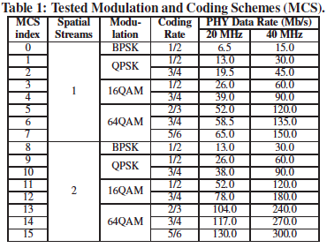
Results show that best MCS for each tested link and channel width configuration. In so doing, mimic the behavior of an ideal rate adaptation mechanism that selects the MCS that maximizes performance. Use the term best throughput to reflect the application layer throughput yielded by the MCS that achieves the highest throughput for the link. Present a fair evaluation of the performance and categorize MCS into two groups.

Slide 16
Outline
1.Introduction
2.Background and related work
3.Test environment
4.Empirical study of channel bonding
5.Identifying channel bonding opportunities
6.Evaluation of intelligent channel bonding
7.Conclusion

Slide 17
4. Empirical study of channel bonding
The purpose is to examine the performance with channel bonding in response to particular network characteristic. In the following, use experimentation to answer questions that are critical to understand the use of 40MHz channel in 802.11n WLAN environments.

Slide 18
4.1 What parameters affect the performance of channel bonding
4.1.1 RSSI:
Figure 1 plots the best throughput between single transmitter and receiver pairs at varying locations, sorted in decreasing order.
As a result , received signal strength indicator(RSSI) alone is not an adequate link quality metric. But it is necessary but not sufficient information to determine when a 40MHz yields a better performance than a 20 MHz channel.

Slide 19
Here we are able to see that operating on 40MHz has a better performance than 20MHz.
And the strongest signal does not mean the best throughput.

Slide 20
4.1 What parameters affect the performance of channel bonding
4.1.2 Rich scattering:
The behavior of transmission cannot be explained using RSSI alone.
With the incorporation of MIMO, the traditionally negative impact of multi-path contributes positively performance.
Evaluate the impact of MIMO by comparing the throughput achieved between links with similar signal quality.
Conclusion: Performance varies considerably due to potential scarcity of independent spatial paths.

Slide 21
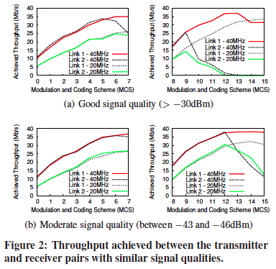
Link 1 and link 2 achieve similar throughput values for low MCS indices, but for MCS greater than 8, link2’s performance drops while link 1 maintains or improves its performance with higher MCSs.
The impact of poor scattering is observed more accurately for strong links where the transmitter and receiver are likely to be in close range, as seen in Link 2 in Figure2(a)

Slide 22
4.1 What parameters affect the performance of channel bonding
4.1.3 what patters do we observe between varying MCS value.
We evaluate performance for all possible MCS values in different link qualities.
PRR gives clearer insight into the quality of a link than RSSI or throughput, since it does not depend on the aggregation.

Slide 23
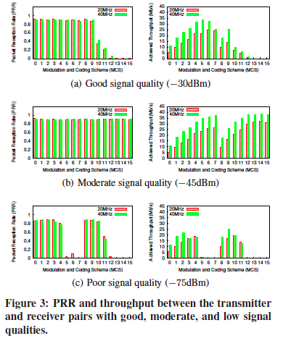
In general, by comparing the behavior of a 40MHz versus 20MHz channel, it is clear that channel bonding outperform a 20MHz channel, particularly when the correct MCS is chosen. Doubling the physical rate compensates for the increased error rate provide that, roughly, PRR_{20MHz}<2PRR_{40MHz.}

Slide 24
4.2 How should bandwidth be assigned
How channel bonding would behave in a realistic setting with neighboring and potentially interfering devices.
Identify and examine two of sub problems:
How to assign non-overlapping channels between neighboring nodes.
How to deal with co-channel interference.

Slide 25
4.2 How should bandwidth be assigned
4.2.1 what is the impact of channel leakage?
Even in the presence of a weal inferer, performance is still negatively impacted.
To achieve complete separation, links with strong to moderate signal strength should be separated by at least 40MHz.
Power leakage produces reception error due to decrease SINR.
The increased error rate can be compensated by using a more reliable modulation. By activating carrier sensing, conllisons are avoided, and the transmitter can use more aggressive modulations.

Slide 26
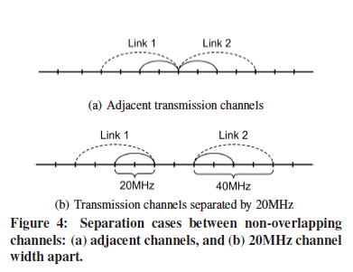
Nodes that operate on non-overlapping, yet adjacent, channels, still suffer interference from channel leakage when power form transmissions on adjacent channels spills to neighboring channels.

Slide 27
An important observation is that channel bonding must be intelligently executed to improve performance.

Slide 28
4.2 How should bandwidth be assigned
4.2.2 what are the effects of sharing the channel
In densely populated network, devices might have to share channel. Two cell may share a channel without being aware due to the known hidden terminal problem.
Configure the network such that two transmitters share the transmission medium.
Define the legend

Slide 29
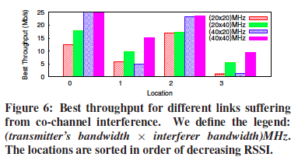
The best performance occurs when both T and S operate on a 40MHz channel (40*40). However, this condition is nor guaranteed and depends on how effectively a link can take advantage of signal strength to increase transmission rate.
Find that slow nodes capture the common medium for longer periods of time, thus penalizing fast stations.

Slide 30
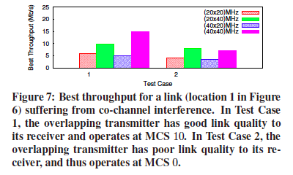
S’s low rates diminish form the benefits of T’s channel boding and lead to no observable improvements.
Regardless of the bandwidth of T, it is more advantageous for T to compete for the channel with an interferer who transmits at 40MHz: 40MHz interferers attain higher transmission rates and alleviate fairness issue in multi-rate scenarios, leading to better performance. However, the decision to channel bond relies on the accurate characterization of T’s potential to take advantage of channel bonding.

Slide 31
Outline
1.Introduction
2.Background and related work
3.Test environment
4.Empirical study of channel bonding
5.Identifying channel bonding opportunities
6.Evaluation of intelligent channel bonding
7.Conclusion

Slide 32
5.Identifying channel bonding opportunities
Through section 4, the network characteristics that are either conducive or detrimental to the performance of channel bonding.
Evaluate a network to determine channel bonding opportunities and to make recommendation of when channel bonding improves the performance.

Slide 33
5.Identifying channel bonding opportunities
5.1 how can unfavorable network conditions be determined from performance metrics?
In this paper, identify two possible unfavorable conditions.
The presence of nodes that operates on overlapping channels.
Interference caused by channel leakage from nodes operating on adjacent channels.

Slide 34
Define the normalized throughput metric and identify it as an indicator for unfavorable network condition.
Only measure achieved throughput at the MAC layer and calculate expected throughput in terms of delay per packet:
Normalized throughput is a good indicator of unfavorable network conditions. The greater the impact an unfavorable condition has on performance, the more clearly the impact is reflected in the computed normalized throughput at each MCS.

Slide 35
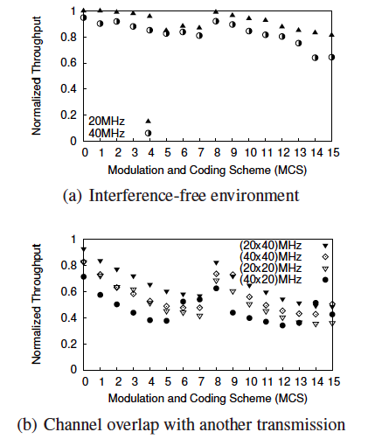
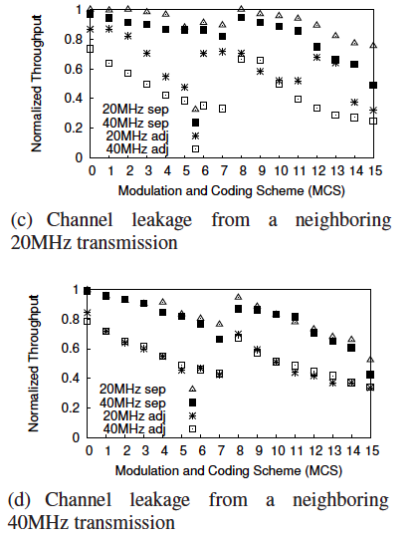
Figure 8 depicts the typical behavior of normalized through for a single link in an interference-free environment.
(b)represents values when a second link operates on an overlapping channel, while (c)and (d)show values when a second link operates on a non-overlapping, yet adjacent, channel.

Slide 36
The behavior of a link in an interference-free environment is consistent.
From the (a), the distance of the achieved throughput form the expected throughput is due to the strict SNR requirements necessary to achieve those rates.
The difference between achieved and expected throughput will be larger if using low MCS value, because penalty imposed on fast stations form sharing common medium with slow stations.
If conditions in a network are that normalized throughput drops for low MCS, the network is unfavorable.

Slide 37
5.2 which parameters determine opportunities for channel bonding?
Compile a list of parameters that facilitate network characterization
Signal strength at receiver(RSSI)
MCS in use
Strength of interfering transmissions
Physical rates of links in CS range

Slide 38
5.3 can performance on a 40MHz channel be inferred from performance on a 20MHz channel
Due to multipath diversity in wireless environments , transmissions are susceptible to frequency-selective fading. Occurs when signals from different paths combine destructively at the receiver and the effect of signal cancellation is deepest only at a particular frequency.
For the above mentioned reasons, performance from a 20MHz channel cannot be used to infer performance on 40MHz channel.

Slide 39
5.4 should we increase channel width to 40MHz with incomplete knowledge of the neighboring 20MHz channel?
So far we cannot increase channel width to 40MHz with incomplete knowledge of the neighboring 20MHz channel. Not only information on the status of the adjacent channel is required due to channel leakage, but even interfering transmissions on separate channels could potentially affect channel management decisions. So there are network parameters that should be identified to perform an intelligent assignment of channel width to improve network throughput.

Slide 40
Outline
1.Introduction
2.Background and related work
3.Test environment
4.Empirical study of channel bonding
5.Identifying channel bonding opportunities
6.Evaluation of intelligent channel bonding
7.Conclusion

Slide 41
6. Evaluation of intelligent channel bonding
Create network scenarios.
Make intelligent decisions that leverage the benefits of channel bonding.
Present three different test case scenarios in Figure 9. in each test, characterized the network environment and decide for a single node T. then evaluate T’s performance and compare.
Case 1: all available channels are occupied.
Case 2: two channels are free.
Case 3: only one unoccupied 20MHz channel.

Slide 42
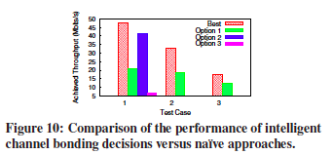
Case1(a):intelligent channel bonding solution maximized performance considerably, with a 1.15 and up to factor increase in achieved throughput compared to the naïve solution.
Case2(b):intelligent channel bonding solution improve performance by a factor by of 83%, from 18Mb/s to 33Mb/s
Case3(c):by identifying the opportunity for channel bonding, increase the performance by 38%, from 13Mb/s to 18Mb/s.

Slide 43
Outline
1.Introduction
2.Background and related work
3.Test environment
4.Empirical study of channel bonding
5.Identifying channel bonding opportunities
6.Evaluation of intelligent channel bonding
7.Conclusion

Slide 44
7.Conclusion
With the advent of new and improved technologies in 802.11n networks, and in the context of 5GHz operation, identify a set of network characteristics in which wider channels can be exploited through channel bonding.
Provide an in-depth study of the behavior of channel bonding and evaluate the impact of different channel bonding choices on network performance.
Find that intelligent channel bonding decision rely on the knowledge of a transmitter’s surrounding.

Slide 45
The Impact of Channel Bonding on 802.11n Network Management
Thank You!
Questions ??
Notes:
Today, Prof Bob Kinicki and I are going to present our paper “Application, Network, and Linklayer measurements of Streaming video over a wireless Campus Network”.
Before I start the presentation, I want to introduce the people from WPI Wireless streaming research group.
They are our group members.
Prof Claypool, prof Kiniki, Mingzhe,Huahui, and Ashishi

