Slide 1
Cloud Control with Distributed Rate Limiting
Raghaven et all
Presented by: Brian Card
CS 577 - Fall 2014 - Kinicki

Slide 2
Outline
Motivation
Distributed Rate Limiting
Global Token Bucket
Global Random Drop
Flow Proportional Share
Simulation and Results
Conclusions

Slide 3
Motivation
Distributed Cloud Based Services are becoming more prevalent
PaaS vendors want to charge for cloud services
In a traffic base pricing model, how do you meter traffic in a distributed system?

Slide 4
Bad Example, 100 Mps for 2 Nodes
50 Mbps Local Limiter
Node1
50 Mbps Local Limiter
Node2

Slide 5
Bad Example, 100 Mps for 2 Nodes
50 Mbps Local Limiter
Node1
80 Mbps
50 Mbps Local Limiter
Node2

Slide 6
Bad Example, 100 Mps for 2 Nodes
50 Mbps Local Limiter
Node1
50 Mbps
80 Mbps
Limiter Reduces
Traffic to 50 Mbps
50 Mbps Local Limiter
Node2

Slide 7
Bad Example, 100 Mps for 2 Nodes
50 Mbps Local Limiter
Node1
50 Mbps
80 Mbps
50 Mbps Local Limiter
Node2
20 Mbps
20 Mbps

Slide 8
Bad Example, 100 Mps for 2 Nodes
50 Mbps Local Limiter
Node1
50 Mbps
80 Mbps
Paying for 100 Mbps,
have 100 Mbps traffic,
only getting 70 Mbps!
50 Mbps Local Limiter
Node2
20 Mbps
20 Mbps

Slide 9
A Better Approach: Distributed Rate Limiter
100 Mbps Shared Limiter
Node1
80 Mbps
80 Mbps
100 Mbps Shared Limiter
Node2
20 Mbps
20 Mbps

Slide 10
A Better Approach: Distributed Rate Limiter
100 Mbps Shared Limiter
Node1
80 Mbps
80 Mbps
Limiters communicate
to determine global limit
100 Mbps Shared Limiter
Node2
20 Mbps
20 Mbps

Slide 11
Design of Distributed Rate Limiting
When global limit is exceeded, packets are dropped
Limiters estimate incoming traffic and communicate results to other limiters
Communication between limiters is performed using the Gossip Protocol over UDP

Slide 12
Token Bucket
Token Buckets are a well known mechanism used to rate limit in networking applications
Tokens are generated at a rate R
Packets are traded for a token
Can handle bursts up to the number of tokens in the bucket
Bursts drain bucket and subsequent traffic is limited until new tokens are generated

Slide 13
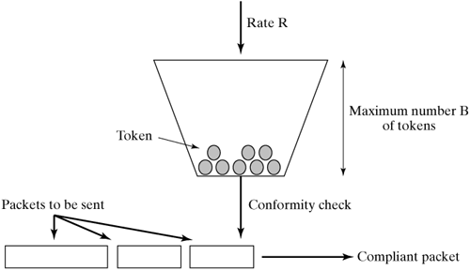
Token Bucket (cont.)

Slide 14
Use of Token Bucket
Authors compare results to Centralized Token Bucket where a single bucket is used to distribute all of the traffic
Single bucket where all limiters must pull tokens from
This scheme is not practical but serves as the baseline for comparing the results

Slide 15
Distributed Rate Limiting Algorithms
Global Token Bucket
Global Random Drop
Flow Proportional Share

Slide 16
Global Token Bucket (GTB)
Simulate a global bucket
Tokens are shared between limiters
When a byte arrives it’s traded for a token in the global bucket
Each limiter maintains an estimate of the global bucket
Limiters broadcast their arrivals to the other limiters which reduces global count
‘Estimate Interval’ defines how frequently updates are sent
✖ Miscounting tokens from stale observations impacts effectiveness

Slide 17
Global Random Drop (GRD)
RED-like probabilistic dropping scheme
Instead of counting tokens, estimate a global drop probability
Apply drops locally based on percentage of traffic received
Aggregate drop rate should be near the global drop rate

Slide 18
Flow Proportional Share (FPS)
Optimized for TCP flows (assumes TCP congestion control)
Tries to ensure fairness between flows
Each limiter has a local bucket, no global bucket
Token generation rate is proportional to the number of flows at that limiter

Slide 19
Flow Proportional Share
Flows are classified as either bottlenecked or unbottlenecked
bottlenecked flows use less than the local rate limit
unbottlenecked flows use more than the local rate limit (or equal)
Flows are unbottlenecked if the limiter is preventing them from passing more traffic
Idea here is to give weight to the unbottlenecked flows because they are the ones fighting for traffic

Slide 20
FPS – Bottlenecks
70 Mbps Limiter
Node1
Flow 1
Flow 2
30 Mbps Limiter
Node2
Flow 3
Flow 4

Slide 21
FPS – Bottlenecks
70 Mbps Limiter
Node1
Unbottlenecked
Flow 1
Bottlenecked
Flow 2
30 Mbps Limiter
Node2
Flow 3
Bottlenecked
Flow 4
Bottlenecked

Slide 22
FPS Weight Calculation Local Arrival Rate ≥ Local Limit
Make a fixed size set of all unbottlenecked flows
Not all flows to avoid scaling issues with per flow state
Pick the largest flow, then divide that by the local rate to find the weight
Ideal weight = local limit / max flow rate
local limit = (ideal weight * limit) / (remote weights + ideal weight)

Slide 23
FPS – Bottlenecks
max flow rate
local limit
90 Mbps
70 Mbps Limiter
Node1
Unbottlenecked
Flow 1
Bottlenecked
Flow 2
30 Mbps Limiter
Node2
Flow 3
Bottlenecked
Flow 4
Bottlenecked

Slide 24
FPS Weight Calculation Local Arrival Rate < Local Limit
Calculate the local flow rate
Ideal weight is calculated proportional to the other flow weights:
ideal = (local flow rate * sum of all remote weights not including this rate) / (local limit – local demand)
Idea is to reduce the local limit to match the arrival rate

Slide 25
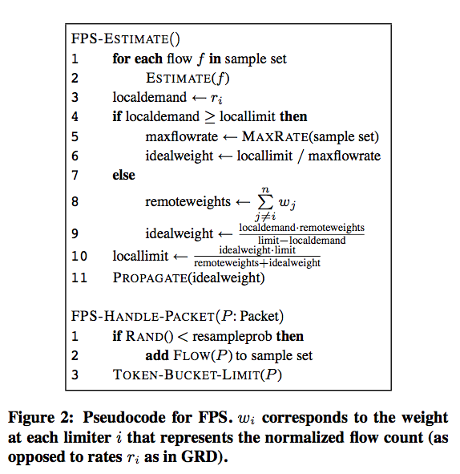
Pseudo-code

Slide 26
Use of EWMA
Estimated Weighted Moving Averages (EWMA) are used to smooth out estimated arrival rates
Also used in Flow Proportional Share to reduce oscillations between two states

Slide 27
Evaluation
Comparison to Centralized Token Bucket
Fairness to Centralized Token Bucket
Simulations with Departing and Arriving Flows
Simulations with Mixed Length Flows
Fairness of Long vs Short Flows
Fairness of Bottlenecked Flows in FPS
Fairness With Respect to RTT
PlanetLab 1/N vs FPS experiments

Slide 28
Setup
Limiters run on Linux
ModelNet is used as the network simulator
Kernel version 2.6.9
TCP NewReno with SACK

Slide 29
Comparison to Centralized Token Bucket
10 Mbps global limit
50 ms estimation interval, 20 second run
3 TCP flows to limiter 1, 7 TCP flows to limiter 2

Slide 30
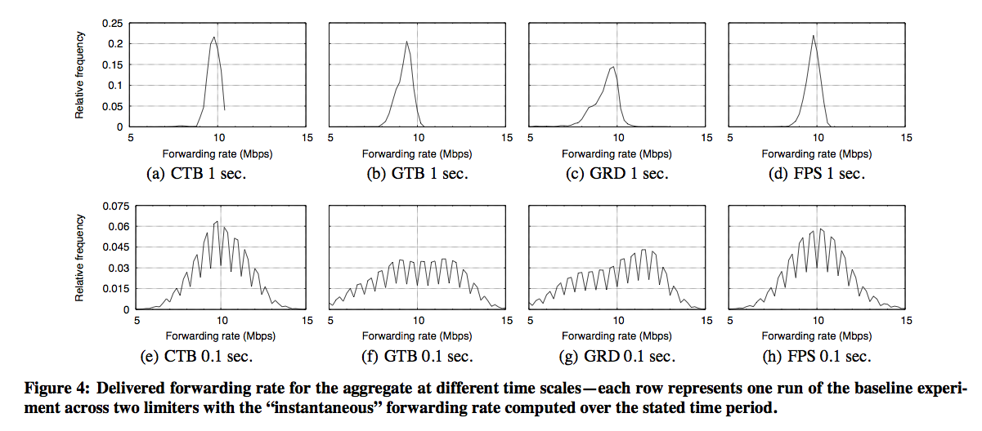
Arrival Rate Patterns
Shows how susceptible the algorithm is to bursting
GTB and GRD are less like our mark (CTB)

Slide 31
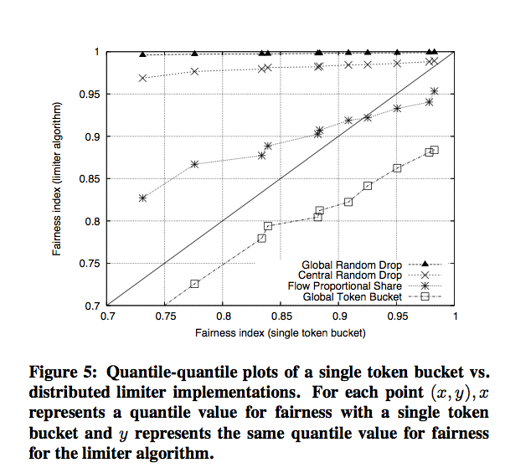
Fairness Compared to CTB
Above the diagonal is more fair than Central Token Bucket, below the line is less fair
GRD and FPS are more fair than CTB in most cases

Slide 32
Departing and Arriving Flows
Every 10 seconds, add a new flow up to 5 flows
After 50 seconds, start removing flows
Notice the reference algorithm CTB is not very fair

Slide 33
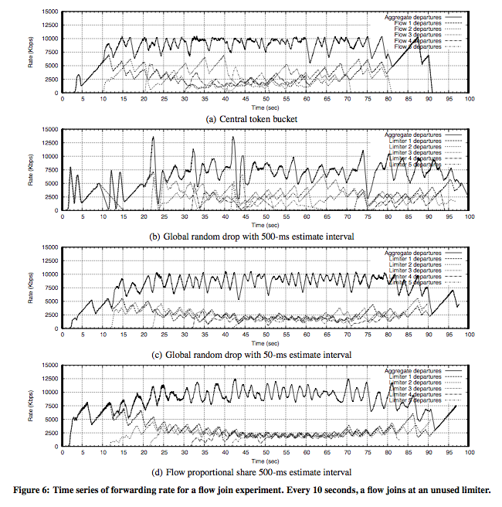

Slide 34
GRD is over the global limit here
FPS is over the global limit here

Slide 35
Mixed Length Flows
10 long lived TCP flows through one limiter
Short lived flows with Poisson distribution through another
Measuring fairness between different types of flows
GRD is the most fair followed by FPS and the CTB

Slide 36
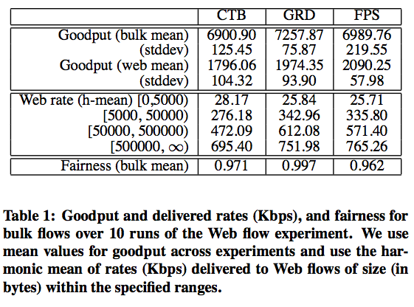
Table 1; Fairness of Long vs Short Flows

Slide 37
Changes in Bottlenecked Flows for FPS
2 limiters, 3 flows to limiter 1, 7 flows to limiter 2
10 Mbps global limit
At 15 seconds the 7 flows are restricted to 2 Mbps by a bottleneck
Should be 8 Mbps to limiter 1 and 2 Mbps to limiter 2
At 31 seconds a new flow arrives at limiter 2
Should split 8 Mbps between the 4 flows, plus 2 Mbps for other 7 flows, so 4 Mbps at limiter 1 and 6 Mbps at limiter 2

Slide 38
Changes in Bottlenecked Flows for FPS
2 Mbps Limit
New Flow

Slide 39
Changes in Bottlenecked Flows for FPS
Not quite 4/6 split
Limiter 1 has too much
2 Mbps Limit
New Flow

Slide 40
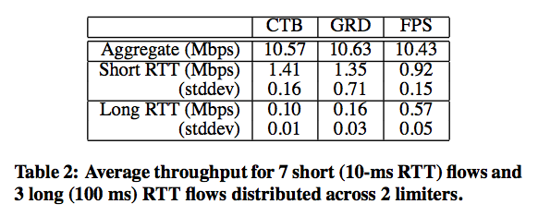
Fairness With Respect to RTT
Same as baseline experiment except changing RTT times of flows
FPS is most fair

Slide 41
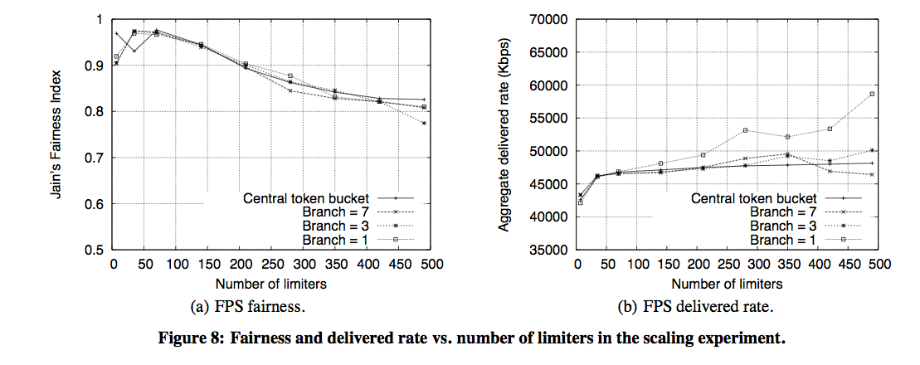
Gossip Branching Factor
Higher branch factor increases limiter communication
Notice fairness degradation at large numbers of limiters

Slide 42
PlanetLab test- 1/N vs FPS
10 PlanetLab servers serving web content
5 Mbps global limit
After 30 seconds 7 of the servers cut out
FPS re-allocates the load to the 3 servers
After another 30 seconds all servers come back
FPS re-allocates the load to all 10 servers

Slide 43
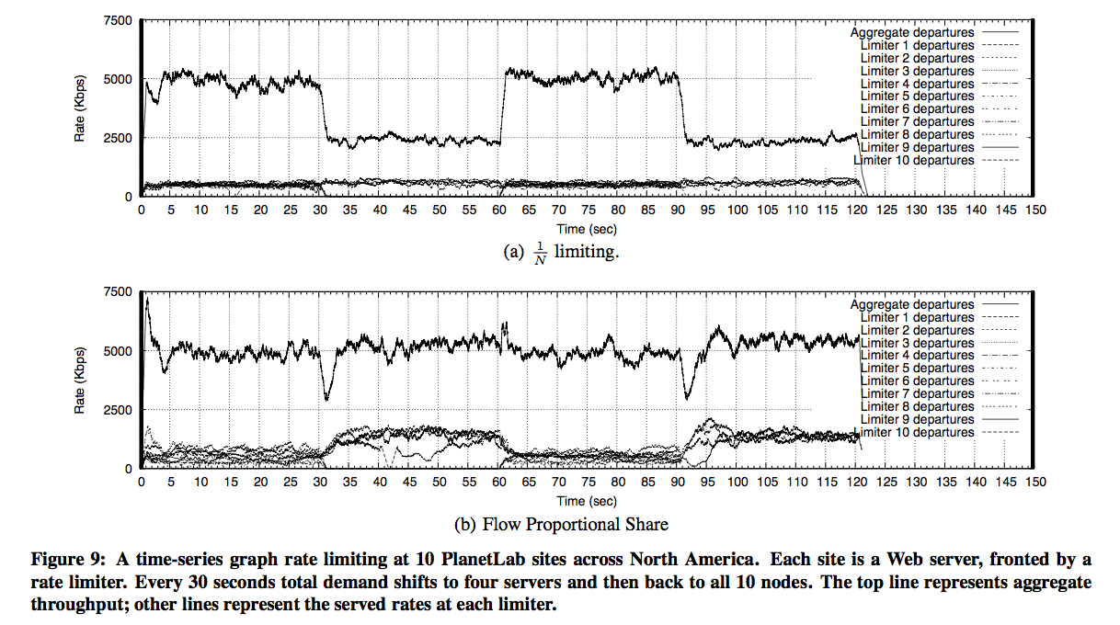
PlanetLab test- 1/N vs FPS

Slide 44
Conclusions
Several algorithms trying to tackle distributed rate limiting
FPS performs well for TCP based flows, other techniques suitable for mixed flows
FPS can perform better than the reference implementation CTB in several scenarios
Overall interesting approach to DRL with a couple of small quirks

