Slide 1
Modification of STC Algorithm
Tianyang Wang Tianxiong Yang
Advanced Computer Networks
Fall 2014

Slide 2
STC⟶M-STC
STC----a distributed topology control algorithm
Reduces energy consumption while preserving connectivity between nodes;
Makes no assumption about distance or direction between nodes;
Achieves same or less complexity and saves more energy compared with other known algorithms.
However, STC doesn’t consider remaining energy of a node, which decides lifetime of a node.
M-STC----pays attention to lifetime to network.

Slide 3
Catalogue
STC Algorithm
⟶Topology Control Algorithm
Basic idea
Pseodo-code
M-STC Algorithm
Goals
Terminology
Design of M-STC
Evaluation

Slide 4
Topology Control Algorithm
Topology Control Algorithm VS. Routing Algorithm
Topology Control Algorithm:
Changes topology of wireless network.
Routing Algorithm:
Selects paths for transmission between nodes.

Slide 5
Topology Control Algorithm
Topology Control Algorithm VS. Routing Algorithm
Topology Control Algorithm and Routing Algorithm can be viewed as two phases to form a transmission of wireless network.
Initial topology
Changed topology
Routing
Topology
Control
Algorithm
u
u
Routing
Algorithm
u
v
v
v
nodes
connections

Slide 6
Topology Control Algorithm
Topology Control Algorithm can be viewed as the set of all directly connections of nodes.
Initial topology:
G_{max} = (V, E_{max})
V: set of nodes
E_{max}: set of all connections
Changed Topology:
G = (V, E)
V: set of nodes
E: set of reduces connections
Initial topology
Changed topology
Topology
Control
Algorithm
u
u
v
v

Slide 7
Topology Control Algorithm
Objectives:
Minimize average energy consumption of all nodes in V:
min $[\sum_{u∈V}{C_{G}(u)}]$,
Minimize average energy consumption of all transmission paths:
min $[\sum_{s, t∈V}{C_{G}(s⟶t, Energy)}]$.

Slide 8
Catalogue
STC Algorithm
Topology Control Algorithm
⟶Basic idea
Pseodo-code
M-STC Algorithm
Goals
Terminology
Design of M-STC
Evaluation

Slide 9
STC Algorithm: Basic idea
Basic idea: Remove a connection if there exists
(a) a forward path that max{C(u,n₁)…C(n_{k},v)}<C(u,v), k≤3
And
(b) A backward path that max{C(v,n’₁)…C(n’_{k},u)}<C(u,v), k≤3.
C(u,v): Energy cost in a transmission from u to v.
n₁
n₂
n₁
n₂
-1.7
Remove connection (u,v)
-1.7
-1.5
-1.4
-1.5
-1.4
u
-6
v
u
v
-1.1
-1.5
-1.1
-1.5
n’₂
-1.3
n’₁
n’₂
-1.3
n’₁

Slide 10
STC Algorithm: Energy Comparison
Compare energy cost between connections:
Define tuple t(u,v)=(t₁,t₂,t₃)
t₁=p_{min}(u,v), t₂=ID_{u}, and t₃=ID_{v}
v₁
ID=2
-1.5
u
ID=1
Tuple(u,v₁)<Tuple(u,v₂)
-1.5
v₂
ID=3

Slide 11
Catalogue
STC Algorithm
Topology Control Algorithm
Basic idea
⟶Pseodo-code
M-STC Algorithm
Goals
Terminology
Design of M-STC
Evaluation

Slide 12
STC Algorithm: Pseudo-Code
01: Function STC at node (u):
02: G←(V, ϕ) /* directed graph with no edges */
03: Compile outTupleList(u) and inTupleList(u)
04: Broadcast outTupleList(u) and inTupleList(u) at maximum power P_{u}
05: Receive outTupleList(n) and inTupleList(n) from each neighbor n in G_{max}
06: Compute fPairOfPaths(n) for each n two or fewer hops away from u
07: Compute bPairOfPaths(n) for each n two or fewer hops away from u
08: Sort outTupleList(u)
09: k←degree of u in G_{max}
10: do k-1 times
11: t(u,v) ←the largest tuple in outTupleList(u)
12: remove t(u,v) from outTupleList(u)
13: vSet = {i | t(i,v)∈inTupleList(v), t(i,v)<t(u,v)
14: NoForwardPath = Ture
15: NoBackwardPath = True
16: for n∈vSet
17: p = the first path in fPairOfPaths(n) without v
18: if max{r | r∈p} < t(u,v)
19: NoForwardPath = False
20: break (out of for loop)
21: end if
22: end for
23: vSet = {i | t(v,i)∈outTupleList(v), t(v,i) < t(v,u)}
24: for n∈vSet
25: p = the first path in bPairOfPaths(n) without v
26: if max{r | r∈p} < t(v,u)
27: NoBackwardPath = False
28: break (out of for loop)
29: end if
30: end for
31: if NoForwardPath or NoBackwardPath
32: add a directed edge (u,v) to G
33: end if
34: end do
Nodes inside belongs to vSet
ForwardPath of n
-1.5
n
-1.5
-3
u
-8
v
Nodes inside belongs to outTupleList(u)

Slide 13
Catalogue
STC Algorithm
Topology Control Algorithm
Basic idea
Pseodo-code
M-STC Algorithm
⟶Goals
Terminology
Design of M-STC
Evaluation

Slide 14
Goals
GOALS:
1. Prolong the lifetime of the network
2. Decrease the cost energy
3. Decrease the complexity

Slide 15
Catalogue
STC Algorithm
Topology Control Algorithm
Basic idea
Pseodo-code
M-STC Algorithm
Goals
⟶Terminology
Design of M-STC
Evaluation

Slide 16
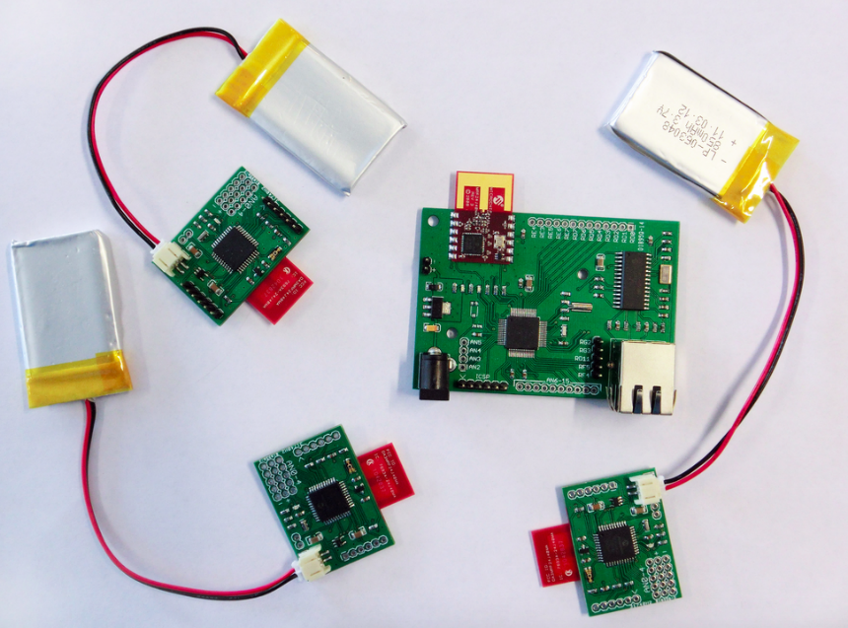
Terminology
Remaining Energy
We use remaining energy to describe the ability to keep communication with other nodes.
Nodes all have limited energy in battery-powered sensor networks

Slide 17
Terminology
Lifetime of the nodes and communication networks
Lifetime of a node (T_{node})=remaining energy/energy cost per second
Energy cost per second contains transmission power, the power of computing data and so on, however, we simplify the energy cost per second to transmission power to highlight the main part of the energy cost.
Lifetime of the communication networks
So we define the lifetime of the communication network or a link as min(T_{node1}, T_{node2}...T_{noden}), where [node1, node2,..., noden]∈the communication network or a link.

Slide 18
Catalogue
STC Algorithm
Topology Control Algorithm
Basic idea
Pseodo-code
M-STC Algorithm
Goals
Terminology
Design of M-STC
Evaluation

Slide 19
Hypothesis
1. We assume the energy in every node is limit and cannot be replenished.
2. The remaining energy in each node can be different. We did not show the domain of the remaining energy. Because the different domain of the remaining energy can make the complexity of the algorithm very different.
3. Every node has an ability to get the power information from the signal it received.

Slide 20
Hypothesis
4. At the beginning of the topology, every node can transmit its own remaining energy information to other nodes. And we also assume that every node has enough memory to store these energy cost information and remaining energy information.
5. Every node has an ability to compute the relation between the energy cost and the remaining energy to get the lifetime of the communication.
6. When the remaining energy goes to a specific number, the whole communication network will do the topology again.

Slide 21
Beginning of the M-STC
Find neighbors
P_{max}
n
u
v

Slide 22
Beginning of M-STC
Information in the Hello signal:
Each node will broadcast the information about its remaining energy, the ID of the node and the P_{max}, which is the maximum transmission power of the node, in its maximum power.

Slide 23
Beginning of M-STC
The STC algorithm relies on each node exchanging information with each of its neighbors regarding the energy costs of communication to all of its neighbors. The modification of STC also follows this rule. And we assume the information the nodes transmitted includes the remaining energy of the nodes and the list of their neighbors. By using these information, the nodes can compute the lifetime of the communication network and find an appropriate connection.

Slide 24
How to Choose Nodes
We also propose an ordered tuple t(u, v)=(t1, t2, t3, t4), where t4 is the lifetime of the link
So we need two parameters α and β. And we assume that
(t1, t2, t3,t4)<( t’1, t’2, t’3, t’4)
if and only if
t4<t’4, and t1<t’1
t4<t’4, and t1>αt’1
t4>βt’4, and t1<t’1
t4=t’4, and t1<t’1
t4<t’4, and t1=t’1,
the other conditions are follow the rules in the STC algorithm.

Slide 25
Catalogue
STC Algorithm
Topology Control Algorithm
Basic idea
Pseodo-code
M-STC Algorithm
Goals
Terminology
Design of M-STC
⟶Evaluation

Slide 26
Evaluation
 | Remaining energy | Location
u | 42 | (0.-1)
1 | 31 | (0.6,-0.5)
2 | 95 | (0.9,-0.3)
3 | 3 | (-0.6,-0.5)
4 | 43 | (0.2,-0.1)
5 | 38 | (-0.1,0.7)

Slide 27
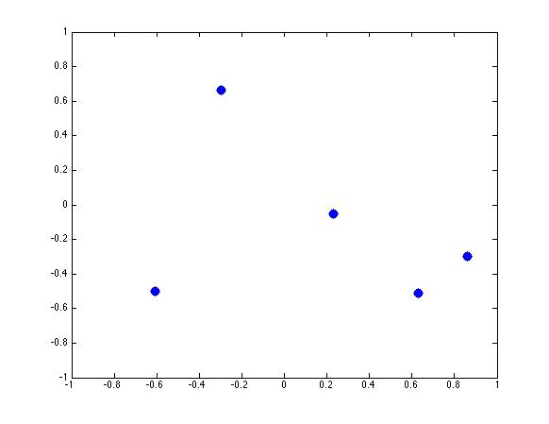
Evaluation
v
5
4
3
1
2
u
t(u,v)=u-2-4-v
t(u,v)=u-4-5-v

Slide 28
Evaluation
 | Path loss | lifetime
Path A | 2.5 | 53
Path B | 2.4 | 42

