Slide 1
The War Between Mice and Elephants
Liang Guo, Ibrahim Matta
Presented by Vasilios Mitrokostas for CS 577 / EE 537
Images taken from Pankaj Didwania's 2013 presentation of this paper
Notes:
This PowerPoint Template includes a series of slide masters with predefined layouts and color schemes for formatting slides
Slide Masters are displayed when you right click on a slide and select Layout from menu
1

Slide 2
An Issue of Fairness
Long connections are unintentionally favored over short connections by TCP congestion control algorithm
2
Notes:
2

Slide 3
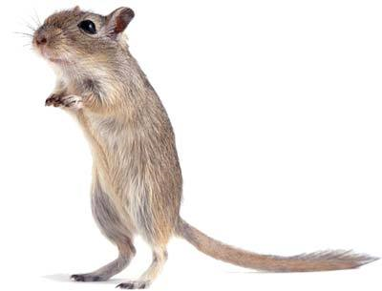
Mouse
3

Slide 4
Mouse
Many connections, short traffic
4

Slide 5
Elephant
5

Slide 6
Elephant
Few connections, large traffic
80-20 rule
6

Slide 7
The Elephant Wins
Blame TCP; three main factors
Conservative ramp up of transmission rate
Painful packet loss for shorter connections
No packet samples for mice
7
Notes:
7

Slide 8
TCP: Conservative Ramp Up
Sending window starts at the smallest value
This hurts many small connections which need to begin at this point each time
8
Notes:
8

Slide 9
TCP: Painful Packet Loss
A short connection's congestion window doesn't have enough packets to detect packet loss by duplicate ACKs
. . . so it's only detected by timeout, slowing the rate of data transmission
9
Notes:
9

Slide 10
TCP: No Packet Samples
TCP uses samples of packets to help determine timeout
. . . but each of the many, short connections lacks sampling data, so timeouts are set to conservative, large value
10
Notes:
10

Slide 11
How to Combat Unfairness
Guo and Matta's proposal; fight fire with fire
Simulations say: give short connections preferential treatment to induce fairness
A weighted policy to classify TCP flows by size
RIO (RED with In and Out) queue management
11
Notes:
11

Slide 12
Validating the Problem
How did the authors draw these conclusions?
A study of short and long TCP flows
Previous papers highlight the uphill battle faced by mice . . . but their solutions modify TCP
Issue: isolating flows by class (short vs. long) may cause packet reordering, leading to poor performance
Guo and Matta: place control inside the network with RIO
12
Notes:
12

Slide 13
Proposed Solution
Mitigate packet loss by giving preferential treatment to short connections
13
Notes:
13

Slide 14
RIO: Classify In or Out
Classify packets as In or Out to determine size, allowing for preferential treatment
Favor short connections at bottleneck link queues, so they experience fewer dropped packets
14
Notes:
14

Slide 15
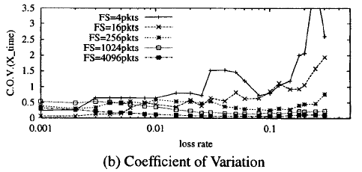
Why Is Packet Loss Critical?
When loss rate is small, average transmission time is not greatly impacted
When loss rate is large, time increases drastically (see TCP-Newreno test below, randomly dropped packets)
15
Notes:
15

Slide 16
Why Does Variability Happen?
High loss rate = high chance for TCP to enter exponential backoff (congestion avoidance) phase, resulting in more variability
Low loss rate = two options for TCP: transmit aggressively with slow-start or transmit in congestion avoidance phase, resulting in more variability (less consistency)
First source of variability is on individual packets—greater impact on short flows due to number
Second source of variability in end-phase—greater impact on long flows which finish beyond slow-start
16
Notes:
16

Slide 17
Comparison by Simulation
Network simulator ns by E. Amir et al.
10 long flows (100 packets) vs. 10 short flows (10,000 packets) (TCP-Newreno)
1.25Mbps link
17
Notes:
17

Slide 18
Too Unfair to Elephants?
RIO-PS (preferential treatment to short flows) graph shows short flows taking more of the total link utilization than long flows . . . unequal
This is OK; early completion returns resources to long flows, so long-term goodput is maintained
In fact, it results in a more stable environment for long flows because of fewer disturbances from short flows (once they finish)
18
Notes:
18

Slide 19
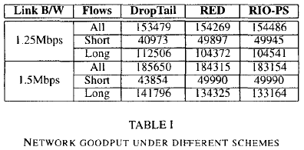
Goodput Comparison
Overall goodput for all flows remains stable
500 second simulation, note difference in load (RED and RIO-PS favor higher loads)
19
Notes:
19

Slide 20
Implementation: Edge Routers
Employ a Diffserv-like network architecture to differentiate between short and long TCP flows
This is done through edge routers
Edge router tracks each flow, counting packets
Once a threshold Lt is met, flow is considered long (the first Lt packets of such a flow are considered short)
Authors claim this is OK because first few packets are vulnerable to packet losses, and this makes the system fair to all starting TCP connections
Every so often (Tu time units), flow is considered finished if no packets are observed in the period
20
Notes:
20

Slide 21
Choosing Variables
Threshold Lt can be static or dynamic; can allow edge router to modify every Tc based on short and long flow counts . . . the Short-to-Long-Ratio (SLR)
Choosing Tu and Tc needs further research (Tu = 1 sec, Tc = 10 sec in simulation)
21
Notes:
21

Slide 22
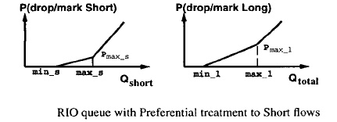
Implementation: Core Routers
Core routers give preferential treatment to short packets using RIO
See packet dropping figure below; note that In (short) packet queuing is not affected by Out (long) packet arrivals
22
Notes:
22

Slide 23
Packet Reordering: Not a Problem
Only one FIFO queue is used for all packets, short and long
No packet reordering even if same-flow packets are classified differently
23
Notes:
23

Slide 24
Simulation
Is RIO-PS as beneficial as claimed?
24
Notes:
24

Slide 25
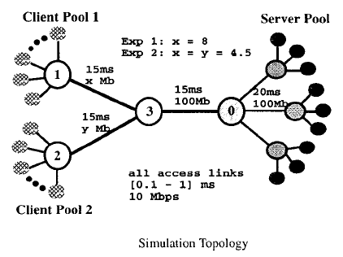
Simulation of RIO-PS
Web traffic model; each page requires TCP connection
Tuned to maximize power, ratio between throughput and delay. High power implies high throughput and low delay
25
Notes:
25

Slide 26
Single Client Experiment
4,000-second simulation
(2,000-second warm-up)
Record response time using preferential treatment
What about initial timeout (ITO) from 3 seconds to 1 second? Authors warn unnecessary retransmissions may lead to congestion collapse (slow links or high round-trip delay), but plot results anyway (donkey)
26
Notes:
26

Slide 27
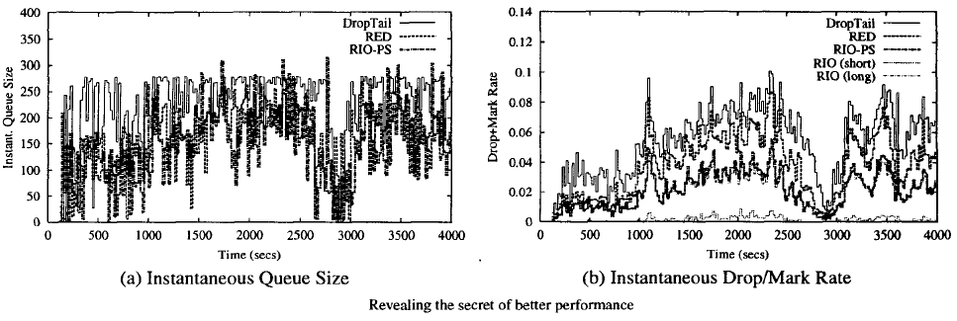
Advantage
Performance improvements; reduction on overall mark/drop rate without risk of queue overload at the bottleneck link
Why? Short flows now have fewer packet drops, which means fewer congestion notifications
27
Notes:
27

Slide 28
Fairness Index
Computed using a fairness index formula based on response time Ti
28
Notes:
28

Slide 29
Fairness Index Continued
Transmission times and goodput
29
Notes:
29

Slide 30
Unbalanced Requests Experiment
Paper suggests preferential treatment still helps, but results are captured in another paper due to space limitation
30
Notes:
30

Slide 31
Evaluation
Does the model hold in real-world cases? Can it be feasibly deployed?
31
Notes:
31

Slide 32
Evaluating the Simulation Model
The web traffic model used for simulation is the “Dumbbell and Dancehall” one-way traffic model
Guo and Matta claim that the RIO-PS scheme still grants an advantage when reverse traffic is present
Why? Short exchanges due to control packet handling on the client side are protected by this scheme (due to the preferential treatment)
Authors also say simulation results mean RIO-PS works in extremely unbalanced cases, so odd traffic topologies would not be a problem (is this true?)
32
Notes:
32

Slide 33
Evaluating Deployment
A paper on edge devices is referenced to show that per-flow state maintenance (In vs. Out) and per-packet processing does not significantly impact end-to-end performance (sounds nebulous)
RIO-PS only needs to be implemented at busy bottleneck links
33
Notes:
33

Slide 34
Conclusions
RIO-PS benefits short connections, which represent the majority of TCP flows
Long flows are thus minimally impacted
Goodput is either the same or improved, depending on the network
Flexible architecture; only edge routers need to be tuned
34
Notes:
34

