Slide 1
A Survey on Security for Mobile Devices
Mariantonietta La Polla
Fabio Martinelli
Daniele Sgandurra

Slide 2
Outline
Introduction
Mobile Technologies
Mobile Malware
Attacks on Mobile Devices
Security Solutions For Mobile Devices
Conclusions

Slide 3
Introduction
This paper aims to provide a structured and comprehensive overview of the research on security solutions for mobile devices over the period 2004-2011.
Group existing approaches aimed at protecting mobile devices against growing number of attacks into different categories, based upon the detection principles, architectures, collected data and operating systems.

Slide 4
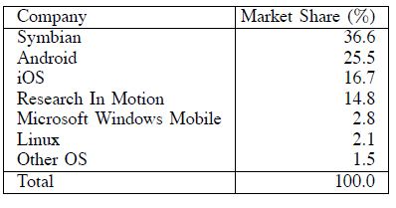
Increasing number of OSes for smartphones -2010-
Growing number of mobile malware in the same trend as malware for PCs in the next incoming years.
new mobile OS vulnerabilities numbers: from 115 in 2009 to 163 in 2010 (42% more vulnerabilities).
Section II introduces some background notions on mobile technologies.
- wireless telecommunication
- networking standards.
Section III
-describes different types of mobile malware
-outlines the differences among security solutions for smartphones and traditional PCs.
Section IV discusses current threats
-analyzes the different methodologies to perform an attack in a mobile environment
-investigates how they can be exploited to reach different goals.
Section V presents security solutions, focusing on those that exploit intrusion detection systems and trusted platform technologies.
Section VI conclusions.

Slide 5
Mobile Technologies
Background Notions on wireless telecommunication technologies
GSM: Global System for Mobile communications is the first and most popular standard in Europe for mobile telecommunication system and is part of 2G wireless telephone technology.
GPRS and EDGE: referred as 2.5 generation.
General Packet Radio Service uses packet switching mechanism to achieve higher data rates and lower access time.
Enhanced Data rates for GSM Evolution supports higher transmission rate and higher reliability
UMTS: the Universal Mobile Telecommunications System represents the third-generation (3G) on cellular system
Circuit switching connections are supported simultaneously with packet switching connections
Users can exploit multiple services and different classes of services, such as conversational, streaming, interactive and background.
-Infrastructure-based Attacks-

Slide 6
Mobile Technologies
Background Notions on Networking Technologies
Bluetooth: Bluetooth is a standard that enables devices to exchange data over a small area through short wavelength radio transmissions.
Wireless LAN IEEE 802.11: IEEE 802.11 is a family of standards for WLAN that includes several protocols for communicating at different frequencies (2.4, 3.6 and 5 GHz).
These standards can be used in two operation mode:
in the infrastructure mode, a device, referred as Access Point (AP), plays the role of the referee: an AP regulates the network access and coordinates the devices that are part of the network
in the infrastructure-less mode (ad hoc mode), no referee exists and devices monitor the spectrum to gain network access

Slide 7
Outline
Introduction
Mobile Technologies
Mobile Malware
Attacks on Mobile Devices
Security Solutions For Mobile Devices
Conclusions

Slide 8
Mobile Malware
Malware is any kind of hostile, intrusive, or annoying software or program code (e.g. Trojan, rootkit, backdoor) designed to use a device without the owner’s consent.
Malware can be grouped in the following main categories, according to its features
virus
worm
Trojan
rootkits
botnet
Mobile malware can spread through several and distinct vectors, such as SMS links, MMS attachments and infected programs received via Bluetooth.
Main goals of malware targeted at smartphones include theft of personal data stored in the phone or the user’s credit.

Slide 9
Mobile Malware
Evolution of Mobile Malware
Predictions and Future Threats
Mobile Security vs. Personal Computer Security

Slide 10
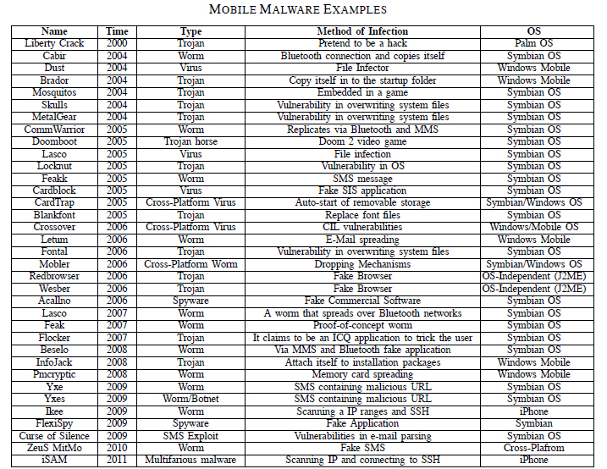
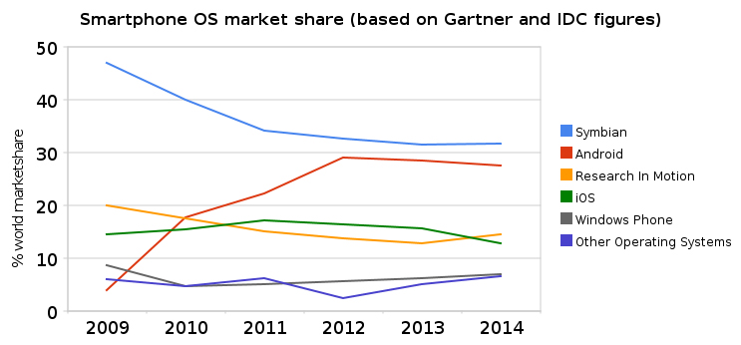

Slide 11
Evolution of Mobile Malware
Roles in prevention solutions and countermeasures
the users, which have to be educated to utilize the device in a secure way
the software developer, which can develop security protection targeted at smartphone;
the network operator, which can enhance the network infrastructure with mechanisms to avoid intrusions;
the phone manufacturers, which should update the devices automatically so that for attackers it would be harder to exploit security holes;
new epidemiological models, to forecast if an already detected virus can initiate an epidemic.

Slide 12
Predictions and Future Threats
Security experts foresee massive attacks to come out at any time, McAfee Labs predicts that 2011 will be a turning point for threats to smartphones.
In the near future cybercriminals will focus their attention on iPhone and Android platforms.
the spreading of mobile virus to desktop platforms
e.g. USB devices are responsible for the spread of auto-run malware, while the Conficker worm contained a propagation capability that used removable drives to increase spread.
The observation of new forms of malware in a testbed environment to predict their behavior
e.g. MAISim, a framework that uses the technology of mobile agents for simulation of various types of malicious software (viruses, worms, malicious mobile code) for smartphones.

Slide 13
Predictions and Future Threats
Future threats in a mobile environment may affect different assets, such as:
personal data;
corporate intellectual property;
classified information;
financial assets;
device and service availability and functionality;
personal and political reputation.
some future risks, threats and countermeasures for smartphones:
data leakage resulting from device loss or theft;
unintentional disclosure of data;
attacks on decommissioned devices;
phishing attacks;
spyware attacks;
network spoofing attacks;
surveillance attacks;
diallerware attacks;
financial malware attacks;
network congestion.

Slide 14
Mobile Security vs. Personal Computer Security
Five key aspects distinguish mobile security from conventional computer security:
mobility: each device comes with us anywhere we go and therefore, it can be easily stolen or physically tampered;
strong personalization: usually, the owner of device is also its unique user;
strong connectivity: a smartphone enables a user to send e-mails, to check her online banking account, to access lot of Internet services; in this way, malware can infect the device, either through SMS or MMS or by exploiting the Internet connection;
technology convergence: a single device combines different technologies: this may enable an attacker to exploit different routes to perform her attacks;
reduced capabilities: even if smartphones are like pocket PCs, there are some characteristic features that lack on smartphones, e.g. a fully keyboard.

Slide 15
Mobile Security vs. Personal Computer Security
The limited resources(CPU and memory) of a smartphone are the most obvious difference with a PC.
It is highly important that a security solution does not constantly drain large portions of available CPU time to avoid battery exhaustion.
Threats to user privacy in a mobile environment are different from those performed on PCs
Sensors (e.g. microphones) are not optional and can be used illicitly to sniff user’s private data. The attacks work even when the user is not interacting with the mobile phone.

Slide 16
Outline
Introduction
Mobile Technologies
Mobile Malware
Attacks on Mobile Devices
Security Solutions For Mobile Devices
Conclusions

Slide 17
Attacks on Mobile Devices
Methodologies of the Attacks
wireless;
break-in;
Infrastructure-based;
worm-based;
botnet;
user-based.
Goals of the Attacks
privacy;
sniffing;
denial of service;
overbilling.

Slide 18
Methodologies of the Attacks
wireless attacks against smartphones, especially those targeting personal and sensitive data
eavesdropping on wireless transmissions to extract confidential information, such as usernames and passwords
abuse the unique hardware identification (e.g.,wireless LAN MAC address) for tracking or profiling the owner of the device
exploit Bluetooth as a medium to speed up its propagation.
Break-in Attacks enable the attacker to gain control over the targeted device for performing further attacks by exploiting either programming errors or format string vulnerabilities

Slide 19
Methodologies of the Attacks
Infrastructure-based Attacks
GSM: the security impact of the SMS interface on the availability of the cellular phone
-e.g. If an attacker is able to simultaneously send messages through available portals into the SMS network, the resulting aggregate load can saturate the control channels and block legitimate voice and SMS communications.

Slide 20
Infrastructure-based Attacks
GPRS: Attacks against GPRS can target the device, the radio access network, the backbone network, and the interfaces connecting GPRS networks with each other or with the Internet.
- Five sensitive area in GPRS security
the mobile station (MS) and the SIM-card
the interface between the MS and the SGSN (Serving GPRS Support Node)
the GPRS backbone network
the packet network that connects different operators
the Internet

Slide 21
Infrastructure-based Attacks
UMTS: UMTS security architecture defines a set of procedures to achieve increased message confidentiality and integrity during their communication.
- Some examples of attacks in UMTS security
dropping ACK signal
modification of unprotected Radio Resource Control (RRC) messages
modification of the initial security capabilities of MS
modification of periodic authentication messages
SQN synchronization
EAP-ALA originated DoS

Slide 22
Methodologies of the Attacks
Worm-Based Attacks
The main features that characterize attacks based upon worms are:
transmission channel
possible routes for infection vectors:
• downloading infected files while surfing the Internet;
• transferring malicious files between smartphones using the Bluetooth interface;
• synchronizing a smartphone with an infected computer;
• accessing an infected memory card;
• opening infected files attached to MMS messages.
spreading parameters
user mobility models

Slide 23
Methodologies of the Attacks
Worm-Based Attacks
The main features that characterize attacks based upon worms are:
transmission channel
spreading parameters: Worms can also attack the communication network itself. Worms that exploit messaging services are potentially more virulent than Bluetooth ones in terms of speed and area of propagation.
user mobility models: mobile worms can infect several devices using proximity attacks against vulnerable devices that are physically nearby without connection with internet.

Slide 24
Methodologies of the Attacks
Botnets Attacks
Since mobile networks are now well integrated with the Internet, threats on the Internet will migrate over the mobile networks including botnets.
Bluetooth Command-and-Control: construct and maintain mobile-based botnets communicating via Bluetooth
SMS C&C: Within the testbed mobile botnet, all C&C communications are carried out using SMS messages. A P2P topology is exploited which makes the detection and disruption much harder.
Hybrid C&C: combine P2P with SMS-HTTP hybrid approach to create a fully functional mobile phone botnet out of Apple’s jailbroken iPhone
command-and-control(C&C) network, used to remotely propagate messages, tasks, updated payload among the bots and the botmasters (and viceversa), can be built out using Bluetooth, SMS messages, the Internet (e.g., HTTP), peer-to-peer (P2P) or any combination of them.

Slide 25
Attacks on Mobile Devices
Goals of the Attacks
Privacy
Privacy attacks of smartphones concern situations in which integrity and confidentiality are corrupted
stealing personal data from a lost smartphone, such as contact list or messages.
location awareness
Sniffing
Sniffing attacks on smartphones are based upon the use of sensors, e.g. microphone, camera, GPS receiver. These sensors can seriously compromise users’ privacy.
Denial of Service;
Overbilling.

Slide 26
Attacks on Mobile Devices
Goals of the Attacks
Privacy
Sniffing
Denial of Service
DoS attacks against smartphones are mostly due to strong connectivity and reduced capabilities: due to the limited hardware, attacking a smartphone can be accomplished with a small effort.
e.g. battery exhaustion attacks; water torture attack(PHY layer)
Overbilling
overbilling attacks charge additional fees to the victim’s account and may transfer these extra fees from the victims to the attackers.

Slide 27
Outline
Introduction
Mobile Technologies
Mobile Malware
Attacks on Mobile Devices
Security Solutions For Mobile Devices
Conclusions

Slide 28
Security Solutions For Mobile Devices
Intrusion Detection Systems
two complementary approaches
- prevention-based approaches
Assure confidentiality, authentication or integrity using cryptographic algorithms, digital signatures and hash functions
- detection-based approaches
effectively identifying malicious activities
two main types of detection
- anomaly detection
compare the “normal” behavior with the “real” one
- signature detection
based upon patterns of well-known attacks
Trusted mobile-based Solutions

Slide 29
Includes some conventional approaches typically implemented by off-the-shelf smartphone applications to provide basic security

Slide 30
Chronologically list the research security solutions that provides a prototype, according to their detection principles, architecture(distributed or local), reaction (active or passive), collected
data (OS event, keystrokes), and OS

Slide 31
Intrusion Detection Systems
partition existing IDS solutions using these features:
detection principles:
– anomaly detection:
∗ machine learning;
∗ power consumption.
– signature-based:
∗ automatically-defined;
∗ manually.
architecture:
– distributed;
– local
reaction:
– active;
– passive.
collected data:
– system calls;
– CPU, RAM;
– keystrokes;
– SMS, MMS.
OS:
– Symbian;
– Android;
– Windows Mobile;
– Apple iOS.

Slide 32
Intrusion Detection Systems
Detection Principles:
Partition existing IDSes using the following detection principles:
anomaly detection
An anomaly detection system compares the “expected” behavior of the smartphone with the “real” behavior.
Anomaly-based approaches for smartphones are either based upon machine learning techniques or upon monitoring power consumption.
signature-based
run-time policy enforcement

Slide 33
Detection Principles:
anomaly detection
signature-based
The signature-based approach checks if each signature derived from an application matches any signature in a malware database.
The database of malware signature can be automatically or manually defined.
run-time policy enforcement
mobile code consumers essentially accept some contractual requirements(a policy) and exploit a supporting mechanism to enforce the policy associated with the code to detect and stop anomalies.

Slide 34
Intrusion Detection Systems
Architecture:
local architecture
both the collecting phase and the analysis phase are locally performed on the device and no interactions with an external server is required. (limited resource)
distributed architecture
a distinct and separated component (i.e., a server) is required to analyze the activities collected and sent by each device.
Reaction
According to whether existing mechanisms for intrusion detection react or not whenever a new threat is found, the solutions can be active reaction or passive reaction.

Slide 35
Intrusion Detection Systems
Collected Data:
All the solutions based upon intrusion detection need to access several features of a smartphone, the problem of privacy of the data accessed should be carefully considered.
Operating System Events
system calls
function calls
network operations
Measurements
CPU activity,
memory consumption
file I/O activity
network I/O activity
Keystrokes
track the keys struck on a keyboard to monitor the actions of the user
Communication Events
Communication events include operations such as sending and receiving of SMS/MMS messages, or file downloads/uploads.
Operating Systems: Symbian; Android;
Windows Mobile; iPhone OS.

Slide 36
Security Solutions For Mobile Devices
Intrusion Detection Systems
Trusted mobile-based Solutions
Trusted Computing Group (TCG) has published a set of specifications to measure, store, and report hardware and software integrity through a hardware root-of-trust, which is the Trusted Platform Module (TPM) and Core-Root-of-Trust-Measurement (CRTM).
Specifications for mobile phone platforms released by the TCG Mobile Phone Working Group, i.e. the Mobile Trusted Module (MTM), provide a root-of-trust for smartphones in the same way as the TPM does for personal computers.

Slide 37
Conclusions
Solutions aimed at preventing the infection and the diffusion of malicious code in smartphone have to consider multiple factors:
limited resources available, including the power and the processing unit
large number of features that can be exploited by the attackers, such as different kinds of connections, services, sensors and the privacy of the user.
Work we have done:
discussed the current scenario of mobile malware by summarizing its evolution, outlined likely future threats and reported some predictions for the near future.
categorized known attacks against smartphones, especially at the application level
reviewed current security solutions for smartphones focusing on existing mechanisms based upon intrusion detection and trusted mobile platforms.

Slide 38
Thank you.

