Slide 1
Fiber Distributed Data Interface (FDDI)
Computer Networks

Slide 2
FDDI Oultine
FDDI
100 Mbps Dual Ring
Multiple-Token
Self-Healing Ring
Target Token Rotation Time (TTRT)
4B/5B Encoder

Slide 3
FDDI
FDDI uses a ring topology of multimode or single mode optical fiber transmission links operating at 100 Mbps to span up to 200 kms and permits up to 500 stations.
Employs dual counter-rotating rings.
In FDDI, token is absorbed by station and released as soon as it completes the frame transmission {multi-token operation}.
16 and 48-bit addresses are allowed.

Slide 4
FDDI: Dual Token Ring
A
E
B
C
D
Leon-Garcia & Widjaja:
Communication Networks

Slide 5
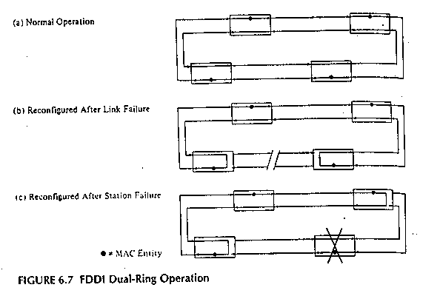
FDDI Repair
Self-healing Dual-Ring

Slide 6
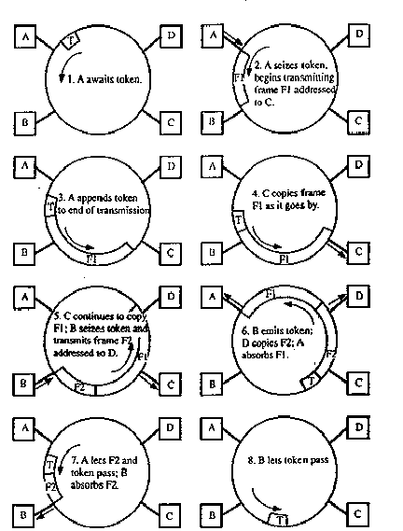
FDDI Ring Operation
Multi-token implies more than one frame on the ring at the same time.

Slide 7
FDDI
To accommodate a mixture of stream and bursty traffic, FDDI is designed to handle two types of traffic:
Synchronous frames that typically have tighter delay requirements (e.g., voice and video).
Asynchronous frames have greater delay tolerances (e.g., data traffic).
** First occasion when design considered QoS.
FDDI uses TTRT (Target Token Rotation Time) to ensure that token rotation time is less than some value.

Slide 8
FDDI Data Encoding
Cannot use Differential Manchester because 100 Mbps FDDI would require 200 Mbaud!
Instead each ring interface has its own local clock.
Outgoing data is transmitted using this clock.
Incoming data is received using a clock that is frequency and phase locked to the transitions in the incoming bit stream.

Slide 9
FDDI Data Encoding
Data is encoded using a 4B/5B encoder.
For each four bits of data transmitted, a corresponding five-bit codeword is generated by the encoder.
There is a maximum of two consecutive zero bits in each symbol.
The symbols are then shifted out through a NRZI encoder which produces a signal transition whenever a 1 bit is being transmitted and no transition when a 0 bit is transmitted.
Local clock is 125MHz. This yields 100 Mbps (80% due to 4B/5B).

Slide 10
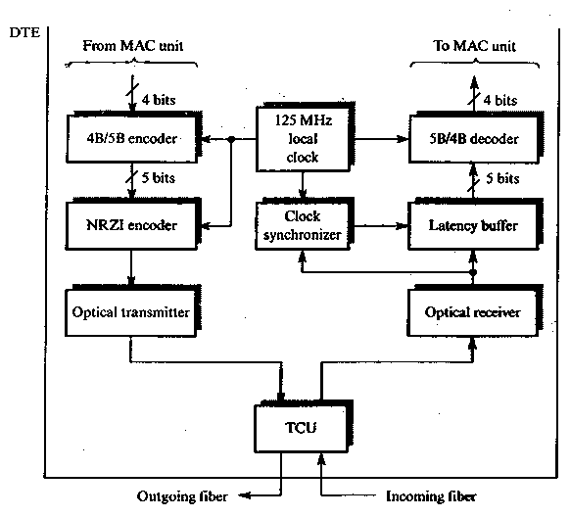
FDDI

Slide 11
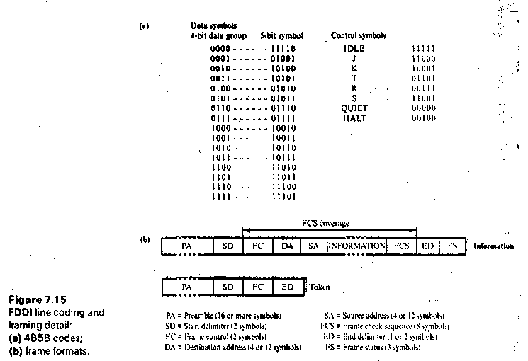
SD
ED
FDDI

Slide 12
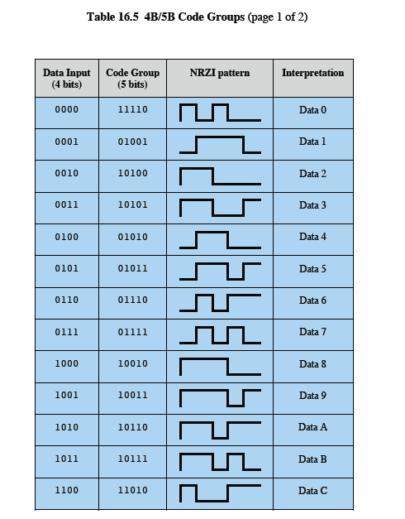
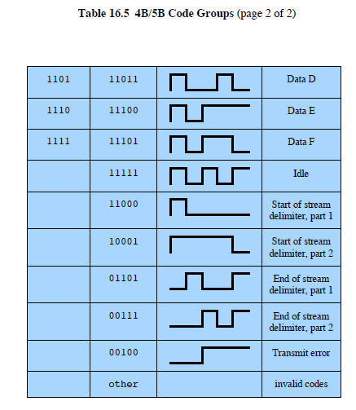
4B/5B Codes
DCC 9th Ed.
Stallings

Slide 13
FDDI Frame Structure
Token Frame Format
PRE
SD
FC
ED
Data Frame Format
8
1
1
2 or 6
2 or 6
4
1
1
PRE
SD
FC
Destination
Address
Source
Address
Information
FCS
ED
FS
Preamble
Frame
Control
CLFFZZZZ C = Synch/Asynch
L = Address length (16 or 48 bits)
FF = LLC/MAC control/reserved frame type
Leon-Garcia & Widjaja:
Communication Networks

Slide 14
More FDDI Details
FDDI Transmission on optical fiber requires ASK (e.g., coding is done via the absence or presence of a carrier signal {Intensity Modulation}.)
Specific 5-bit codeword patterns chosen to guarantee no more than three zeroes in a row to provide for adequate synchronization.
1300 nm wavelength specified.
Dual rings (primary and secondary) – transmit in opposite directions.
Normally, second ring is idle and used for redundancy for automatic repair (self-healing).

Slide 15
IEEE 802.5 versus FDDI
802.5 Token Ring
Shielded twisted pair
4, 16 Mbps
No reliability specified
Differential Manchester
Centralized clock
Priority and Reservation bits
Three distinct token operations are possible.
FDDI
Optical Fiber
100 Mbps
Reliability specified (dual ring)
4B/5B encoding
Distributed clocking
Timed Token Rotation Time (TTRT)
Multi-token operation

Slide 16
FDDI Summary
FDDI
100 Mbps Dual Ring
Multiple-Token
Self-Healing Ring
Target Token Rotation Time
Two classes of traffic
4B/5B Encoder

