Slide 1
Physical Layer (Part 1)
Computer Networks
Spring 2013

Slide 2
Physical Layer Outline (Part 1)
Definitions
Nyquist Theorem - noiseless
Shannon’s Result – with noise
Analog versus Digital
Amplifier versus Repeater
Advantages/Disadvantages of Analog vs Digital Transmissions

Slide 3
A Very Simple Abstraction
Transmitter
Receiver
Communication channel
The Physical Layer is concerned with physical considerations and limitations.
Leon-Garcia & Widjaja:
Communication Networks

Slide 4
Physical Layer Definitions
The time required to transmit a character depends on both the encoding method and the signaling speed (i.e., the modulation rate - the number of times/sec the signal element changes).
baud (D) - the number of signal elements per second.
bandwidth (H) - the range of frequencies that is passed by a channel. The transmitted signal is constrained by the transmitter and the nature of the transmission medium in cycles/sec (hertz).
channel capacity (C) – the rate at which data can be transmitted over a given channel under given conditions.{This is also referred to as data rate (R).}

Slide 5
Modulation Rate
modulation rate
is doubled
DCC 6th Ed.
Stallings

Slide 6
Nyquist Theorem {assume a noiseless channel}
If an arbitrary signal is run through a low-pass filter of bandwidth H, the filtered signal can be completely reconstructed by making 2H samples/sec.
This implies for a signal of V discrete levels,
Note – a higher sampling rate is pointless because higher frequency signals have been filtered out.
Max. data rate :: C = 2H log ₂ (V) bits/sec.

Slide 7
Physical Transmission Issues
A(f)
A(f)
1
f
f
0
H
0
H
(b) Maximum pulse transmission rate is 2H pulses/second
Channel
t
t
Leon-Garcia & Widjaja:
Communication Networks

Slide 8
Voice-grade Phone Line
Example 1. {sampling rate}
H = 4000 Hz
2H = 8000 samples/sec.
➔ sample every 125 microseconds!!
Example 2. {noiseless capacity}
D = 2400 baud {note D = 2H}
V = each pulse encodes 16 levels
C = 2H log ₂ (V) = D x log ₂ (V)
= 2400 x 4 = 9600 bps.

Slide 9
Signal Constellations
B_{k}
B_{k}
A_{k}
A_{k}
4 “levels”/ pulse
2 bits / pulse
2D bits per second
16 “levels”/ pulse
4 bits / pulse
4D bits per second
Leon-Garcia & Widjaja:
Communication Networks

Slide 10
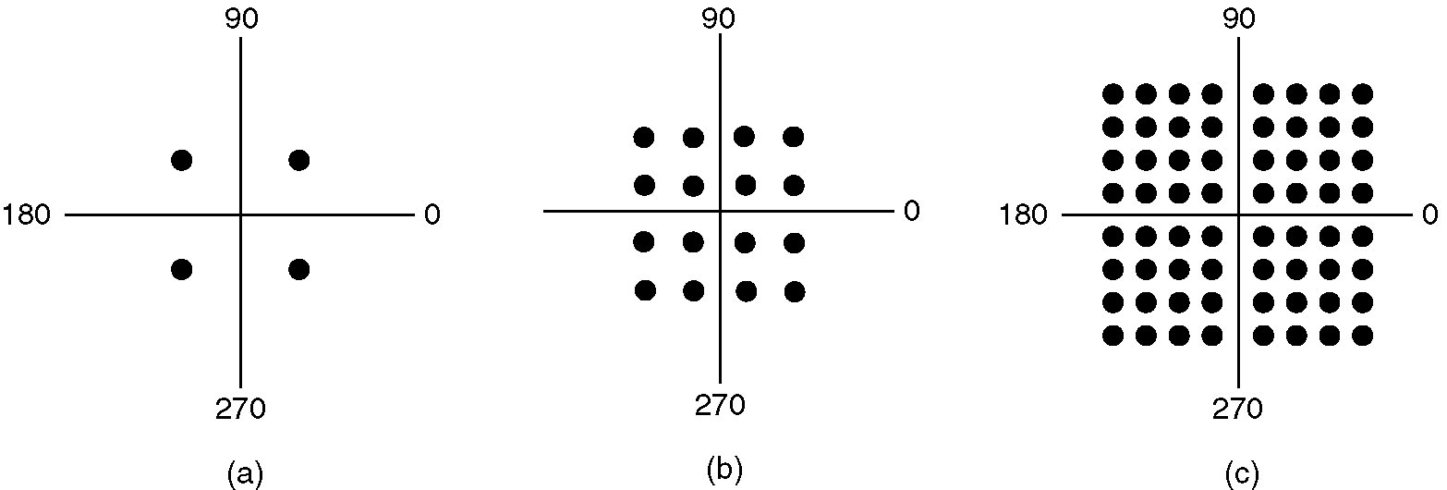
Constellation Diagrams
(a) QPSK. (b) QAM-16. (c) QAM-64.
Figure 2-25.
Tanenbaum

Slide 11
Signal to Noise Ratio (SNR)
signal
noise
signal + noise
High
SNR
t
t
t
signal
noise
signal + noise
Low
SNR
t
t
t
Average Signal Power
SNR =
Average Noise Power
SNR (dB) = 10 log₁₀ SNR
Leon-Garcia & Widjaja:
Communication Networks

Slide 12
Shannon’s Channel Capacity Result {assuming only thermal noise}
For a noisy channel of bandwidth H Hz. and a signal-to-noise ratio SNR, the max. data rate::
Regardless of the number of signal levels used and the frequency of the sampling.
C = H log ₂ (1 + SNR)

Slide 13
Shannon Example – Noisy Channel
Telephone channel (3400 Hz) at 40 dB SNR
C = H log ₂ (1+SNR) b/s
SNR (dB) = 40 dB
40 dB =10 log ₁₀ (SNR)
4 = log ₁₀ (SNR)
SNR =10,000
C = 3400 log ₂ (10001) = 44.8 kbps
Leon-Garcia & Widjaja:
Communication Networks

Slide 14
Data Communications Concepts
Analog and Digital correspond roughly to continuous and discrete , respectively.
These two terms can be used in three contexts: data, signals, transmissions.
1. data:: entities that convey meaning (or information).
analog – voice and video are continuously
varying patterns of intensity.
digital - take on discrete values (e.g., integers, ASCII text).
Data are propagated from one point to another by means of electrical signals.
DCC 6th Ed.
Stallings

Slide 15
Analog and Digital Contexts: data signals transmissions
DCC 9th Ed.
Stallings
Notes:
Analog and Digital Transmission
Both analog and digital signals may be transmitted on suitable transmission media. The way these signals are treated is a function of the transmission system. Stallings DCC9e Table 3.1 summarizes the methods of data transmission. Analog transmission is a means of transmitting analog signals without regard to their content; the signals may represent analog data (e.g., voice) or digital data (e.g., binary data that pass through a modem). In either case, the analog signal will become weaker (attenuate) after a certain distance. To achieve longer distances, the analog transmission system includes amplifiers that boost the energy in the signal. Unfortunately, the amplifier also boosts the noise components. With amplifiers cascaded to achieve long distances, the signal becomes more and more distorted. For analog data, such as voice, quite a bit of distortion can be tolerated and the data remain intelligible. However, for digital data, cascaded amplifiers will introduce errors.
Digital transmission, in contrast, assumes a binary content to the signal. A digital signal can be transmitted only a limited distance before attenuation, noise, and other impairments endanger the integrity of the data. To achieve greater distances, repeaters are used. A repeater receives the digital signal, recovers the pattern of 1s and 0s, and retransmits a new signal. Thus the attenuation is overcome.
The same technique may be used with an analog signal if it is assumed that the signal carries digital data. At appropriately spaced points, the transmission system has repeaters rather than amplifiers. The repeater recovers the digital data from the analog signal and generates a new, clean analog signal. Thus noise is not cumulative.
The question naturally arises as to which is the preferred method of transmission. The answer being supplied by the telecommunications industry and its customers is digital. Both long-haul telecommunications facilities and intrabuilding services have moved to digital transmission and, where possible, digital signaling techniques. The most important reasons:
Digital technology: The advent of large-scale integration (LSI) and very-large-scale integration (VLSI) technology has caused a continuing drop in the cost and size of digital circuitry. Analog equipment has not shown a similar drop.
Data integrity: With the use of repeaters rather than amplifiers, the effects of noise and other signal impairments are not cumulative. Thus it is possible to transmit data longer distances and over lower quality lines by digital means while maintaining the integrity of the data.
Capacity utilization: It has become economical to build transmission links of very high bandwidth, including satellite channels and optical fiber. A high degree of multiplexing is needed to utilize such capacity effectively, and this is more easily and cheaply achieved with digital (time division) rather than analog (frequency division) techniques. This is explored in Chapter 8.
Security and privacy: Encryption techniques can be readily applied to digital data and to analog data that have been digitized.
Integration: By treating both analog and digital data digitally, all signals have the same form and can be treated similarly. Thus economies of scale and convenience can be achieved by integrating voice, video, and digital data.

Slide 16
Analog and Digital Signaling
signals:: electric or electromagnetic representations of data.
2. signaling :: is the physical propagating of the signal along a suitable medium.
Analog signal – a continuously varying electromagnetic wave that may be propagated over a variety of medium depending on the spectrum (e.g., wire, twisted pair, coaxial cable, fiber optic cable and atmosphere or space propagation).

Slide 17
Analog and Digital Signaling
digital signal – a sequence of voltage pulses that may be transmitted over a wire medium.
Note – analog signals to represent analog data and digital signals to represent digital data are not the only possibilities.

Slide 18
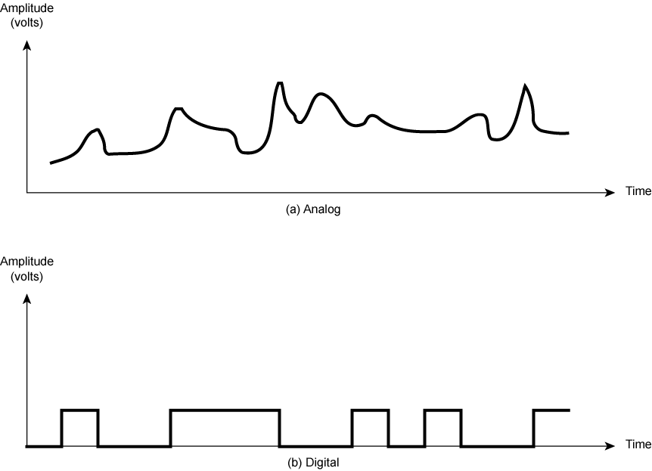
Analog and Digital Signals
DCC 9th Ed.
Stallings
Notes:
Stallings DCC9e Figure 3.1 shows an example of both analog or digital signals. The continuous signal might represent speech, and the discrete signal might represent binary 1s and 0s.

Slide 19
Signals Details
Means by which data are propagated.
Analog Signals
Continuously variable
Various media
wire, fiber optic, space
Speech bandwidth 100Hz to 7kHz
Telephone bandwidth 300Hz to 3400Hz
Video bandwidth 4MHz
Digital Signals
Use two DC components.
DCC 6th Ed.
Stallings

Slide 20
Analog and Digital Signaling
Digital data can be represented by analog signals using a modem (modulator/demodulator).
The digital data is encoded on a carrier frequency.
Analog data can be represented by digital signals using a codec (coder-decoder).

Slide 21
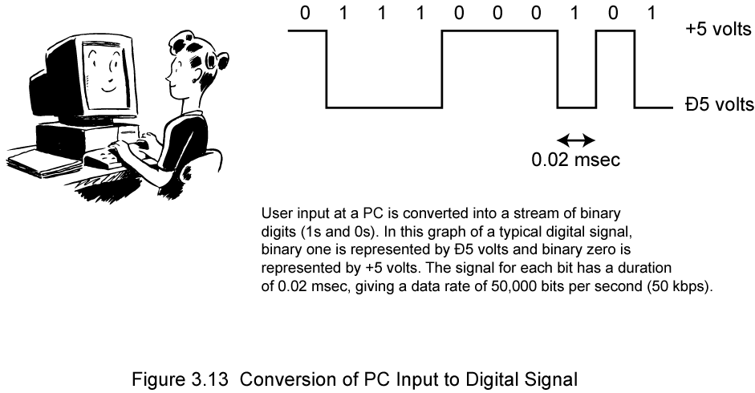
PC Input Converted to Digital Signal
DCC 9th Ed.
Stallings
Notes:
Finally, the third example described is the general case of binary data. Binary data is generated by terminals, computers, and other data processing equipment and then converted into digital voltage pulses for transmission, as illustrated in Stallings DCC9e Figure 3.13. A commonly used signal for such data uses two constant (dc) voltage levels, one level for binary 1 and one level for binary 0. (In Chapter 5, we shall see that this is but one alternative, referred to as NRZ.) Again, we are interested in the bandwidth of such a signal. This will depend, in any specific case, on the exact shape of the waveform and the sequence of 1s and 0s. We can obtain some understanding by considering Stallings DCC9e Figure 3.8 (compare Figure 3.7). As can be seen, the greater the bandwidth of the signal, the more faithfully it approximates a digital pulse stream.

Slide 22
Analog Signals
Notes:
Analog and Digital Signals
Stallings DCC9e Figure 3.14a shows a communications system, data are propagated from one point to another by means of electromagnetic signals. An analog signal is a continuously varying electromagnetic wave that may be propagated over a variety of media, depending on spectrum; examples are wire media, such as twisted pair and coaxial cable; fiber optic cable; and unguided media, such as atmosphere or space propagation

Slide 23
Digital Signals
Notes:
Data and Signals
In the foregoing discussion, we have looked at analog signals used to represent analog data and digital signals used to represent digital data. Generally, analog data are a function of time and occupy a limited frequency spectrum; such data can be represented by an electromagnetic signal occupying the same spectrum. Digital data can be represented by digital signals, with a different voltage level for each of the two binary digits.
As Stallings DCC9e Figure 3.14 illustrates, these are not the only possibilities. Digital data can also be represented by analog signals by use of a modem (modulator/demodulator). The modem converts a series of binary (two-valued) voltage pulses into an analog signal by encoding the digital data onto a carrier frequency. The resulting signal occupies a certain spectrum of frequency centered about the carrier and may be propagated across a medium suitable for that carrier. The most common modems represent digital data in the voice spectrum and hence allow those data to be propagated over ordinary voice-grade telephone lines. At the other end of the line, another modem demodulates the signal to recover the original data.
In an operation very similar to that performed by a modem, analog data can be represented by digital signals. The device that performs this function for voice data is a codec (coder-decoder). In essence, the codec takes an analog signal that directly represents the voice data and approximates that signal by a bit stream. At the receiving end, the bit stream is used to reconstruct the analog data.
Thus, Stallings DCC9e Figure 3.14 suggests that data may be encoded into signals in a variety of ways. We will return to this topic in Chapter 5.

Slide 24
Analog vs Digital Signaling
Digital signaling is:
Cheaper
Less susceptible to noise interference
Suffers more attenuation.

Slide 25
Attenuation
Attenuation of a signal::
the reduction or loss of signal strength (power) as it is transferred across a system.
Attenuation is an increasing function of frequency.
The strength of the received signal must be strong enough for detection and must be higher than the noise to be received without error.

Slide 26
Attenuation

Slide 27
Attenuation vs Frequency
30
26 gauge
24 gauge
27
24
22 gauge
21
18
Attenuation (dB/mi)
15
19 gauge
12
9
6
3
f (kHz)
1
10
100
1000
Leon-Garcia & Widjaja:
Communication Networks

Slide 28
Analog and Digital Transmissions
{Stalling’s third context}
3. Transmissions :: communication of data by the propagation and processing of signals.
Both analog and digital signals may be transmitted on suitable transmission media.
[Stalling’s argument] The way the signals are “treated” is a function of the transmission system and here lies the crux of the distinction between transmission types.

Slide 29
Analog vs Digital Transmission
(a) Analog transmission: all details must be reproduced accurately.
Sent
Received
e.g. AM, FM, TV transmission
(b) Digital transmission: only discrete levels need to be reproduced.
Sent
Received
e.g digital telephone, CD Audio
Leon-Garcia & Widjaja:
Communication Networks

Slide 30
Analog Transmissions
Analog transmission:: a means of transmitting analog signals without regard to their content (i.e., the signals may represent analog data or digital data).
Transmissions are attenuated over distance.
Analog signal – the analog transmission system uses amplifiers to boost the energy in the signal.

Slide 31
Analog Transmissions
Amplifiers boost the energy ➔ this
amplifies the signal and amplifies the noise.
The cascading of amplifiers distorts the signal.
Note – voice (analog data) can tolerate much distortion but with digital data, distortion introduces errors.

Slide 32
Digital Transmissions
Digital transmissions:: assume a binary content to the signal. Attenuation is overcome without amplifying the noise.
1. Analog signals {assumes digital data}:
With retransmission devices [analog repeater] at appropriate points the device recovers the digital data from the analog signal and generates a new clean analog signal.
the noise is not cumulative!!

Slide 33
Digital Transmissions
2. digital signals - digital repeaters are used to attain greater distances.
The digital repeater receives the digital signal, recovers the patterns of 0’s and 1’s and retransmits a new digital signal.
The treatment is the same for analog and digital data.

Slide 34
Analog vs Digital Transmission
Analog Transmission
Source
Amplifier
Amplifier
Destination
Digital Transmission
Source
Repeater
Repeater
Destination
Leon-Garcia & Widjaja:
Communication Networks

Slide 35
Analog Transmissions
Attenuated &
distorted signal
+
noise
Recovered signal
+
residual noise
Amp.
Equalizer
Amplifier
Leon-Garcia & Widjaja:
Communication Networks

Slide 36
Digital Transmissions
Decision Circuit.
& Signal
Regenerator
Amplifier
Equalizer
Timing
Recovery
Repeater (digital signal)
Leon-Garcia & Widjaja:
Communication Networks

Slide 37
Digital Transmission Advantages
Superior cost of digital technology
Low cost LSI/VLSI technology
Repeaters versus amplifiers costs
Superior quality {Data integrity}
Transmit longer distances over lines with lower error rates
Capacity utilization
Economical to build high bandwidth links
High degree of multiplexing easier with digital techniques
TDM (Time Division Multiplexing) is easier and
cheaper than FDM (Frequency Division Multiplexing).
DCC 9th Ed.
Stallings

Slide 38
Digital vs Analog Transmissions
Digital transmission advantages
Security & Privacy
Encryption techniques readily applied to digitized data.
Integration
Can treat analog and digital data similarly.
Economies of scale come from integrating voice, video and data.
Analog transmission advantages
Digital signaling not as versatile or practical (digital impossible for satellite and microwave systems).
LAN star topology reduces the severity of the noise and attenuation problems.
DCC 6th Ed.
Stallings

Slide 39
Physical Layer Summary (Part 1)
Definitions of bandwidth, capacity and modulation rate.
Nyquist Theorem
noiseless channel, sampling rate
Shannon’s Result
Channel with thermal noise, voice-grade line, SNR, constellations

Slide 40
Physical Layer Summary (Part 1)
Analog versus Digital
Data, signals, transmissions
Attenuation of the signal as a function of transmission frequency.
Amplifier versus Repeater
Effect of cascading amplifiers
Analog and digital repeaters
Advantages/Disadvantages of Analog vs Digital Transmissions

