Slide 1
MAC Protocols for Health Care Wireless Sensor Networks (HCWSNs)
Bob Kinicki
WPI CS Professor
PEDS Seminar September 19, 2011

Slide 2
Outline
Introduction/Motivation for Health Care Wireless Sensor Networks (HCWSNs)
Brief Wireless Sensor Network (WSN) ‘Primer’
Types of WSNs
Power-Aware MAC Protocols
Requirements for Health Care WSNs
CSMA MAC Protocols for HCWSNs
Conclusions

Slide 3
Introduction / Motivation
Wireless Sensor Networks (WSNs) are now viable for:
Medical care applications
Patients, doctors, geriatrics (assisted living, nursing home), hospital and lab situations
”Inexpensive sensors are generously embedded in the environment to automate vital signs monitoring and aggregation to health facilities in real-time.” [DS-MAC]
Disaster response applications
First responders’ conditions, environmental conditions, victim recovery and coordination.

Slide 4
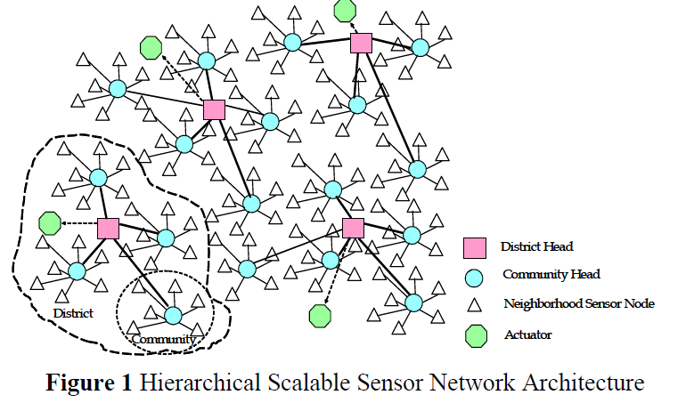
A Vision for Wireless MIS
[DS-MAC]
Concept includes smart phone platforms
to streamline continuous monitoring.
4

Slide 5
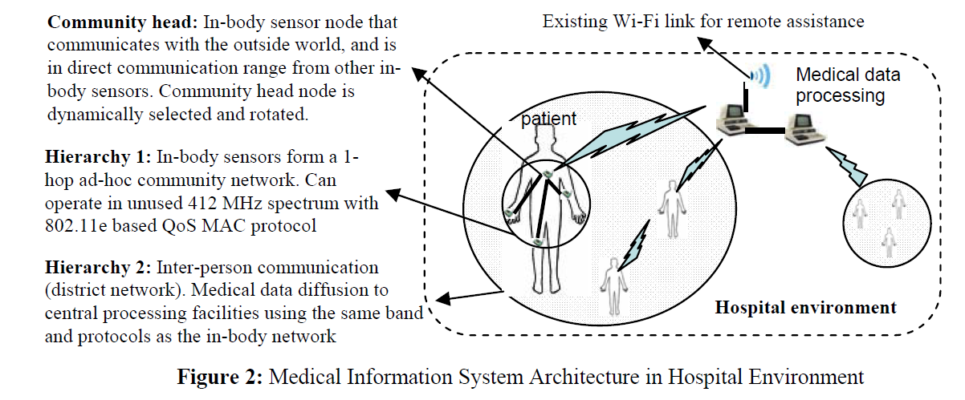
A Vision for Wireless MIS
[DS-MAC]
Health surveillance region provides a multi-hop path
from body sensor networks to central data log and
processing nodes.
5

Slide 6
WSNs for Assisted Living
Alarm-Net
University of Virginia
Berkeley Fall Detection System
6

Slide 7
WSNs for Assisted Living

Slide 8
WSNs for Assisted Living
Two-Tiered
WSN
Architecture

Slide 9
Outline
Introduction/Motivation for Health Care Wireless Sensor Networks (HCWSNs)
Brief Wireless Sensor Network (WSN) ‘Primer’
Types of WSNs
Power-Aware MAC Protocols
Requirements for Health Care WSNs
CSMA MAC Protocols for HCWSNs
Conclusions

Slide 10
Wireless Sensor Networks
A distributed connection of nodes that coordinate to perform a common task.
In many applications, the nodes are battery powered and it is often very difficult to recharge or change the batteries.
Prolonging network lifetime is a critical issue.
Sensors often have long period between transmissions (e.g., in seconds).
Thus, a good WSN MAC protocol needs to be energy efficient.

Slide 11
Wireless Sensor Networks
Sources of energy waste:
Idle listening, collisions, overhearing and control overhead and overmitting.
Idle listening dominates (measurements show idle listening consumes between 50-100% of the energy required for receiving.)
Idle listening:: listen to receive possible traffic that is not sent.
Overmitting:: transmission of message when receiver is not ready.

Slide 12
Power Measurements
[SCP-MAC]

Slide 13
Wireless Sensor Networks
Duty cycle:: ratio between listen time and the full listen-sleep cycle.
central approach – lower the duty cycle by turning the radio off part of the time.
Three techniques to reduce the duty cycle:
TDMA
Schedule contention periods
LPL (Low Power Listening)

Slide 14
Techniques to Reduce Idle Listening
TDMA requires cluster-based or centralized control.
Scheduling – ensures short listen period when transmitters and listeners can rendezvous and other periods where nodes sleep (turn off their radios).
LPL – nodes wake up briefly to check for channel activity without receiving data.
If channel is idle, node goes back to sleep.
If channel is busy, node stays awake to receive data.
A long preamble (longer than poll period) is used to assure than preamble intersects with polls.

Slide 15
Outline
Introduction/Motivation for Health Care Wireless Sensor Networks (HCWSNs)
Brief Wireless Sensor Network (WSN) ‘Primer’
Types of WSNs
Power-Aware MAC Protocols
Requirements for Health Care WSNs
MAC Protocols for HCWSNs

Slide 16
Types of WSNs
Infrastructure
Single BS (Base Station) or AP (Access Point) connection to wired networks
Multi-Tiered
Clusters
Fixed, dynamic or virtual
MANETs
Mobile nodes requiring routing
Grids
Mesh networks (can be tiered)

Slide 17
Tiered WSN Architectures
[ Stathopoulos]

Slide 18
Choosing Dynamic Cluster Heads/ Forming Clusters
Two-tier scheme:
A fixed number of cluster heads that communicate with BS (base station).
Nodes in cluster communicate with head (normally TDMA).
TDMA allows fixed schedule of slots for
sensor to send to cluster head and receive head transmissions.
BS

Slide 19
Choosing Cluster Heads/ Forming Clusters
Periodically select new cluster heads to minimize power consumption and maximize WSN lifetime.
More complex problem when size of cluster changes dynamically.
As time goes by, some sensor nodes die!
Not worried about coverage issues!
X
X
X
BS
X
X

Slide 20
Outline
Introduction/Motivation for Health Care Wireless Sensor Networks (HCWSNs)
Brief Wireless Sensor Network (WSN) ‘Primer’
Types of WSNs
Power-Aware MAC Protocols
Requirements for Health Care WSNs
CSMA MAC Protocols for HCWSNs

Slide 21
Power Aware MAC Protocols
1997
1998 PAMAS
1999
2000 SMACS
2001 S-MAC
2002 LPL NPSM STEM
2003 DE-MAC EMACs Sift TMAC TinyOS TRAMA
2004 AI-LMAC BMAC DMAC DSMAC LMAC MS-MAC WiseMAC

Slide 22
Power Aware MAC Protocols
2005 Bit-MAC FLAMA MMAC PMAC RateEst-MAC SeeSaw Z-MAC
2006 SCP-MAC SS-TDMA X-MAC
2007 Crankshaft MH-MAC ML-MAC RMAC Sea-MAC
2008 AS-MAC DS-MAC DW-MAC RI-MAC W-MAC
2009 ELE-MAC MD-MAC ME-MAC RA-MAC Tree-MAC
2010 A-MAC BuzzBuzz MiX-MAC
2011 BAS-MAC EM-MAC MC-LMAC

Slide 23
Power Aware MAC Protocols
Three approaches to saving power:
1. TDMA: TRAMA, EMACs, L-MAC
2. Schedule: PAMAS, S-MAC, T-MAC, D-MAC, P-MAC, SCP-MAC, Crankshaft, AS-MAC
{roughly CSMA protocols are here!}
3. Low Power Listening: LPL, B-MAC, WiseMAC

Slide 24
Requirements for Health Care WSNs
Reliability
Energy efficiency
Routing
Node Mobility {mobility aware}
Timeliness {delay sensitive}
Context aware
Privacy (part of security)

Slide 25
Outline
Introduction/Motivation for Health Care Wireless Sensor Networks (HCWSNs)
Brief Wireless Sensor Network (WSN) ‘Primer’
Types of WSNs
Power-Aware MAC Protocols
Requirements for Health Care WSNs
CSMA MAC Protocols for HCWSNs
Conclusions

Slide 26
CSMA MAC Protocols for HCWSNs
Mobility Aware
S-MAC
Delay Sensitive
Context
Aware
MS-MAC
DSMAC
DS-MAC
MD-MAC
[survey]

Slide 27
Sensor-MAC (S-MAC)
All nodes periodically listen, sleep and wakeup. Nodes listen and send during the active period and turn off their radios during the sleep period.
The beginning of the active period is a SYNC period used to accomplish periodic synchronization and remedy clock drift {nodes periodically broadcast SYNC frames to neighbors}.
Following the SYNC period, data may be transferred for the remainder of the fixed-length active period using RTS/CTS for unicast transmissions.

Slide 28
Sensor-MAC (S-MAC)
Long frames are fragmented and transmitted as a burst.
SMAC controls the duty cycle to tradeoff energy for delay.
However, as density of WSN grows, SMAC incurs additional overhead in maintaining neighbors’ schedules.

Slide 29
S-MAC
[S-MAC]

Slide 30
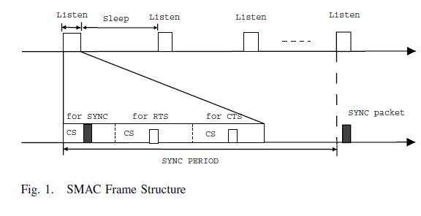
S-MAC
[DSMAC]

Slide 31
Dynamic Sensor MAC (DSMAC)
S-MAC trades higher delay for lower energy.
An adjustment is needed for delay-sensitive apps (health, disaster and military).
Dynamic Sensor MAC (DSMAC) dynamically changes the sleeping interval with fixed listen interval.

Slide 32
Dynamic Sensor MAC (DSMAC)
One-hop latency (i.e., time difference between frame entering queue and being sent) is recorded by sender in frame header.
Receiver computes average one-hop latency during current SYNC period.

Slide 33
Dynamic Sensor MAC (DSMAC)
When delay is too high, double duty cycle (shorten sleep time).
When delay and queue are low, halve duty cycle.
SYNC packet now contains field indicating initiator’s duty cycle.
Duty cycle adjustments do not affect neighbor’s schedules (as long as done as a multiple of cycle).

Slide 34
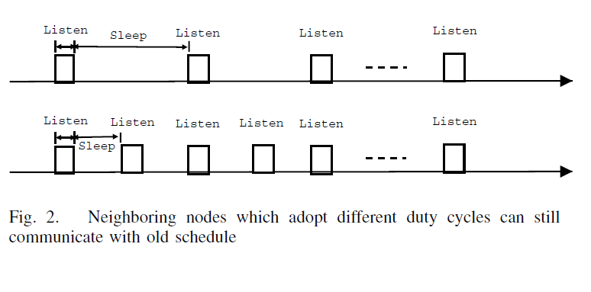
DSMAC
Duty cycle is doubled!!
[DSMAC]

Slide 35
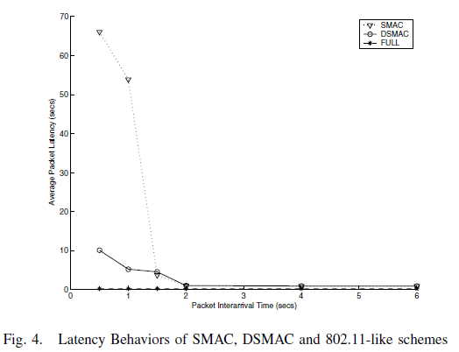
DSMAC
[DSMAC]

Slide 36
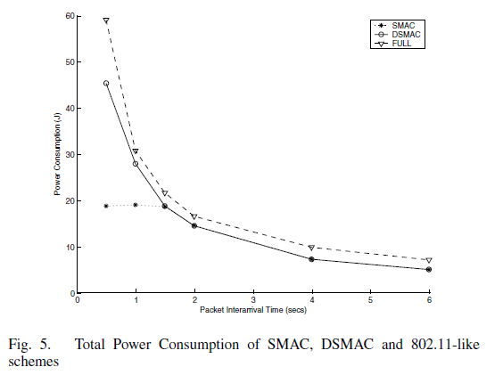
DSMAC
[DSMAC]

Slide 37
Mobility-Aware MAC (MS-MAC)
Target mobile sensor apps:
Patients’ health conditions monitored via wearable bio-sensors.
Workers equipped with sensor devices in disaster recovery situations.
Soldiers wearing sensors in the battle field.

Slide 38
MS-MAC
S-MAC requires only nodes in a ‘virtual cluster” to utilize a 10 second synchronization period once every 2 minutes.
MS-MAC discussed in terms of border nodes B between virtual clusters
B

Slide 39
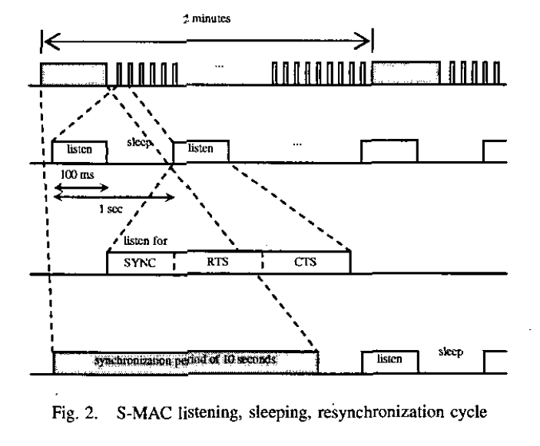
MS-MAC
[MS-MAC]

Slide 40
MS-MAC
Basic idea of MS-MAC is to use measure of received signal strength (SiNR) to estimate mobility speed of neighbors and maximum speed of all neighbors is added to SYNC frames.
Mobility info is used to create an active zone around a mobile node when it moves from one cluster to another cluster.

Slide 41
MS-MAC
If border node detects change of received signal levels, it adds mobility info in SYNC message and broadcasts.
Neighbors will expedite the frequency of their synchronization periods according to the speed of the mobile node.

Slide 42
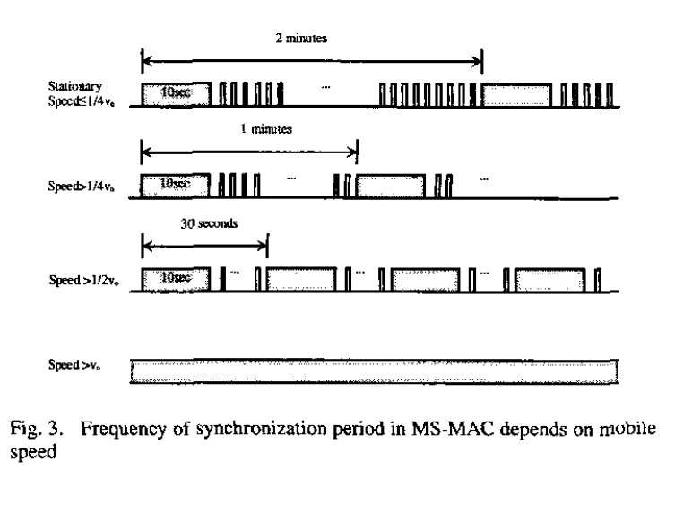
MS-MAC
Speed up SYNC period!!
[MS-MAC]

Slide 43
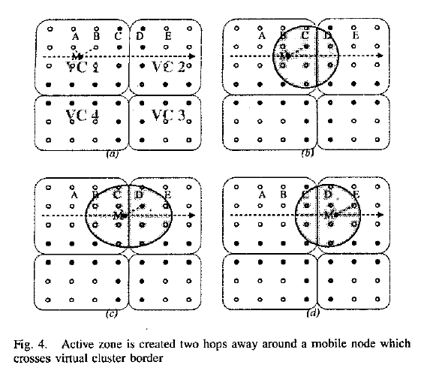
MS-MAC
[MS-MAC]

Slide 44
MD-MAC
Authors claim three available mobility-aware WSN MAC protocols (M-MAC, ML-MAC and MS-MAC) ignore delay.
MD-MAC combines DSMAC and MS-MAC while cleaning up details in the two protocols (e.g., mobile node discards old schedule once it has new schedule for new virtual cluster
Adds one extra field ‘queue delay’ to the data frames.

Slide 45
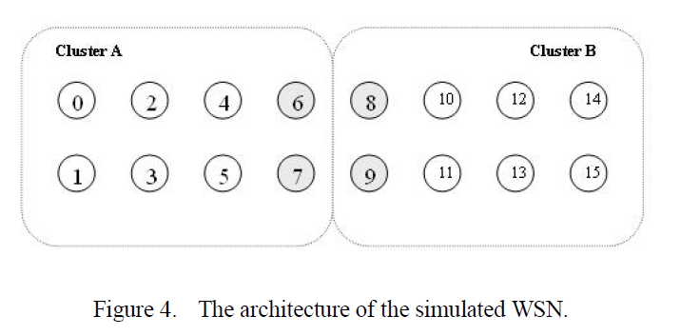
MD-MAC
[MD-MAC]

Slide 46
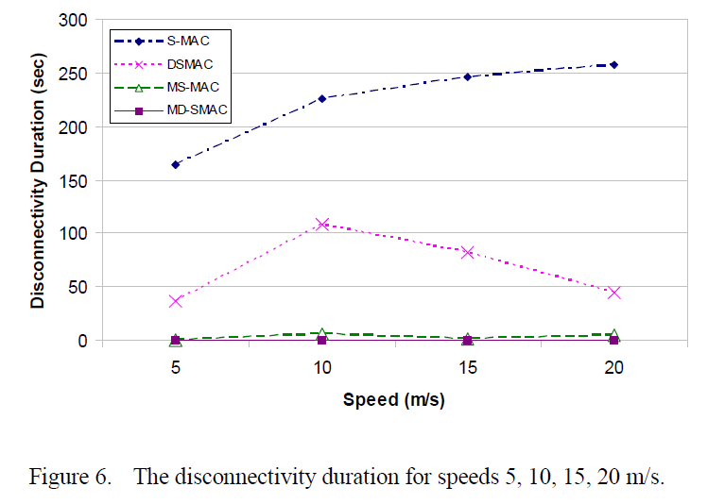
MD-MAC
[MD-MAC]

Slide 47
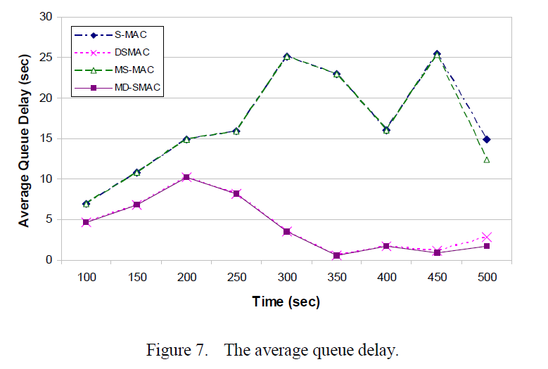
MD-MAC
[MD-MAC]

Slide 48
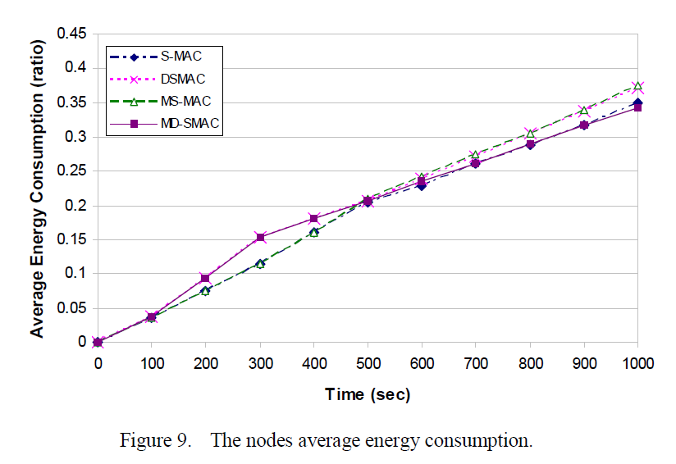
MD-MAC
[MD-MAC]

Slide 49
Differential Services MAC (DS-MAC)
This HCWSN protocol is concerned with reliability, power consumption and context aware (routine, warning and emergency medical situations).
Key addition is priority of messages.
DS-MAC is IEEE802.11e priorities (classes of service) plus pre-emption.
Only queueing models and simple NS2 simulations provided.

Slide 50
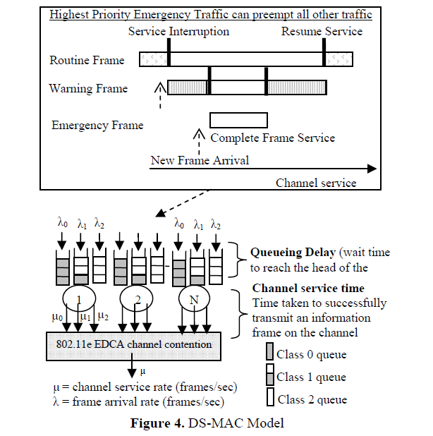
DS-MAC
[DS-MAC]

Slide 51
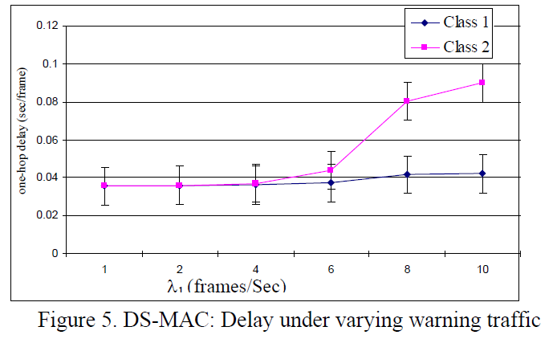
DS-MAC
[DS-MAC]

Slide 52
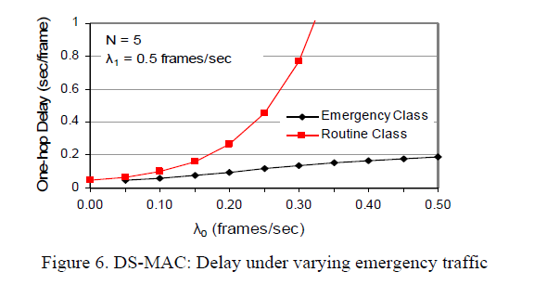
DS-MAC
[DS-MAC]

Slide 53
Conclusions
HCWSN is newer area of research.
MD-MAC represents merge of two other ideas.
DS-MAC deals context-aware in terms of priorities, but results are minimal and not compared against others.
None of the surveyed protocols deal with privacy (and security) which is critical for medical applications.

Slide 54
References
[survey] E. Egbogah and A. Fapojuwo. A Survey of System Architecture Requirements for Health Care-Based Wireless Sensor Networks. Sensors, 11(5):4875–4898, 2011.
[DSMAC] P. Lin, P. Qiao, and X. Wang. Medium Access Control with a Dynamic Duty Cycle for Sensor Networks. In IEEE Wireless Communications and Networking Conference (WCNC), volume 3,
pages 1534 –1539, Atlanta, GA, March 2004.
[DS-MAC] X. Yuan, S. Bagga, M. Balakrishnan, and D. Benhaddou. DS-MAC: Differential Service Medium Access Control Design for Wireless Medical Information Systems. In The 30th Annual IEEE Conference on Engineering in Medicine and Biology Society, pages 1801 – 1804, Vancouver, BC, August, 2008.

Slide 55
References
[MD-MAC] S. Hameed, H. Faheem, E. Shaaban, and S. Ghoneimy. Mobility-Aware MAC Protocol for Delay-Sensitive Wireless Sensor Networks. In The International Conference on Ultra Modern Telecommunications (ICUMT09), pages 1–8, St. Petersburg, Russia, October 2009.
[MS-MAC] H. Pham and S. Jha. An Adaptive Mobility-Aware MAC Protocol for Sensor Networks (MS-MAC). In The IEEE International Conference on Mobile Ad-Hoc and Sensor Systems, pages 558 – 560, Fort Lauderdale, FL, October 2004.
[S-MAC] W. Ye, J. Heidemann, and D. Estrin. An Energy-Efficient MAC Protocol for Wireless Sensor Networks. In The 21st Annual Joint Conference of the IEEE Computer and Communications
Societies(INFOCOM02), volume 3, pages 1567 – 1576, New York, June 2002.

Slide 56
Reference
[SCP-MAC] W. Ye, F. Silva, and J. Heidemann. Ultra-Low Duty Cycle MAC with Scheduled Channel Polling. In The Fourth ACM Conference on Embedded Networked Sensor Systems (SenSys06), pages 321–333, Boulder, CO, November 2006.

Slide 57
Thank You!
Questions?

