Slide 1
6LoBAC: A new IPv6 Data Link
Kerry Lynn
<kerlyn@ieee.org>
15 December 2015

Slide 2
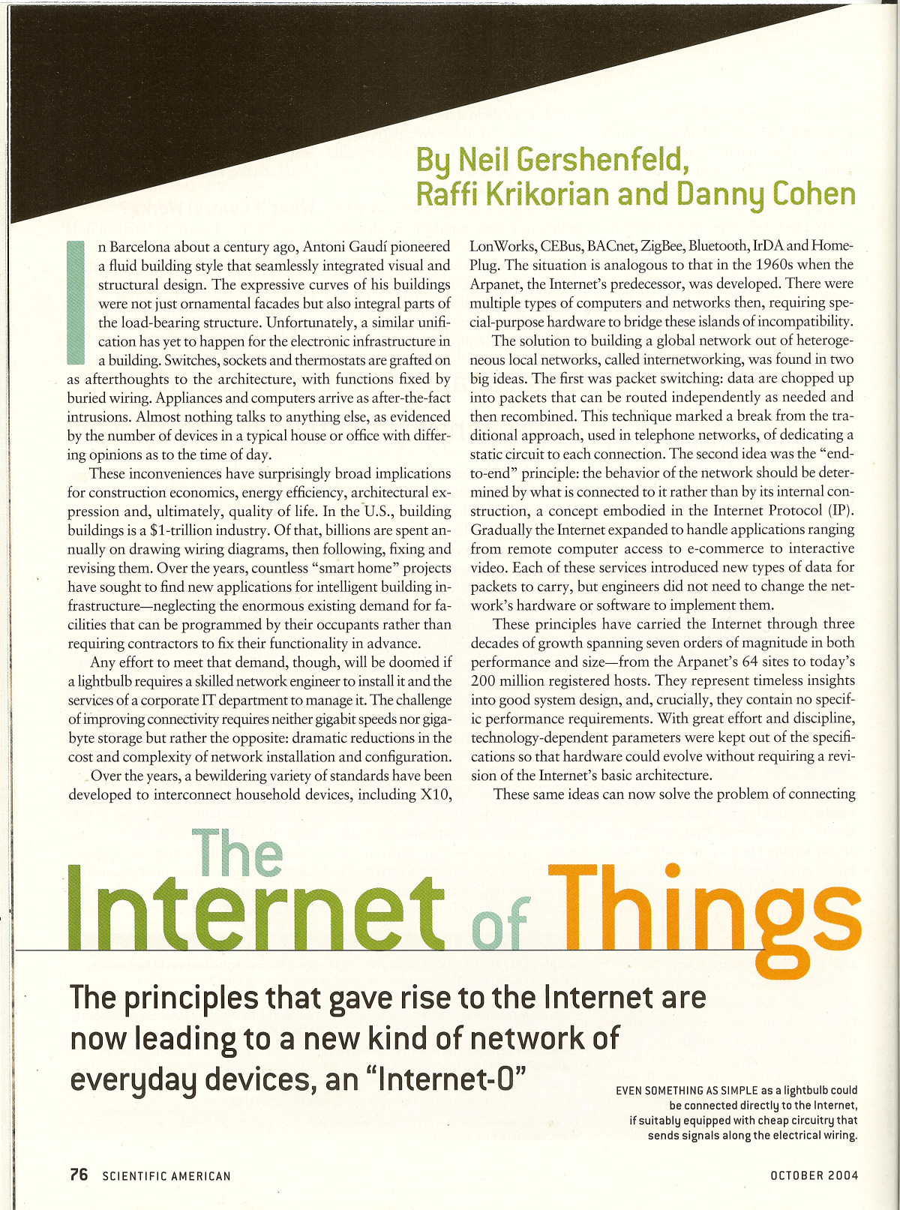
IoT Background

Slide 3
Review (Layered Model)
source A
source B
source C
HTTPS
COAPS
Application
TCP/TLS
UDP/DTLS
Transport
IPv6
Inter/network
6LoWPAN
Data Link
(MAC/PHY)
802.3
802.15.4
Other
dest. A
dest.B
dest. C
Notes:
Network engineers think in “layers”
Each layer generally has a service interface and protocol header

Slide 4
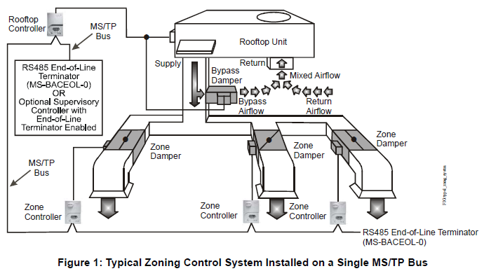
Goal
Develop a low-cost wired IPv6 solution for commercial building control applications

Slide 5
Technical Approach
Leverage elements of 6LoWPAN solution [RFCs 4944, 6282, 6775]
Minimize changes to existing MS/TP specification [BACnet Clause 9]
Goal: co-existence with legacy MS/TP nodes
No changes to frame header format, control frames, or MS/TP Master Node state machine
MS/TP Extended Frames proposal includes:
New frame type for IPv6 (LoBAC) Encapsulation
Larger MSDU (1500+ octets)
32-bit FCS (CRC-32K)
COBS (Consistent Overhead Byte Stuffing) encoding
Notes:
- Top-down design, bottom-up implementation

Slide 6
MS/TP Background
BACnet is the ISO/ANSI/ASHRAE [Standard 135-2012] data communication protocol for Building Automation and Control networks
MS/TP (Master-Slave/Token-Passing) is a widely used data link defined in BACnet
Based on RS-485 single twisted pair PHY; supports data rates up to 115.2 kpbs and 1 km diameter
Contention-free MAC (token passing bus)
Consider it a wired alternative to IEEE 802.15.4

Slide 7
MS/TP Extended Frame Format
0
31
0x55
0xFF
FrameType
DestAddr
SrcAddr
Length (MS octet first)
HeaderCRC
COBS Encoded Data (1 – 1500 octets before encoding)
…
…
Data CRC (CRC-32K, LS octet first, COBS Encoded)
Optional 0xFF
Frame Type: 34 = IPv6 (LoBAC) Encapsulation
Destination Address: 0 – 127, 255 (all nodes)
Source Address: 0 – 127

Slide 8
CRC Background
Encoder
Noisy Channel
Decoder
Noisy channel acts like a random bit mask XOR’d
with the data word
We use cyclic redundancy code (CRC) to detect
these errors
Data word (frame) is divided by a polynomial G(x);
remainder is CRC
Detection capability is related to size and co- efficients of G(x)

Slide 9
COBS Encoding Basics
Code | Followed By | Meaning
0x00 | (not applicable) | (not allowed)
0x01 | nothing | A single zero byte
0x02 | one data byte | The single data byte, followed by a zero byte
1 ≤ n ≤ 253 | (n – 1) data bytes | The (n – 1) data bytes, followed by a zero byte
0xFF | 254 data bytes | The 254 data bytes, not followed by a zero byte
00
➔
01
x
00
➔
02
x
x
y
00
➔
03
x
y
x
y
z
...
z
y
➔
FF
x
y
z
...
y

Slide 10
COBS Encoding in Detail
"Phantom zero" is appended to input to resolve ambiguity in final code block:
H
e
l
l
o
➔
06
H
e
l
l
o
H
e
l
l
o
00
➔
06
H
e
l
l
o
01
An arbitrary octet (e.g. 0x55) may be removed by XOR-ing it over the COBS encoder output stream
COBS overhead:
At least, one octet per field
At most, one octet per 254 (6 octets per 1500;
≈ 0.4%)

Slide 11
6Lo Background
Need to define encapsulation
Need to define mapping of MAC address for:
Interface Identifier (IID)
Stateless Address Auto-Configuration (SLAAC)
Unicast and multicast transmission
Header compression
Security Considerations
Other (e.g. abstract MAC interface)

Slide 12
LoBAC Encapsulation
Uses 6LoWPAN Dispatch Header [RFC 4944]:
1 2 3
0 1 2 3 4 5 6 7 8 9 0 1 2 3 4 5 6 7 8 9 0 1 2 3 4 5 6 7 8 9 0 1
+-+-+-+-+-+-+-+-+-+-+-+-+-+-+-+-+-+-+-+-+-+-+-+-+-+-+-+-+-+-+-+-+
|0 1| Dispatch | Type-specific header
+-+-+-+-+-+-+-+-+-+-+-+-+-+-+-+-+-+-+-+-+-+-+-+-+-+-+-+-+-+-+-+-+
Pattern | Header Type
00 XXXXXX | NALP – Not a LoWPAN (LoBAC) frame
01 000000 | ESC – Additional Dispatch octet follows
01 000001 | IPv6 – Uncompressed IPv6 header
... | Reserved by RFC 4944
01 1XXXXX | LOWPAN_IPHC – Compressed IPv6 header

Slide 13
LoBAC Encapsulation (cont.)
No mesh, broadcast, or fragmentation headers
Two options remain:
IPv6 Dispatch
IPv6 Header
Payload
A LoBAC encapsulated IPv6 datagram
IPHC Dispatch
IPHC Header
Payload
A LoBAC encapsulated LOWPAN_IPHC
[RFC 6282] compressed datagram

Slide 14
IPHC Compression [RFC 6282]
Assumes some 6LBR-like behavior, e.g. 6LoWPAN Context Option (6CO, [RFC 6775])
Uses 6LoWPAN short address format, formed by appending 8-bit MS/TP address to the octet 0x00
For example, an MS/TP node with a MAC address of 0x4F results in the following IPHC short address:
|0 1|
|0 5|
+----------------+
|0000000001001111|
+----------------+

Slide 15
IPv6 Link Local Address
The IPv6 link-local address [RFC 4291] for an MS/TP interface is formed by appending the Interface Identifier (defined in previous slide) to the prefix FE80::/64:
10 bits 54 bits 64 bits
+----------+-----------------------+----------------------------+
|1111111010| (zeros) | Interface Identifier |
+----------+-----------------------+----------------------------+

Slide 16
Unicast Address Mapping
The Source/Target Link-Layer Address option has the following form when the link layer is MS/TP and the addresses are 8-bit MS/TP MAC addresses:
0 1 Option fields:
0 1 2 3 4 5 6 7 8 9 0 1 2 3 4 5
+-+-+-+-+-+-+-+-+-+-+-+-+-+-+-+-+ Type:
| Type | Length=1 | 1 = Source Link-layer address
+-+-+-+-+-+-+-+-+-+-+-+-+-+-+-+-+ 2 = Target Link-layer address
| |
+ Padding + Length:
| (all zeros) | The value of this field is
+ +-+-+-+-+-+-+-+-+ 1 for 8-bit MS/TP addresses
| | MS/TP Address |
+-+-+-+-+-+-+-+-+-+-+-+-+-+-+-+-+ MS/TP Address:
The 8-bit MAC address in
canonical bit order

Slide 17
Multicast Address Mapping
MS/TP only supports link-local broadcast
Uses 6LoWPAN short address format, formed by appending 0xFF to the octet 0x00
All IPv6 multicasts on the MS/TP link map to the following IPHC short destination address:
|0 1|
|0 5|
+----------------+
|0000000011111111|
+----------------+

Slide 18
Summary
6LoBAC was the first to propose re-use of 6LoWPAN solutions (RFCs 4944, 6282, 6775)
Served as a pattern for subsequent proposals (Z-Wave, BTLE, NFC, etc.) resulting in formation of the IETF 6lo working group
Remains the only wired 6lo PHY
Has passed ETSI Interoperability Plugtest
About to enter WG “last call”

Slide 19
Thank You
Questions?

