Slide 1
Dynamic Spectrum Sensing using Software Defined Radio on Raspberry Pi with RTL-SDR
Presenter: Renato Iide, Le Wang
Presentation Date: 12/16/2015
Notes:
This template can be used as a starter file to give updates for project milestones.
Sections
Sections can help to organize your slides or facilitate collaboration between multiple authors. On the Home tab, under Slides, click Section, and then click Add Section.
Notes
Use the Notes pane for delivery notes or to provide additional details for the audience. You can see these notes in Presenter View during your presentation.
Keep in mind the font size (important for accessibility, visibility, videotaping, and online production)
Coordinated colors
Pay particular attention to the graphs, charts, and text boxes.
Consider that attendees will print in black and white or grayscale. Run a test print to make sure your colors work when printed in pure black and white and grayscale.
Graphics, tables, and graphs
Keep it simple: If possible, use consistent, non-distracting styles and colors.
Label all graphs and tables.

Slide 2
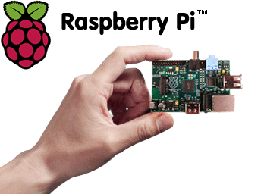
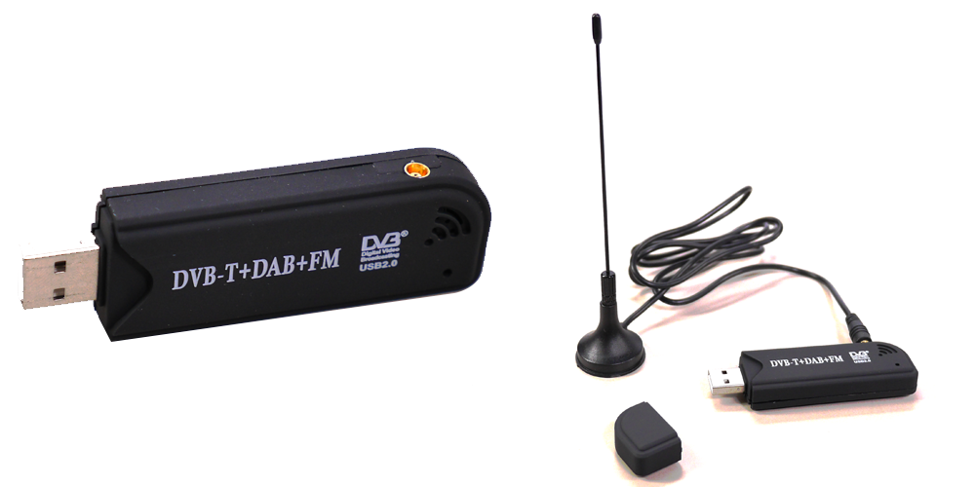
Project Overview
Introduction
Motivation
Cognitive Radio
TV White Space
Dynamic Spectrum Access
Spectrum Sensing
Spectrum Analysis
Spectrum Decision
Implementation
Hardware
Software
Notes:
What is the project about?
Define the goal of this project
Is it similar to projects in the past or is it a new effort?
Define the scope of this project
Is it an independent project or is it related to other projects?
* Note that this slide is not necessary for weekly status meetings

Slide 3
Project Overview
Introduction
Motivation
Cognitive Radio
TV White Space
Dynamic Spectrum Access
Spectrum Sensing
Spectrum Analysis
Spectrum Decision
Implementation
Hardware
Software
Notes:
What is the project about?
Define the goal of this project
Is it similar to projects in the past or is it a new effort?
Define the scope of this project
Is it an independent project or is it related to other projects?
* Note that this slide is not necessary for weekly status meetings

Slide 4
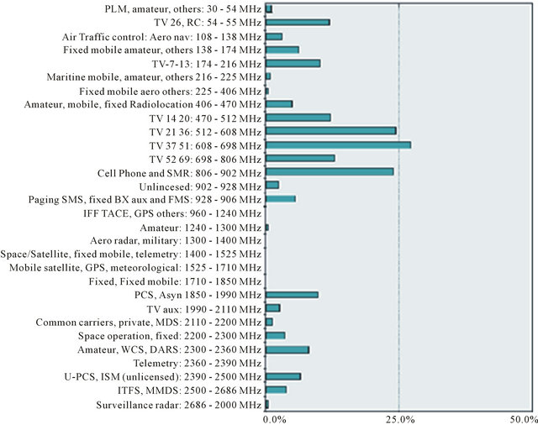
Motivation
Notes:
* If any of these issues caused a schedule delay or need to be discussed further, include details in next slide.

Slide 5
Motivation
Low utilization
Caused by inefficient fixed frequency allocations instead of physical shortage of spectrum.
Dynamic Spectrum Access (DSA):
To increase spectrum efficiency via spectrum sensing, probing and connectivity in cognitive radio networks.
Cognitive Radio (CR) networks:
Primary User (PU) and Secondary User (SU)
PUs (licensed) have priority over SUs (Secondary) when accessing the wireless channel.
Notes:
Duplicate this slide as necessary if there is more than one issue.
This and related slides can be moved to the appendix or hidden if necessary.

Slide 6
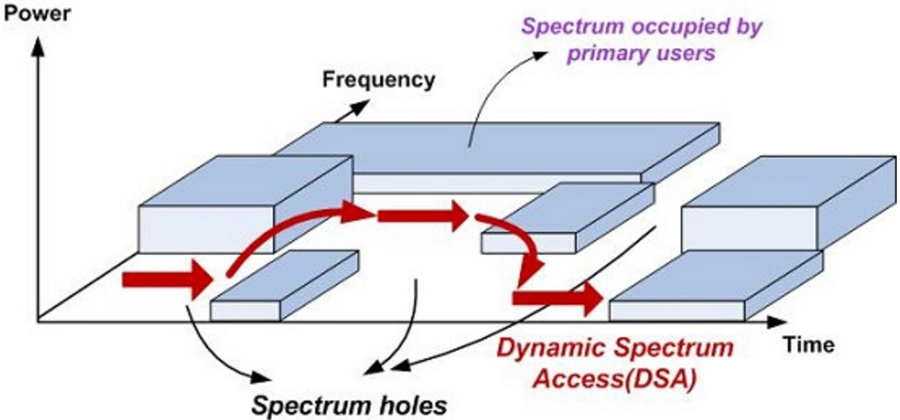
Cognitive Radio Networks

Slide 7
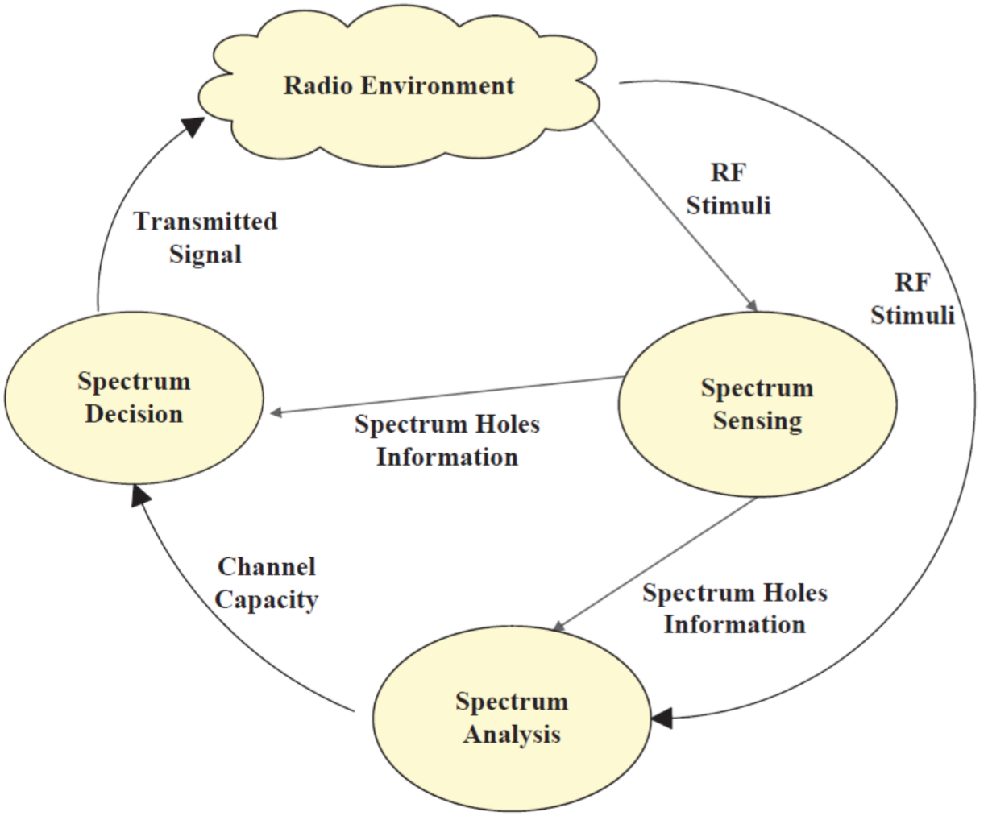
Cognitive Radio Networks

Slide 8
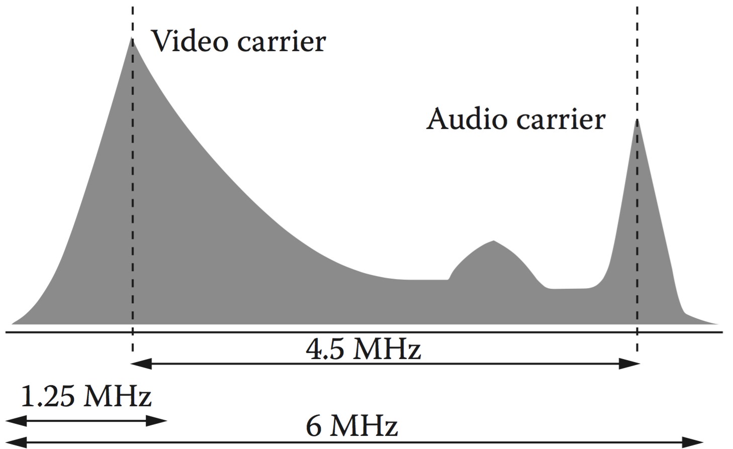
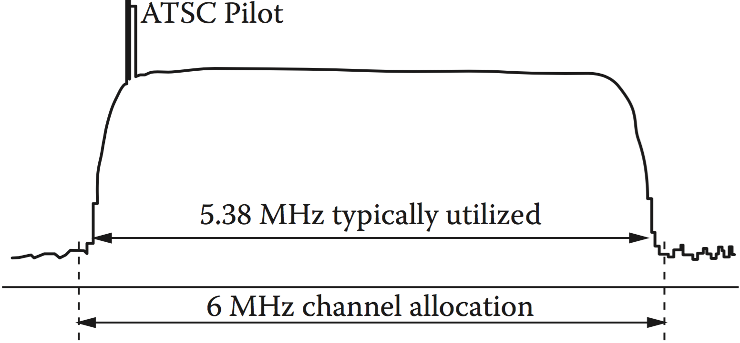
TV White Space (TVWS)
TVWS, defined by FCC, means unused TV spectrum
NTSC Channel Spectrum
National Television System Committee (NTSC)
An analogy television system
DTV-ATSC Spectrum
Advanced Television System Committee (ATSC)
A digital television system
Notes:
The following slides show several examples of timelines using SmartArt graphics.
Include a timeline for the project, clearly marking milestones, important dates, and highlight where the project is now.

Slide 9
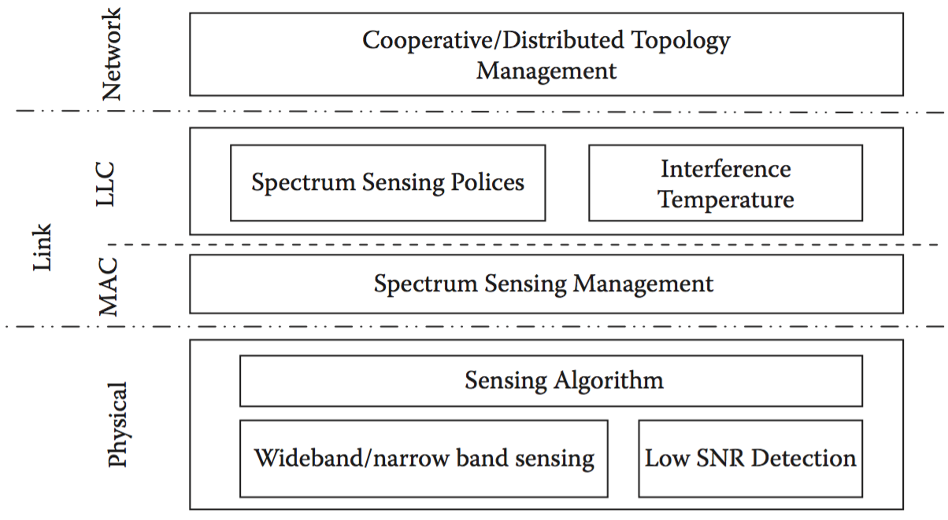
Spectrum Sensing Function Stack

Slide 10
Project Overview
Introduction
Motivation
Cognitive Radio
TV White Space
Dynamic Spectrum Access
Spectrum Sensing
Spectrum Analysis
Spectrum Decision
Implementation
Hardware
Software
Notes:
What is the project about?
Define the goal of this project
Is it similar to projects in the past or is it a new effort?
Define the scope of this project
Is it an independent project or is it related to other projects?
* Note that this slide is not necessary for weekly status meetings

Slide 11
Dynamic Spectrum Access (DSA)
Step 1. Spectrum Sensing
Step 2. Spectrum Analysis
Step 3. Spectrum Decision
Notes:
Duplicate this slide as necessary if there is more than one issue.
This and related slides can be moved to the appendix or hidden if necessary.

Slide 12
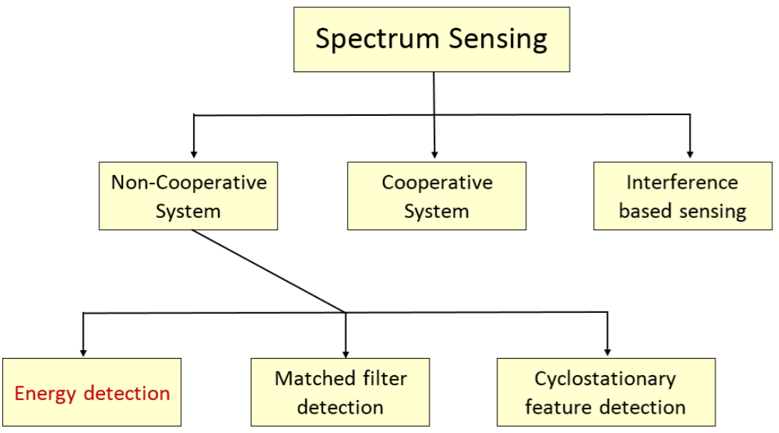
DSA – Spectrum Sensing
The secondary users (SU) need to detect the presence of primary users (PU) in a licensed spectrum.
If a PU emerges, the SU should quit ASAP in order to avoid interference to PUs.
Notes:
Duplicate this slide as necessary if there is more than one issue.
This and related slides can be moved to the appendix or hidden if necessary.

Slide 13
DSA – Spectrum Sensing
Energy Detection (ED):
The PSD of the signal is passed through a Band Pass Filter to select the channel.
Then integrated over time interval, i.e., the observation interval.
The output of the integrator is compared to a predefined threshold (Ho/H1)
Notes:
Duplicate this slide as necessary if there is more than one issue.
This and related slides can be moved to the appendix or hidden if necessary.

Slide 14
Comments on Energy Detection (ED)
Advantages:
Simple
Is not required to know the primary user signal in advance.
Disadvantages:
A pure energy detection scheme is confounded by the in-band interference because it is not robust against spread spectrum signals
Its performance severely suffers under fading conditions
Notes:
Duplicate this slide as necessary if there is more than one issue.
This and related slides can be moved to the appendix or hidden if necessary.

Slide 15
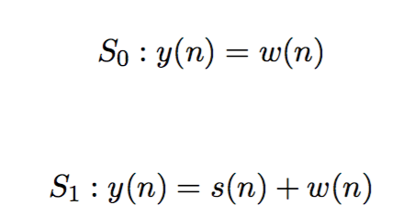
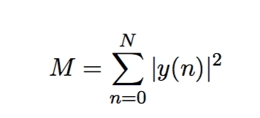
DSA – Spectrum Analysis
So: Scenario when only noise exists
S1: Scenario when both noise and signal exist.
The decision metric for the energy detector:
M is used in Spectrum decision step by comparing M with the threshold
Notes:
Duplicate this slide as necessary if there is more than one issue.
This and related slides can be moved to the appendix or hidden if necessary.

Slide 16
DSA – Spectrum Decision
Spectrum Decision is implemented by comparing M with $λ_{E}$
Probability of detection:
Probability of false alarm:
So: Scenario when only noise exists
S1: Scenario when both noise and signal exist.
Notes:
Duplicate this slide as necessary if there is more than one issue.
This and related slides can be moved to the appendix or hidden if necessary.

Slide 17
Project Overview
Introduction
Motivation
Cognitive Radio
TV White Space
Dynamic Spectrum Access
Spectrum Sensing
Spectrum Analysis
Spectrum Decision
Implementation
Hardware
Software
Notes:
What is the project about?
Define the goal of this project
Is it similar to projects in the past or is it a new effort?
Define the scope of this project
Is it an independent project or is it related to other projects?
* Note that this slide is not necessary for weekly status meetings

Slide 18
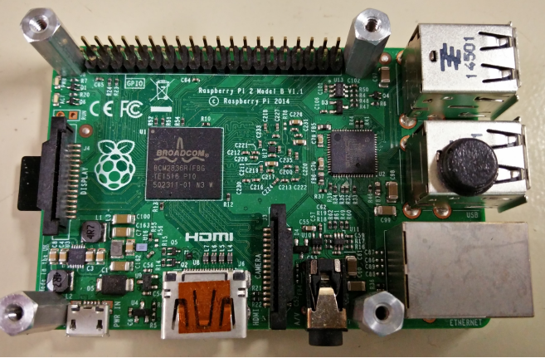
Hardware – Raspberry Pi B 2
Model | Raspberry Pi 2 Model B
CPU | 900 MHz quad-core ARM Cortex-A7
Memory (SDRAM) | 1 GB (Shared with GPU)
GPU | Broadcom Video Core IV @ 250 MHz

Slide 19
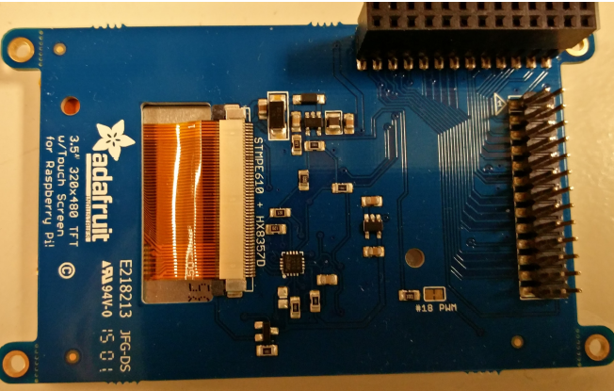
Hardware – 3.5” PiTFT Display
480 x 320 resolution; Touch screen;
Use SPI and GPIO pins.

Slide 20
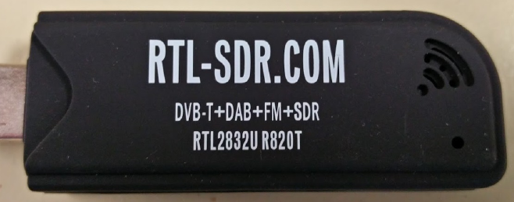
Hardware – RTL-SDR
RTL2832u ;
R820T Tuner: 24 - 1766 MHz;
Sample Rate: 2.56 MSamples/s.

Slide 21
Software
Linux Modified Kernel
FreqShow
Scan Function
Report

Slide 22
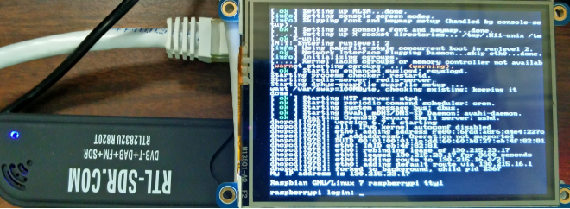
Software – Linux Modified Kernel
Distribution | Rasbian Wheezy (Debian 7.0)
Kernel | Linux 4.1.6
GCC | 4.6.3
CMAKE | 2.8.9
Python | 2.7.3

Slide 23
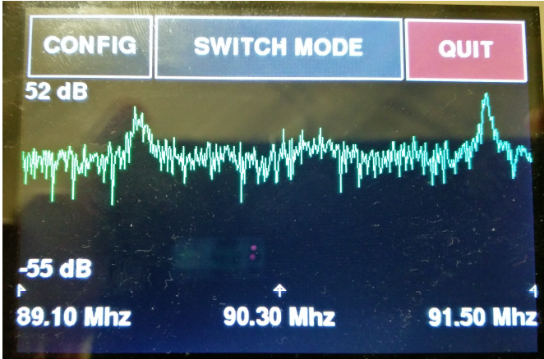
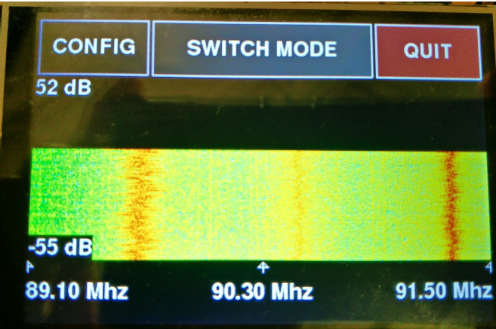
Software – FreqShow
Waterfall Spectrum from 89.1 MHz to 91.5 MHz
Spectrum from 89.1 MHz to 91.5

Slide 24
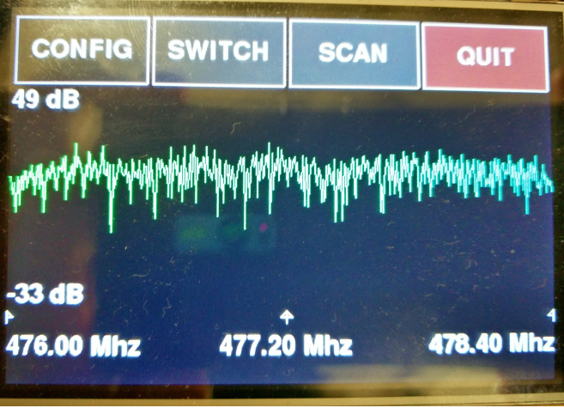
Software – Add New Function : Scan

Slide 25
Scan Screen
Create
Report
Previous Channel
Next Channel

Slide 26
Scan Screen
Quit the program
Pause the data

Slide 27
Scan Screen
High Peak
Low Peak

Slide 28
Scan Screen
High Peak
Value
Low Peak
Value
Energy

Slide 29
Scan Screen
Lower Frequency
Channel Number
Higher Frequency

Slide 30
Report Formatted
Channel Number | Energy in dB | Average Power in dB | Peak Value in dB | Frequency of peak in Mhz
14 | 13.68 | 6.94 | 19.2 | 470.95
15 | 14.27 | 8.48 | 20.74 | 476.68
16 | 12.33 | 6.63 | 19.19 | 482.94
17 | 14.24 | 8.4 | 20.1 | 488.95
18 | 16.23 | 10.17 | 22.53 | 494.63
19 | 16.44 | 9.88 | 21.49 | 500.47

Slide 31
Contribution
Learned:
Dynamic Spectrum Control, Cognitive Radio, TV White Space, etc.
Configured:
Raspberry Pi 2 with 3.5” TFT touch screen and RTL-SDR
Implemented:
Energy Detection function in Python
Notes:
Prepare slides for the appendix in the event that more details or supplemental slides are needed. The appendix is also useful if the presentation is distributed later.

Slide 32
Live Demonstration
Show the sensor working

