Slide 1
Performance Investigation and Optimization of IEEE802.15.4 for Industrial Wireless Sensor Networks
Mohsin Hameed, Henning Trsek, Olaf Graeser and
Juergen Jasperneite
Presented By: Aniket Shah

Slide 2
Outline
Introduction
Related Work
Engineering Aspects
Performance Evaluation
Limitations
GTS scheduling and optimization
Conclusion
Review

Slide 3
Introduction
Use of Guaranteed Time Slots (GTS) as a medium access control mechanism for real time data transmission in WSN
GTS limited by number of nodes usage and scalability
Introduction of Earliest Due Date GTS Allocation (EDDGTSA); a scheduling algorithm

Slide 4
Introduction
IEEE 802.15.4 has become a standard for LR-WPAN
Features:
Communication Area < 10m (POS)
Transfer Rate: 20,40, 100, 250 kbps
Provides GTS
Two network configuration nodes:
Beacon enabled
Non beacon enabled

Slide 5
Introduction
PHY and MAC layers defined
PHY layer:
Use DSSS to spread across all frequency bands
ISM frequency bands used as shown below
FREQUENCY (MHz) | NO. OF CHANNELS | DATA RATES (kbps) / MODULATION
868 – 868.6 | 1 | 20 / BPSK, 100 / O-QPSK, 250 / ASK/O-QPSK
902 – 298 | 10 | 40 / BPSK, 250 / ASK/O-QPSK
2400 – 2483.5 | 16 | 250 / O-QPSK
Notes:
DSSS – Direct Sequence Spread Spectrum
BPSK – Binary Phase Shift Keying
ASK – Amplitude PSK
O-QPSK – Offset Quadrature PSK

Slide 6
Introduction
MAC layer:
Bacon management
Channel access
GTS management
Frame validation
Frame delivery acknowledgements
Association and Dis-association
This paper focuses on beacon enabled mode operating at 2.4 GHz ISM frequency and data rate of 250 kbps

Slide 7
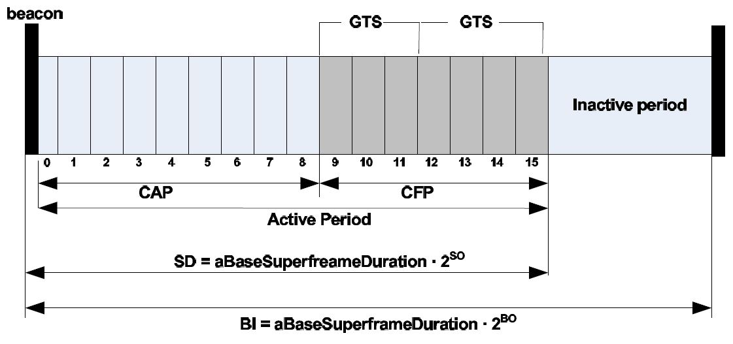
Super-frame Structure
[Fig 1]
Notes:
Used only in Beacon enabled mode

Slide 8
Super-frame Structure
Two parameter: Beacon Order (BO) and Superframe Order (SO) where 0 ≤ SO ≤ BO ≤ 14
If SO = 15; superframe is not active & if BO = 15; superframe doesn’t exist and Non beacon enabled mode used
Superframe Duration (SD) = aBaseSuperframeDuration . 2^{SO} ; Beacon Interval (BI) = aBaseSuperframeDuration . 2^{BO} Eq. (1) and (2)
aBaseSuperframeDuration = aBaseSlotDuration . aNumSuperframeSlots Eq. (3)
aBaseSlotDuration = No. of symbols forming superframe slot & aNumSuperframeSlots = No. of slots in any superframe

Slide 9
Super-frame Structure
Contention Access Period (CAP) uses CSMA mechanism
Contention Free Period (CFP) uses GTS; can be activated by request from node
Minimum CAP length = 440 symbols

Slide 10
Related Work
Previous evaluations on security and energy efficiency
IEEE 802.15.4 in factory automation with delay consideration
GTS behavior analysis with respect to delay and throughput
GTS scheduling schemes are assessed

Slide 11
Engineering Aspects
Industrial Automation is based on static offline configuration that impacts WSN handling
Use of Industrial Ethernet Standard PROFINET using a generic markup language GSDML
GSDML file transferred to PROFINET IO tool and then to the controller to configure all devices
GSDML file helps with mapping by providing WSN configuration.
Problem : No dynamic behavior leading to static network configuration; Solution : Scheduling after startup phase

Slide 12
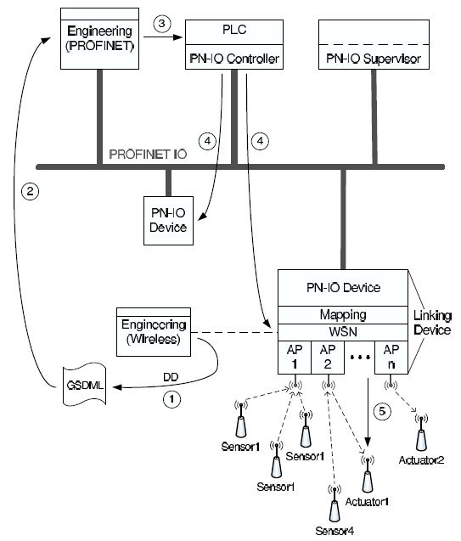
Engineering of Industrial Automation System
[Fig 2]

Slide 13
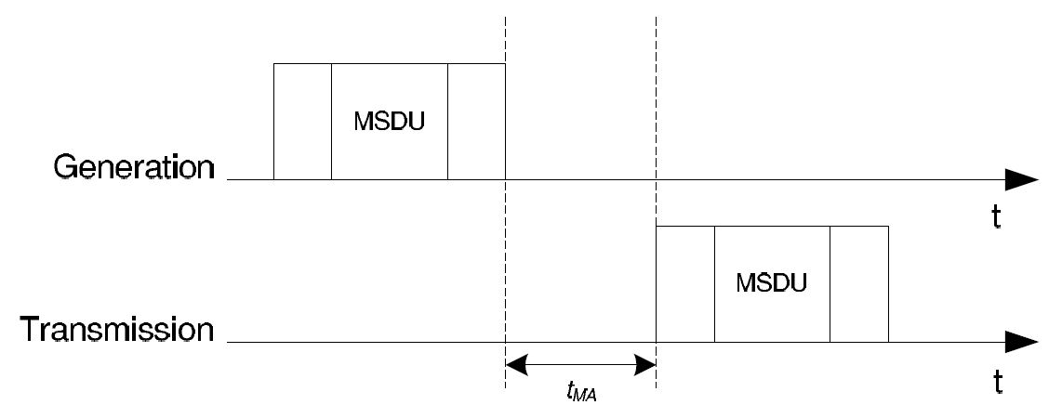
Performance Evaluation
OPNET simulation model developed as per Koubba for 802.15.4 [8]
Main metric for performance evaluation is Medium Access Delay
Medium Access Delay = time interval between frame generation and actual medium access of frame
[Fig 3]

Slide 14
Performance Evaluation
For CSMA, t_{MA} depends on node back-off time, for GTS, t_{MA} depends on GTS length, SO and payload size
Scenario 1: Delay vs Number of Nodes
Interval time = 1s
SO = BO = 1
MSDU size = 128 bits
Result: GTS performs better than CSMA as number of nodes increase
Reason: CSMA delay increases steeply due to more collisions on channel due to increased network load

Slide 15
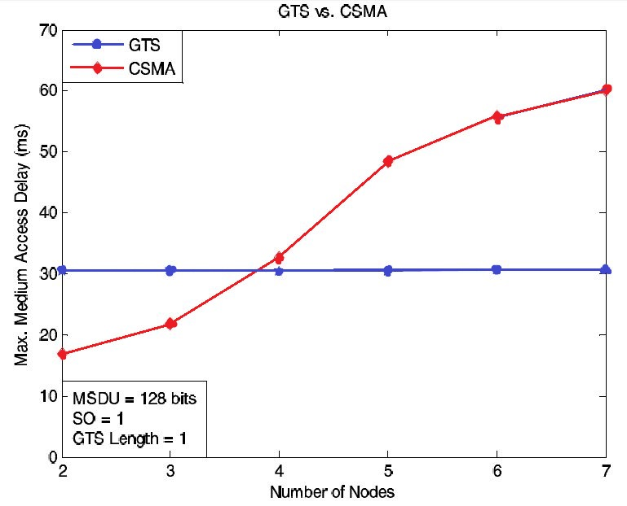
GTS vs CSMA delay comparison
[Fig 4]

Slide 16
Performance Evaluation
Scenario 2: Max Delay in GTS for different MSDU sizes for varying no. of nodes
SO = BO = 1
GTS length = 1
MSDU size = 10, 40, 75, 128 bits
Result: For MSDU size of 40 bits or lower, the medium access delay < 30ms while for MSDU size > 40 bits, 30 ms > medium access delay > 31 ms
Observations: Payload size and Number of nodes do not significantly affect medium access delay

Slide 17
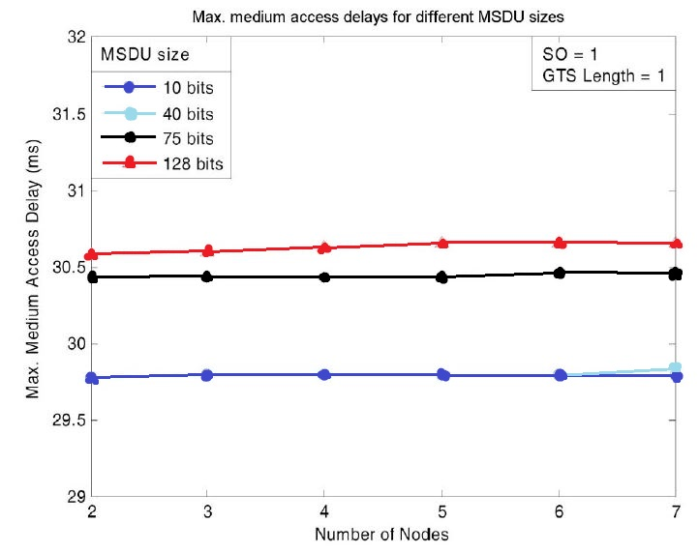
Max Delay vs Number of nodes & MSDU size
[Fig 5]

Slide 18
Performance Evaluation
Scenario 3: Effect of GTS length on max delay for 2 nodes
MSDU size = 128 nits
SO = BO = 1
Result: Increase in GTS length significantly reduces max delay
Observation: Increase in GTS length decreases number of nodes used

Slide 19
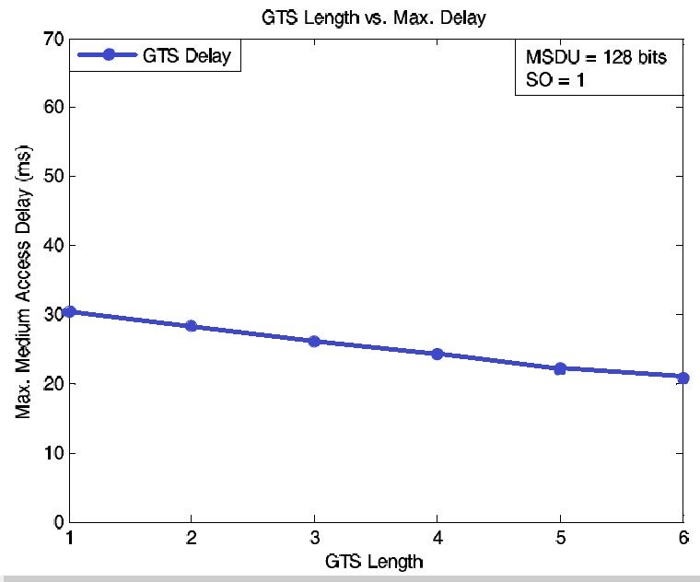
GTS length vs Max Delay
[Fig 6]

Slide 20
Limitations
Max 7 GTSs in one superframe
Exclusive dedication of every GTS to its respective node; Thus, max 7 nodes at a time can be supported
Scalability for large scale industrial application using WSN
Solution: Optimized GTS Scheduling scheme

Slide 21
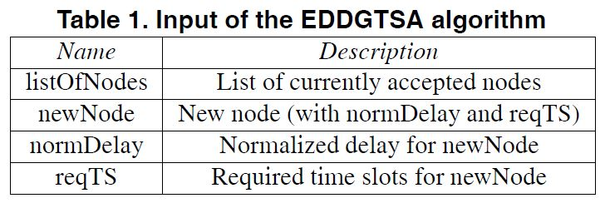
Optimized GTS Scheduling
Introduction of Earliest Due Date GTS Allocation (EDDGTSA), an optimized scheduling algorithm
Basic concept is to schedule nodes based on their maximum allowed delays
Input for EDDGTSA:

Slide 22
Optimized GTS Scheduling
All nodes send max delay to PAN coordinator
Max delay is normalized as a multiple of Beacon Interval and superframe cycle, given by normDelay
normDelay = maxDelay / BI
EDDGTSA requests list of all nodes as argument to handle node sorting
Table of nodes created with each row consisting of nodes with same normalized delay

Slide 23
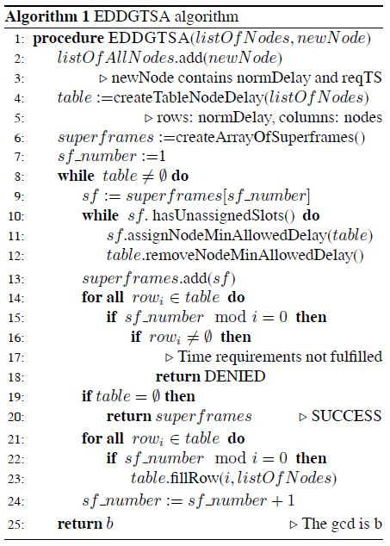

Slide 24
Optimized GTS Scheduling
Algorithm creates a chain of superframes; first 7 slots of first superframe assigned to nodes with smallest normDelay
Assigned nodes removed from table ....(lines 11,12)
Steps for filling superframe, deleting nodes from table and refiling specific nodes of table are repeated until table is completely filled
When complete table is empty, algorithm stops because scheduling task is finished

Slide 25
Optimized GTS Scheduling
Number of rows r_{i} empty after assembling superframe SF_{j} are determined by the equation as shown
r_{i} = { must be checked for emptiness and refilled; if j mod i = 0 . { must neither be checked nor refilled; otherwise
Worst Case Scenarios:
When each of the n nodes requires 7 slots, max allowed delay ≥ n or more cycles, the algorithm requires n superframes resulting in n iterations of the while loop
When each node has a different max allowed delay, table consists of n nodes resulting in the n iterations of the for all loops

Slide 26
Optimized GTS Scheduling
Upper bound for algorithm is given by O(n²)
Assumptions:
Effect of Collisions were disregarded for analytic calculations
No packets were lost during transmission
Reason: GTS mechanism provides a contention free period which results in zero collisions
Results of the algorithm performance for normDelay are shown below. It shows the number of nodes connected to the coordinator and the requirements for different scenarios

Slide 27
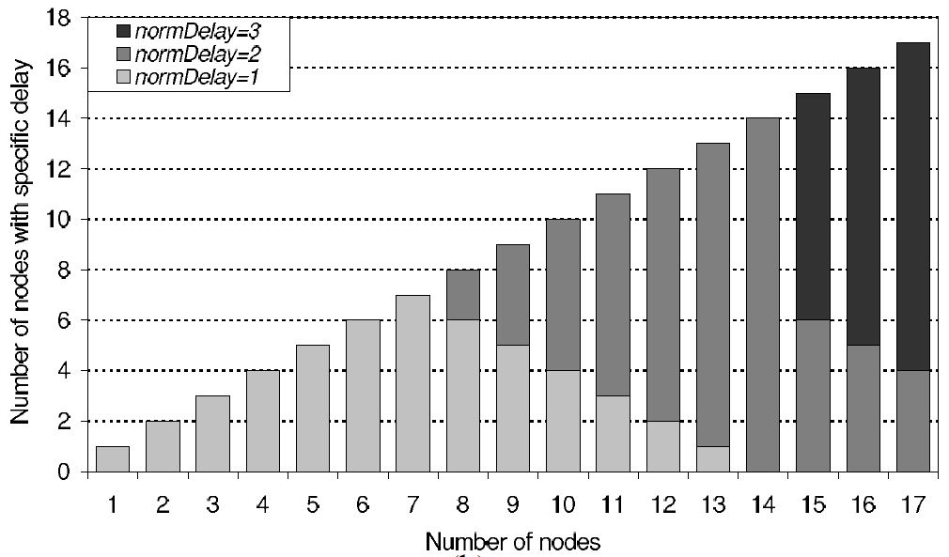
No. of Nodes wrt Requested Max Delay
[Fig 7 (b)]

Slide 28
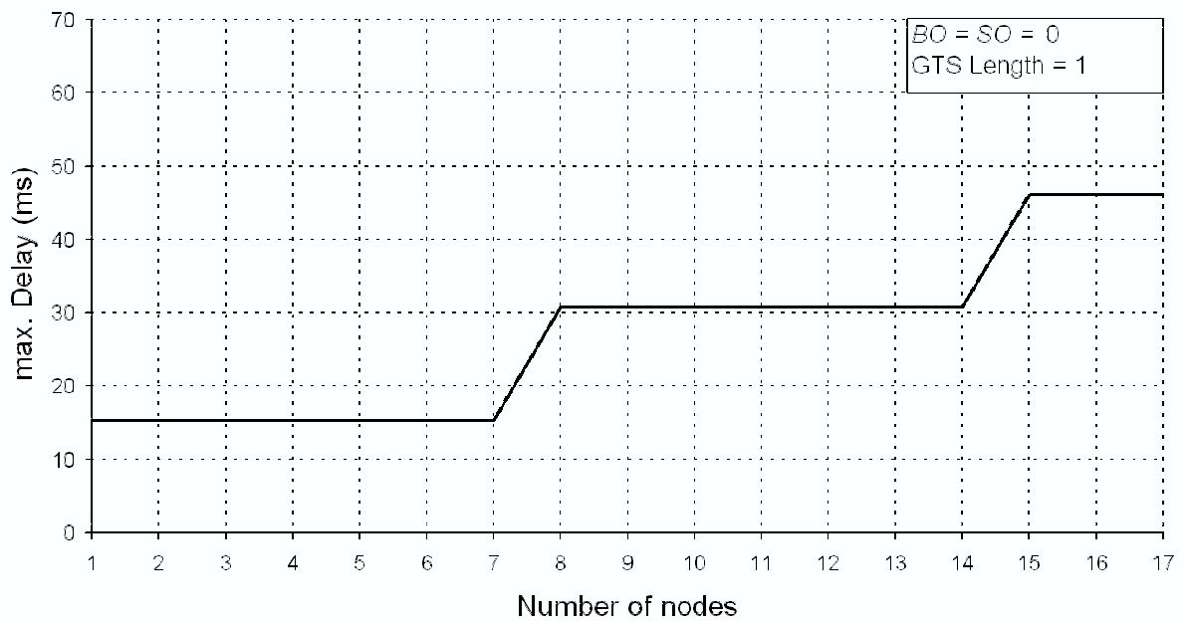
Max Allowed Delay vs No. of Nodes
Condition of experiment:
Requirement of every node is identical
[Fig 8]

Slide 29
Conclusion
GTS outperformed CSMA; maintained its bounds while CSMA fulfilled requirements only with fewer nodes
GTS mechanisms has its limitations that can be overcome by using EDDGTSA
EDDGTSA allows multiple nodes to share same GTS time slots in different superframes based on their max allowed delays
EDDGTSA works reasonably well in industrial WSNs and should be deployed more
Future work: Detailed simulation study of proposed algorithm for further refinement and implementation on an evaluation platform

Slide 30
Review
Authors cover an important topic with regards to IEEE 802.15.4 communication, i.e. scheduling of time slots wrt number of nodes
Provide convincing, readable results for their experimentation
Could have provided more detail on the OPNET simulation model and maybe evaluated on a few more metrics
As a reviewer, I wouldn’t accept the paper as I feel there hasn’t been enough experimentation done

Slide 31
Questions

