Slide 1
LTE and IEEE802.p for vehicular networking: a performance evaluation
Zeeshan Hameed Mir*
Fethi Filali
EURASIP Journal on Wireless Communications and Networking
Presenter – Renato Iida v2

Slide 2
Outline
Introduction
Related Work
Vehicular network with IEEE 802.11p and LTE
Vehicular networking applications and requirements
Performance evaluation
Discussion
Conclusion

Slide 3
Introduction
Reliable and low-latency communication
Select the most appropriate technology
Know the strengths and weakness of each technology

Slide 4
Comparison of 802.11p and LTE
How do different networking parameters such as beaconing frequency, vehicle density, and vehicle average speed affect the performance of IEEE 802.11p and LTE?
For what settings of parameter values that the performance of IEEE 802.11p and LTE degrades against a set of vehicular networking application requirements?
Does the performance in terms of delay, reliability, scalability, and mobility support degrade significantly or trivially with the change in different parameter values?
What types of applications would be supported by IEEE 802.11p and LTE?

Slide 5
Related Work
Describe references that describe the technologies used for vehicular network
Examples are WiMax, 3G, Bluetooth, Wave

Slide 6
Vehicular network with IEEE 802.11p and LTE
Describe the WAVE technologies.
  OBUs – Onboard unit
  RSU – roadside unit
Describe the elements of LTE
  Next slide

Slide 7
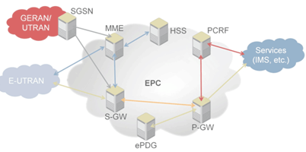
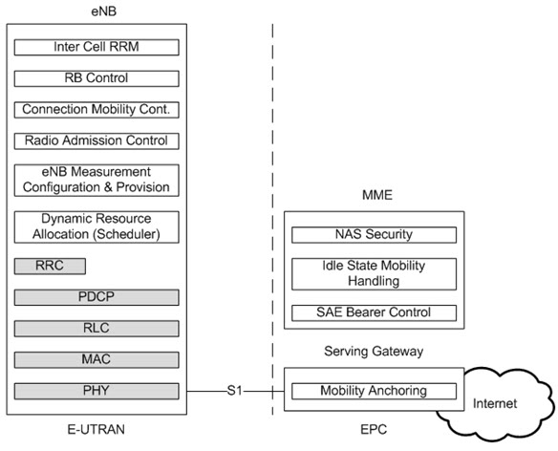
Lte Architecture

Slide 8
Simulation Scenario

Slide 9
Vehicular networking applications and requirements
Active Road Safety Applications
  Lower latency < 100ms
  Short to long coverage (300m to 20 km)
  Minimum transmission frequency 10 Hz ( 10 beacons per second)
  Low to medium data rate (1 to 10Kbps)
Cooperative traffic efficiency
  Medium latency < 200 ms
  Short to medium distance (300m to 5 km)
  Message to 1 to 10 Hz
  Low to medium data rate (1 to 10Kbps)
Infotainment

Slide 10
Performance evaluation
Performance comparison using ns-3
End-to-end delay
  computed as the sum of all mean delays for each vehicle, normalized over the total number of flows in the network, where mean delay is defined as the ratio between the sums of all delays and the total number of received packets.
Packet delivery ratio (PDR)
  computed as the ratio between the number of received packets and the transmitted packets during the simulation time.
Throughput
  defined as the sum of received data frame bytes at the destinations, averaged over the total number flows in the network.

Slide 11
Simulation Environment
5x5 Manhattan grid with 25 block
Six vertical and six horizontal two-lane roads
Vehicles routes and movement generate in SUMO
Number of vehicle
  Varies from 25 to 150
  steps of 25
Average speed
  from 20 to 100 km/h
  Increment of 20 km/h

Slide 12
Simulation Environment
eNB

Slide 13
802.11p simulation parameter
Communication range 250 m
EnergyDetectionThreshold
  Set to -83 dBm
  If the received power of a signal is above that threshold then the packet can be decoded (probably successfully)
CCAModelThreshold
  set −86 dBm
  threshold when the node senses the wireless channel.

Slide 14
802.11p simulation parameter
Nakagami fading channel
  5.8 GHZ central frequency
  Data rate 6 Mbps
Transmit 256 bytes beacons
  UDP based
Single hop broadcast without using RSU

Slide 15
Lte parameters
Single LTE cell
Frequency Information
  Downlink band 2110 MHz
  Uplink band 1710 Mhz
  Each bandwidth of 10Mhz
Transmission power
  eNB 40 dBm
  Vehicle 20 dBm
Omni direction antenna
Single input single output

Slide 16
Lte parameters
Traffic profile of background traffic
  Video bit rate 44 kbps
  Packet Size 1203 bytes
  Exponential distribution with arrival rate of 1
  Duration is until the end of the simulation

Slide 17
Simulation parameters table

Slide 18
Simulations Results
Impact of varying beacon transmission frequency

Slide 19
Information common to both graph and parameters
Results from 802.11p
Results from LTE

Slide 20
End to End Delay 20Km/h

Slide 21
Packet Delivery Rate 20 km/h

Slide 22
Throughput 20 km/h

Slide 23
Simulations Results
Impact of varying car speed

Slide 24
Information common to both graph and parameters
Results from 802.11p
Results from LTE

Slide 25
End to End Delay
Packet Rate 10 Hz

Slide 26
Packet Delivery Rate
Packet Rate 10 Hz

Slide 27
Throughput
Packet Rate 10 Hz

Slide 28
Results of 802.11p
Results without direct comparison with LTE

Slide 29
End to End Delay 20 km/h
802.11p only
25 vehicles
50 vehicles

Slide 30
Packet Delivery Ratio 20 km/h
802.11p only
25 vehicles
50 vehicles

Slide 31
End to End Delay
Packet ratio 10 Hz 802.11p only
25 vehicles
50 vehicles

Slide 32
Packet Delivery Ratio
Packet ratio 10 Hz 802.11p only
25 vehicles
50 vehicles

Slide 33
Results of LTE
Results without direct comparison with 802.11p

Slide 34
End-to-end delay

Slide 35
Conclusion
LTE scale better, delivers data reliably and meets latency.
LTE is suitable for most of the applications
The LTE gains is attributed to fewer network elements and infrastructure-assisted scheduling and access control
Performance degradation of 802.11p lack of coordinated channel access and distributed congestion control

Slide 36
Personal Comments
The LTE don’t make handover
The background traffic is not well defined and probably would be much higher in a Manhattan scenario
Should have another scenario in highway that LTE would have problem with the allocation and handover
The 802.11p using UDP is not the correct protocol. Should use WSMP

Slide 37
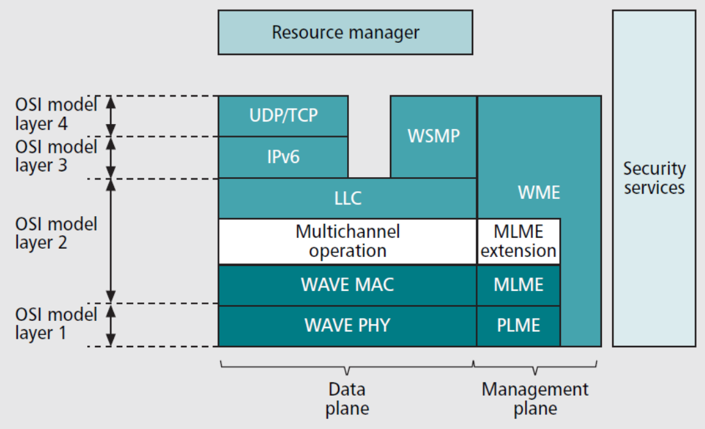
WAVE protocol stack

