Slide 1
Low-Power Interoperability for the IPv6 Internet of Things Adam Dunkels, Joakim Eriksson, Nicolas Tsiftes Swedish Institute of Computer Science Presenter - Bob Kinicki
Internet of Things
Fall 2015

Slide 2
Introduction
The Internet of Things is a current ‘buzz’ term that many see as the direction of the “Next Internet”.
This includes activities such as Smart Grid and Environmental Monitoring.
This is a world of ubiquitous sensor networks that emphasizes energy conservation!
This paper provides an overview of the low-power IPv6 stack.

Slide 3
Steps for IoT Interoperability
1. Interoperability at the IPv6 layer
Contiki OS with uIPv6 stack provides IPv6 Ready stack.
2. Interoperability at the routing layer
Interoperability between RPL implementations in Contiki and TinyOS have been demonstrated.
3. low-power interoperability
Radios must be efficiently duty cycled.
Not yet done!!

Slide 4
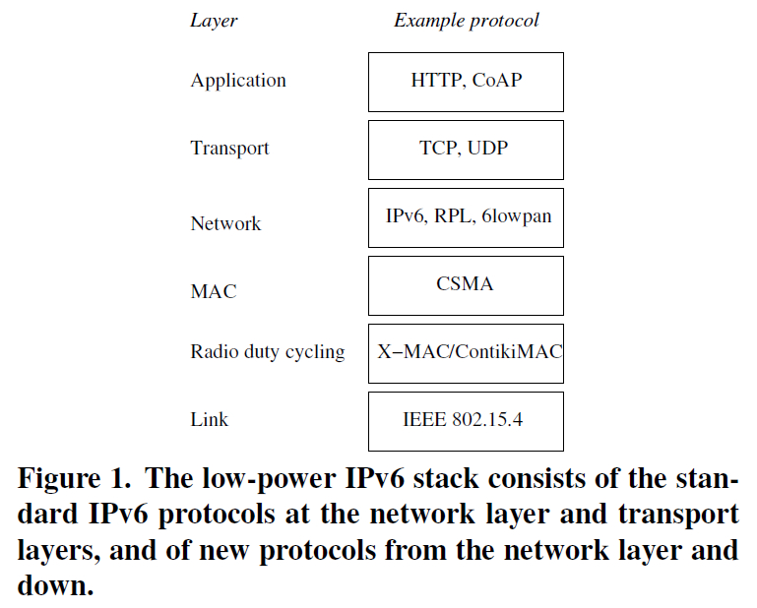
Low-Power uIPv6 Stack
focus of
this paper

Slide 5
Contiki MAC Layer Choices
X-MAC
Contiki-MAC
LPP Low Power Probing

Slide 6
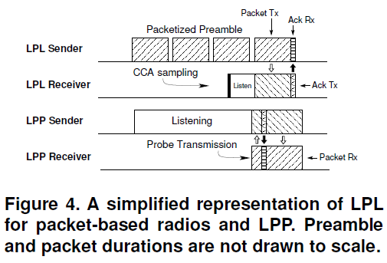
LPP (Low Power Probing)
Koala paper 2008

Slide 7
IPv6 for Low-Power Wireless
IPv6 stack for low-power wireless follows IP architecture but with new protocols from the network layer and below.
6LoWPAN adaptation layer provides header compression mechanism based on IEEE 802.15.4 standard to reduce energy use for IPv6 headers.
Also provides link-layer fragmentation and reassembly mechanism for 127-byte maximum 802.15.4 frame size.

Slide 8
IPv6 for Low-Power Wireless
IETF ROLL (Routing over Low-power and Lossy networks) group designed RPL (Routing Protocol for Low-power and Lossy networks) for routing in multi-hop sensor networks.
RPL optimized for many-to-one traffic pattern while supporting any-to-any routing.
Supporting different routing metrics, RPL builds a directed acyclic graph (DAG) from the root node for routing.
Since CSMA and IEEE 802.15.4 are most common, the issue becomes the radio duty cycling layer.

Slide 9
Radio Duty Cycling Layer
To reduce idle listening, radio transceiver must be switched off most of the time.
Figures show ContikiMAC for unicast and broadcast sender {similar to X-MAC}.
ContikiMAC sender “learns” wake-up phase of the receivers.
Performance relationship between RPL and duty cycling layer yet to be studied.

Slide 10
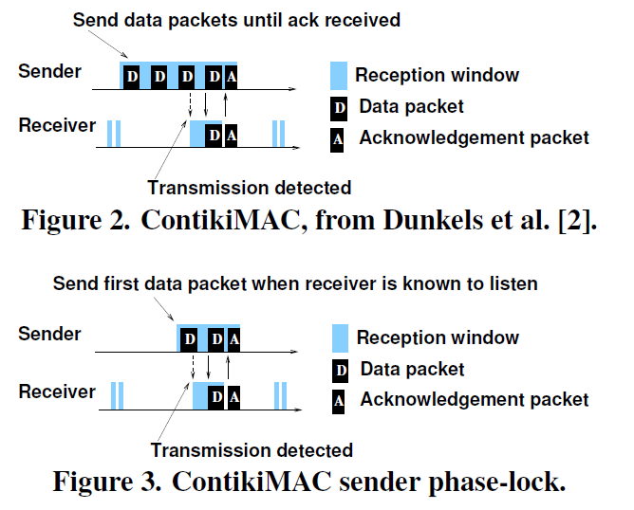
ContikiMAC Unicast

Slide 11
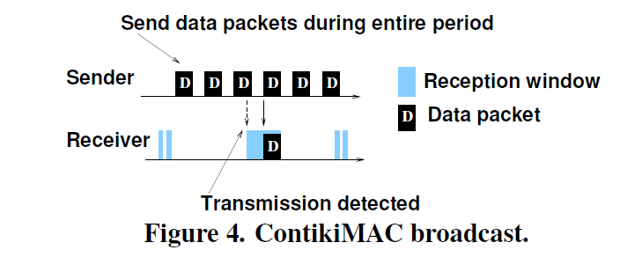
ContikiMAC Broadcast
ContikiMAC broadcast is the same as the A-MAC broadcast scheme.

Slide 12
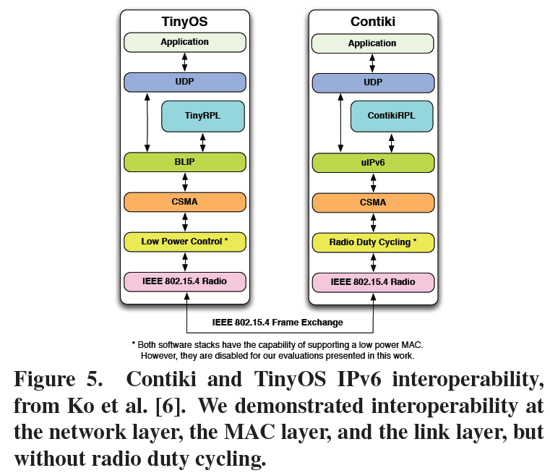
Interoperability
REST/CoAP
DTLS/UDP
IPSec/IPv6
Adding Security

Slide 13
Low-Power Interoperability
Interoperable radio duty cycling is essential!
Thus far interoperability demos have ONLY been with always-on radio layer.
Two implementations with good performance on their own can have sub-optimal performance when mixed.

Slide 14
Low-Power Interoperability
Results suggest IoT implementations need to be tested for performance and NOT just correctness.
Contiki simulation tool (Cooja) can be used to study challenges of low-power IPv6 interoperability.

Slide 15
Low-Power Interoperability
Three challenges:
1. Existing duty cycle mechanisms NOT designed for interoperability.
e.g., ContikiMAC and TinyOS BoX-MAC have no formal specifications.
* Mentions 802.15.4e group for standardization
2. Duty cycling protocols are typically timing sensitive.
Makes testing of interoperability difficult.

Slide 16
Low-Power Interoperability
3. Current interoperability testing is done via physical meetings of separate protocol developers.
This bounds the testing time.
Hence, this strategy is not well-suited for interoperability testing of duty cycling protocols.

Slide 17
Conclusions
While IPV6 provides IoT interoperability, attaining low-power interoperability for the Internet of Things is still an open problem because:
Existing protocols for LLNs are not designed for duty cycling.
Existing duty cycling protocols are NOT designed for interoperability.

