Slide 1
Towards Efficient Mobile M2M Communications: Survey and Open Challenges Carlos Pereira and Ana Aguiar Sensors, Volume 14, Issue 10
Presenter - Bob Kinicki
Internet of Things
Fall 2015

Slide 2
Outline
Motivation/ Introduction
M2M Literature Review
Interoperable M2M
M2M Communication Models and Paradigms
REST
Publish-Subscribe
M2M Application Protocols
CoAP
MQTT and MQTT-S
Smartphones as Mobile M2M Gateways
Conclusions and Critique

Slide 3
M2M Motivation
Machine-to-Machine (M2M) communications imply networked devices exchanging information seamlessly without human intervention.
IoT is a major driver for M2M applications.
Smartphone pervasiveness make them critical to IoT and mobile M2M communications predictions for the future are high:
2018 mobile M2M will be 6% of all mobile data.
2020 number of vehicles with built-in M2M connection capabilities will reach 90% of the market.

Slide 4
Survey Focus
Reviews mobile M2M communications considering its impact on devices with limited capabilities and constraints.
Emphasizes resource usage efficiency as enhanced by gateway devices.
Includes brief look at M2M related standards:
Constrained Application Protocol (COAP)
Message Queuing Telemetry Transport (MQTT)
Briefly studies impact of smartphones collecting and aggregating sensor information.

Slide 5
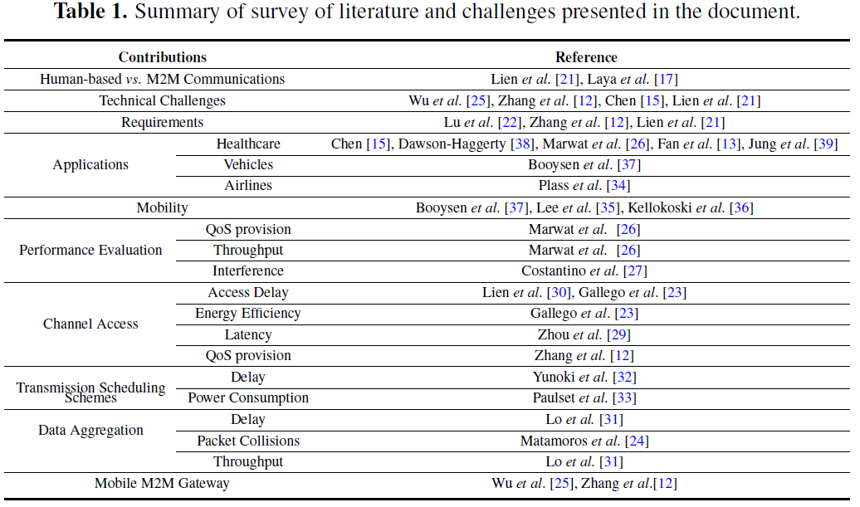
Table 1: M2M Literature Review

Slide 6
M2M Literature Review
Current M2M literature centers around performance evaluation and improvement (delay or resource usage efficiency).
Differences between H2H (Human-to-Human) and M2M transmissions include:
H2H traffic is likely bursty, can tolerate long delays and normally emphasizes downlink.
M2M traffic most likely small and infrequent via uplink.
M2M tends to require high priority (in terms of strict delay deadlines) and much larger number of devices.

Slide 7
M2M Support in Wireless
Reliability is critical for M2M.
Sensor to gateway issues exist with researchers searching for better techniques to efficiently aggregate data to optimize bandwidth utilization.
Wireless MAC strategies include both contention-based (CSMA/CA) and reservation-based (e.g. TDMA in wireless HART).

Slide 8
M2M Support in Cellular
Expectation is M2M traffic will dramatically impact future 4G LTE traffic in terms of QoS and throughput.
Costantino evaluates LTE gateway using CoAP and representative M2M traffic using simulation.
Studies interested in simultaneous uplink traffic. Lo et al introduce concepts including: M2M relay node for data aggregation; tunnel-based aggregation and priority classes for aggregation.
Others study EVDO and GPRS for M2M.

Slide 9
Energy Efficiency
Energy efficiency is important mobile M2M communications requirement.
M2M will not be widely accepted until energy efficiency is met.
Use smart mobile M2M Gateway as intermediary for neighboring sensors (cognitive gateway).
Example: Use currently scheduled airplanes as relays between ground and satellites.

Slide 10
Device Mobility, Autonomy & Security
Worry about vertical handover issues for mobile devices connected to multiple networks.
Seamless implies that self-configuration, self-management and self-healing are important in M2M.
M2M requires autonomous data collection.
Security is a problem – especially for vehicular and healthcare applications.

Slide 11
Open M2M Challenges
Support for many and diversified devices.
Traffic volume and traffic patterns.
Mixing H2H and M2M traffic exposes networks capacity limitations.
Overhead from handoff inefficiencies is a still a problem.
More studies of data compression needed to optimize performance.

Slide 12
Interoperable M2M
Current M2M markets are segmented and often rely on proprietary solutions.
Interoperability requires standards-based M2M.
ETSI (European Telecommunications Standards Institute) M2M architecture discussed.
ETSI M2M service platform employs horizontal middleware to facilitate sharing.

Slide 13
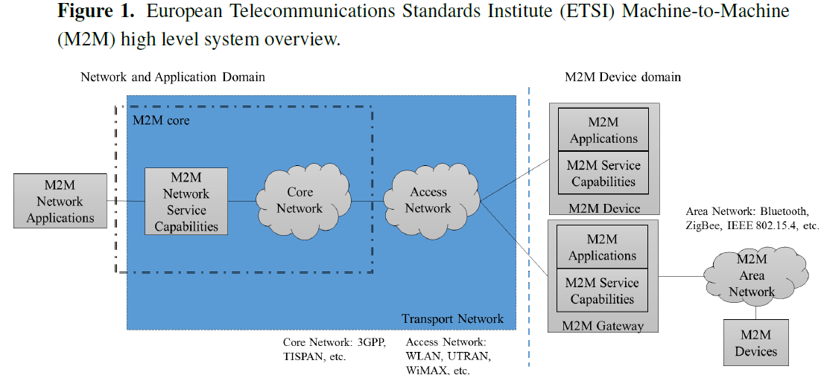
Figure 1: ETSI System Architecture

Slide 14
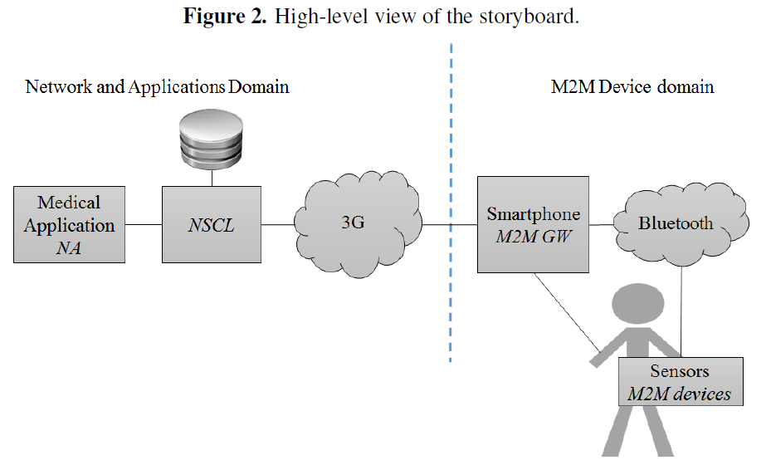
Figure 2: Storyboard
Wearable
Devices
ETSI M2M service platform is a
horizontal middleware where
applications share network elements
and M2M is ‘agnostic’ of technologies.

Slide 15
M2M Communication Models and Paradigms
M2M communication is categorizes as:
event-based or polling-based.
Polling follows request-response pattern.
Event communications triggered by a particular event.
ETSI adopts RESTful architecture style. REST (Representational State Transfer) is a client-server paradigm with stateless interactions.

Slide 16
REST
While REST is stateless communication, it provides unique addresses for distributed applications with resources that change state.
REST uses Create, Read, Update and Delete to manipulate resources.
REST is inherently request-response, but publish-subscribe is more reasonable for event-based communications.

Slide 17
Publish-Subscribe
Publish-subscribe is a one-to-many paradigm where subscribers state there interest (subscription) to message brokers to being notified of data/events produced by publishers.
Publishers transmit to message brokers who in turn deliver message to the subscribers.
Subscribers are only notified when events are produced {saves sensor energy}.

Slide 18
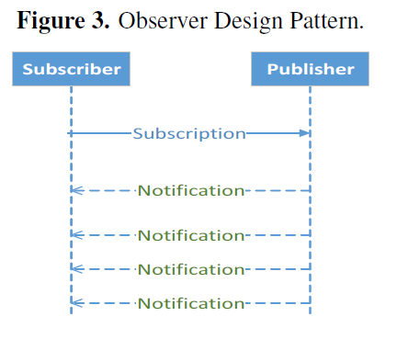
Figure 3: Publish-Subscribe

Slide 19
M2M Application Protocols
M2M Partnership Project agreed to consider CoAP, HTTP and MQTT as de facto M2M communications protocols.
Authors introduce CoAP and MQTT (more details in future papers).
HTTP uses four request types: GET, POST, PUT and DELETE and a URI (Uniform Resource Identifier).
CoAP is lightweight REST compliant protocol that uses same request types.

Slide 20
CoAP
CoAP conceptually separated into two layers:
Messaging layer: provides asynchronous message services over datagram.
Request-response layer: provides handling of tracking of requests and responses exchanged between client and a server.
This layer provides direct support for web services.
Tokens in request/response pairs used for ACKs.

Slide 21
CoAP
Messaging layer implements the publish-subscribe model.
CoAP observer model lets CoAP client observe a resource on another CoAP entity (think sensor here!).
Subscription made with an extended Get request.
In this model (Figure 3), publisher is also the broker.

Slide 22
CoAP
CoAP message types include:
Confirmable (CON) message which expects an ACK.
Non-confirmable message
Ack message
RST message : reset
Resource discovery is accomplished in CoAP with Confirmable Get.
CoAP uses UDP and not TCP.

Slide 23
CoAP
Using UDP, CoAP can utilize multicast IP destination addresses.
Security is handled using Datagram Transport Layer Security (DTLS).
IPsec is too heavy for energy-aware sensors!
CoAP philosophy includes caching and proxies (which are often found in border router serving as a gateway and a proxy).

Slide 24
MQTT
MQTT was developed by IBM as a lightweight, broker-based, publish-subscribe messaging protocol.
MQTT does NOT comply with REST.
MQTT has 14 different message types and is an asynchronous protocol.
MQTT supports three levels of application reliability and is based on the TCP/IP stack (mainly TCP).

Slide 25
MQTT-S
MQTT for Sensor Networks (MQTT-S) is an MQTT extension that is optimized for low-cost, battery-operated devices.
MQTT-S operates on UDP and is aimed at minimizing capacity and resource requirements while targeting reliability.
MQTT-S gateway can be integrated into broker to translate between MQTT and MQTT-S.

Slide 26
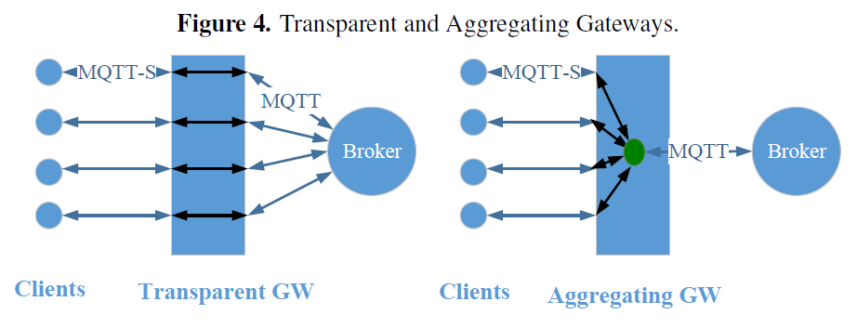
Figure 4: MQTT Gateways (GW)
Transparent GW maintains separate MQTT connection to broker for each MQTT-S client.
Aggregate GW has only one MQTT connection to broker which is shared by all MQTT-S clients through GW .

Slide 27
Comparison of CoAP vs MQTT
CoAP validated through experiments (see future papers) and used with HTTP/CoAP proxy to handle web traffic into a WSN.
Two open-source implementations of MQTT exist (Mosquito and Paho).
CoAP header twice the size of MQTT header.
CoAP performs better than MQTT (see future papers).
MQTT does not provide service discovery.

Slide 28
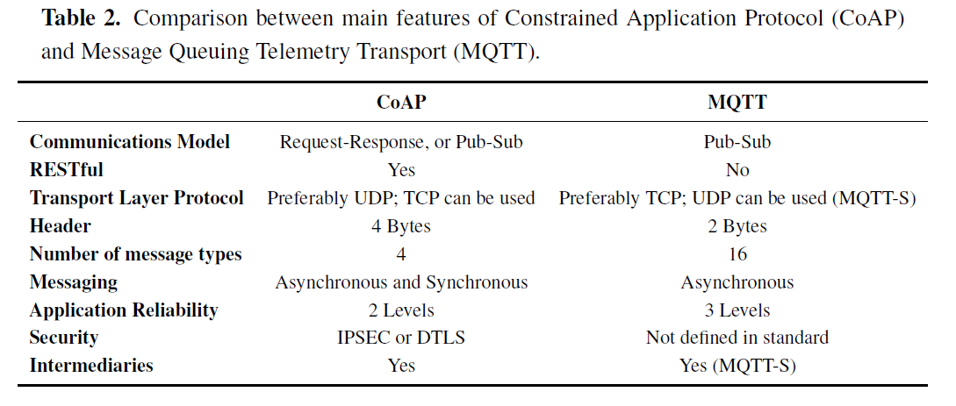
Table 2: CoAP vs MQTT

Slide 29
Smartphones as Mobile M2M Gateways
Healthcare applications include remote monitoring of patient vital signs (see Table 3) using sensors.
Sensors can forward collected data to a gateway using short-range wireless (e.g. Bluetooth).
Smartphones can play the role of the mobile M2M gateway, but battery depletion is an issue.

Slide 30
Table 3: Representative Sensor Traffic

Slide 31
Smartphones in M2M
Authors employ mobile smartphone energy model relative to data collection strategy from sensors to determine if it is possible to collect data and aggregate at a reasonable rate during the day and still be able to re-charge the battery at night.

Slide 32
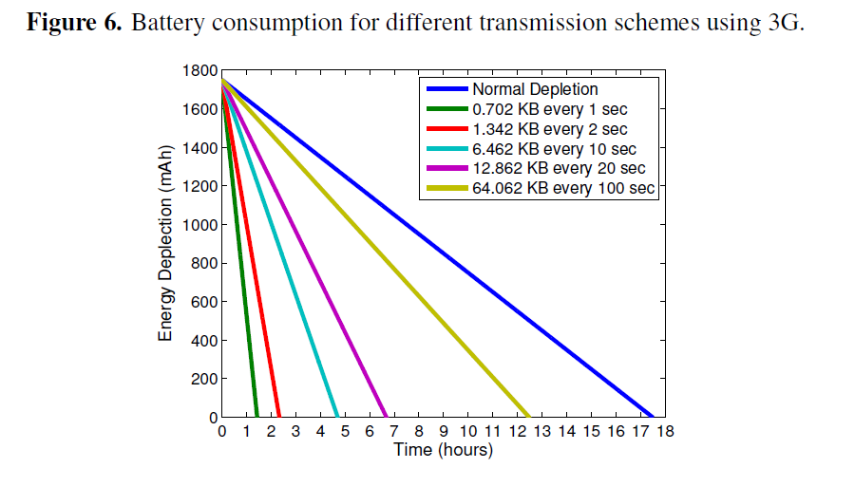
Figure 6; Battery Consumption
This aggregation
level keeps battery
alive 12 hours!

Slide 33
Conclusions
Mobile M2M communications are becoming ubiquitous in heathcare, telemetry and intelligent transport IoT applications.
Future work needs to focus on the M2M gateways and their ability to aggregate and compress data to reduce WSN energy consumption.
Claim: resource usage efficiency is still an open research area in mobile M2M communications.

Slide 34
Critique
Reasonable survey but uneven in treatment of topics.
CoAP explanation could have been better.
More MQTT details needed too.
“middleware” approach should have been discussed more.
List of 82 references is valuable.

