Slide 1
RPL under Mobility K.C. Lee, R. Sudhaakar, L. Dai, S. Addepalli and M. Gerla IEEE Consumer Communications and Networking Conference, 2012
Presenter - Bob Kinicki
Internet of Things
Fall 2015

Slide 2
Outline
Introduction
Motivating RPL for VANETs
RPL with Trickle Implementation
Modifications to RPL for Mobility
Simulation Details
Performance Evaluation Results
Conclusions and Critique

Slide 3
Introduction
Authors envision vehicles on the road with multiple mobile onboard units (OBUs).
We have seen in previous papers this concept of vehicular communication being a combination of Wifi and cellular (4G LTE).
This paper studies the issue of an appropriate routing protocol for access to road-side infrastructure either directly or via multi-hops through wireless OBUs.

Slide 4
Introduction
Authors stay away from MIP (Mobile IP) protocols and focus on protocols complementary to global mobile protocols.
They study RPL (Routing Protocol for Low power and Lossy Networks (LLNs)) claiming design elements from RPL transfer to vehicular environment.
Paper conducts simulation performance study of RPL and RPL tuning in VANETs.

Slide 5
RPL Motivation
RPL is a distance vector routing protocol that builds a Destination Oriented Directed Acyclic Graph (DODAG) rooted at a single node (normally the sink).
With a single root, the network takes a tree topology.
DODAG minimizes cost to reach the root per an Objective Function (OF) (e.g., ETX).

Slide 6
RPL Motivation
RPL does NOT handle seamless mobility when vehicle moves from the coverage area.
OBUs can implement a global mobility solution such as LISP.
RPL can be used with a global mobility solution that hides the mobility event from end-user devices.

Slide 7
RPL Attributes
RPL can have better response time compared to reactive protocols (e.g., AODV and DSR) as they are susceptible to route breaks under high mobility. “Adapted” RPL can adjust the parent update rate.
RPL does not flood the network but only exchanges local information with neighbors.
Idea is to combine RPL with another multi-hop routing protocol to improve routing efficiency for mobile peer-to-peer communication.

Slide 8
RPL Implementation
Road-side infrastructure nodes (e.g., WiFi access points) are root nodes for DODAG.
OBUs use RPL to reach root directly or via other OBUs.
Root node builds topology by broadcasting Directed Acyclic Graph (DAG) Information Option (DIO messages).
DIO contains info about broadcasting nodes rank (root rank = 1).

Slide 9
RPL Implementation
Receiving node determines its rank based on rank in DIO and the cost to reach the node.
DIO node broadcast contains: sender’s rank, OF and the DAG joined.
DIOs propagate from root to most distant nodes to create a DODAG.
RPL defines rules for parent selection based on several pieces of “local quality” information.
Any node with lower rank than receiving node becomes a candidate parent.

Slide 10
RPL and Trickle
RPL uses Trickle interval mechanisms (discussed in previous paper) to determine t.
I bounded by [I_{min,} I_{max} ]
Notation difference:
I_{max} = I_{min} x 2^{Idoubling}
t ,randomly picked from [I/2,I], serves as periodic emission time of DIOs sent by each node in DODAG. Namely when t expires, DIO is sent if c < k.

Slide 11
RPL and Trickle
A node’s c is incremented every time DIO received from neighbors does not change node’s rank {namely, rank is RPL consistency state}.
When I expires, if node’s rank did not change from DIOs of its neighbors,
then I ← min (2xI, I_{max})
else I ← I_{min}.
t reset within internal defined by new I {only when I expires}.

Slide 12
Stale DIO Messages
To avoid stale DIOs, nodes have an ETX periodic timer which probes neighbors for their ETX value.
If probe detects ETX changes,
then a new parent may be selected and a new DIO is sent to inform neighbors of node’s updated rank.
else no DIO sent and t set to old value upon expiry (not doubled as RFC states).

Slide 13
RPL Mobility Modifications
Since RPL designed for static WSNs, RPL rank does not update in a timely fashion to reflect frequent topology changes caused by moving vehicles.
Three RPL mobility modifications/issues:
Disable DIO Trickle timer.
Immediate ETX Probing for a New Neighbor
Loop Avoidance and Detection

Slide 14
Disabling DIO Trickle Timer
Since Trickle timer is designed for LLNs where network topology does not change frequently, authors disable the Trickle timer and use a fixed timer to focus study on other fundamental factors that impact RPL performance:
DIO periods
ETX periods
ETX

Slide 15
Immediate ETX probing
When a node discovers a new neighbor, it should schedule a future PING request to determine the new neighbor’s ETX.
This new ETX may trigger the node to seek a new parent (depending on neighbor’s rank).
In mobile networks with fast moving nodes, nodes are likely to quickly change their rank, authors initiate immediate ETX probe to make preferred parent selection timely!

Slide 16
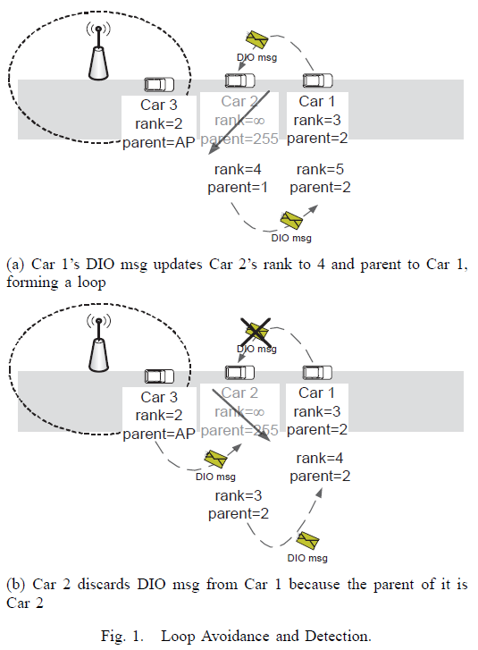
Figure 1: Loop Avoidance and Detection
Figure 1(a) is an example of loop formation.
Figure 1(b) is the ‘fix’. Add parent ID to DIO. If parent ID = node ID then node discards DIO.
RPL can also use this technique to detect and break a loop.

Slide 17
Simulation Details
Study uses Qualnet 4.5 simulator to evaluate Modified RPL in terms of connectivity duration and DIO overhead.
Simulation consists of 10 mobile nodes traversing a straight line of 5000 m.
WiFi is simulated 802.11b broadcast with approximate radio range of 250 m.
AP (root node for RPL) is at the line middle (2500 m).
Vehicle speeds: 25, 45 and 65 mph.
DIO period: 2s to 10s in 2s increments.

Slide 18
Performance Evalution Results
First set of RPL results (Figure 2): 10 cars traveling together in caravan with car 1 leading and car 10 last (distance between cars and simulation duration not specified).
DIO = 2s, ETX period = 5s
only initial results presented due to space constraints!
Figure 3: Percentage of Connectivity Duration (PCD)
Figure 4: PCD standard deviation as DIO period varies.

Slide 19
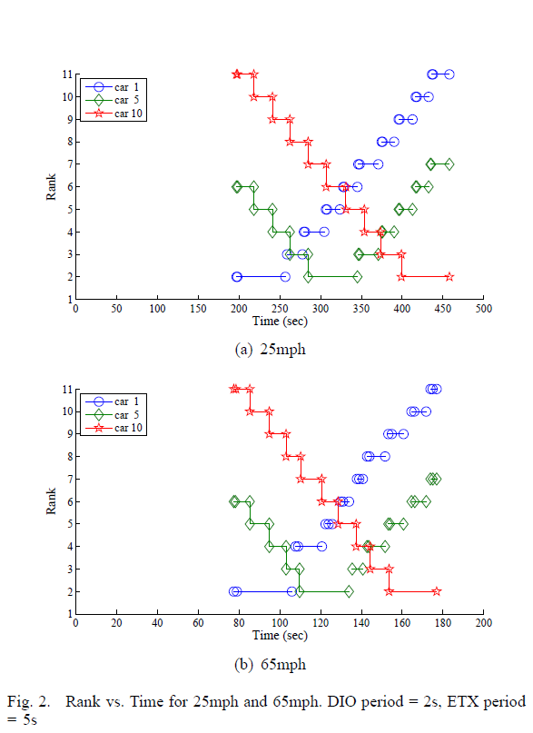
Figure 2: Rank vs Time
Fig 2(a) rank duration is 22s.
Fig 2(b) rank duration is 9 s. (varies with speed)
Rank duration also varies with DIO period.
If DIO period too long, RPL skips a rank.
Car 1 has disconnects near AP – looking for parent.

Slide 20
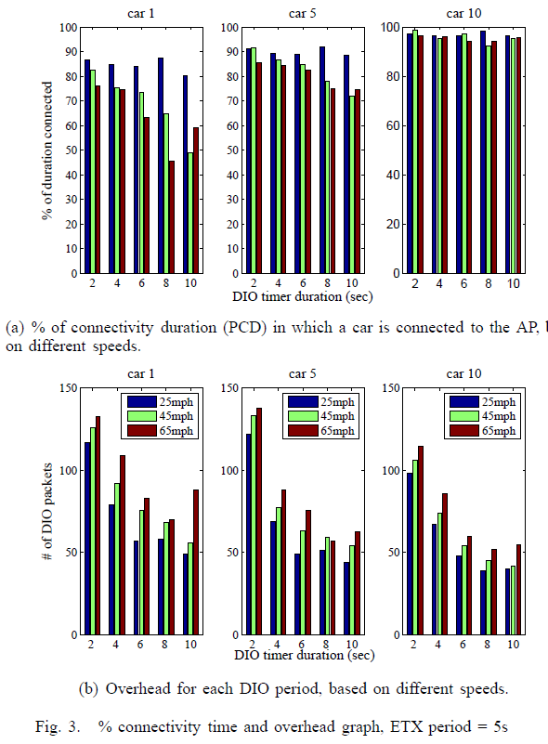
Figure 3: PCD (Percentage of Connectivity Duration)
Fig 3(a):
PCD decreases as speed increases (Cars 1& 5 and DIO not 10).
PCD increases as car number increases (later cars do not disconnect with AP as much).
Fig 3(b):
DIO overhead proportional to DIO period. {diminishing returns}
DIO overhead increases with speed (due to frequent topology changes) .

Slide 21
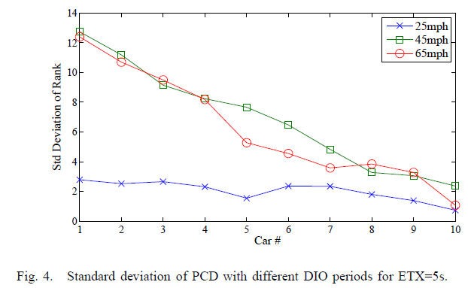
Figure 4: PCD StdDev Varying DIO Period
Speed impacts variation of connectivity.
→ important to adjust DIO period at high speed.

Slide 22
Conclusions
Paper studies modified RPL parameter effects on connectivity duration and overhead.
Modified RPL simulated because RPL does not adapt to high speed vehicular movement well.
High speed decreases connectivity duration.
Loops are avoided with parent ‘hints’.

Slide 23
Critique
Although paper is short, concepts are complex.
Explanation of car caravan idea, car spacing and simulation duration are all missing from simulation details.
Authors chose to take Trickle timer out to simplify the analysis.
Analysis of results is well done.

