Slide 1
Wireless Sensor Networks and the Internet of Things: Do We Need a Complete Integration?
Cristina Alcaraz, Pablo Najera, Javier Lopez, Rodrigo Roman
Presented by Alexander Witt and Aniket Shah

Slide 2
Overview
Introduction
Security Integration Challenges
Integration Approaches
Demystifying the TCP/IP solution issues
Case Study
Technical Overview
Conclusion
Critical Review

Slide 3
Introduction
WSN – an important element in IoT paradigm; facilitates collaboration of heterogeneous information systems and services
Many companies have bought into the above idea, working to find solutions. E.g. : A Smarter Planet by IBM, CeNSE by HP Labs
Integration with the Web; 6LoWPAN uses IPv6 for web services such as SOAP and REST
Many challenges associated with this sector such as security, physical and virtual connections; especially between WSN and the Internet, etc.

Slide 4
Security Integration Challenges
WSN in IoT raises security challenges; paper focuses on connections at network level
Security needs to be considered at a global perspective, not just local
Ensures the curbing of additional requirements to integrate local nodes on a global scale
Security is an important factor as it helps user perceive control over information and not vice versa
Data privacy is another important feature
Segregation of shared and private data
Confidentiality in business scenarios

Slide 5
Security Integration Challenges
Another significant aspect under consideration is Component security
Security protocols at network level
Interaction between objects and services
Objects and infrastructures of an IoT network should be able to handle several identification and security mechanisms in a transparent and scalable way
Need to reach equilibrium point in secure interactions is an interesting problem

Slide 6
Integration Approaches
For network design, it is necessary to know the integration approaches to connect to both infrastructures of WSN and the Internet
Classification: Stack based or Topology based
Stack based: integration level depends on similarities between network stacks of WSN and Internet
Classification: Front End, Gateway or TCP/IP
Topology based: integration level depends on actual location of nodes
Classification: Hybrid or Access Point

Slide 7
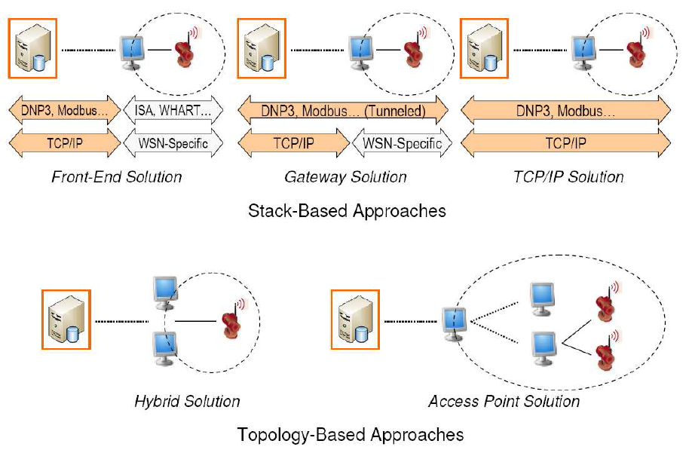
Integration Approaches
[Fig. 1]

Slide 8
Stack-based Classification
Front-end solution: WSN independent from the Internet
Implements its own protocols
All interaction managed by a centralized base station
Gateway solution: WSN can exchange information with Internet hosts
Internet hosts and sensor nodes can address each other indirectly through a gateway
Base station acts as application layer gateway; translating lower layer protocols and routing information
TCP/IP solution: WSN shares a compatible network layer protocol
Sensor nodes implement TCP/IP (or 6LoWPAN) to become a part of the Internet
Sensor nodes may not be able to use specific WSN protocols

Slide 9
Topology-based Classification
Hybrid solution: Dual sensor nodes located at root of the WSN
A set of nodes located at the edge can access the Internet directly and become base stations
This approach provides redundancy and network intelligence
Access Point solution: Backbone of devices that allow sensing nodes to access the Internet in a single hop
WSNs become unbalanced tree with multiple roots (sensor nodes with Internet enabled nodes)
Increases capabilities of nodes in the backbone network
In most cases, Topology based networks are combined with Stack based classification except for the TCP/IP solution

Slide 10
Demystifying the TCP/IP solution issues
TCP/IP provides best solution to integrate WSN and the Internet
External system can access node information directly
Nodes can query Internet for services
Multiple factors to be considered for complete integration
Existing issues may affect WSN whose nodes are completely integrated into the Internet
More challenging to assure security of WSNs that make use of the TCP/IP solution

Slide 11
Factors determining integration approach
Resilience: Security mechanisms to increase robustness against attacks (such as Denial of Service)
User Authentication and Authorization: Permission storage; consider implementing single sign-on systems
Communication Security: Analyze other secure communication channels (e.g. TLS); study different key exchange mechanisms
Accountability: Be able to record interactions with user; will help recreate security incidents and abnormal situations

Slide 12
Factors determining integration approach
Functionality: Some nodes need not be aware of the Internet due to limited functions (tasks)
Hardware: Certain nodes may not connect to the Internet directly due to memory constraints of security mechanisms
Inherent weakness: Decide whether certain applications should isolate nodes from the Internet; filtering traffic at the network edge
Network redundancy: Necessary to develop mechanisms in TCP/IP environments to deal with exceptions such as unreachable nodes
Protocol optimization: Most protocols allow a network to self-heal and optimize internal behavior; yet to be found for 6LoWPAN networks

Slide 13
Case Study – SCADA Systems and First Responders
Pure TCP/IP integration solution has certain limitations, especially in terms of security
Application requirements determine the type of integration solution
Two sensor network applications analyzed:
WSN enabled SCADA system
First Responder system

Slide 14
SCADA Systems
SCADA – Supervisory Control and Data Acquisition system
Uses new technology to monitor many critical infrastructures in real time
Main elements of a SCADA system:
Central control systems – remote monitoring of infrastructures by humans
Remote subsystems – located within the infrastructure; provides data/ information from various elements of the infrastructures

Slide 15
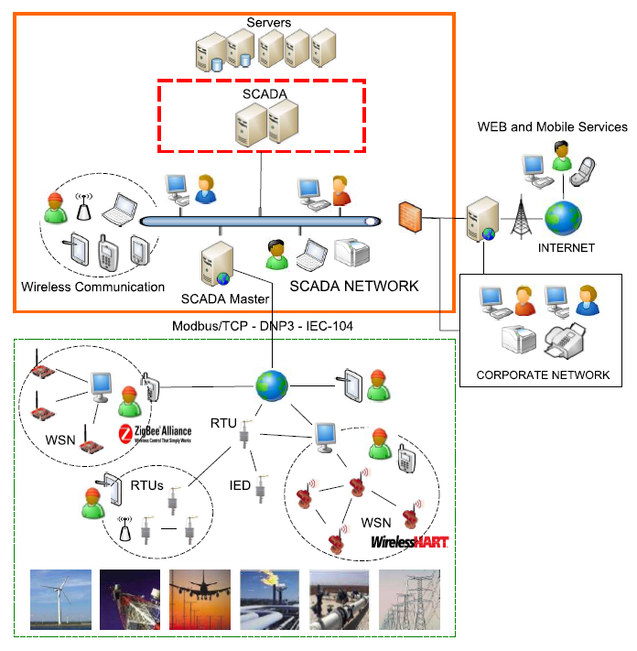
SCADA Network Architecture
[Fig. 2]

Slide 16
SCADA Systems
Migration to IP for automation has increased with TCP/IP real time monitoring and communication
Led to development of hybrid technologies (e.g. Bluetooth, Wi-Fi, Zig-Bee, WSNs, etc.)
WSNs considered as key technology
Smart and autonomous
Auto-configuration
Self monitoring and self-healing
Anomaly detection and tracking

Slide 17
SCADA Systems
Industrial applications have led to various products
MeshNetics nodes (Zig-Bee) launched SensiLink Integration platform
Cooper Power Systems’ wireless Outage advisor for Electric power systems
Sensus’ FlexNet SmartPoints for power systems
Interoperability of products is based on industrial standards such as ZigBee, WirelessHART and ISA100.11a (based on the IEEE 802.15.4-2006 standard) which specifies the PHY and MAC layers of WPANs
Main goal of these standards
secure connectivity
energy saving using a wireless mesh network
interoperability with other systems
data reliability

Slide 18
First Responder Systems
Sensor networks play disaster response roles such as monitoring, tracking, triage etc. Hence the name first responder systems
Creates and maintains information structure when other communication and support system not available
Reason: Dynamic and autonomous nature of WSN
Many advantages of WSN-base first responder system integration with the Internet
Network at disaster location helps visualize distant evets
Global view of disaster situation
Interaction with centralized situation to optimize task distribution

Slide 19
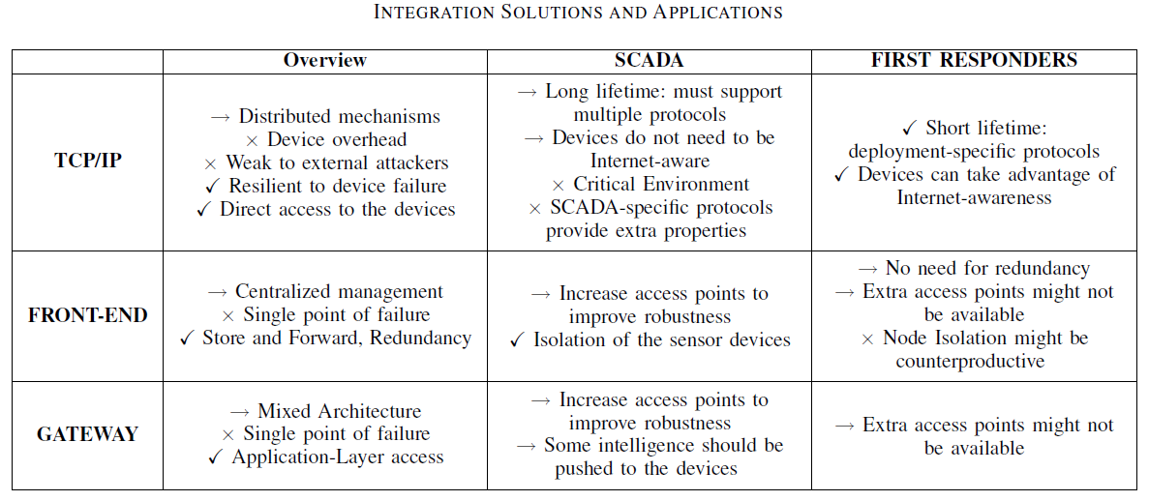
Analysis
[Table 1]

Slide 20
Analysis
For SCADA systems, benefits of pure TCP/IP solution don’t warrant complete integration of WSN with the Internet
Increase in network traffic can become problematic for WSN nodes due to their limited capabilities
Existence of a central entry point makes the Gateway solution vulnerable against availability attacks. This can be solved by using the Hybrid and Access Point solutions
TCP/IP solution for First responders works well as there is limited overhead on nodes
Benefits associated with Front-end and Gateway solutions for First responder systems are not so important in these emergency scenarios

Slide 21
Technical Overview
Different technologies used to protect a WSN
Cryptographic primitives (ECRYPT Stream Ciphers, PKC ECC, Rabbit)
Attestation and detection systems
Key management systems
Security technologies being developed
Secure routing
Time synchronization
Trust management
Secure middleware
Essential for protection to nodes (in nodes or inside routers / base stations)

Slide 22
Conclusion
Full integration at the network level may not be necessary
Some applications should not connect their nodes directly to the Internet
There are more security issues when integrating WSN with the IoT:
Integration of security mechanisms & services
User acceptance
Management of data privacy

Slide 23
Critical Review
Good indication of tradeoffs existing in different approaches to integration
Do not impose a doctrine for good IoT security but discuss security attributes
Discuss attributes of the environment that may influence scheme selection
The paper is organized well but could explain certain sections better
Discuss TCP/IP connectivity to the Internet
Do not mention if battery life is a constraint to consider (are WSNs wired or not)
Good bearing on the value of cryptographic primitives in IoT
Lightweight Simon & Speck block cipher undergoing standardization

Slide 24
Thank You

