Slide 1
Routing in Vehicular Ad Hoc Networks: A Survey Fan Li, Yu Wang IEEE Vehicular Technology Magazine, June 2007
Speaker: Le Wang.

Slide 2
Outline
1. Motivation and overview
2. Routing Protocols
Ad Hoc Routing
Position-Based Routing
Cluster-Based Routing
Broadcast Routing
Geocast Routing
3. Mobility Model
4. Application
5. Summary

Slide 3
Outline
1. Motivation and overview
2. Routing Protocols
Ad Hoc Routing
Position-Based Routing
Cluster-Based Routing
Broadcast Routing
Geocast Routing
3. Mobility Model
4. Summary

Slide 4
Motivation
Vehicular Ad Hoc Network (VANET):
integrates ad hoc network, wireless LAN (WLAN) and cellular technology
to achieve intelligent inter-vehicle communications
to improve road traffic safety and efficiency
Distinguish from other kinds of ad hoc networks:
Hybrid network architectures
Node movement characteristics
New application scenarios

Slide 5
Major Application
Co-operative traffic monitor
Control of traffic flows
Real-time detour routes computation
Blind crossing prevention of collisions
Nearby information services
Internet connectivity to vehicular nodes while on the move, such as streaming video, email etc.

Slide 6
Standards
The formal 802.11p standard is scheduled to be published in April, 2009 (this is a 2007 paper)
IEEE Std 802.11p-2010, now incorporated in IEEE Std 802.11-2012
Use 5.85 – 5.925 Ghz
75 MHz of sprectrum
WAVE: Wireless Access in Vehicular Environments
IEEE 1609 protocols suites
IEEE 1609.2: Security
IEEE 1609.3: Management Control
IEEE 1609.4: Multichannel Operation

Slide 7
Outline
1. Motivation and overview
2. Routing Protocols
Ad Hoc Routing
Position-Based Routing
Cluster-Based Routing
Broadcast Routing
Geocast Routing
3. Mobility Model
4. Summary

Slide 8
Routing Protocol for VANETs
Goal: to achieve minimal communication time with minimum consumption of network resources.
The performance of the existing routing protocols developed for MANETs (Mobile Ad Hoc Networks) suffer from poor performance due to:
Fast vehicles movement
Dynamic information exchange
Relative high speed of mobile nodes

Slide 9
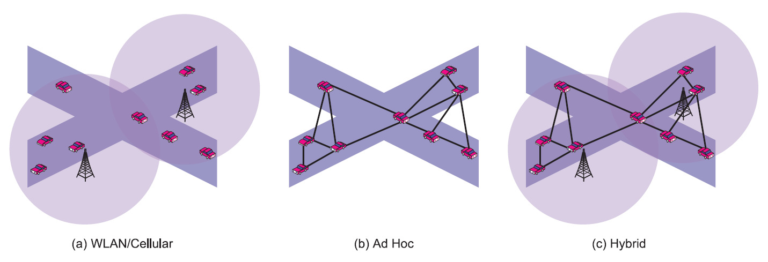
VANET Architectures
(a) Vehicular to Infrastructure (V2I)
(b) Vehicular to Vehicular (V2V)
(c) Hybrid of V2I and V2V

Slide 10
VANETs Characteristics
Highly dynamic topology
High speed of movement between vehicles results in topology change.
eg: Distance of two cars: 250m; Speed: 60 mph in opposite directions; Link will last only for 10 seconds.
Frequently disconnected network
The connectivity of the VANETs could be changed frequently.
One solution is to pre-deploy several relay nodes or AP along the road to keep the connectivity (V2I).
Sufficient energy and storage
The nodes have ample energy and power
Geographical type of communication
VANETs address geographical areas where packets need to be forwarded

Slide 11
VANETs Characteristics
Mobility modelling and predication
Mobility model and predication play an important role in VANETs protocol design.
Various communications environments
In highway traffic scenarios, the environment is simple and straightforward;
In city, direct communication is difficult because the streets are often separated by buildings, trees and other obstacles.
Hard delay constraints
Delay has to be considered;
eg: when brake event happens, the message should be transferred and arrived in a certain time to avoid car crash.
Interaction with on-board sensors
On-board sensors is to provide information which can be used to form communication links and for routing purposes.

Slide 12
Outline
1. Motivation and overview
2. Routing Protocols
Ad Hoc Routing
Position-Based Routing
Cluster-Based Routing
Broadcast Routing
Geocast Routing
3. Mobility Model
4. Summary

Slide 13
Ad Hoc Routing
AODV, PRAODV, PRAODVM
LAR

Slide 14
Routing: Ad Hoc Routing
A.k.a. Topology-based routing
Similarities with MANET:
not relying on fixed infrastructure; self-organization; self-management; low bandwidth and short radio transmission range.
AODV: Ad-hoc On-demand Distance Vector
DSR: Dynamic Source Routing
Differences from MANET:
Highly dynamic topology
AODV evaluation
PRAODV
PRAODVM
ZOR and LAR

Slide 15
Ad Hoc Routing
AODV (Ad-hoc On-demand Distance Vector) in VANET:
Unable to quickly find, maintain and update long routes in a VANET.
TCP is impossible because of the excessive lost of packets.
Even when the scalability is not a problem with path lengths of only a few hops, AODV still breaks very quickly due to the dynamic nature.
PRAODV and PRAODVM:
Prediction-based: predict the link lifetimes.
PRAODV builds a new alternate route before the end of the predicted lifetime, while AODV does it when route failure happens.
PRAODVM: select the max predicted lifetime instead of selecting the shortest path in AODV and PRAODV
Results: Slightly improvement and heavily depend on the accuracy of the prediction method.

Slide 16
Ad Hoc Routing
LAR (location-aided routing):
AODV is modified to only forward the route requests within the Zone of Relevance (ZOR).
ZOR can be rectangular or circular range determined by the application
For example: ZOR covers the region behind the accident on the side of highway where the accident happens.

Slide 17
Outline
1. Motivation and overview
2. Routing Protocols
Ad Hoc Routing
Position-Based Routing
Cluster-Based Routing
Broadcast Routing
Geocast Routing
3. Mobility Model
4. Application
5. Summary

Slide 18
Position-based Routing
GPSR
GSR
GPCR
A-STAR

Slide 19
Routing: Position-Based Routing
Node movement in VANETs is usually restricted in bidirectional movements
Obtaining geographical location information from street maps, GPS is feasible.
More promising routing paradigm for VANETs.

Slide 20
Position-Based Routing: GPSR
GPSR (Greedy Perimeter Stateless Routing)
Greedy routing always forwards the packet to the node that is geographically closest to the destination.
GPSR combines the greedy routing with face routing.
Using face routing to get out of the local minimum where greedy routing failed.
Suitable for free open space scenario with evenly distributed nodes.

Slide 21
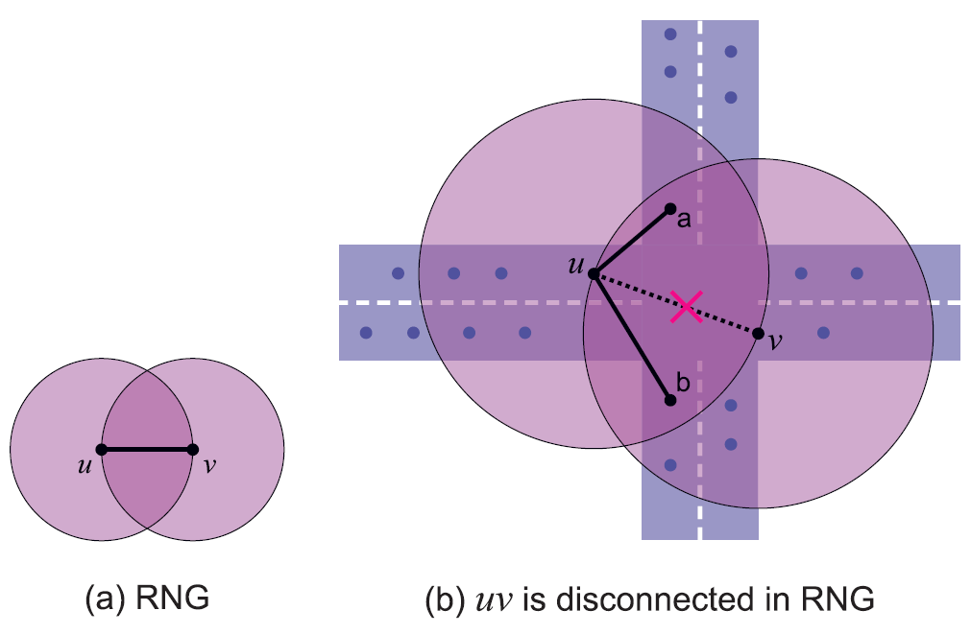
Position-Based Routing: GPSR
GPSR’s failure
a. The relative neighborhood graph (RNG) is a planar topology used by GPSR. A link uv will exist if the intersection of two circles centered at u and v does not contain any other nodes.
b. Link uv is removed by RNG since nodes a and b are inside the intersection of two circles centered at u and v. However, due to obstacles there is no direct link ua or ub. Thus the network is disconnected between u and v

Slide 22
Position-Based Routing: GSR
GSR (Geographic Source Routing) assumes the aid of a street map in city environments.
Use Reactive Location Service (RLS) to get the global knowledge of the city topology.
Given the above information, the sender determines the junctions that have be traversed by the packet using the Dijkstra’s shortest path algorithm.
Forwarding between junctions is then done by position-based fashion.

Slide 23
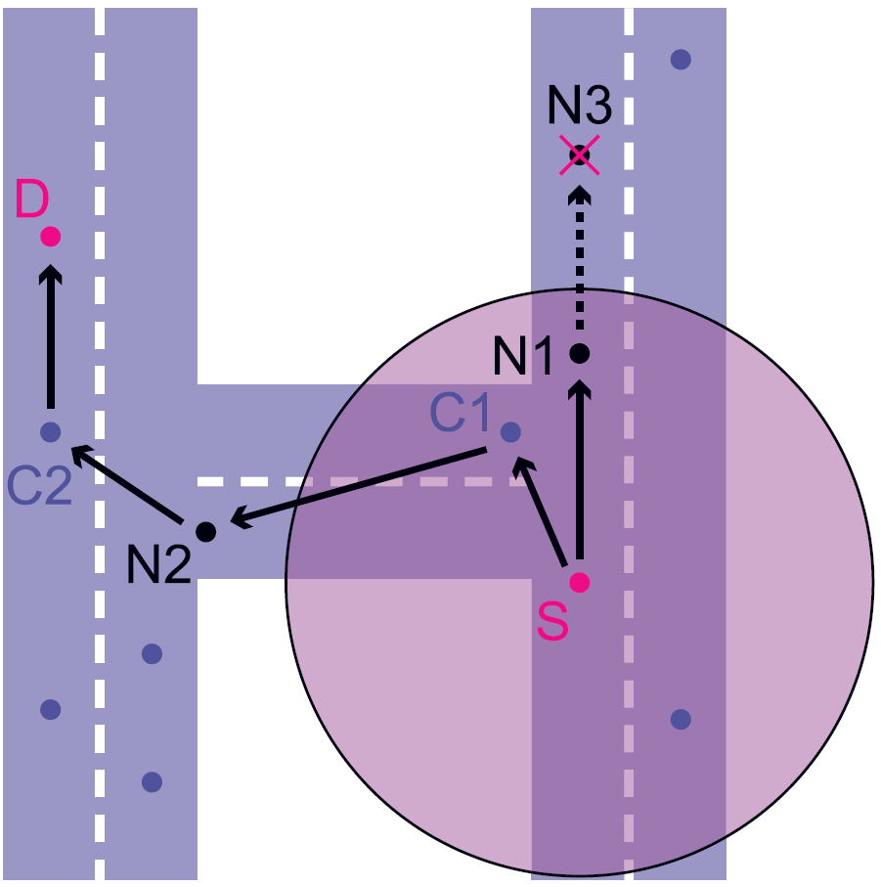
Position-Based Routing : GPCR
GPCR (Greedy Perimeter Coordinator Routing) does not use either source routing (DSR or GSR) or street map.
It utilizes the fact that the nodes at a junction follow a natural planar graph.
Thus a restricted greedy algorithm can be followed as long as the nodes are in a street.
Junctions are the only places where routing decisions are taken. Therefore packets should be forwarded on a junction rather than across the junction.
Restricted greedy routing
S wants to forward the packet to D.
For regular greedy forwarding, the packet will be forwarded to N1, then N3.
For greedy routing, the packet will be forwarded to C1, then N2,C2,D.

Slide 24
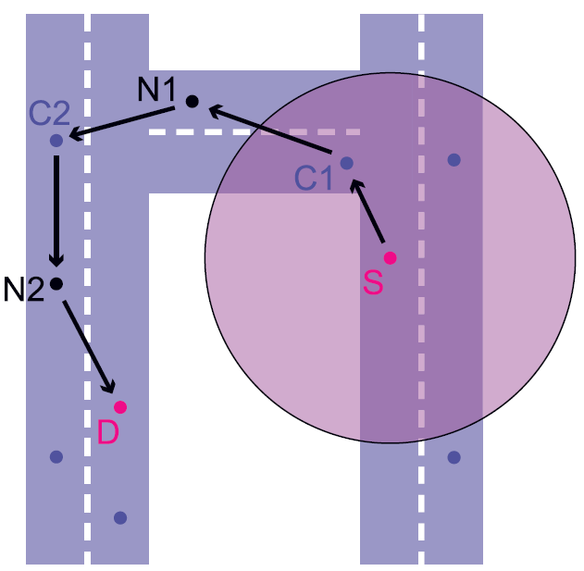
Position-Based Routing: GPCR
GPCR also uses a repair strategy to get out of the local minimum, i.e., no neighbor exists which is closer to the destination than the intermediate node itself.
1. decides, on each junction, which street the packet should follow next, by right hand rule.
2. applies greedy routing, in between junctions, to reach the next junction.
S is the local minimum since no other nodes is closer to the destination D than itself.
The packet is routed to C1, which chooses the street that is the next one counter-clock wise from the street the packet has arrived on.
The packet is forwarded to C2 through N1.
Then C2 forward the packet to N2. Now, the distance from N2 to D is closer than at the beginning of the repair strategy at Node S.
GPCR switches back to modified greedy routing.
GPCR has higher delivery rate than GPSR with large number of hops and slight increase in latency

Slide 25
Position-Based Routing : A-STAR
Challenge:
in a built-up city, vehicles are not evenly distributed;
the constrained mobility by the road patterns;
difficult signal reception due to radio obstacles such as high-rise buildings may lead VANETs unconnected.
A-STAR (Anchor-based Street and Traffic Aware Routing)
Use street map to compute the sequence of junctions (anchors) through which a packet must pass to reach the destination.
Unique:
Use statistically rated maps by counting the number of city bus routes on each street to identify anchor paths.
Or use Dynamically rated maps by monitoring the latest traffic condition to identify the best anchor paths.
The packet is salvaged by traversing the new anchor path. To prevent other packets from traversing through the same void area, the street is marked as out of service temporarily.
Results: A-STAR shows the best performance compared to GSR and GPSR with traffic awareness.

Slide 26
Outline
1. Motivation and overview
2. Routing Protocols
Ad Hoc Routing
Position-Based Routing
Cluster-Based Routing
Broadcast Routing
Geocast Routing
3. Mobility Model
4. Application
5. Summary

Slide 27
Cluster-based Routing
COIN
CORA_CBF

Slide 28
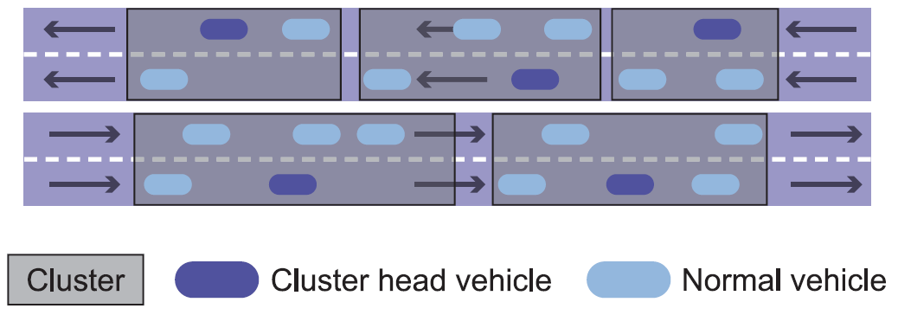
Routing: Cluster-Based Routing
A virtual network infrastructure must be created through the clustering of nodes.
Each cluster can have a cluster head, which is responsible for intra- and inter-cluster coordination in the network management function.
Nodes inside a cluster communicate via direct links.
Inter-cluster communication is performed via the cluster-heads.
Vehicles from multiple clusters in cluster-based routing

Slide 29
Cluster-Based Routing: COIN
Current MANETs clustering techniques are unstable in VANET because the clusters are too short-lived to provide scalability with low communications overhead.
COIN (Clustering for Open IVC Networks)
Cluster head election is based on vehicular dynamics and driver intentions, instead of ID or any classical clustering methods.
Accommodate the oscillatory nature of inter-vehicle distances.
Results:
COIN increases the average cluster lifetime by 192%;
reduces number of cluster membership changes by 46%.

Slide 30
Cluster-Based Routing: LORA_CBF
LORA_CBF Process:
Each node can be the cluster head, gateway or cluster member.
Each cluster has exactly one cluster-head.
If a node is connected to more than one cluster, it is called a gateway.
The cluster-head maintains information about its members and gateways.
If the destination is unavailable, the source will send out the location request (LREQ) packets.
It is similar to AODV, but only the cluster heads and gateways will disseminate the LREQ and LREP (Location Reply) messages.
Results: Network mobility and size affect the performance of AODV and DSR more significantly than LORA_CBF.

Slide 31
Cluster-Based Routing
Cluster-based routing protocols can achieve good scalability for large networks
But a significant hurdle for them in fast-changing VANET systems is a delay and overhead involved in forming and maintaining these clusters.

Slide 32
Outline
1. Motivation and overview
2. Routing Protocols
Ad Hoc Routing
Position-Based Routing
Cluster-Based Routing
Broadcast Routing
Geocast Routing
3. Mobility Model
4. Application
5. Summary

Slide 33
Broadcast Routing
Flooding
BROADCOMM
UMB
Others

Slide 34
Routing: Broadcast Routing
Broadcast is frequently used in VANET
Flooding is the simplest routing way by using broadcast.
Advantages:
Each node re-broadcasts messages to all of its neighbors except the one it got this message from.
Flooding guarantees the message will eventually reach all nodes.
Easy and suitable for small number of nodes.
Disadvantages:
When network increases, the performance drops quickly and the bandwidth requested increase exponentially.
Also cause contentions and collisions, broadcast storms.

Slide 35
Broadcast Routing: BROADCOMM
BROADCOMM:
The high way is divided into virtual cells, which moves as the vehicles move.
The nodes are organized into two level of hierarchy:
First level includes all the nodes in the same cell.
Second level included cell reflectors, which are nodes located closed to the geographical center of the cell.
Cell reflectors
can act as a temporary base station (cluster head) to handle the emergency messages coming from neighbor cells.
can also decides which message will be the first to be forwarded.
Limitation: Only works with simple highway networks.

Slide 36
Cluster Routing: UMB
UMB (Urban Multi-Hop Broadcast)
Designed to overcome interference, packet collisions and designed to overcome interference, packet collisions and hidden nodes problems.
In UMB:
The sender select the furthest node in the broadcast direction.
At the intersection, repeaters are installed to forward the packets to all road segment.
Results:
UMB has much higher success percentage at high packet loads and vehicle traffic densities than CSMA/CA.

Slide 37
Cluster Routing: Others
Vector-based TRAcking Detection(V-TRADE), History-enhanced V-TRADE (HV-TRADE) are GPS based message broadcasting protocols.
Based on position and movement information, they classify the neighbors into different forwarding groups.
For each group, only a small subset of vehicles (border vehicles) is selected to rebroadcast the message.
Significant improvement of bandwidth utilization with slightly loss of reachability as fewer vehicles will rebroadcast themessage.

Slide 38
Outline
1. Motivation and overview
2. Routing Protocols
Ad Hoc Routing
Position-Based Routing
Cluster-Based Routing
Broadcast Routing
Geocast Routing
3. Mobility Model
4. Application
5. Summary

Slide 39
Geocast Routing
Simple Geocast Routing
Cashed Geocast Routing
Abiding Geocast Routing

Slide 40
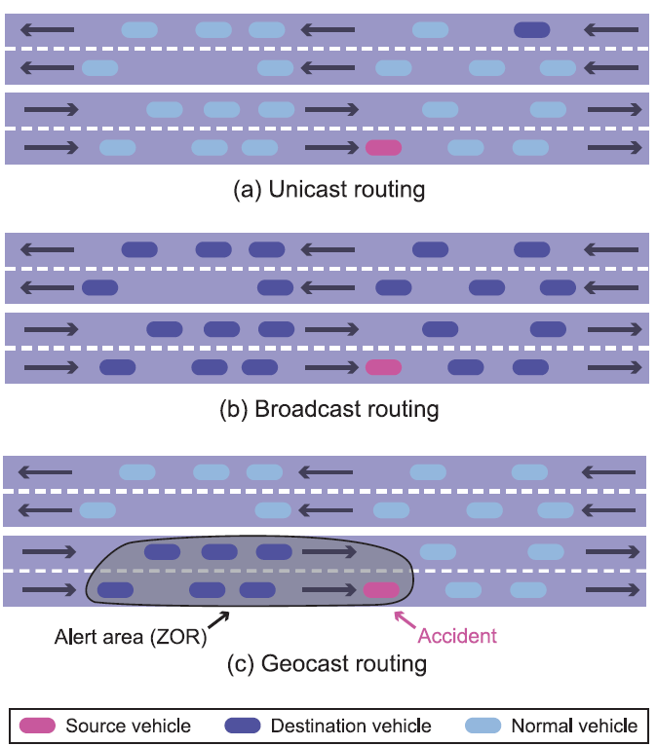
Routing: Geocast Routing
Objective: to deliver the packet from a source node to all other nodes with a specified geographical region (Zone of Relevance, ZOR).
Different Communication Scenarios:
Unicast routing
Broadcast routing
Geocast routing
Different Communication scenarios in VANETs

Slide 41
Geocast Routing
Simple geocast scheme to avoid collision and reduce rebroadcast:
When a node receives a packet, it does not rebroadcast it immediately but has to wait some time.
The further the distance between this node and the sender, the shorter the waiting time is.
Mainly nodes at the border of the reception area forward the packet quickly.
When the waiting time is over, if it does not receive the same message form another node then it will rebroadcast this message.
By this way, broadcast storm can be avoided.

Slide 42
Geocast Routing
Cashed Greedy Geocast:
to deal with high velocities in VANET.
Inside the ZOR, a small cache is added to the routing layer for holding packets that a node cannot forward instantly.
When a new neighbor comes or old neighbors left, the cashed message can be possible forwarded to the newly discovered node.
It chooses the closest node to destination instead of the node transmission range in the general greedy routing mode.
Results: can significantly improve the geocast delivery success ratio and significantly decrease network load and decreased end-to-end delivery delay.

Slide 43
Geocast Routing
Abiding Geocast
the packets need to delivered to all nodes that are sometime during the geocast lifetime inside the geocast destination region.
Solutions:
a server is used to store the geocast messages
an elected node inside the geocast region stores the messages
each node stores all geocast packets destined for its location and keeps the neighbor information.

Slide 44
Outline
1. Motivation and overview
2. Routing Protocols
Ad Hoc Routing
Position-Based Routing
Cluster-Based Routing
Broadcast Routing
Geocast Routing
3. Mobility Model
4. Application
5. Summary

Slide 45
Mobility Model
Realistic mobility models for VANETS need to be taken into account:
Street conditions
Urban conditions,
Traffic speed
Vehicle density
Obstacles such as buildings

Slide 46
Mobility Model: RWP
RWP (Random WayPoint Mobility) model
Nodes randomly choose a destination and continue to move toward that destination at a uniform speed.
When the destination is reached, another destination is chosen at random.
Widely used in NS-2.
Saha, Johnson model
Use TIGER (Topologically Integrated Geographic Encoding and Referencing) US road map, and convert the map into a graph.
Assume each node starts at some random point on a road segment and moves toward a random destination following shortest path algorithm with a speed uniformly distributed within 5mph above and below the speed limit.
STRAW model
Based on TIGER; Use a simple car-following model.
Consider the interaction among cars, traffic congestion and traffic controls.
New trend of building mobility model using the realistic vehicular trace data

Slide 47
Outline
1. Motivation and overview
2. Routing Protocols
Ad Hoc Routing
Position-Based Routing
Cluster-Based Routing
Broadcast Routing
Geocast Routing
3. Mobility Model
4. Application
5. Summary

Slide 48
Applications
Intelligent transportation applications
On-board navigation;
co-operative traffic monitoring;
control of traffic flows;
analysis of traffic congestion on the fly
detour routes computation based on traffic conditions and destination.
Comfort applications
allow the passenger to communicate either with other vehicles or with Internet hosts which improve passengers’ comfort.
Download music, etc.

Slide 49
Outline
1. Motivation and overview
2. Routing Protocols
Ad Hoc Routing
Position-Based Routing
Cluster-Based Routing
Broadcast Routing
Geocast Routing
3. Mobility Model
4. Application
5. Summary

Slide 50
Summary
Routing Protocols:
Ad Hoc Routing:
Position-Based Routing:
Cluster-Based Routing:
Broadcast Routing:
In general, position-based routing and geocasting are more promising because of the geographical constrains.
The performance of a routing protocol depends on mobility model, driving environment and vehicular density.
For certain VANETs application, we need to design specific routing protocol and mobility model to fulfill its requirements.

Slide 51
Thank You!

