Slide 1
Observations on the 4th International Conference on the Internet of Things (IoT)
Bob Kinicki
PEDS Seminar
October 13, 2014

Slide 2
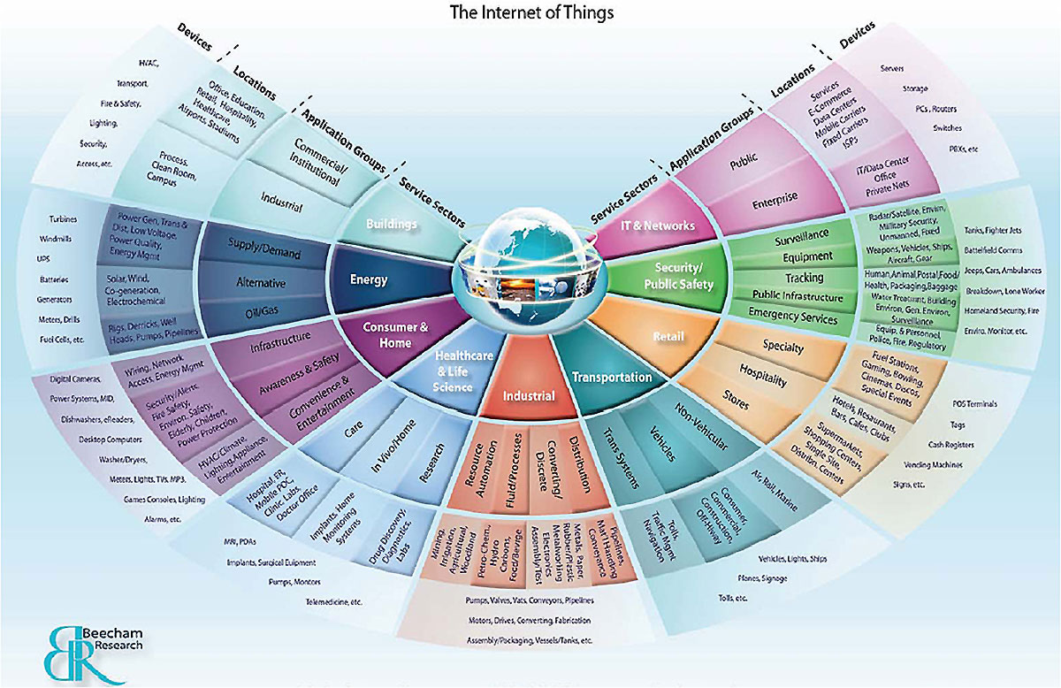
Internet of Things (IoT)

Slide 3
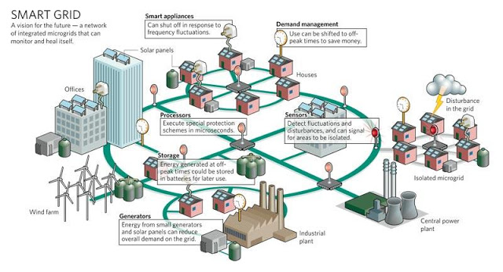
Smart Grid
LoCal Project

Slide 4
Enabling Technologies
Technologies needed:
RFID
Power for Sensors*
Mobile and Smart phones
Nanoscience and Miniaturization
Smart Objects (intelligence) and Robotics
M2M communication
Standardization* of communication, protocols, security
IPv6*, Zigbee
Others
Big Data and the Cloud
And now BAD GUY drones!!

Slide 5
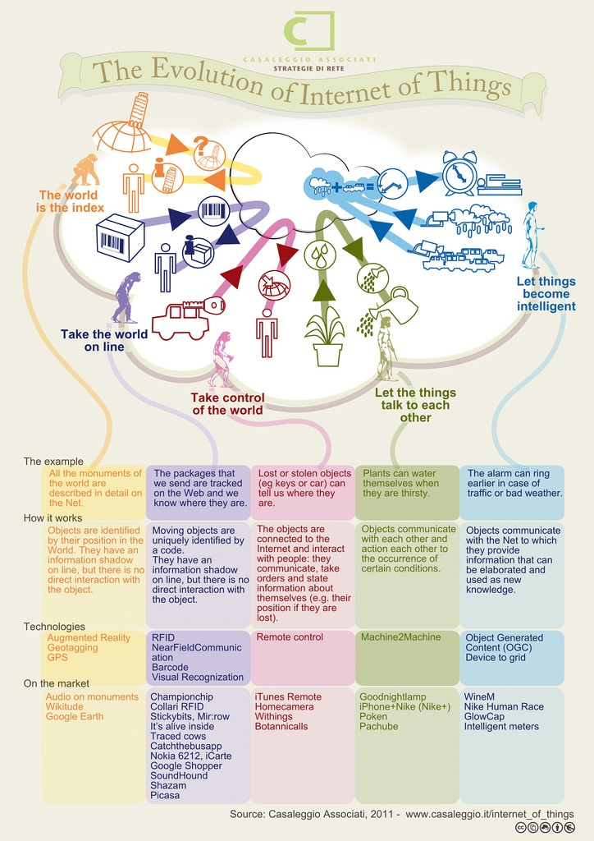

Slide 6
Californium Paper {page 10}
Author: Matthias Kovatsch ETH
A systems architecture redesign for scalable IoT cloud services based on CoAP.
Multi-Core server to provide ‘Cloud’ services
Centralized exchange management
Independent concurrency model on multi-cores.

Slide 7
Californium Paper
Showed that CoAP’s low overhead had significant advantage over HTTP in the IoT service backend.
64 times higher throughput!!
Used a benchmark with many small but numerous messages.

Slide 8
Relevance and Impact of IPv6 multicasting on WSANs based on 6LoWPAN in RESTful Environments
Author: Markus Jung Vienna
WSANs – Wireless Sensor and Actuator Networks essential role in IoT.
developed group communication mechanism (multicasting) for a Web service stack based on IPv6, CoAP and oBIX object representation on Contiki.

Slide 9
Relevance and Impact of IPv6 multicasting on WSANs based on 6LoWPAN in RESTful Environments
6LoWPAN choices include RPL and MPL and SMRF.
Idea:: is a shared network concept using a form of customized controlled flooding by using 6LoWPAN sequence numbers.
Used COOJA simulator to evaluate.
Created decentralized control logic and show low latency interaction.

Slide 10
Demo Session I Talks page 20
4th International Conference
on the Internet of Things

Slide 11
Demo Talks
“Heart Sense” India
Heart rate variability
Respiration rate estimation
Blood pressure estimation
“Snap Sense” Dublin
a modular sensor platform
How can we make it easy

Slide 12
Demo Talks
“Appliance Recognition on Internet-of-Things Devices” Paris & Fribourg
demo is coffee machine
Machine learning in sensor networks
Likelihoods in ML
BR (border router issues)
A single point of failure
Congestion
Attack point

Slide 13
Demo Talks
“Appliance Recognition on Internet-of-Things Devices” Paris & Fribourg
replace BR by ‘virtual sensor’
Their system recognizes devices (e.g. coffemaker or TV) and tries to determine its impact (percentage) of the electric bill

Slide 14
Demo Talks
“GS1 code based Web of Things Service Architecture with Healthcare Scenario” Korea
Compared Bluetooth versus 802.15.4 with IPv6 and CoAP server
Interacted with Cloud

Slide 15
Demo Talks
“CANthings: Context Aware Networks …” Toronto
Idea:: There are now too many apps on a smartphone.
Use component aggregations
And context aggregations
Uses a Zone concept with virtual user space.

Slide 16
Demo Talks
“DasData” Romania
Connect and store data with an API that is based on CoAP/SOAP
Then visualize
Then share using JSON/RSS.

Slide 17
Demo Talks
“IoTified Platform for Constructing IPv6-based Embedded Web of Things Systems” Cairo
Diagram showing Internet (Web) with HTPP/XMPP going through a gateway to WSN running CoAP, 802.15.4 with optimized neighbor discovery.
Light weight service discovery
Pull Model and Push Model with multicast service announcements
Demo:: AC Control using infrared
and light control

Slide 18
Demo Talks
“Solar-Powered Password Theft
Author: sophomore from George Washington Univresity
an amazing, scary talk about how to steal anything from your wireless device while in Starbucks!! with mobile device hidden in your backpack.

Slide 19
Wednesday IoT Architecture {page 12}
“IOT Interoperability: A Hub-based Approach Author: Michael Blackstone UBC
A Hub for “Smart Streets”
64000 sensor feeds
Hyper Cat needs ontology
Lessons:: minimal interoperability and the need for sensor meta data
Cloud-hosted web-based hubs
Are Hub-to-Hub communications different?
Scalability requires federated Hubs.

Slide 20
Wednesday IoT Architecture {page 12}
“Game Theoretic Secure Localization in WSNs” Berkeley
Sensors cannot afford GPSs
Use anchor nodes which have GPS
Problem: compromised anchor nodes
boring with lots of math formulas
– I switched to RFID talk.

Slide 21
Wednesday IoT Device {page 11}
“Near-Field RFID Tag Antenna Based Sensing: …” NEC Japan
Factors disturbing far-field communications:
non-line of sight
Multipath interference – both decrease RSSI
Good photos of apps:
foot recognition at airports?
Detecting emptying holes in plastic bottle shelf

Slide 22
Workshop on Privacy, Trust and IoT {page 17}
“RIPPLE: Scaled Medical Telemetry ..Combat Rescue”
EMT responders
Sensor-based data for first responders
Google glass,tablet and collaborative interface
“Model-Based … Time-Critical Decision Making” Wright State University
Battle field scenario with mobile devices
LVC – Live Virtual & Constructive sensor integration for data fusion

Slide 23
Workshop on Web of Things {page 18}
KeyNote :: Florian Michahelles
Idea:: Put more smart things in the process and then let them interact locally if possible.
WoT sensor example:
Make decision locally with domain knowledge
Pump,Pressure, Flow Temp
The opposite of Big Data!!
Need to bring together heavy-loaded ontologies and embedded systems.
Big Goal – semantics for a unified language.

Slide 24
Workshop on Web of Things
“Scalable Cloud Storage for Sensor Networks” Author: Gerome Bovet ParisTech
* Best Paper Award
Autonomous and self-sufficient networks with local “cloud-like storage”
Smart Building design:
Cost of communication motivates independent Zones
SCs( Storage Coordinators):
Manage a Zone; RESTful interface with CoAP and multicast
SPs (Storage Peers):
Small databases; RESTful interface with CoAP; assemble the data and peers use multicast.

Slide 25
Workshop on Web of Things
“Scalable Cloud Storage for Sensor Networks”
CoAP improvements:
Dynamically create multicast endpoints
Activate observations
Send notifications to multicast addresses
Accomplished how?
Combine observations with group communications

Slide 26
Workshop on Web of Things
“Bet and Energy – From Load Forecasting to Demand Response in a Web of Things”
Author: Till Riedel Karlsrube
Idea:: It’s about the price. Saving money is a motivator. Dynamic pricing for household energy usage. Treat it like a game and bet on your ability to conserve energy. Competition is another human motivator.
They link a mobile game with energy and monetary rewards.
Data collection via a REST API.

Slide 27
Conference Takeaways
America is far behind the rest of the world in IoT and WoT.
CoAP and REST are here to stay.
Getting multicast right in WSNs is important.
Keep data and decisions close to the sensors for scalability. {Anti Big Data}
The security issues loom yet early IoT implementation ignores it due to energy issues!!!

Slide 28
Questions?
Thanks!

