Slide 1
A Few Random IoT Thoughts
PEDS Seminar
November 23, 2015

Slide 2
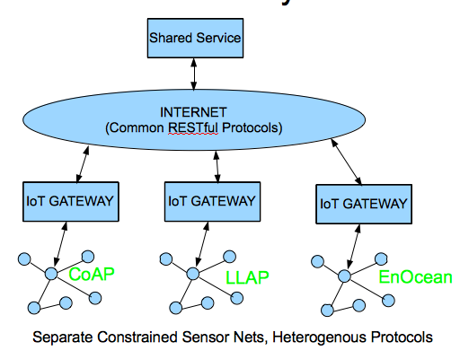
Data Location Viewpoints
Cloud
Real time
deadlines

Slide 3
Operating System Battle
TinyOS
Contiki
RIOT
Google’s Brillo

Slide 4
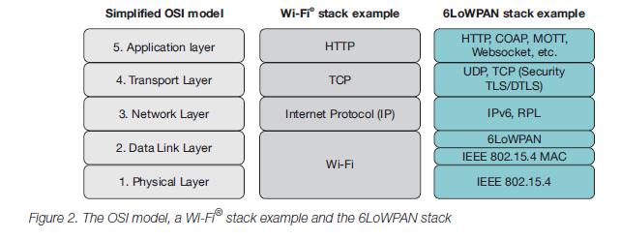
µIP stack
Important Puzzle Pieces: *6 LoWPAN, RPL, DTLS and CoAP vs MQTT
RPL uses Trickle

Slide 5
The Emergence of a Networking Primitive in Wireless Sensor Networks P. Levis, E. Brewer, D. Culler, D. Gay, S. Madden, N. Patel, J. Polastre, S. Shenker, R. Szewczyk and A. Woo CACM Volume 51, Number 7
Presenter - Bob Kinicki
PEDS Seminar
November 23, 2015

Slide 6
Outline
Introduction
WSN
WSN Protocols
Dissemination Protocols
Collection Protocols
Trickle Algorithm
Maté Case Study
Trickle Discussion
Conclusions

Slide 7
Introduction
Sensors are normally on a mote platform with a low-power CMOS radio.
Mote constraints include:
Power supply
Limited memory (a few kilobytes of RAM)
Unattended operation
Lossy and transient wireless communications
WSNs (a collection of motes) are typically embedded in physical environment associated with their application.

Slide 8
Wireless Sensor Networks
Physical device location often dictated by application and physical constraints.
Any retransmission, response or ACK contributes to contention, interference and loss.
Redundancy is essential to reliability!
The variety of WSN topologies and densities calls for a polite, density-aware, local retransmission policy.

Slide 9
Networking Protocols
Network protocols focus on minimizing transmissions and providing reliability (namely, making sure transmitted packets arrive successfully).
Most sensor networks rely on two multi-hop protocols:
a collection protocol for pulling data out of a network.
A dissemination protocol for pushing data into a network.

Slide 10
Dissemination
WSN administrators need to adjust how the network collects data by changing the sampled sensors, the sampling rate or the code running on the nodes.
Administrator needs to disseminate these changes to every node in the network.

Slide 11
Dissemination
Early systems used flooding to disseminate.
Flooding can be unreliable and many, concurrent packet broadcasts yield a broadcast storm.
Adaptive flooding uses an estimate of node density to limit the flooding rate.
Getting this to work across network densities is tricky!

Slide 12
Dissemination Protocols
Another view – dissemination protocols ensure every node eventually has a consistent version of a shared state.
Casting dissemination as a data consistency problem means it does not provide full reliability.
Eventual consistency only implies delivery of the most recent version to connected nodes.

Slide 13
Dissemination Protocols
An effective dissemination protocol needs to bring nodes up to date quickly while sending few packets when every node has the most recent version.
Hence, this is a requirement for the underlying consistency mechanism.

Slide 14
Collection Protocols
WSNs report observations on a remote environment and thereby need a collection protocol.
Collection protocols provide unreliable datagram delivery to a collection point using a minimum-cost routing tree.
Typically cost measured in ETX (expected number of transmissions) which is related to packet delivery rate.
Nodes send packets on the route that requires the fewest transmissions to reach a collection point.

Slide 15
Collection Protocols
An early collection protocol, directed diffusion, used collection trees based on data-specific node requests.
Experiences with low-power wireless networks moved strategies towards a simpler approach where each node decides on a single next hop for all forwarded traffic.
→ creating routing trees to fixed collection points.
Tree built using a routing cost gradient.
Collection point has a cost of 0.

Slide 16
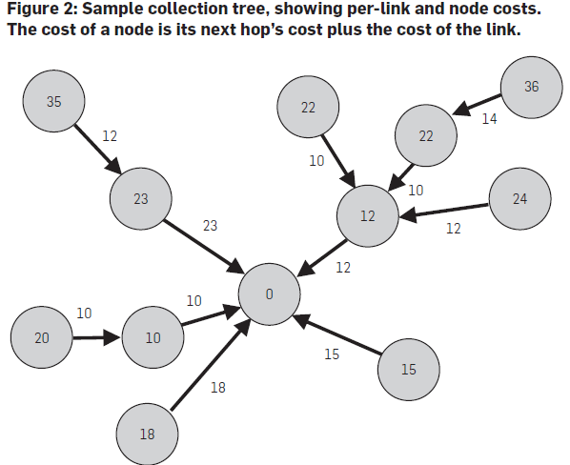
Figure 2: Collection Tree

Slide 17
Collection Protocols
Collection variation includes:
How to quantify and calculate link costs.
The number of links in the tree.
How link state changes are propagated.
How frequently to re-evaluate link costs and switch parents.

Slide 18
Collection Protocols
Early collection protocols used link costs.
Second generation (similar to AODV and DSDV) used periodic broadcasts to estimate transmissions per delivery.
Third generation added physical layer quality data.
Current generation (e.g., Collection Tree Protocol (CTP)) gets information from multiple layers.

Slide 19
Collection Protocols
Newer protocols reduce control traffic to increase efficiency.
However, they need to send link-layer broadcasts to their local neighbors to advertise their presence and routing cost.
Transmission frequency of routing advertisements causes design tension.
Protocols reduce this tension by converting routing gradient to a data consistency problem.

Slide 20
Data Consistency Mechanism
To address both dissemination and collection protocols as a problem of maintaining data consistency, the data consistency requirements are:
Resolve inconsistencies quickly.
Send few packet when data is consistent.
Require very little state.
Trickle meets these three requirements.

Slide 21
Trickle
Trickle algorithm establishes a density-aware local broadcast with an underlying consistency model that guides when a node communicates.
The algorithm controls the send rate such that each node hears a trickle of packets (enough to stay consistent).
Trickle relies only on local broadcasts and its basic mechanism is a randomized suppressive broadcast.

Slide 22
Trickle Algorithm [Bjamaa 15]
Trickle variables:
c consistency counter
I Trickle interval
t transmission time
Trickle configuration parameters:
Imin minimum interval size (time units)
Imax determines maximum interval size as: Imin x 2^{Imax}
k redundancy constant

Slide 23
Trickle Algorithm
0. Initialization:
I ← random value in range [Imin, Imin x 2^{Imax}];
1. c ← 0;
Pick t uniformly at random from range [I/2, I];
start timer;
{anytime during interval, if node hears a consistent message increment c;}
2. Once timer reaches t
iff c < k node transmits message; suppression possible!
3. When I expires, double interval length until I reaches Imin x 2^{Imax}; go to 1.
{anytime during interval, if node hears an inconsistent message and if I > Imin then (I ← Imin ; go to 1) }

Slide 24
Message Suppression
Listen-only period addresses short-listen problem.
When c > k , state is consistent and other transmissions are suppressed.

Slide 25
Short-listen Problem
Short-listen comes from non-synchronized intervals among neighbors.
N2 and N3 in (b) suffer from short-listen problem.
(c) shows listen-only impact.

Slide 26
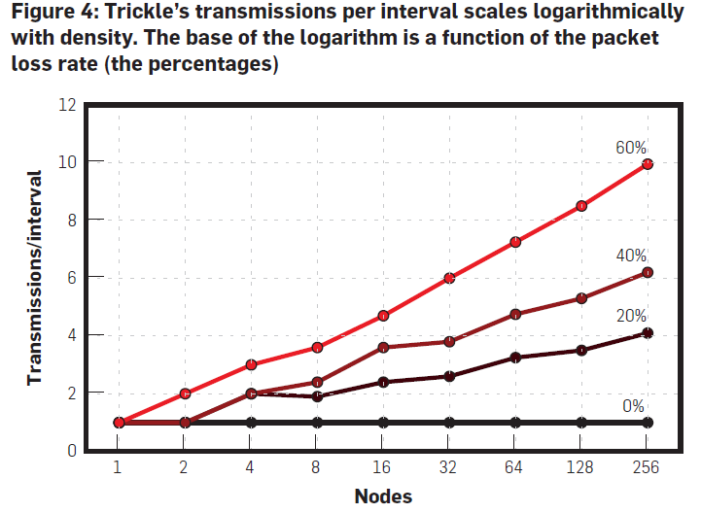
Figure 4: Transmissions vs Nodes
These graphs assume
nodes are synchronized.

Slide 27
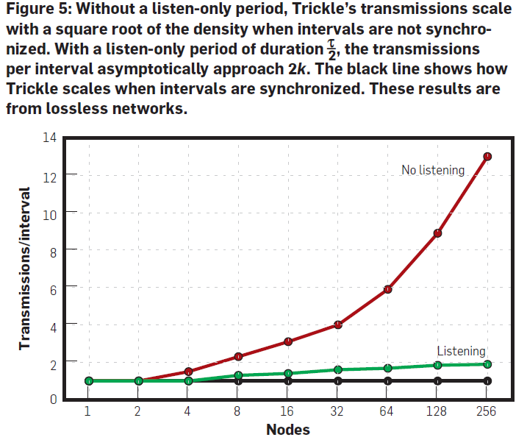
Figure 5: Listen-only Effect

Slide 28
Maté Case Study
Maté :: a lightweight, bytecode interpreter for WSNs.
Maté uses Trickle as a propagation service to periodically broadcast version summaries.
30-byte code fits into one frame.
Consistency mechanism – broadcast missing routines 1,3 and 7 seconds after hearing there is an inconsistency.
Trickle resources are small (70 bytes RAM, 11 bytes counters, 1.8K executable).

Slide 29
TOSSIM Simulation Details
TOSSIM, a TinyOS simulator, models wireless connectivity at the bit level and wireless loss.
Node density modeled via spacing between nodes (5 to 20 ft. in 5 ft. increments).
Imin = 1 second;
Imin x 2^{Imax} = 1 minute;
400 sensor nodes “regularly spaced” in a 20 x 20 grid (note - graph shows distances between a 19 x 19).

Slide 30
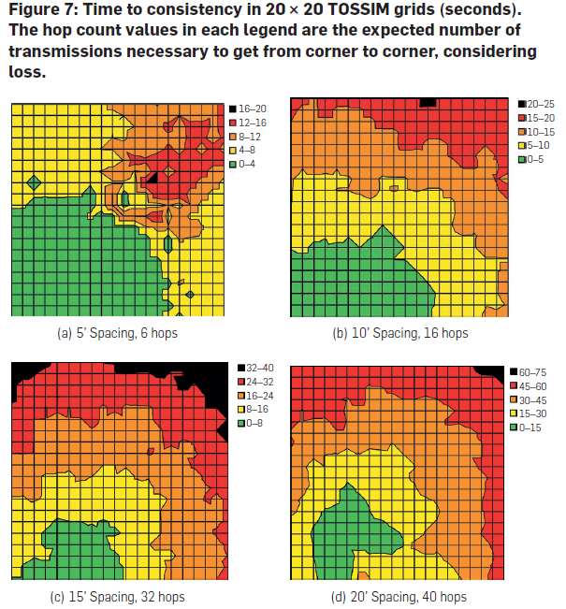
Figure 7: Time to Consistency
Crossing the network takes from 6 to 40 hops.
Time to complete propagation varied from 16 sec (dense network) to 70 sec (sparce network).
Minimum per hop delay is Imin/2 with 1 sec broadcast time → best case delay is 1.5 sec/hop.
Claim: graphs show nodes cooperate efficiently.

Slide 31
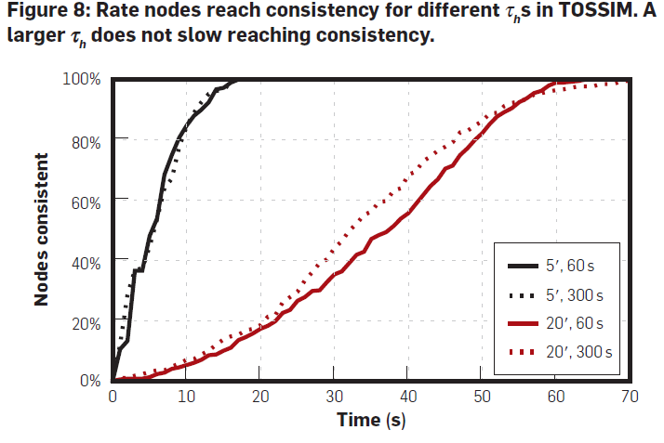
Figure 8: Consistency Rate

Slide 32
Uses and Improvements
Trickle used in many dissemination protocols today (e.g., Deluge, MNP, Drip and Tenet).
More efficient collection protocols also using Trickle for consistency (e.g., TinyOS, 6LoWPAN IPv6 routing tables and ICMP neighbor lists).
Drawback – Trickle maintenance costs grow O (n) with number of data items.

Slide 33
Trickle Discussion
WSNs do not know interconnection topology apriori. This topology is not static (even when nodes are NOT mobile).
Redundancy both helps and hurts!
Trickle’s design comes from two areas:
Controlled, density-aware flooding algorithms from wireless and multicast networks
Epidemic and gossip algorithms for maintaining data consistency in distributed systems.

Slide 34
Trickle Discussion
Trickle adapts to local network density like controlled flooding, but continually maintains consistency in a manner similar to epidemic algorithms.
Trickle uses broadcast nature of wireless channel to conserve energy.
Trickle’s exponential times work in reverse of standard backoff. Namely, it defaults to largest time window and decreases only for inconsistency.

Slide 35
Trickle Discussion (cont)
Trickle leads to energy-efficient, density-aware dissemination by avoiding collisions and suppressing unnecessary retransmissions.
Trickle suppresses implicitly through nearby nodes that hear a broadcast.

Slide 36
Conclusions
Two authors also authored original Trickle RFC (author list is impressive).
Paper puts Trickle into a WSN routing context and does not just define Trickle.
Trickle algorithm explanation is not concise.
Discussed well the tension in performance associated with run time choices.
Paper shows basic performance trends and Maté case study.

Slide 37
References
[Djamaa 2015] Djamaa, B. and Richardson, M. The Trickle Algorithm: Issues and Solutions. Cranfield Univesity Reseach Report. January 2015.

