Slide 1
Local Area Networks
Aloha
Slotted Aloha
CSMA (non-persistent, 1-persistent,
p-persistent)
CSMA/CD
Ethernet
Token Ring

Slide 2
Network Layer
Network Layer
LLC
802.2 Logical Link Control
Data Link
Layer
802.3
CSMA-CD
802.5
Token Ring
802.11
Wireless
LAN
Other
LANs
MAC
Physical
Layer
Physical
Layer
Various Physical Layers
Copyright ©2000 The McGraw Hill Companies
IEEE 802
OSI
Figure 6.11

Slide 3
Ethernet

Slide 4
Ethernet [DEC, Intel, Xerox]
1-persistent, CSMA-CD with Binary Exponential Backoff.
Manchester encoding.

Slide 5
Ethernet [operational in 1974]
Initially 3 Mbps baseband coaxial cable (thick Ethernet).
Operational Description
Ethernet stations sense the channel.
When the channel is free, the station transmits a frame.
The stations monitor the ‘ether’ during the transmission.
If a collision is detected by any station, the transmission is terminated immediately and a jam signal is sent.
Upon collision, transmitting stations backoff using a local counter and then retransmit.

Slide 6
Collision Detection [worst case]
A begins to
transmit at
t=0
A
B
B begins to
transmit at
t= t_{prop}-δ;
B detects
collision at
t= t_{prop}
A
B
A
B
A detects
collision at
t= 2 t_{prop}-δ
It takes 2 t_{prop} to find out if channel has been captured
Copyright ©2000 The McGraw Hill Companies
Leon-Garcia & Widjaja: Communication Networks
Figure 6.22

Slide 7
Ethernet
frame
contention
frame
Figure 6.23
A frame seizes the channel after 2 t_{prop}
On 1 km Ethernet, t_{prop} is approximately 5 microseconds.
Contention interval = 2 t_{prop}
Interframe gap = 9.6 microseconds
Modeled as slotted scheme with slot = 2 t_{prop}

Slide 8
Binary Exponental Backoff
Upon a collision, the sending stations increment a local counter K. The backoff interval is randomly selected using a uniform distribution over the L = 2^{K} slots.
K is initially set to 0.
Thus upon collision, the value of L is doubled locally for each sending station.

Slide 9
Binary Exponential Backoff (BEB)
Slotted ALOHA has been shown to be unstable when
p > 1/n
Since Ethernet permits up to 1024 stations, backoff continues until K = 10, L = 2¹⁰, and p = 1/2¹⁰
Normally K is incremented up to 10, but BEB is set for 16 retries. After 16 retries, MAC gives up trying to send the frame.
{The IP packet is now considered lost}.

Slide 10
802.3 MAC Frame
7
1
2 or 6
2 or 6
2
4
Preamble
Destination
Address
Source
Address
Length
Information
Pad
FCS
SD
Synch
Start
frame
64 to 1518 bytes
0
Single address
Destination address is either single address
or group address (broadcast = 111...111)
Addresses are defined on local or universal basis
2⁴⁶ possible global addresses
1
Group address
0
Local address
1
Global address
Copyright ©2000 The McGraw Hill Companies
Leon-Garcia & Widjaja: Communication Networks
Figure 6.52

Slide 11
Ethernet Frame
7
1
2 or 6
2 or 6
2
4
Preamble
Destination
Address
Source
Address
Type
Information
Pad
FCS
SD
Synch
Start
frame
64 to 1518 bytes
Copyright ©2000 The McGraw Hill Companies
Leon-Garcia & Widjaja: Communication Networks
Figure 6.53

Slide 12
Copyright ©2000 The McGraw Hill Companies
Figure 6.54
ORG
Type
3
2
SNAP PDU
SNAP Header
Information
LLC PDU
AA AA 03
1
1
1
802.3 Frame
MAC Header
FCS

Slide 13
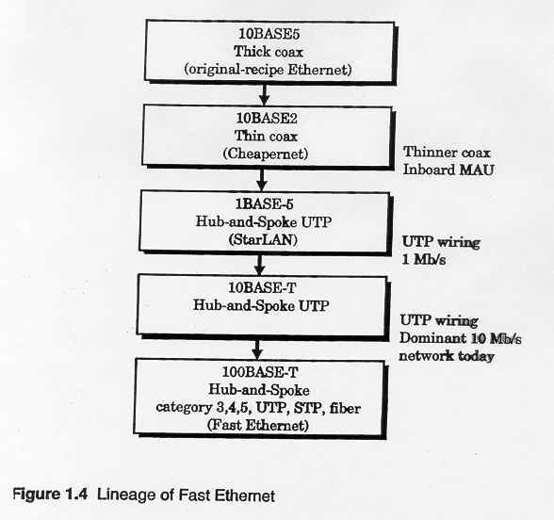

Slide 14
Ethernet Evolution
10BASE5 {1983}
10 Mbps
500 meter segment length
Signal-regenerating repeaters
Thick Coax
  Advantages: Low attenuation, excellent noise immunity, superior mechanical strength
  Disadvantages: Bulky, difficult to pull, transceiver boxes too expensive
Wiring represented a significant part of total installed cost.

Slide 15
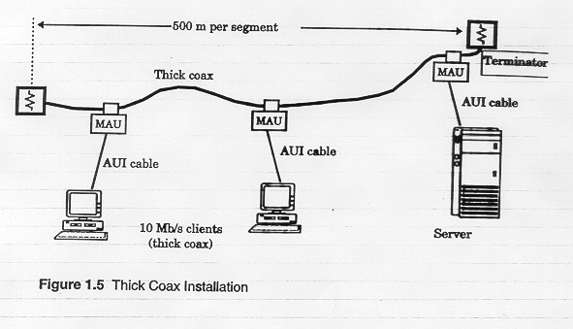
MAU device is physically hooked on main cable.
50 meter AUI cable from MAU to station.

Slide 16
Ethernet Evolution
10BASE2 Cheapernet {1985}
10 Mbps
185 meter segment length
Signal-regenerating repeaters
Transceiver was integrated onto the adapter
Thin Coax (coax thinner and lighter)
  Advantages: Easier to install, reduced hardware cost, BNC connectors widely deployed ➔ lower installation costs.
  Disadvantages: Attenuation not as good, could not support as many stations due to signal reflection caused by BNC Tee Connector.

Slide 17
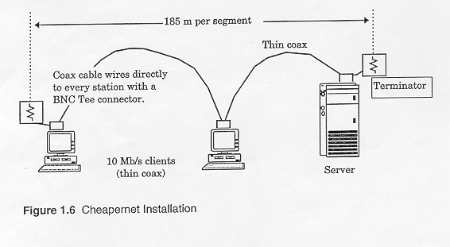

Slide 18
Thick Ethernet Cable
(a)
transceivers
(b)
Thin Ethernet Cable
Figure 6.55

Slide 19
Ethernet Evolution
1BASE5 StarLAN {1987}
1 Mbps
250 meter segment length
Signal-regenerating repeaters
Transceiver integrated onto the adapter
Hub-and-Spoke topology (star topology)
Two pairs of unshielded twisted pair
  Advantages: Since four or more UTP are ubiquitous in buildings, it is easier to use installed wiring in the walls. Telephone wiring is hierarchical ➔ can use wiring closets.

Slide 20
Ethernet Evolution
10BASET {1990} **Most popular
10 Mbps
100 meter segment length
Signal-regenerating repeaters
Transceiver integrated onto adapter
Two pairs of UTP
Hub-and-spoke topology {Hub in the closet}
  Advantages: could be done without pulling new wires. Each hub amplifies and restores incoming signal.

Slide 21
The Hub Concept
Separate transmit and receive pair of wires.
The repeater in the hub retransmits the signal received from any input pair onto ALL output pairs.
Essentially the hub emulates a broadcast channel with collisions detected by receiving nodes.

Slide 22
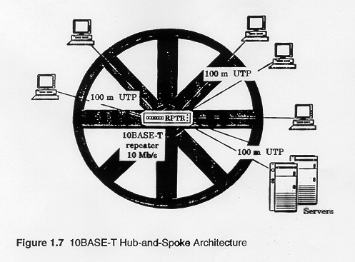

Slide 23
Twisted Pair Ethernet
(a)
hub
Single collision domain
●     
switch
High-Speed Backplane or Interconnection fabric
(b)
●   
Copyright ©2000 The McGraw Hill Companies
Figure 6.56

Slide 24
Switched Ethernet
Basic idea: improve on the Hub concept
The switch learns destination locations by remembering the ports of the associated source address in a table.
The switch may not have to broadcast to all output ports. It may be able to send the frame only to the destination port.
➔ a big performance advantage over a hub, if more than one frame transfer can go through the switch concurrently.

Slide 25
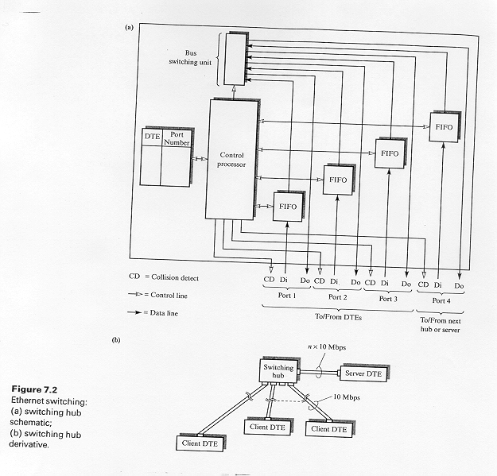

Slide 26
Switched Ethernet
The advantage comes when the switched Ethernet backplane is able to repeat more than one frame in parallel (a separate backplane bus line for each node).
  The frame is relayed onto the required output port via the port’s own backplane bus line.
Under this scheme collisions are still possible when two concurrently arriving frames are destined for the same station.
Note – each parallel transmission can take place at 10Mbps!!

Slide 27
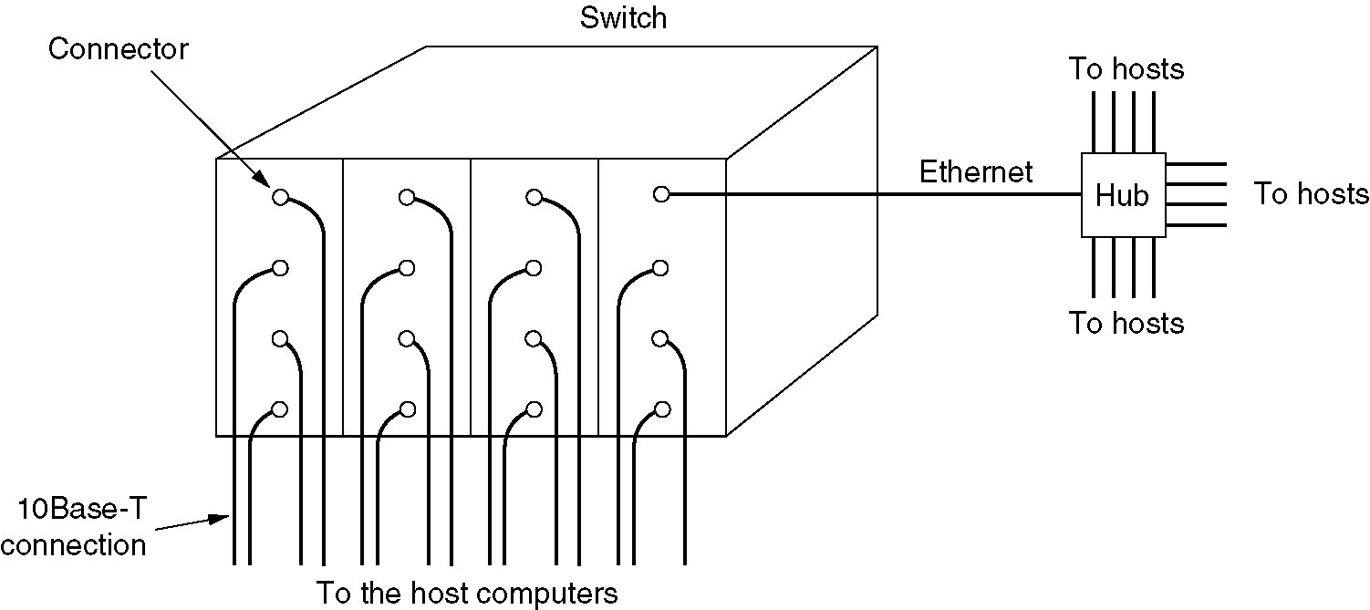
Switched Ethernet
Note: Tanenbaum’s discussion
considers a more powerful switch
that reduces collisions even
further!!
Figure 4-20.A simple example of switched Ethernet.

Slide 28
Switched Ethernet Hub
Since servers are often shared by multiple nodes, one can employ a switching hub with a port which operates at a higher rate than the other ports.
This requires extra buffering inside the hub to handle speed mismatches.
Can be further enhanced by higher rated port full-duplex.

Slide 29
Fast Ethernet
Switch
Ethernet Switch
Server
100 Mbps links
Ethernet Switch
10 Mbps links
Copyright ©2000 The McGraw Hill Companies
Leon-Garcia & Widjaja: Communication Networks
Figure 6.57

