Slide 1
Data Link Layer as a Reliable Data Transport Protocol
Computer Networks
Term B14

Slide 2
Data Link Layer Outline
Parallelism between Transport and Data Link Layer
Tanenbaum’s Treatment/Model of Data Link Layer
Protocol 1: Utopia
Protocol 2: Stop-and-Wait
Protocol 3: Positive Acknowledgment with Retransmission [PAR]
Old ‘flawed version
Newer version

Slide 3
DL Layer Outline (cont)
Pipelining and Sliding Windows
Protocol 4: One Bit Sliding Window
Protocol 5: Go Back N
Protocol 6: Selective Repeat
Further Details and Decisions

Slide 4
Reliable Protocols at Two Layers
ACK/NAK
Transport Layer
End to End
1
2
3
4
5
Data
Data
Data
Data
Leon-Garcia & Widjaja:
Communication Networks
Hop by Hop
Data Link Layer
Data
Data
Data
Data
1
2
3
4
5
ACK/NAK
ACK/NAK
ACK/NAK
ACK/NAK

Slide 5
Tanenbaum’s DL Layer Treatment
Concerned with communication between two adjacent nodes in the subnet (node to node).
Assumptions:
The bits are delivered in the order sent.
A rigid interface between the HOST and the node ➔ the communications policy and the Host protocol (with OS effects) can evolve separately.
He uses a simplified model.

Slide 6
Tanenbaum’s ‘Simplified Model
Host
A
Layer 4
Host
B
Layer 2
Node
1
Node
2
frame
Tanenbaum’s Data Link Layer Model
Assume the sending Host has infinite supply of messages.
A node constructs a frame from a single packet message.
The CRC is automatically appended in the hardware.
The protocols are developed in increasing complexity to help
students understand the data link layer issues.

Slide 7
Basic Elements of ARQ
Information
frames
Error-free
packet
sequence
Packet
sequence
Transmitter
Receiver
Station A
Control frames
Station B
CRC
CRC
Header
Information
packet
Header
Control frame
Information Frame
Leon-Garcia & Widjaja:
Communication Networks

Slide 8
Tanenbaum’s Protocol Definitions
Continued →
Figure 3-9. Some definitions needed in the protocols to follow. These are located in the file protocol.h.

Slide 9
Protocol Definitions (continued)
Figure 3-9. Some definitions needed in the protocols to follow. These are located in the file protocol.h.

Slide 10
Packet and Frame Definitions
packet
network layer
buffer
frame
info
ack
seq
kind
data link layer
physical layer

Slide 11
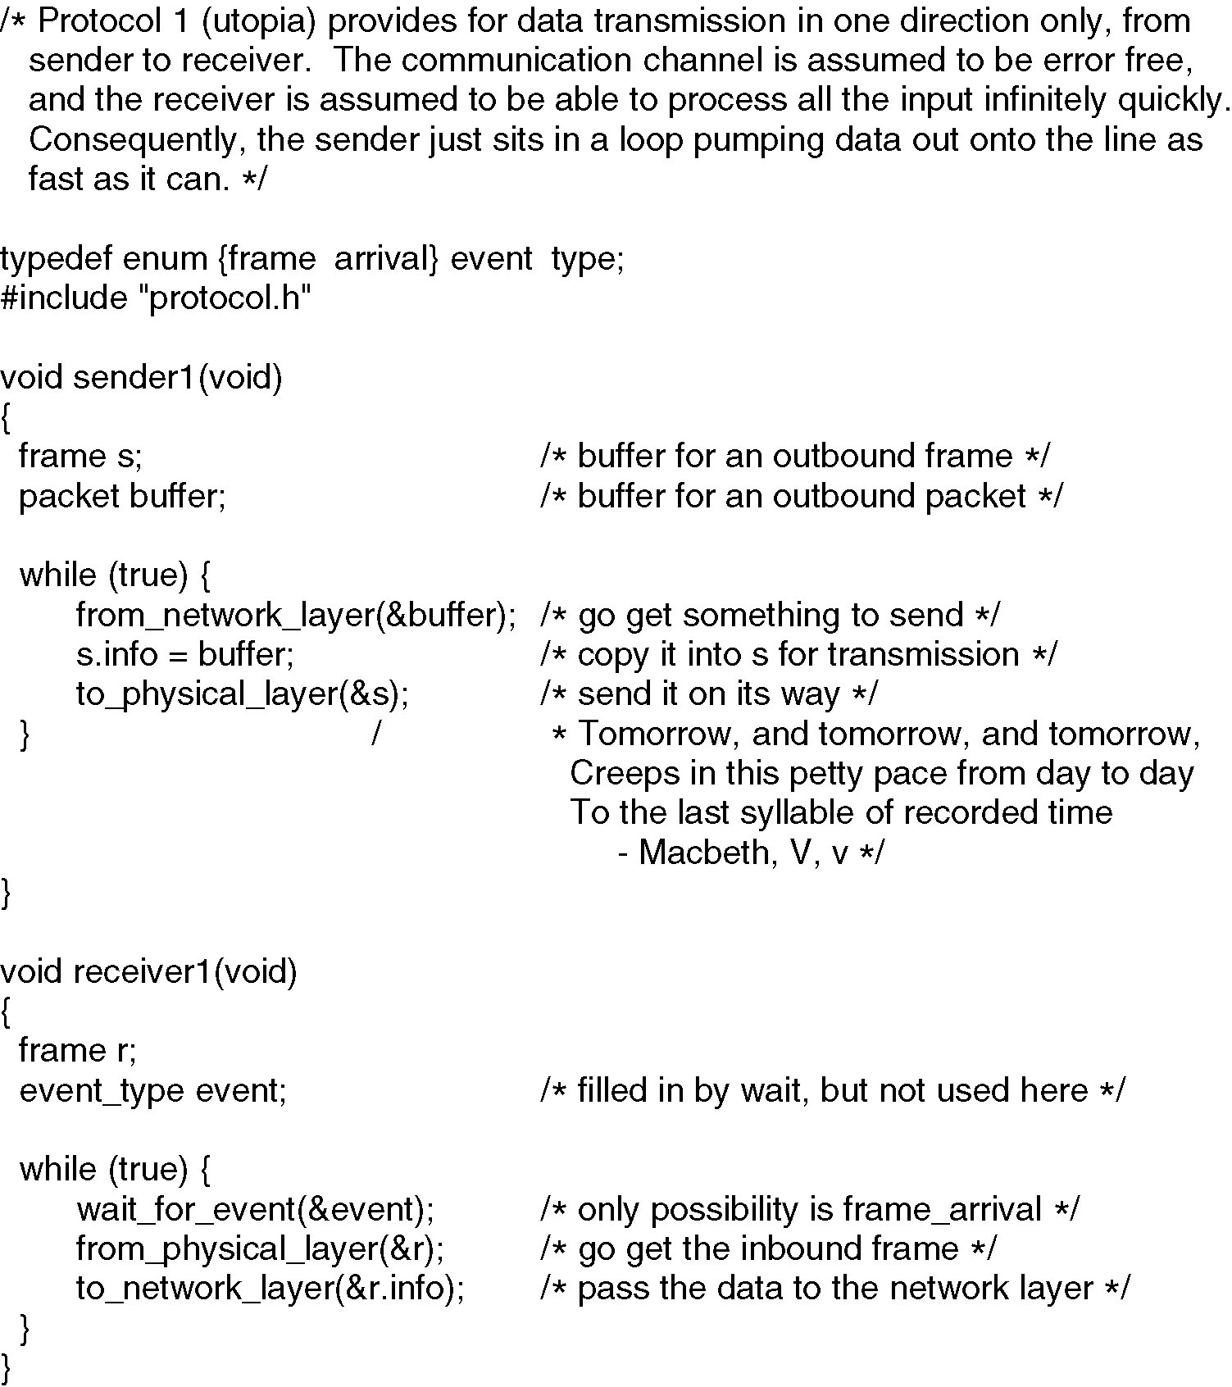
Figure 3-10 Unrestricted Simplex Protocol

Slide 12
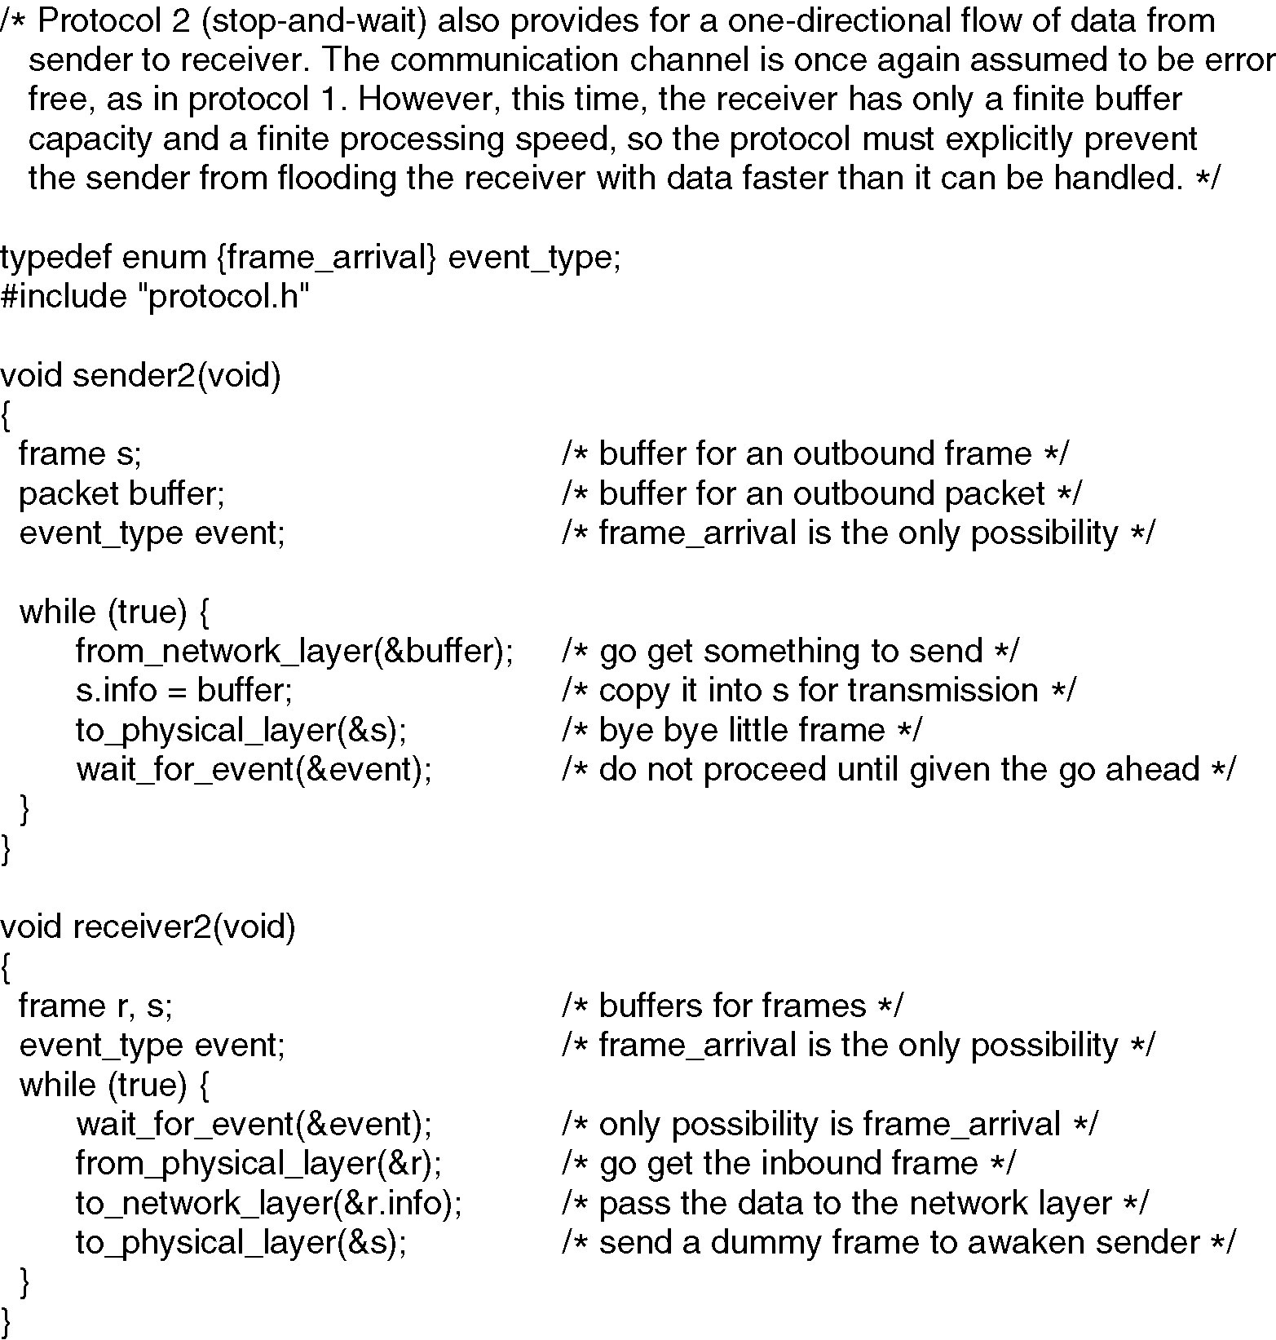
Figure 3-11 Simplex Stop-and-Wait Protocol

Slide 13
Protocol 3: Positive Acknowledgement with Retransmissions [PAR]
Introduce Noisy Channels
This produces:
Damaged and lost frames
Damaged and lost ACKs
PAR Protocol
Tools and issues:
Timers
Sequence numbers
Duplicate frames

Slide 14
Stop-and-Wait [with errors]
(a) Frame 1 lost
Time-out
time
A
frame
0
frame
1
frame
1
frame
2
B
ACK
ACK
without sequence numbers
ambiguous results !!
(b) ACK lost
Time-out
time
A
frame
0
frame
1
frame
1
frame
2
ACK
ACK
ACK
B
In parts (a) and (b) transmitting station A acts the same way, but part (b) receiving station B accepts frame 1 twice.

Slide 15
Protocol 3 Positive ACK with Retransmission (PAR) [Old Tanenbaum Version]
#define MAX_SEQ 1
typedef enum {frame_arrival, cksum_err, timeout} event_type;
include “protocol.h”
void sender_par (void)
{
seq_nr next_frame_to_send;
frame s;
packet buffer;
event_type event;
next_frame_to_send = 0;
from_network_layer (&buffer);
while (true)
{ s.info = buffer;
s.seq = next_frame_to_send;
to_physical_layer (&s);
start_timer (s.seq);
wait_for_event (&event);
if (event == frame_arrival) {
from_network_layer (&buffer);
inc (next_frame_to_send); }
}
}

Slide 16
Protocol 3 Positive ACK with Retransmission (PAR) [Old Tanenbaum Version]
void receiver_par (void)
{
seq_nr next_frame_to_send;
frame r, s;
event_type event;
frame_expected = 0;
while (true)
{ wait_for_event (&event);
if (event == frame_arrival)
{ from_physical_layer (&r);
if (r.seq == frame_expected) {
to_network_layer(&r.info);
inc (frame_expected);
}
to_physical_layer (&s);
}
}
}
/* Note – no sequence number on ACK */

Slide 17
PAR [OLD] problem
Ambiguities occur when ACKs
are not numbered.
premature
time-out
time
A
frame
0
frame
0
frame
1
frame
2
ACK
ACK
B
Transmitting station A misinterprets duplicate ACKs
Leon-Garcia & Widjaja:
Communication Networks

Slide 18
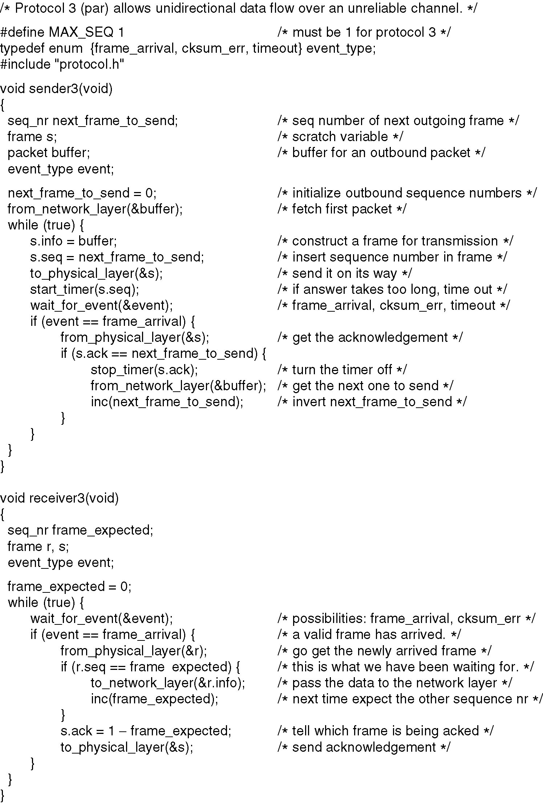
PAR Simplex Protocol for a Noisy Channel
Code added
Figure 3-12.A Positive Acknowledgement with Retransmission protocol.
Continued →

Slide 19
A Simplex Protocol for a Noisy Channel
Code added
Figure 3-12.A Positive Acknowledgement with Retransmission protocol.

Slide 20
State Machine for Stop-and-Wait
0 1
0 1
0 1
0 1
0 1
0 1
0 1
0 1
S_{last}
R_{next}
Timer
S_{last}
Transmitter
Receiver
Station A
R_{next}
Station B
(0,0)
Error-free frame 0
arrives at receiver
(0,1)
Global State:
(S_{last}, R_{next})
ACK for
frame 0
arrives at
transmitter
ACK for
frame 1
arrives at
transmitter
Error-free frame 1
arrives at receiver
(1,0)
(1,1)

Slide 21
Sliding Window Protocols [Tanen]
Must be able to transmit data in both directions.
Choices for utilization of the reverse channel:
mix DATA frames with ACK frames.
Piggyback the ACK
Receiver waits for DATA traffic in the opposite direction.
Use the ACK field in the frame header to send the sequence number of frame being ACKed.
➔ better use of the channel capacity.

Slide 22
Sliding Window Protocols
ACKs introduce a new issue – how long does receiver wait before sending ONLY an ACK frame?
Now we need an ACKTimer !!
The sender timeout period needs to be set longer.
The protocol must deal with the premature timeout problem and be “robust” under pathological conditions.

Slide 23
Sliding Window Protocols
Each outbound frame must contain a sequence number. With n bits for the sequence number field, maxseq = 2^{n} - 1 and the numbers range from 0 to maxseq.
Sliding window :: the sender has a window of frames and maintains a list of consecutive sequence numbers for frames that it is permitted to send without waiting for ACKs.
The receiver has a window of frames that has space for frames whose sequence numbers are in the range of frame sequence numbers it is permitted to accept.
Note – sending and receiving windows do NOT have to be the same size.
The windows can be fixed size or dynamically growing and shrinking.

Slide 24
Sliding Window Protocols
The Host is oblivious to sliding windows and the message order at the transport layer is maintained.
sender’s DL window :: holds frames sent but not yet ACKed.
new packets from the Host cause the upper edge inside the sender’s window to be incremented.
acknowledged frames from the receiver cause the lower edge inside the sender’s window to be incremented.

Slide 25
Sliding Window Protocols
All frames in the sender’s window must be saved for possible retransmission and we need one timer per frame in the window.
If the maximum sender window size is B, the sender needs at least B buffers.
If the sender’s window gets full (i.e., it reaches the maximum window size, the protocol must shut off the Host (the network layer) until buffers become available.

Slide 26
Sliding Window Protocols
receiver’s DL window
Frames received with sequence numbers outside the receiver’s window are not accepted.
The receiver’s window size is normally static.
The set of acceptable sequence numbers is rotated as “acceptable” frames arrive.
If a receiver’s window size = 1, then the protocol only accepts frames in order.
This scheme is referred to as
Go Back N.

Slide 27
Sliding Window Protocols
Selective Repeat :: receiver’s window size > 1.
The receiver stores all correct frames within the acceptable window range.
Either the sender times out and resends the missing frame, or
Selective repeat receiver sends a NACK frame back the sender.

Slide 28
Choices in ACK Mechanisms
The ACK sequence number indicates the last frame successfully received.
- OR -
2. ACK sequence number indicates the next frame the receiver expects to receive.
Both schemes can be strictly individual ACKs or represent cumulative ACKs.
Cumulative ACKs is the most common technique used.

Slide 29
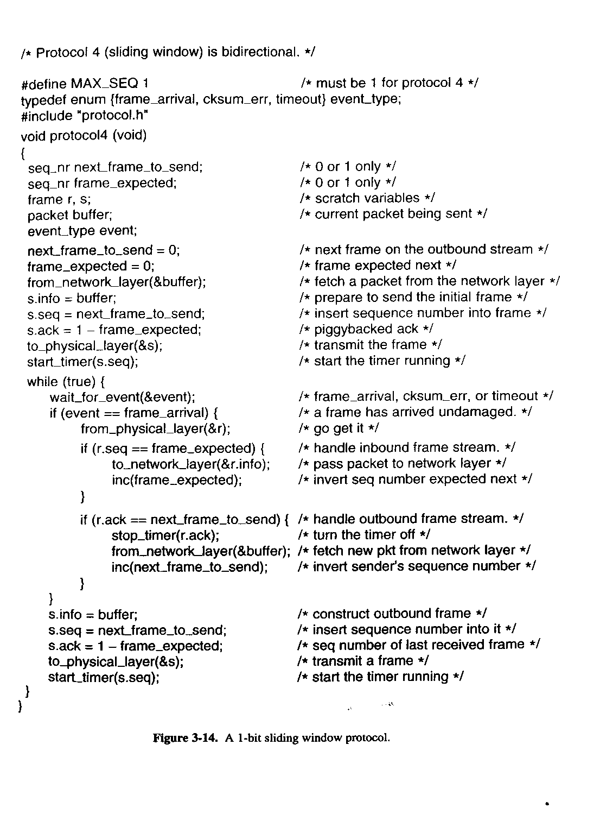
One-Bit Sliding Window Protocol

Slide 30
Go Back N
Timeout Occurs for frame 3 !!
4 outstanding frames
so go back 4
Go-Back-4:
fr
0
fr
1
fr
2
fr
3
fr
4
fr
5
fr
6
fr
3
fr
4
fr
5
fr
6
fr
7
fr
8
fr
9
time
A
B
ACK1
ACK2
ACK3
Out-of-sequence frames
ACK4
ACK5
ACK6
ACK7
ACK8
ACK9
error
ACKing next frame expected
Leon-Garcia & Widjaja:
Communication Networks

Slide 31
Go Back N
with NAK error recovery
Transmitter goes back to frame 1
Go-Back-7:
fr
0
fr
1
fr
2
fr
3
fr
4
fr
5
fr
1
fr
2
fr
3
fr
4
fr
5
fr
6
fr
7
fr
0
time
A
B
ACK1
NAK1
Out-of-sequence
frames
ACK2
ACK3
ACK4
ACK5
ACK6
ACK7
error
Leon-Garcia & Widjaja:
Communication Networks

Slide 32
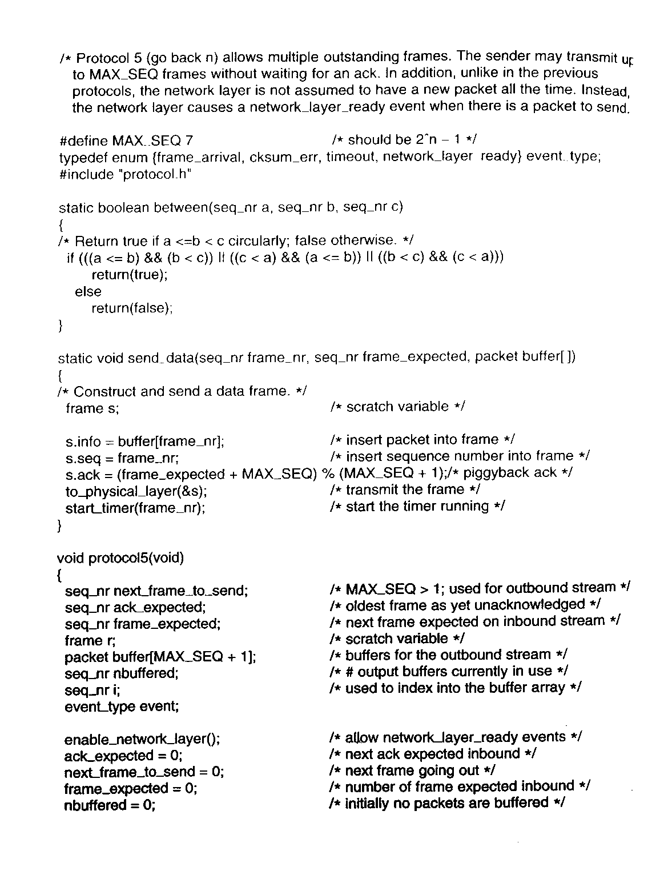

Slide 33
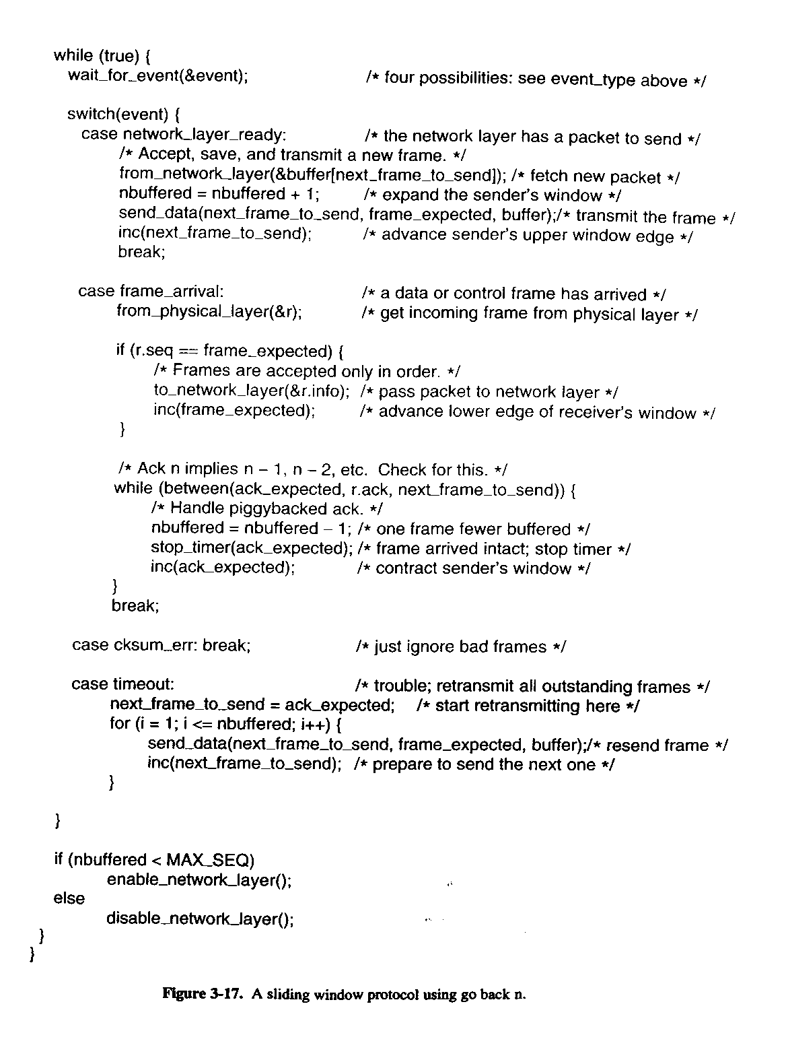

Slide 34
Selective Repeat
with NAK error recovery
Retransmit only frame 2
fr
0
fr
1
fr
2
fr
3
fr
4
fr
5
fr
6
fr
2
fr
7
fr
8
fr
9
fr
10
fr
11
fr
12
time
A
B
ACK1
ACK2
NAK2
ACK2
ACK2
ACK2
ACK7
ACK8
ACK9
ACK10
ACK11
ACK12
error
Cumulative ACK

Slide 35
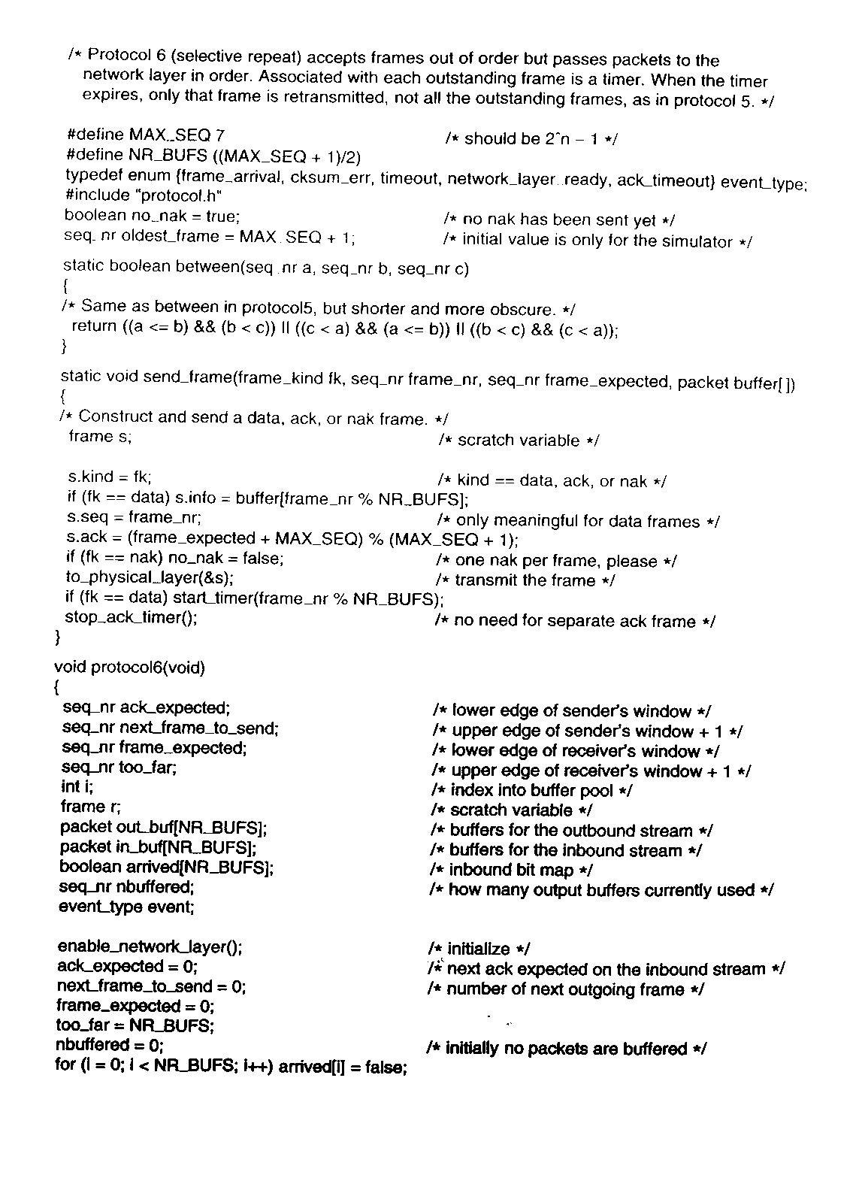

Slide 36
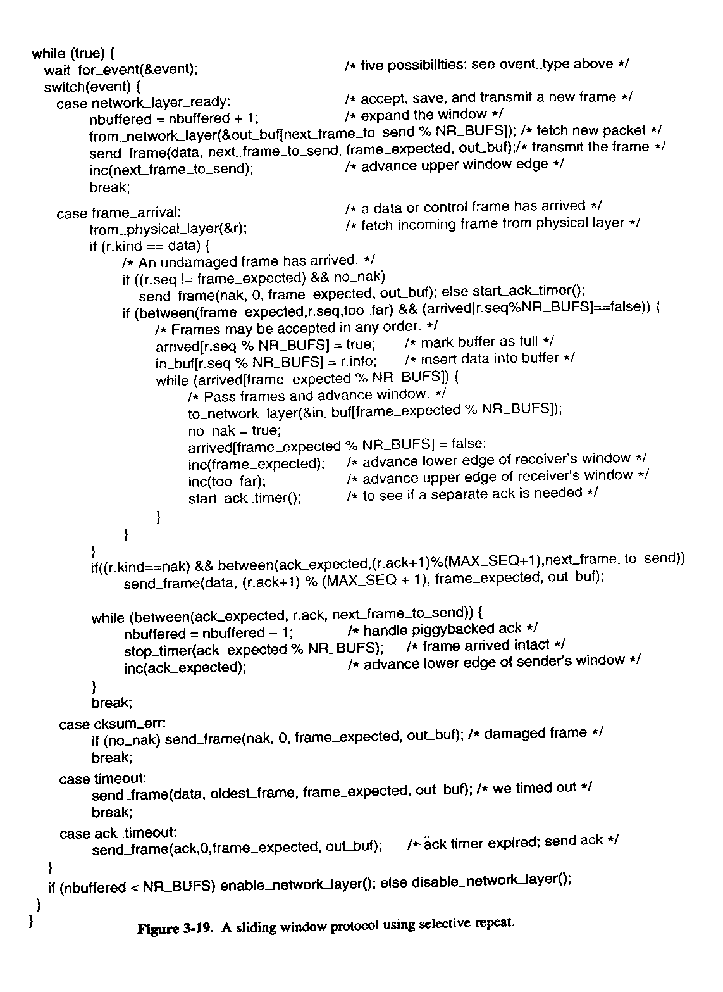

Slide 37
Data Link Layer Summary
Parallelism between Transport and Data Link Layer
Tanenbaum’s Treatment/Model of Data Link Layer
Protocol 1: Utopia
Protocol 2: Stop-and-Wait
Protocol 3: Positive Acknowledgment with Retransmission [PAR]
Old ‘flawed version
Newer version

Slide 38
DL Layer Summary (cont)
Pipelining and Sliding Windows
Protocol 4: One Bit Sliding Window
Protocol 5: Go Back N
Protocol 6: Selective Repeat
Further Details and Decisions

