Slide 1
Physical Layer (Part 2) Data Encoding Techniques
Advanced Computer Networks

Slide 2
Data Encoding Techniques
Digital Data, Analog Signals [modem]
Digital Data, Digital Signals [wired LAN]
Analog Data, Digital Signals [codec]
Frequency Division Multiplexing (FDM)
Wave Division Multiplexing (WDM) [fiber]
Time Division Multiplexing (TDM)
Pulse Code Modulation (PCM) [T1]
Delta Modulation

Slide 3
Analog and Digital Transmissions
Figure 2-23.The use of both analog and digital transmissions for a computer-to-computer call. Conversion is done by the modems and codecs.
Tanenbaum

Slide 4
Digital Data, Analog Signals [Example – modem]
Basis for analog signaling constant-frequency is a continuous, signal known as the carrier frequency.
Digital data is encoded by modulating one of the three characteristics of the carrier: amplitude, frequency, or phase or some combination of these.

Slide 5
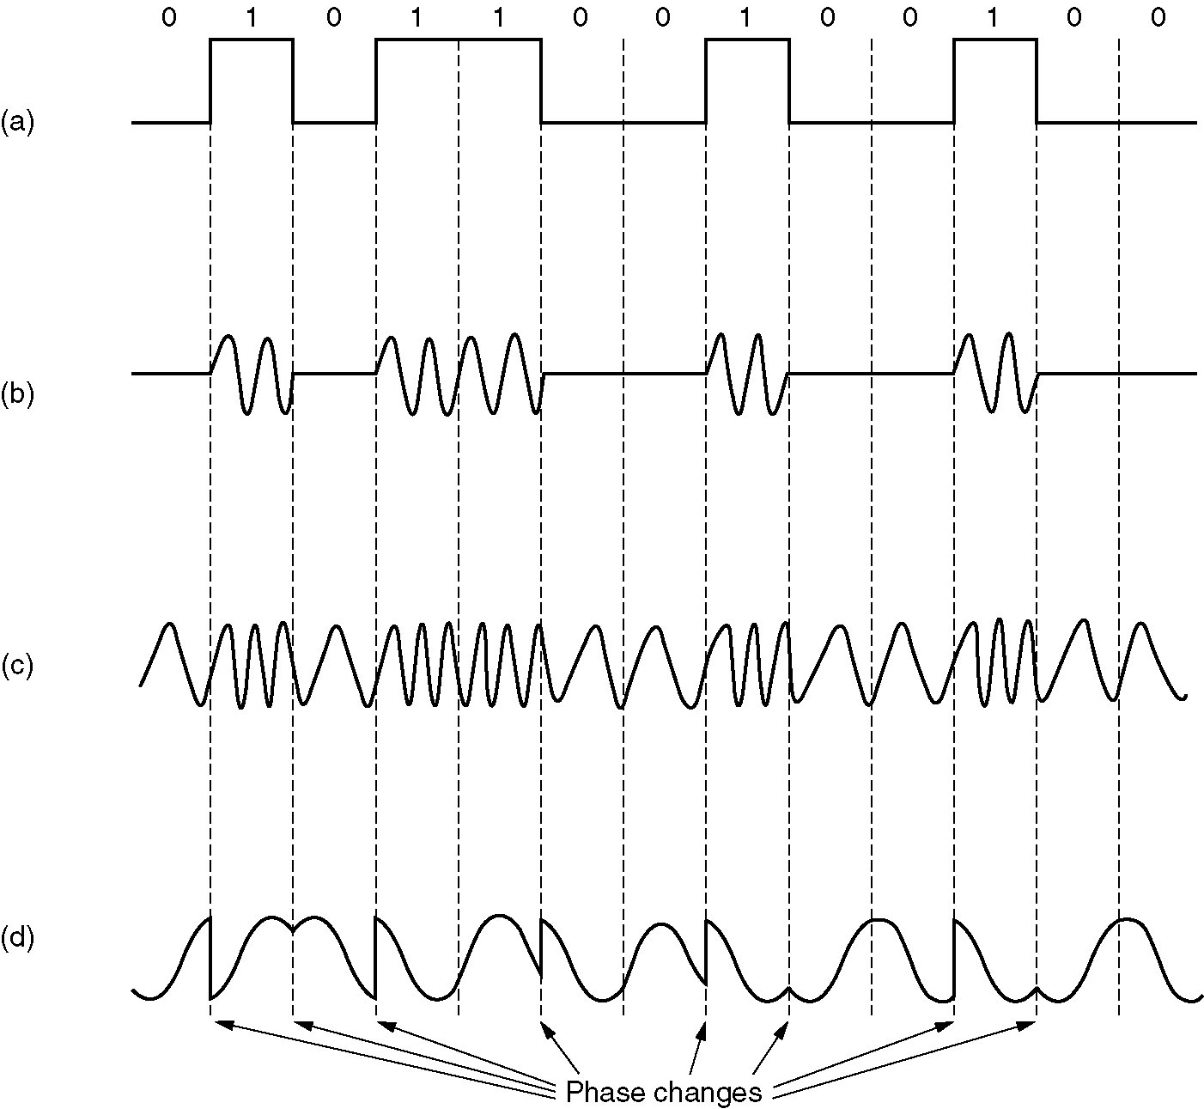
Signal Modulation
A binary signal
Amplitude
modulation
Frequency
modulation
Phase modulation
Figure 2-24.
Tanenbaum

Slide 6
Modems
All advanced modems use a combination of modulation techniques to transmit multiple bits per baud.
Multiple amplitude and multiple phase shifts are combined to transmit several bits per symbol.
QPSK (Quadrature Phase Shift Keying) uses multiple phase shifts per symbol.
Modems actually use Quadrature Amplitude Modulation (QAM).
These concepts are explained using constellation points where a point determines a specific amplitude and phase.

Slide 7
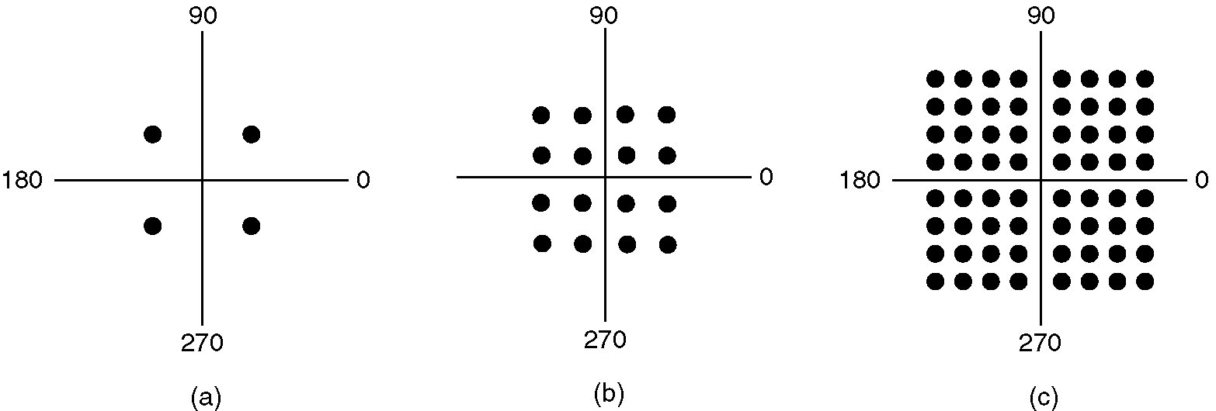
Constellation Diagrams
(a) QPSK. (b) QAM-16. (c) QAM-64.
Figure 2-25.
V = 64
v = log₂ V = 6
Tanenbaum

Slide 8
Digital Data, Digital Signals [the technique is used in a number of LANs]
Digital signal – is a sequence of discrete, discontinuous voltage pulses.
Bit duration :: the time it takes for the transmitter to emit the bit.
Issues
Bit timing (sender/receiver clock drift)
Recovery from signal
Noise immunity

Slide 9
NRZ ( Non-Return-to-Zero) Codes
Uses two different voltage levels (one positive and one negative) as the signal elements for the two binary digits.
NRZ-L ( Non-Return-to-Zero-Level)
The voltage is constant during the bit interval.
NRZ-L is used for short distances between a terminal and modem or terminal and computer.
1 ⬄ negative voltage
0 ⬄ positive voltage

Slide 10
NRZ ( Non-Return-to-Zero) Codes
NRZ-I ( Non-Return-to-Zero-Invert on ones)
The voltage is constant during the bit interval.
NRZI is a differential encoding scheme (i.e., the signal is decoded by comparing the polarity of adjacent signal elements.)
1 ⬄ existence of a signal transition at the beginning of the bit time
(either a low-to-high or a high-to-low transition)
0 ⬄ no signal transition at the beginning of the bit time

Slide 11
Bi–Phase Codes
Bi-phase codes – require at least one transition per bit time and may have as many as two transitions.
➔ the maximum modulation rate is twice that of NRZ
➔ greater transmission bandwidth is required.
Advantages:
Synchronization – with a predictable transition per bit time the receiver can “synch” on the transition [self-clocking].
No d.c. component
Error detection – the absence of an expected transition can be used to detect errors.

Slide 12
Manchester Encoding
There is always a mid-bit transition {which is used as a clocking mechanism}.
The direction of the mid-bit transition represents the digital data.
Consequently, there may be a second transition at the beginning of the bit interval.
Used in 802.3 baseband coaxial cable and CSMA/CD twisted pair.
Some
textbooks
disagree
on this
definition!!
1 ⬄ low-to-high transition
0 ⬄ high-to-low transition

Slide 13
Differential Manchester Encoding
mid-bit transition is ONLY for clocking.
Differential Manchester is both differential and bi-phase.
Note – the coding convention for Differential Manchester is the opposite convention from NRZI.
Used in 802.5 (token ring) with twisted pair.
* Modulation rate for Manchester and Differential Manchester is twice the data rate ➔ inefficient encoding for long-distance applications.
1 ⬄ absence of transition at the beginning of the bit interval
0 ⬄ presence of transition at the beginning of the bit interval

Slide 14
Bi-Polar Encoding
Has the same issues as NRZI for a long string of 0’s.
A systemic problem with polar is the polarity can be backwards.
1 ⬄ alternating +1/2 , -1/2 voltage
0 ⬄ 0 voltage

Slide 15
Digital Encoding Techniques
1
0
1
0
1
1
1
0
0
Unipolar
NRZ
Polar NRZ
NRZ-Inverted
(Differential
Encoding)
Leon-Garcia & Widjaja:
Communication Networks
Bipolar
Encoding
Manchester
Encoding
Differential
Manchester
Encoding

Slide 16
Analog Data, Digital Signals [Example – PCM (Pulse Code Modulation)]
The most common technique for using digital signals to encode analog data is PCM.
Example: To transfer analog voice signals off a local loop to digital end office within the phone system, one uses a codec.
Because voice data limited to frequencies below 4000 HZ, a codec makes 8000 samples/sec. (i.e., 125 microsec/sample).

Slide 17
Multiplexing
Multiplexing {general definition} ::
Sharing a resource over time.
(a)
(b)
A
A
A
Trunk
group
A
B
B
B
MUX
MUX
B
C
C
C
C
Leon-Garcia & Widjaja:
Communication Networks

Slide 18
Frequency Division Multiplexing (FDM) vs Time Division Multiplexing (TDM)
Example:
FDM
4 users
frequency
time
TDM
frequency
K & R
time
Notes:
Two simple multiple access control techniques.
Each mobile’s share of the bandwidth is divided into portions for the uplink and the downlink. Also, possibly, out of band signaling.
As we will see, used in AMPS, GSM, IS-54/136

Slide 19
Frequency Division Multiplexing
(a) Individual signals occupy H Hz
A
f
0
H
B
0
f
H
C
f
0
H
(b) Combined signal fits into channel bandwidth
A
B
C
f
Leon-Garcia & Widjaja:
Communication Networks

Slide 20
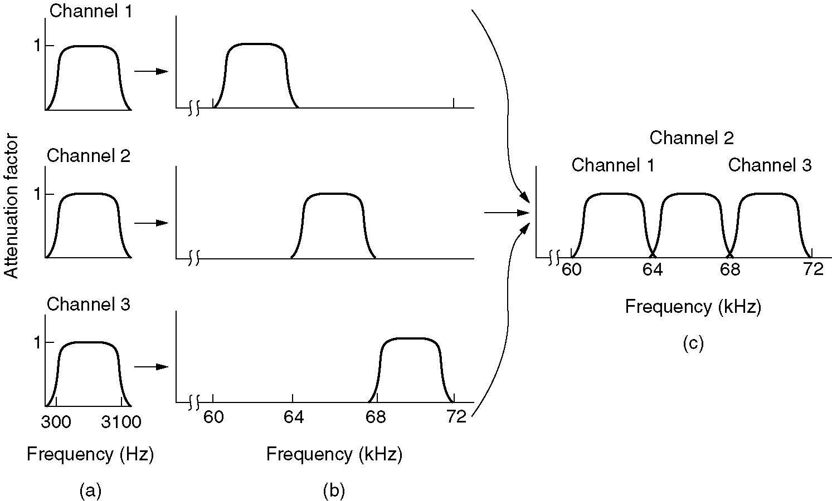
Frequency Division Multiplexing
Figure 2-31. (a) The original bandwidths. (b) The bandwidths raised in frequency. (c) The multiplexed channel.
Tanenbaum

Slide 21
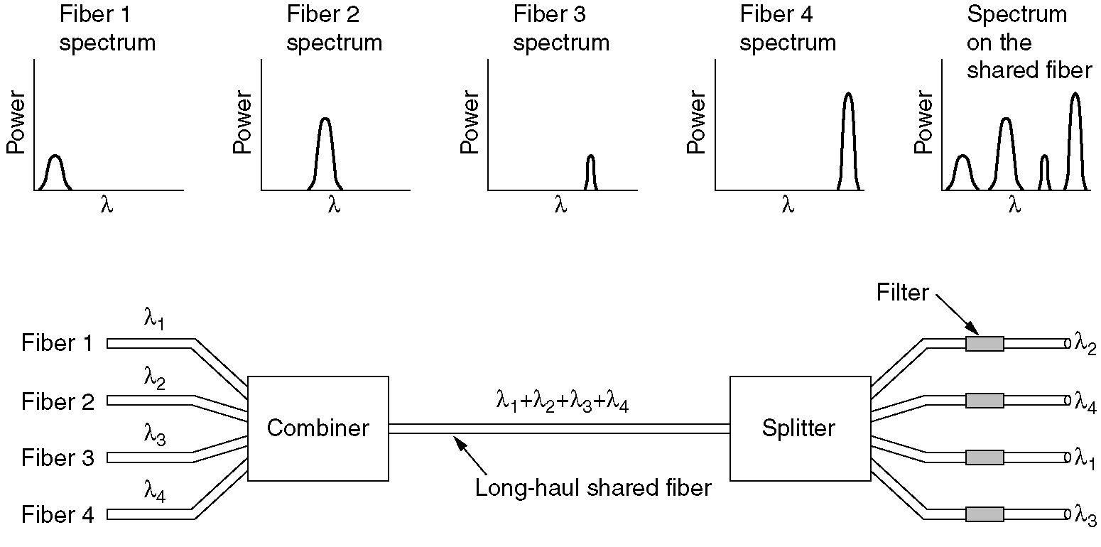
Wavelength Division Multiplexing
Wavelength division multiplexing.
Figure 2-32.
Tanenbaum

Slide 22
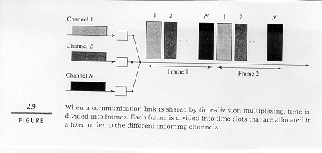
Time Division Multiplexing

Slide 23
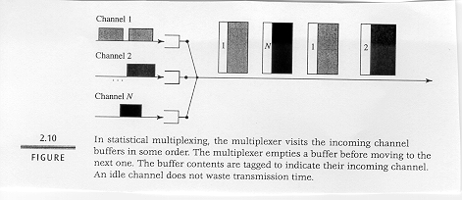
Concentrator [Statistical Multiplexing]

Slide 24
T1 System
A
A
B
MUX
MUX
B
22
23
24
b
1
2
. . .
24
b
C
C
frame
Leon-Garcia & Widjaja:
Communication Networks

Slide 25
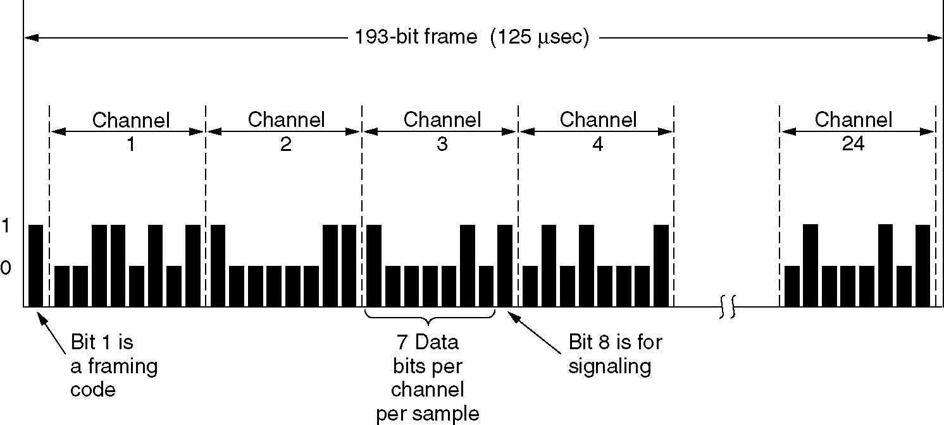
T1 - TDM Link
The T1 carrier (1.544 Mbps).
Figure 2-33.T1 Carrier (1.544Mbps)
Tanenbaum

Slide 26
Pulse Code Modulation (PCM)
T1 example for voice-grade input lines:
implies both codex conversion of analog to digital signals (PCM) and TDM.

Slide 27
Pulse Code Modulation Stages
DCC 8th Ed.
Stallings

Slide 28
Pulse Code Modulation (PCM)
Analog signal is sampled.
Converted to discrete-time continuous-amplitude signal (Pulse Amplitude Modulation)
Pulses are quantized and assigned a digital value.
A 7-bit sample allows 128 quantizing levels.

Slide 29
Pulse Code Modulation (PCM)
PCM uses non-linear encoding, i.e., amplitude spacing of levels is non-linear.
There is a greater number of quantizing steps for low amplitude.
This reduces overall signal distortion.
This introduces quantizing error (or noise).
PCM pulses are then encoded into a digital bit stream.
8000 samples/sec x 7 bits/sample = 56 Kbps for a single voice channel.

Slide 30
PCM Stages
DCC 8th Ed.
Stallings

Slide 31
PCM Nonlinear Quantization
DCC 8th Ed.
Stallings

Slide 32
Delta Modulation (DM)
The basic idea in delta modulation is to approximate the derivative of analog signal rather than its amplitude.
The analog data is approximated by a staircase function that moves up or down by one quantization level at each sampling time. ➔ output of DM is a single bit.
PCM preferred because of better SNR characteristics.

Slide 33
Delta Modulation
DCC 8th Ed.
Stallings

Slide 34
Data Encoding Summary
Digital Data, Analog Signals [modem]
Three forms of modulation (amplitude, frequency and phase) used in combination to increase the data rate.
Constellation diagrams (QPSK and QAM)
Digital Data, Digital Signals [wired LANs]
Tradeoffs between self clocking and required frequency.
Biphase, differential, NRZL, NRZI, Manchester, differential Manchester, bipolar.

Slide 35
Data Encoding Summary
Analog Data, Digital Signals [codec]
Multiplexing Detour:
Frequency Division Multiplexing (FDM)
Wave Division Multiplexing (WDM) [fiber]
Time Division Multiplexing (TDM)
Statistical TDM (Concentrator)
Codex functionality:
Pulse Code Modulation (PCM)
T1 line {classic voice-grade TDM}
PCM Stages (PAM, quantizier, encoder)
Delta Modulation

