Slide 1
Characterization of 802.11 Wireless Networks
in the Home
Michael Bruno
James Lawrence

Slide 2
Introduction
Home networks have become increasingly popular
Anecdotal evidence indicates unpredictable performance
Little is really known about the properties of home networks
This paper attempts to measure the characteristics of typical home wireless networks

Slide 3
Experimental Environment
Three homes (two in the US and one in the UK) with different properties were evaluated
The experiments were designed to investigate the impact of
Type of house, e.g. size, construction material.
Wireless technology used: 802.11a or 802.11b.
Transmission power, denoted by txpower.
Transmission rate, denoted by txrate.
Node location.
Interference from appliances.

Slide 4
Experimental Environment
High-level details of the three homes:
Label | Size (ft²) | Construction | # Floors | # Nodes
ushome1 | 2,500 | Wood | 2 | 6
ushome2 | 2,000 | Wood | 2 | 6
ukhome1 | 1,500 | Brick / steel | 3 | 6

Slide 5
Experimental Setup
6 nodes in each home
Each node is
For the 802.11b experiments: a small form-factor PC with a Netgear MA701 compact flash 802.11b card, running Linux kernel version 2.4.19 and the hostap driver
For the 802.11a experiments: a laptop with a NetGear WAG511 CardBus 802.11a card running Linux kernel version 2.4.26 and the MIT madwifi-stripped driver
Nodes placed “wherever computing or consumer electronic devices might be located”
All nodes joined to an ad-hoc network, at a frequency at least 5 channels away from the next occupied frequency

Slide 6
Experimental Methodology
Each node, in turn, sends a series of UDP packets to each other node
All Packets list source node and sequence number
Each node tests link to every other node by sending 300 1024 byte UDP packets over 150 seconds.
This test is repeated for different transmission rates and powers
Link layer retransmissions are disabled

Slide 7
Experimental Methodology
Each link tested individually (i.e. between node 1 and node 2)
No simultaneous transmissions occur during testing
Receiving node records source node and sequence number of all successful receives
Most tests performed at night

Slide 8
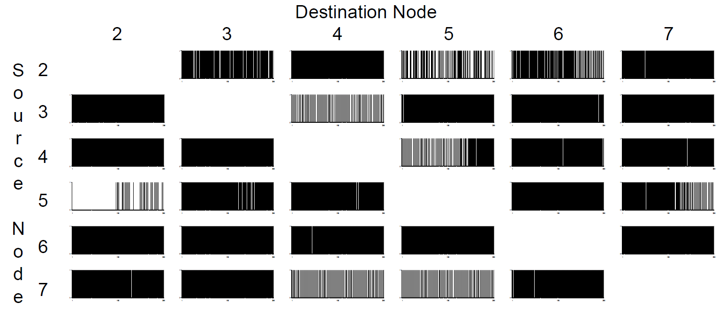
Experimental Methodology
Results in ushome1, 30 mW, 2 Mbps

Slide 9
Experimental Methodology
Note asymmetry between nodes 3 and 4

Slide 10
Methodology Validation
Same experiment run with same node setup twice
Both tests run at same time of day (on different days)
Tests whether loss rates for each link is property of link or transient
Results indicate that loss rates are generally not transient
This was done in each of the three homes
The following results are from ushome1

Slide 11
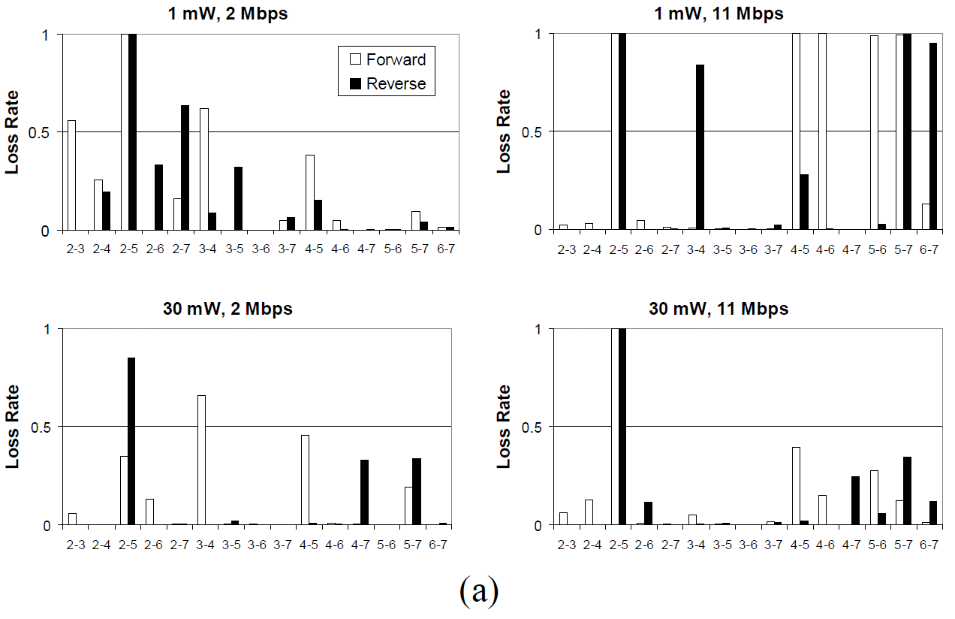
Methodology Validation

Slide 12
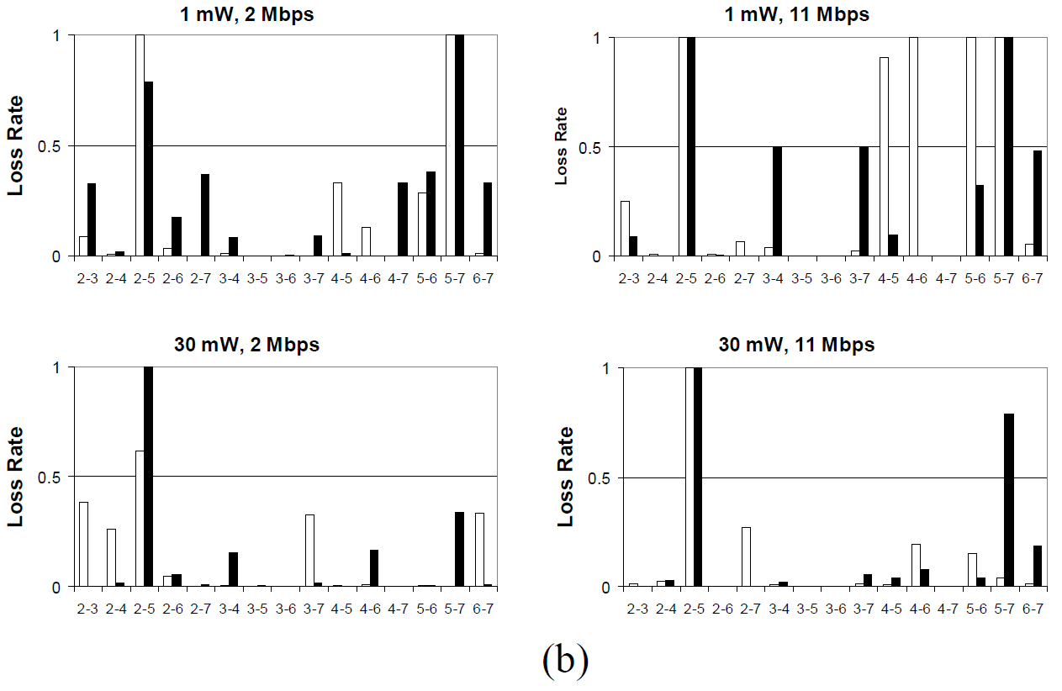
Methodology Validation

Slide 13
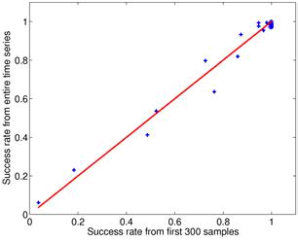
Methodology Validation
Validity of using only 300 packets was tested
Same tests in ushome1 ran for 20 minutes each (2400 packets) at 30 mW, 11 Mbps
Success rate from first 300 packets compared with success rate from all 2400 packets:

Slide 14
Methodology Validation
Validity of running tests at night tested
Two 150 second, 300 packet, tests run once per hour for 24 hours
One from node 4 to 6
One from node 6 to 4
Link from 4 to 6 is “bad” at night
Link from 6 to 4 is “good” at night
Found that time of day does not play a large role, but good link does suffer around noon
Since time of day does play a small role, all comparable data is taken at same time of day

Slide 15
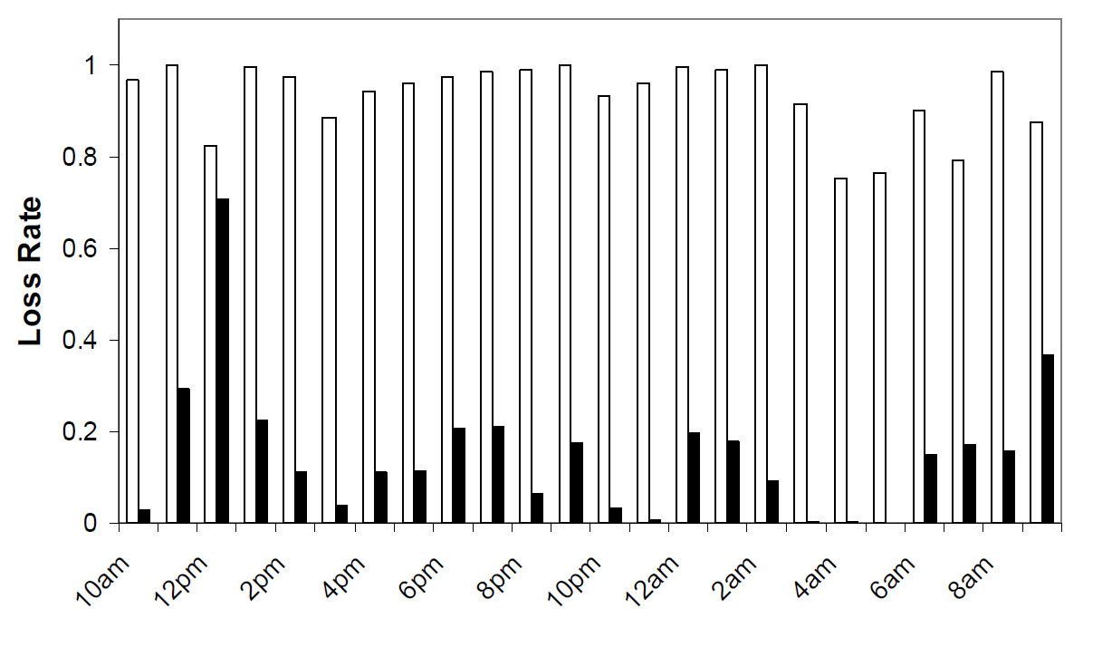
Methodology Validation
Tested at 30mW, 11Mbps
First bar is node-4 to node-6
Second bar is node-6 to node-4

Slide 16
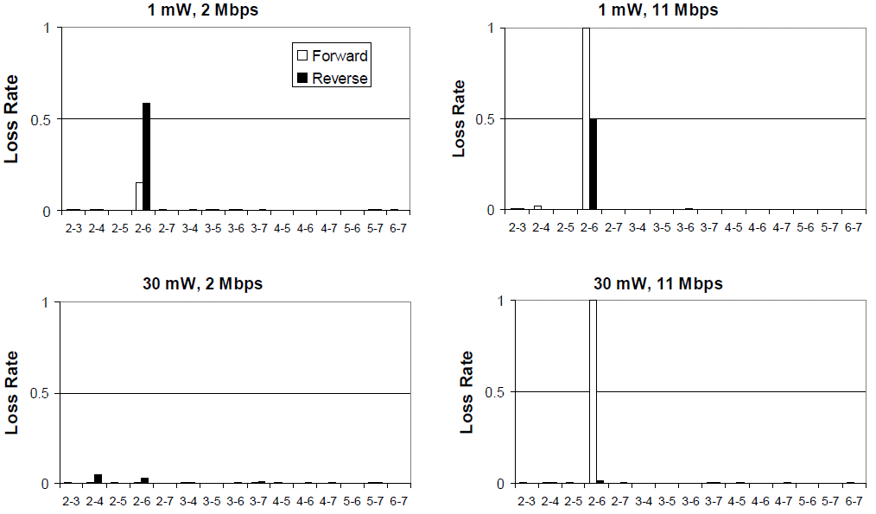
Results: Overall Characteristics
Loss rates for ukhome1

Slide 17
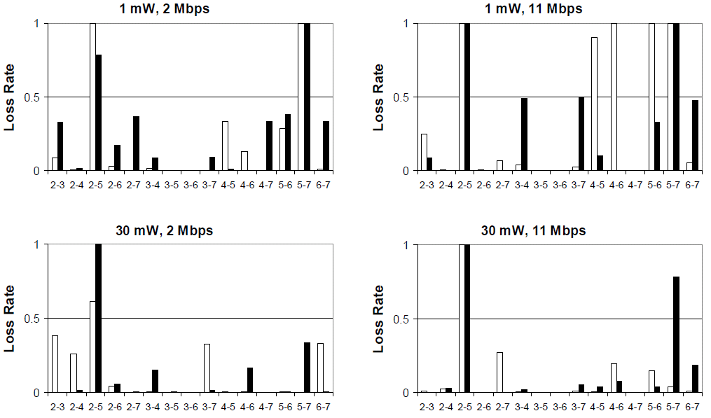
Results: Overall Characteristics
Loss rates for ushome1

Slide 18
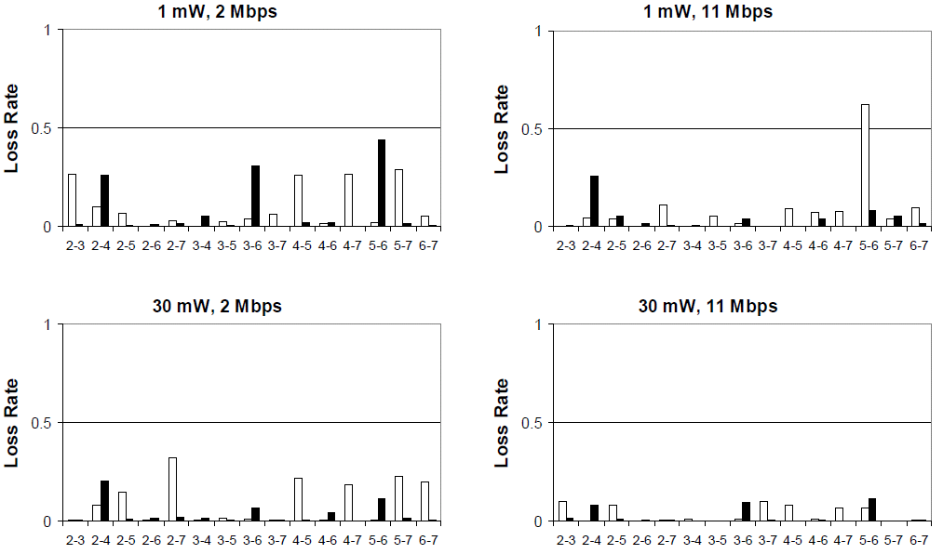
Results: Overall Characteristics
Loss rates for ushome2

Slide 19
Results: Overall Characteristics
In general
Lossy links likely to be found inside every home
Loss rates higher when encoding rate higher
Loss rates lower when the power level increased
Wireless connectivity not always omnipresent
Many asymmetric links present among all power levels and rates
Changes to power or transmission rate
Will not generally eliminate loss in bad links, but can decrease it
Will not generally affect loss in good links

Slide 20
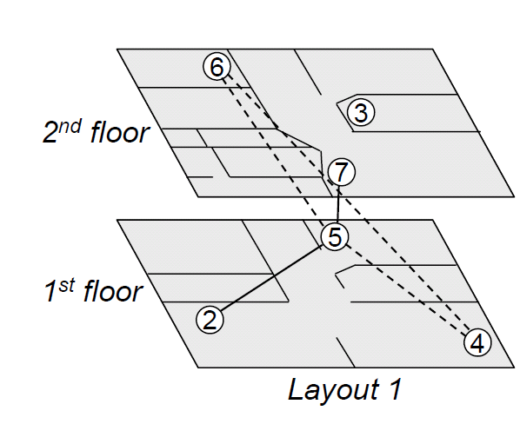
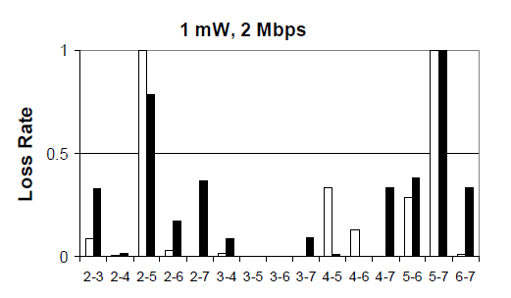
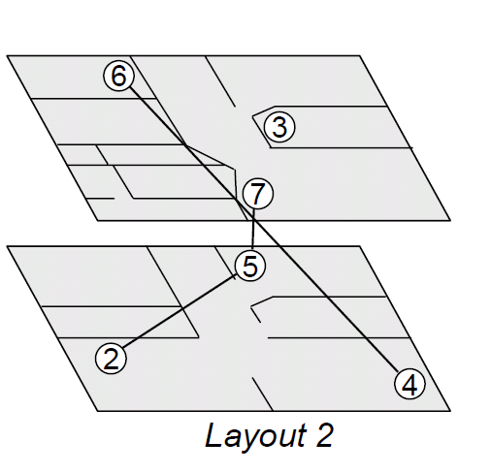
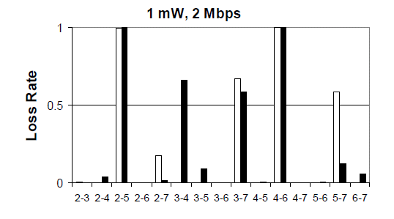
Multipath fading
The same signal can take multiple paths and cause interference with itself, leading to locations with high loss rates.

Slide 21
Signal Attenuation
Same as wired networks, the further away the two destinations are the weaker the signal, and more error prone.
Not as large a factor on loss rate as node orientation and positioning.

Slide 22
US Home 1
US Home 2
Loss Rate Vs Distance 802.11a

Slide 23
802.11a/b Physical layers
Differences between the 802.11a and 802.11b
11a operates at 5ghz, 11b operates at 2.4ghz.
801.11b loss rates have more variation.
Similarities
Both sensitive to small changes in orientation or position.
Distance is not a large indicator of loss rate.

Slide 24
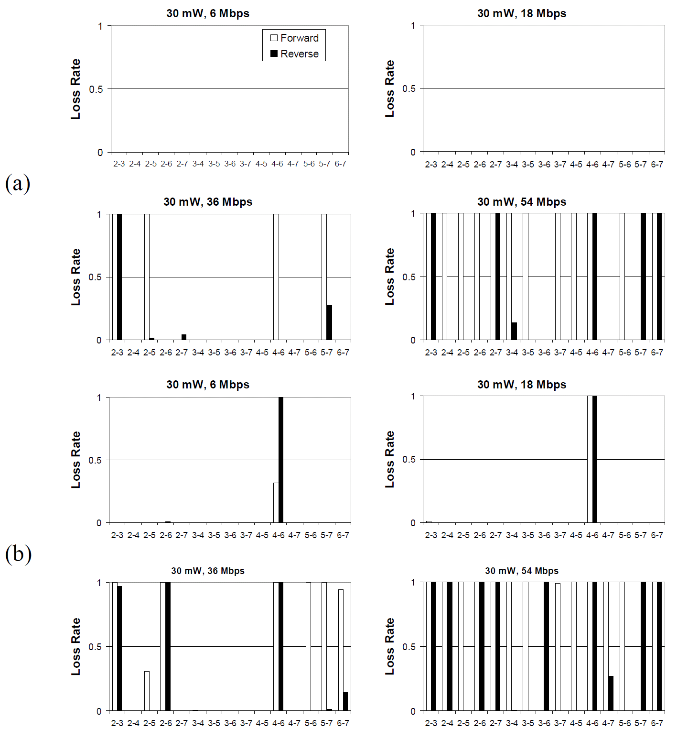

Slide 25
External Interference
Homes contain many sources of radio interference.
Devices such as Microwaves can create localized interference.

Slide 26
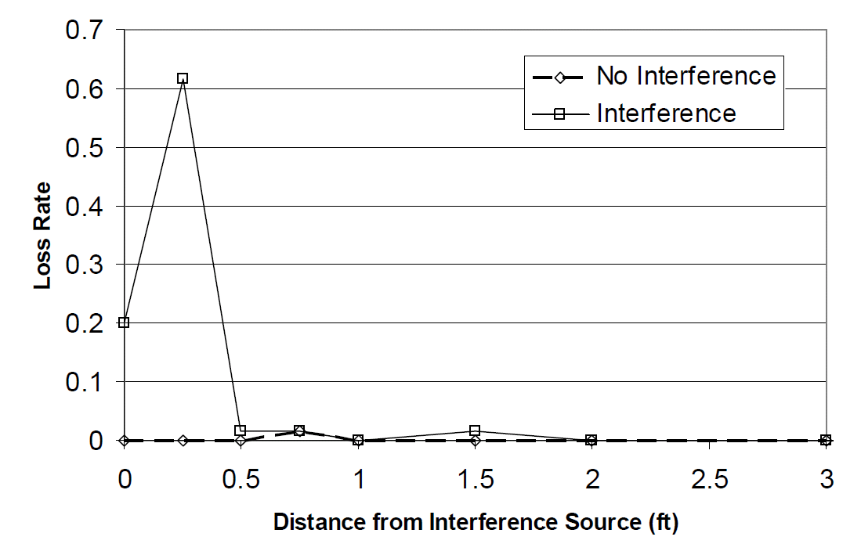

Slide 27
Conclusions
Homes often have obstacles that can make communication between nodes impossible.
Distance is often not the issue for node connectivity.
Node positioning extremely important.
802.11a/b are unlikely operate effectively at the highest rates due to loss.
Wide variety in link performance based off node location.
Due to AP usually being determined by the point of entry for internet service new topologies may be needed for wireless networks in the home.

