Slide 1
Introduction
Advanced Computer Networks

Slide 2
Introduction Outline
Preliminary definitions
Network application paradigms
Classifying networks
by transmission technology
by size/scale
by topology

Slide 3
Definitions
computer network ::
[Tan] a collection of “autonomous” computers interconnected by a single technology.
[LG&W] communications network ::a set of equipment and facilities that provide a service.
In a distributed system the collection of independent computers appears to its users as a single coherent system.

Slide 4
Internet Access and Flows
T
X
Z
W1
W2
W
Y
Host
L
AP
W3
Host
M
Host
A
2
3
W4
4
Host
B
1
5
nodes
14
16
11
Host
J
Host
C
12
17
15
6
10
13
7
Host
H
Host
D
9
8
Host
G
Host
E
Host
F

Slide 5
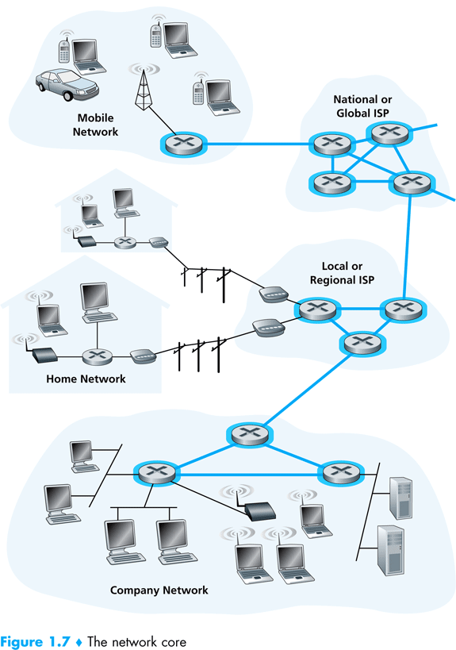
K & R

Slide 6
Networking Application Paradigms
Advanced Computer Networks
Introduction

Slide 7
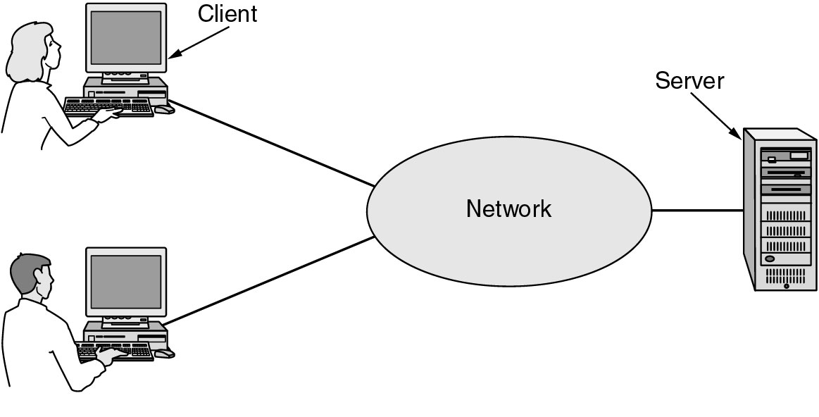
Client-Server Applications
Figure 1.1 A network with two clients and one server.
Tanenbaum

Slide 8
Client-Server Model
Figure 1-2. The client-server model involves requests and replies.
Tanenbaum

Slide 9
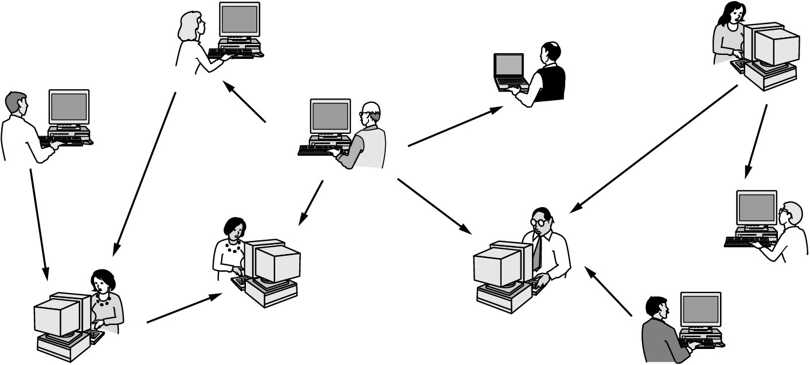
Peer-to-Peer Applications
Figure 1.3 In a peer-to-peer system there are no fixed clients and servers.
Tanenbaum

Slide 10
Wireless versus Mobile Applications
Wirelesss involves transmissions through the air (type depends on frequency).
Mobile can refer to the Hosts.
Laptops can be moveable and wired.
Laptops can be moveable and wireless.
Cell phones, Iphones, PDAs and devices in vehicles are mobile and wireless.
Mobile Ad Hoc NETworks (MANETs)::
wireless devices are both Hosts and subnet nodes.

Slide 11
Network Classifications
Advanced Computer Networks
Introduction

Slide 12
Classifying by Transmission Technology
broadcast :: a single communications channel shared
by all machines (addresses) on the network.
Broadcast can be both a logical or a physical concept (e.g. Media Access Control (MAC) sublayer ) .
multicast :: communications to a specified group.
This requires a group address (e.g. – multimedia multicast).
unicast :: a communication involving a single sender and a single receiver.
point-to-point :: connections made via links between pairs of nodes.

Slide 13
Classification by Size
LANs {Local Area Networks}
Wired LANs: typically physically broadcast at the MAC layer (e.g., Ethernet, Token Ring)
Wireless LANs (WLANs)
Wireless Sensor Networks (WSNs)
MANs {Metropolitan Area Networks}
campus networks connecting LANs logically or physically.
often have a backbone (e.g., FDDI and ATM) to connect campus networks.

Slide 14
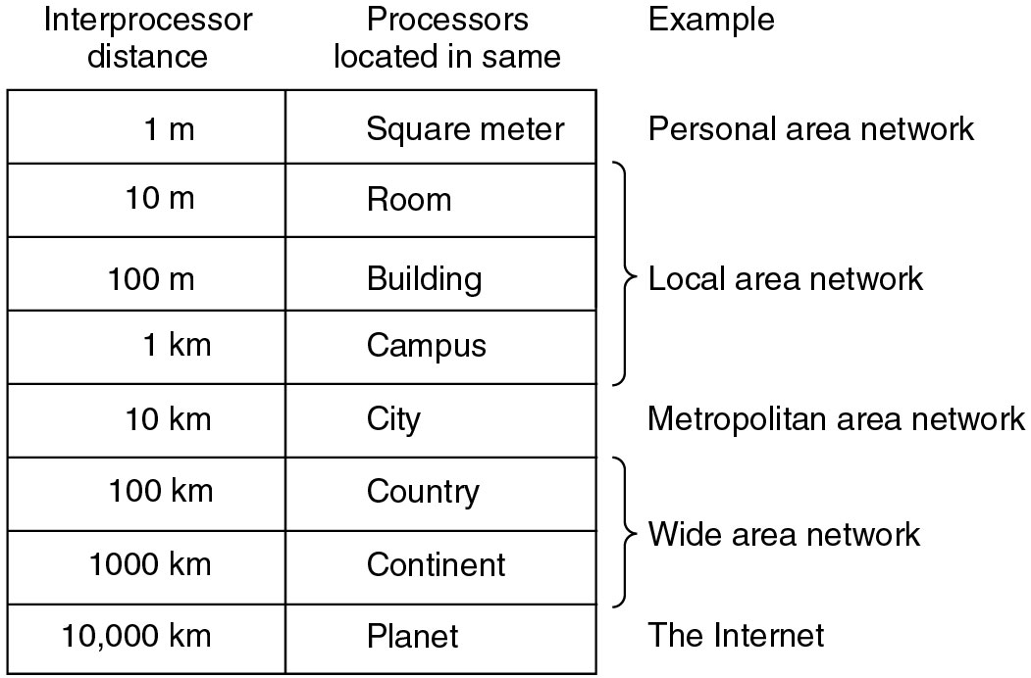
Classification by Size
Figure 1-6. Classification of interconnected processors by scale.
Tanenbaum

Slide 15
Wired LANs
transceivers
●     
Ethernet bus
Ethernet hub
Leon-Garcia & Widjaja:
Communication Networks

Slide 16
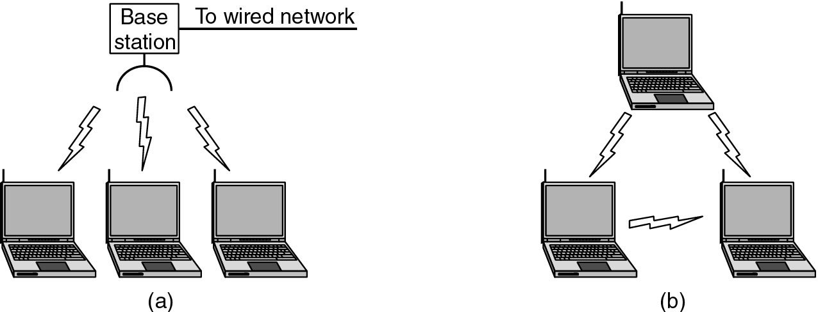
Wireless LANs (WLANs)
Figure 1-35. (a) Wireless networking with a base station. (b) Ad hoc networking.
Tanenbaum

Slide 17
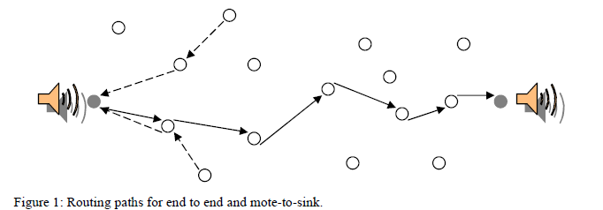
Wireless Sensor Networks (WSNs)
N. Chohan
WSNs can have mobile or fixed nodes but require a routing algorithm and normally have power concerns.

Slide 18
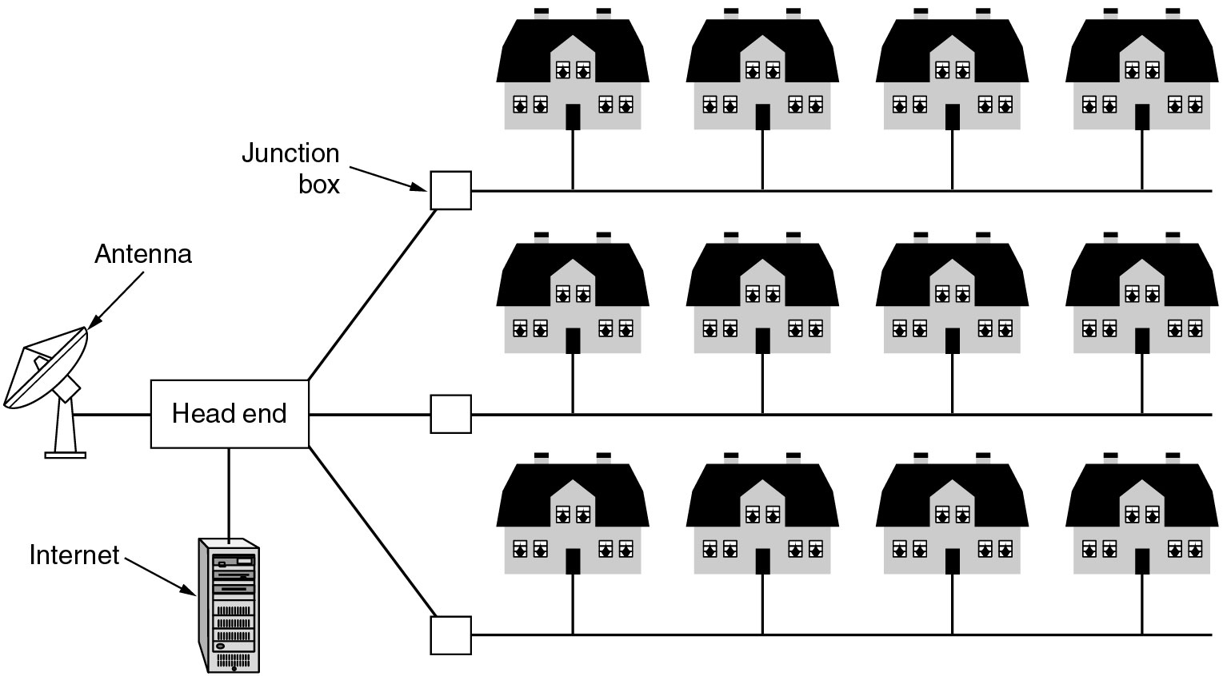
Metropolitan Area Networks
Figure 1-8. A metropolitan area network based on cable TV.
Tanenbaum

Slide 19
MANs within a Hierarchical Topology
1*
a
b
2
Metropolitan network A consists of access subnetworks: a, b, c, d.
4
3
A
c
d
Hierarchical Network Topology
National network consists of regional subnetworks: α, β, γ.
Metropolitan network A is part of regional subnetwork α.
A
α
β
γ
Leon-Garcia & Widjaja:
Communication Networks

Slide 20
Network Classification by Size
WANs {Wide Area Networks}
also referred to as “point-to-point” networks.
ARPANET → Internet
usually hierarchical with a backbone.
Enterprise Networks, Autonomous Systems (ASs)
VPNs (Virtual Private Networks).

Slide 21
ARPAnet circa 1972
AMES
McCLELLAN
UTAH
BOULDER
GWC
CASE
RADC
ILL
LINC
CARN
AMES
USC
MIT
UCSB
MITRE
STAN
SCD
ETAC
UCLA
RAND
TINKER
BBN
HARV
NBS
A point-to-point network
Leon-Garcia & Widjaja:
Communication Networks

Slide 22
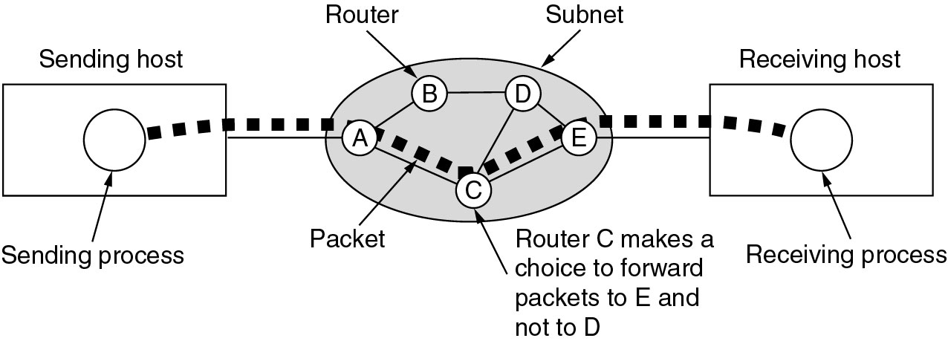
Wide Area Networks (WANs)
Figure 1-10.A stream of packets from sender to receiver.
Tanenbaum

Slide 23
internet
net 3
G
net 1
G
G
G = gateway
G
net 5
net 2
G
net 4
G
A network of networks
Leon-Garcia & Widjaja:
Communication Networks

Slide 24
Network Classification by Topology
flow of data
Bidirectional flow
Default is baseband
cabling
Repeater
Bus Topology

Slide 25
Network Classification by Topology
Note - A ring implies unidirectional flow.
Repeater
Repeater
Ring Topology

Slide 26
Network Classification by Topology
Headend
Tree Topology
Advanced Computer Networks Introduction

Slide 27
Tree Topology
N. Chohan
WSN end-to-end routing often employs a spanning tree for routing.

Slide 28
Network Classification by Topology
hub, switch
or repeater
Star Topology

Slide 29
Network Classification by Topology
Wireless Infrastructure
W2
W1
AP
W3
W4
Star Topology

Slide 30
Introduction Summary
Define: network, distributed system, Internet, subnet, Host, node, flow, channel and link.
Paradigms: Client-Server, Peer-to-Peer, Wireless and Mobile.
Classifications and Acronyms:
Braodcast, multicast, unicast
LAN, MAN, WAN, WLAN, WSN
The Internet versus an internet
Hierarchical, bus, ring,tree, and star topology

