Slide 1
International Standards Organization Open Systems Interconnect (OSI) Reference Model
Advanced Computer Networks

Slide 2
OSI Reference Model
Application A
Application B
Application
Layer
Application
Layer
Presentation
Layer
Presentation
Layer
Session
Layer
Session
Layer
Transport
Layer
Transport
Layer
Communication Network
Network
Layer
Network
Layer
Network
Layer
Network
Layer
Data Link
Layer
Data Link
Layer
Data Link
Layer
Data Link
Layer
Physical
Layer
Physical
Layer
Physical
Layer
Physical
Layer
Electrical and/or Optical Signals

Slide 3
OSI Reference Model
Application A
Application B
data
Application
Layer
data
ah
Application
Layer
Presentation
Layer
Presentation
Layer
data
ph
Session
Layer
data
sh
Session
Layer
Transport
Layer
data
th
Transport
Layer
Network
Layer
data
nh
Network
Layer
Data Link
Layer
Data Link
Layer
dt
data
dh
Physical
Layer
Physical
Layer
bits

Slide 4
Layer Encapsulation
Leon-Garcia & Widjaja:
Communication Networks
HTTP Request
TCP Header contains source and destination port numbers
TCP Header
Header contains source and destination IP addresses; transport protocol type
IP Header
Header contains source and destination physical addresses; network protocol type
Frame Check Sequence
Ethernet Header

Slide 5
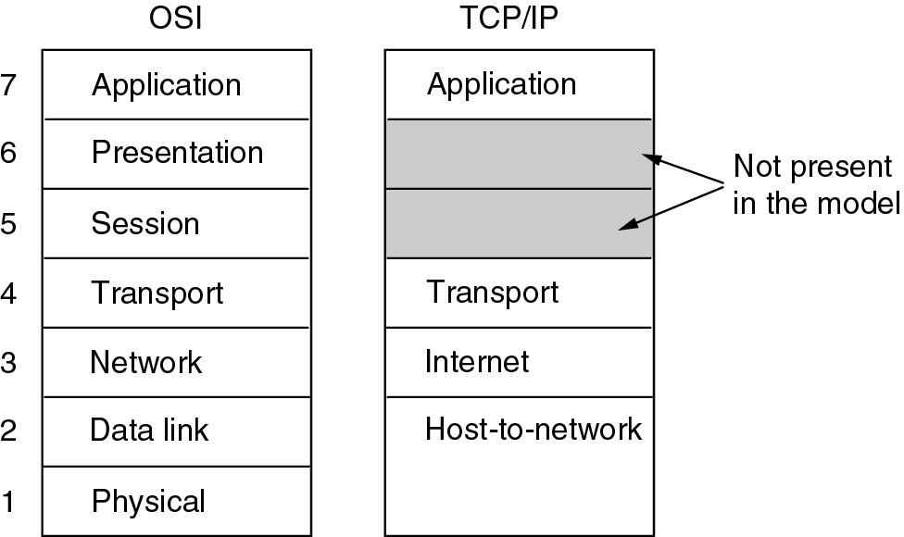
OSI versus TCP/IP
Figure 1-21. The TCP/IP reference model.
Tanenbaum

Slide 6
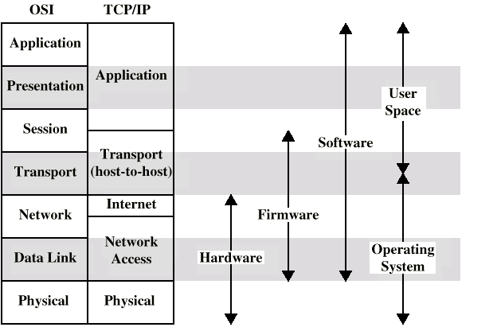
OSI versus TCP/IP
DCC 6th Ed., W. Stallings

Slide 7
Seven Layer OSI Model
Application Layer
Provides users access to the OSI environment and distributed information services.
Presentation Layer
Provides application processes independence from
differences in data representation ( e.g. abstract syntax notation).
Session Layer
Provides the control structure for communicating between applications.
Establishes, manages and terminates session connections between cooperating applications.
Transport Layer
Provides reliable transparent transfer of data between end points.
Provides end-to-end flow control and error recovery.
Network Layer
Provides upper layers with independence from the data transmission, routing and switching
technologies used to connect systems. Responsible for establishing, managing and terminating connections.
Data Link Layer
Provides for reliable transfer of information across the physical layer.
Sends and receives frames with the necessary synchronization, flow control and error control.
Physical Layer
Concerned with transmission of an unstructured bit stream over a physical medium.
Deals with the mechanical, electrical, functional and procedural characteristics to access the physical medium.

