Slide 1
Performance Anomaly of 802.11b
February 11, 2010
Paper By: Martin Heusse, Franck Rousseau, Gilles Berger-Sabbatel, Andrzej Duda
Presentation By: Daniel Mitchell, Brian Shaw, Steven Shidlovsky

Slide 2
Outline
802.11b Basics
The Anomaly
Simulation Verification
Experimental Verification

Slide 3
Abstract
When one host on a IEEE 802.11b network is forced to transmit at less than the maximum bit rate of 11 Mbps then all other hosts are forced to also transmit at this lower rate

Slide 4
Behind the Problem
Access method – Distributed Coordination Function (DCF)
Uses CSMA/CA
Low quality radio transmissions will result in a decrease in bit rate
5.5, 2, or 1 Mbps
Performance anomaly caused
Privileges low speed hosts, penalize high speed hosts

Slide 5
DFC Performance
Overall transmission time
T = t_{tr} + t_{ov}
Each packet has constant overhead time
t_{ov} = DIFS + t_{pr} + SIFS + t_{pr} + t_{ack}
DIFS = Time wait between senses of channel
SIFS = Period access point waits to send ACK
t_{pr} = PLPC Transmission time
t_{ack} = MAC acknowledgement transmission time

Slide 6
Throughput Efficiency
Equation to determine useful throughput
P = (T_{tr}/T) * (1500/1534)
Result: 70% useful throughput
Thus 11 Mbps has 7.74 Mbps useful data

Slide 7
Multiple Hosts
Increases overall transmission time
Decreases the proportion of useful throughput
P(N) = t_{tr}/T(N)
T(N) = Overall transmission time due to multiple hosts

Slide 8
The Anomaly
Since the slow hosts need more time to transmit the same data, all the hosts slow down to roughly the same speed
The slow host holds the channel for a proportionately longer amount of time!
This anomaly occurs regardless of how many fast hosts are present
Collisions and contention affect all hosts proportionally

Slide 9
Why the Anomaly Exists
sd: Amount of data to be transmitted
Time to transmit data = sd/(data rate)
Over the long term, CSMA/CA provides each host with an equal probability of accessing the channel
Therefore, all hosts will have the opportunity to transmit the same amount of data
Fast hosts have a lower channel utilization

Slide 10
Further Discussions
See Heuse, et. al. page 3 for the full mathematics.
Contention periods and collisions are accounted for.
UDP is expected to obey the mathematical models as generally no ACK packets are sent.
TCP behaves as though there is 2 slow hosts, but can be shown mathematically to behave similarly.
The second slow host is the ACK packets returning to it.
TCP also incorporates congestion control, so a host may stop transmitting when its data rate is substantially below the 1Mbps minimum.

Slide 11
Verification
A simulation was conducted to verify the mathematical results.
Simulator is targeting a worst-case scenario: The channel is always busy the first time a node wants to transmit.
All nodes configured to use 802.11b with exponential backoff
Simulation showed the mathematics are good, though not perfect
The error: Other factors, besides the proportion of collisions, affect the average time spent in collisions

Slide 12
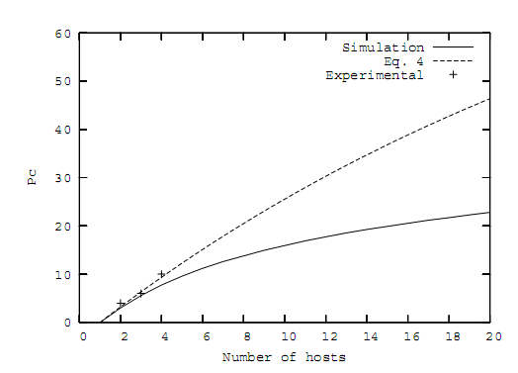
Proportion of Collisions
Figure 3
The mathematics assume a greater number of collisions than the simulation shows, particularly for very large numbers of hosts

Slide 13
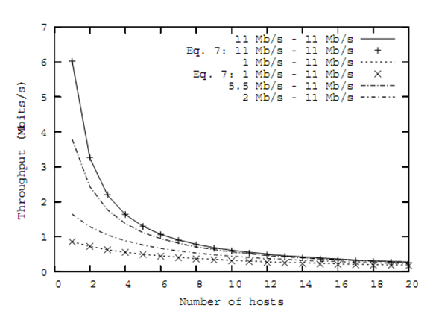
Throughput
Figure 4
The performance anomaly is observed. Note that no configuration gets acceptable throughput for very large numbers of hosts. This triggers TCP congestion control algorithms and may force hosts to stop transmitting.

Slide 14
Experimental Verification
Measure Throughput
Four notebooks(Marie, Milos, Kea, Bali)
RedHat 7.3, 802.11b cards
Access Point is not the bottleneck

Slide 15
Tool Used
Netperf:: generates TCP or UDP traffic and measures throughput
Tcpperf:: generates TCP traffic and measures the throughput
Udpperf:: generates UDP traffic and measures the throughput
Measurements done with netperf, compared to results of tcpperf and udpperf

Slide 16
Test 1: No Mobility
All hosts near access point
Force one to use degraded bit rate
One test run with TCP, the other with UDP
Using 2 hosts, 3 hosts, and 4 hosts, at bit rates 11, 5.5, 2, and 1 for Bali (slow host)
For TCP, hosts are competing with the access point, which is sending TCP ACKs on behalf of the destination
For UDP, hosts compete with each other

Slide 17
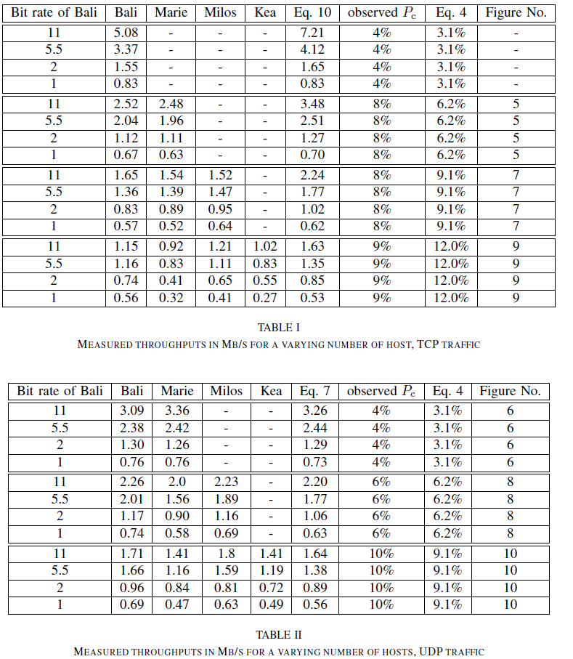

Slide 18
Test 1: Discussion
Measured values correspond well to analytical values (better for UDP)
TCP traffic pattern more complex, due to Access Point competing with hosts (TCP ACKs), dependence on overall RTT and bottleneck link
Pattern can become correlated with data segment traffic, since TCP ACK is sent upon arrival of data segment

Slide 19
Test 2: Mobile Hosts
Bali (slow host) is a mobile host, bit rate automatically adapts to varying transmission conditions
Other hosts located near access point with good conditions

Slide 20
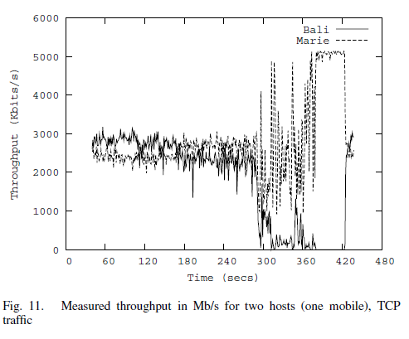
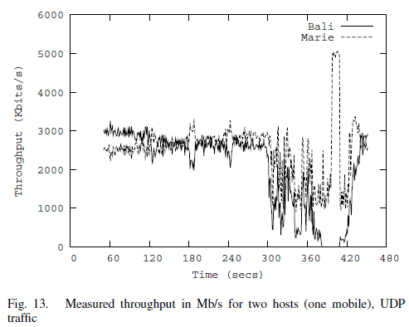

Slide 21
Test 2: Discussion
For TCP, when transmission conditions are bad (300-380) the throughput of Marie increases. This is due to Bali limiting its sending rate in adverse conditions
Note, at 380, Bali stops sending completely even if its bit rate is not 0, and Marie gains almost all available throughput
UDP shows similar results, although Marie’s gains during adverse conditions are not quite as large, unless Bali stops sending

Slide 22
Related Work
There have been many other papers studying 802.11 WLANs, but no prior papers use varying bit rates for hosts
Most other papers use simulations, rather than analysis, which can give complex results
Short-term unfairness of CSMA-based medium access protocols is also a topic of interest

Slide 23
Conclusions
Throughput much lower than nominal bit rate
Proportion of useful throughput depends strongly on number of hosts
If a host degrades its bit rate due to bad transmission conditions, other hosts throughputs will drop roughly to the rate of the slower host
However, in real conditions using TCP, the slow host will be subject to packet loss, limiting its sending rate, allowing other hosts to take advantage of the unused capacity

