Slide 1
Physical Layer (part 3) Transmission Media
Advanced Computer Networks

Slide 2
Transmission Media Choices
Twisted Pair
Coaxial Cable
Optical Fiber
Wireless Communications

Slide 3
Transmission Media
Transmission medium:: the physical path between transmitter and receiver.
Repeaters or amplifiers may be used to extend the length of the medium.
Communication of electromagnetic waves is guided or unguided.
Guided media:: waves are guided along a physical path (e.g., twisted pair, coaxial cable and optical fiber).
Unguided media:: means for transmitting but not guiding electromagnetic waves (e.g., the atmosphere and outer space).

Slide 4
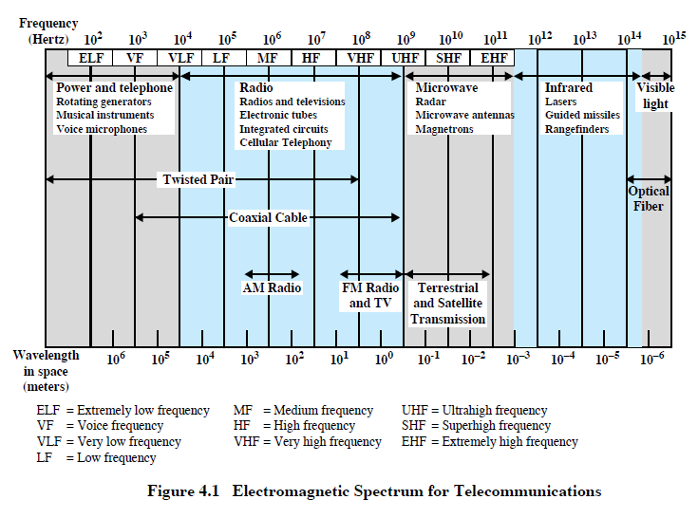
Telecommunications Spectrum
DCC 8th Ed.
Stallings

Slide 5
Guided Media Characteristics
DCC 8th Ed.
Stallings

Slide 6
Twisted Pair
Two insulated wires arranged in a spiral pattern.
Copper or steel coated with copper.
The signal is transmitted through one wire and a ground reference is transmitted in the other wire.
Typically twisted pair is installed in building telephone wiring.
Local loop connection to central telephone exchange is twisted pair.

Slide 7
Twisted Pair
Limited in distance, bandwidth and data rate due to problems with attenuation, interference and noise.
Issue: cross-talk due to interference from other signals.
“shielding” wire (shielded twisted pair (STP)) with metallic braid or sheathing reduces interference.
“twisting” reduces low-frequency interference and crosstalk.

Slide 8
Twisted Pair
Fig 2-3. (a) Category 3 UTP.
(b) Category 5 UTP.
Tanenbaum

Slide 9
10-BASE -T
10 Mbps baseband transmission over twisted pair.
Two Cat 3 cables, Manchester encoding,
Maximum distance - 100 meters
Ethernet Hub
●     
Leon-Garcia & Widjaja:
Communication Networks

Slide 10
Twisted Pair
DCC 8th Ed.
Stallings

Slide 11
EIA/TIA 568 and ISO/IEC 11801 Wiring Grades
Grade 1 - Unshielded Untwisted wiring.
Commonly called inside wire by the Telco community.
Grade 2 - Unshielded twisted pair (UTP) derived from IBM Type 3 spec.
Category 3 - Unshielded twisted pair with 100 ohm impedance and electrical
characteristics supporting transmission at frequencies up to 16 MHz. May
be used with 10Base-T, 100Base-T4, and 100Base-T2 Ethernet. (Obsolete)
Category 4 - Unshielded twisted pair with 100 ohm impedance and electrical
characteristics supporting transmission at frequencies up to 20 MHz.
May be used with 10Base-T, 100Base-T4, and 100Base-T2 Ethernet. (Obsolete)
Category 5 - Unshielded twisted pair with 100 ohm impedance and electrical
characteristics supporting transmission at frequencies up to 100 MHz.
May be used with 10Base-T, 100Base-T4, 100Base-T2, and 100Base-TX Ethernet.
May support 1000Base-T, but cable should be tested. (Superceded by Cat5e)

Slide 12
EIA/TIA 568 and ISO/IEC 11801 Wiring Grades
*Category 5e - "Enhanced Cat 5" exceeds Cat 5 performance. Very similar to Cat 5, it has improved specifications for NEXT (Near End Cross Talk), PSELFEXT (Power Sum Equal Level Far End Cross Talk), and Attenuation. May be used for 10Base-T, 100Base-T4, 100Base-T2, 100BaseTX and 1000Base-T Ethernet. (Minimum acceptable wiring grade)
Category 6 - In June 2002 TIA approved specification for Cat 6 doubling Cat 5 bandwidth to 250 MHz. Cat 6 is backward compatible with lower Category grades and supports the same Ethernet standards as Cat 5e. A Cat 6 whitepaper is available from TIA. Currently there are no Ethernet standards that take advantage of Cat 6. ANSI/TIA854 is working on 1000Base-TX. When complete this standard will use two pair in each direction as opposed to all four for 1000Base-T over Cat 5e. This is expected to reduce the cost of Gigabit Ethernet implementations. 1000Base-TX will only operate over Cat6.
Category 7 - Proposed standard to support transmission at frequencies up to 600 MHz over 100 ohm twisted pair.

Slide 13
EIA/TIA 568 and ISO/IEC 11801 Wiring Grades
NOTES:
1) EIA 568 limits UTP copper cabling to maximum distance of 100 meters (328 feet). 90 meters of cable plus 10 meters of patch cord split between both ends.
2) The FCC recently changed the requirement for telephone inside wiring to minimum of Cat 3 due to crosstalk problems with nontwisted quad-four. Cat 3 is no longer recognized by TIA. The minimum wiring grade for structured wiring is Cat 5e.
3) For installation to meet specific Category requirements all components must meet or exceed the designated Category. Using a Cat 3 receptacle (or patch cord) on Cat 6 reduces performance to Cat 3.

Slide 14
Dial-up Modem
central office
telephone
network
Internet
home
PC
home dial-up
modem
ISP modem
(e.g., AOL)
Uses existing telephony infrastructure
Home is connected to central office.
up to 56Kbps direct access to router (often less).
Can’t surf and phone at same time: not “always on”.
K & R

Slide 15
Digital Subscriber Line
Telephone companies originally transmitted within the 0 to 4K HZ range to reduce crosstalk. Loading coils were added within the subscriber loop to provide a flatter transfer function to further improve voice transmission within the 3K HZ band while increasing attenuation at the higher frequencies.
ADSL (Asymmetric Digital Subscriber Line)
Uses existing twisted pair lines to provide higher bit rates that are possible with unloaded twisted pairs (i.e., there are no loading coils on the subscriber loop.)

Slide 16
ADSL
the network transmits downstream at speeds
ranging from 1.536 Mbps to 6.144Mbps
asymmetric
bidirectional
digital transmissions
users transmit upstream at speeds
[higher frequencies] ranging from 64 kbps to 640 kbps
0 to 4K HZ used for conventional analog telephone signals

Slide 17
Digital Subscriber Lines
Figure 2-28. Operation of ADSL using discrete multitone modulation.
Tanenbaum

Slide 18
ADSL
ITU-T G992.1 ADSL standard uses Discrete Multitone (DMT) that divides the bandwidth into a large number of small subchannels.
A splitter is required to separate voice signals from the data signal.
The binary information is distributed among the subchannels. Each subchannel uses QAM.
DMT adapts to line conditions by avoiding subchannels with poor SNR.

Slide 19
Digital Subscriber Lines
Figure 2-29. A typical ADSL equipment configuration.
Tanenbaum

Slide 20
Digital Subscriber Line (DSL)
Existing phone line: 0-4KHz phone; 4-50KHz upstream data; 50KHz-1MHz downstream data
Internet
home
phone
DSLAM
telephone
network
splitter
DSL
modem
central
office
home
PC
Also uses existing telephone infrastructure.
up to 1 Mbps upstream (today typically < 256 kbps)
up to 8 Mbps downstream (today typically < 1 Mbps)
dedicated physical line to telephone central office.
K & R

Slide 21
Coaxial Cable
Center
conductor
Dielectric
material
Braided
outer
conductor
Outer
cover
Leon-Garcia & Widjaja:
Communication Networks

Slide 22
Coaxial Cable
Discussion divided into two basic categories for coax used in LANs:
50-ohm cable [baseband]
75-ohm cable [broadband or single channel baseband]
In general, coaxial cable has better noise immunity for higher frequencies than twisted pair.
Coaxial cable provides much higher bandwidth than twisted pair.
However, the cable is ‘bulky’.

Slide 23
Baseband Coax
50-ohm cable is used exclusively for digital transmissions.
Uses Manchester encoding, geographical limit is a few kilometers.
10Base5 Thick Ethernet :: thick (10 mm) coax
10 Mbps, 500 m. max segment length, 100 devices/segment, awkward to handle and install.
10Base2 Thin Ethernet :: thin (5 mm) coax
10 Mbps, 185 m. max segment length, 30 devices/segment, easier to handle, uses T-shaped connectors.

Slide 24
Broadband Coax
75-ohm cable (CATV system standard).
Used for both analog and digital signaling.
Analog signaling – frequencies up to 500 MHZ are possible.
When FDM used, referred to as broadband.
For long-distance transmission of analog signals, amplifiers are needed every few kilometers.

Slide 25
Hybrid Fiber-Coaxial System
Upstream fiber
Fiber
Fiber
Head
end
Fiber
node
Fiber
node
Downstream fiber
Coaxial
distribution
plant
Bidirectional
Split-Band
Amplifier
Leon-Garcia & Widjaja:
Communication Networks

Slide 26
Residential Access: Cable Modems
Does not use telephone infrastructure.
Instead uses cable TV infrastructure.
HFC: Hybrid Fiber Coax
asymmetric: up to 30Mbps downstream, 2 Mbps upstream
A network of cable and fiber attaches homes to ISP router.
homes share access to router.
unlike DSL, which provides dedicated access.
K & R

Slide 27
Residential Access: Cable Modems
K & R
Diagram: http://www.cabledatacomnews.com/cmic/diagram.html

Slide 28
Cable Network Architecture: Overview
Typically 500 to 5,000 homes
cable headend
cable distribution
network (simplified)
home
K & R

Slide 29
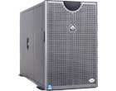
Cable Network Architecture: Overview
server(s)
cable headend
cable distribution
network
home
K & R

Slide 30
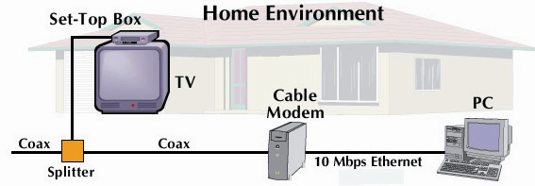
Cable Network Architecture: Overview
cable headend
cable distribution
network (simplified)
home
K & R

Slide 31
Cable Network Architecture: Overview
FDM (more shortly):
C
O
N
T
R
O
L
V
I
D
E
O
V
I
D
E
O
V
I
D
E
O
V
I
D
E
O
V
I
D
E
O
V
I
D
E
O
D
A
T
A
D
A
T
A
1
2
3
4
5
6
7
8
9
Channels
cable headend
cable distribution
network
home
K & R

Slide 32
Optical Fiber
Optical fiber:: a thin flexible medium capable of conducting optical rays. Optical fiber consists of a very fine cylinder of glass (core) surrounded by concentric layers of glass (cladding).
a signal-encoded beam of light (a fluctuating beam) is transmitted by total internal reflection.
Total internal reflection occurs in the core because it has a higher optical density (index of refraction) than the cladding.
Attenuation in the fiber can be kept low by controlling the impurities in the glass.

Slide 33
Optical Fiber
(a) Geometry of optical fiber
light
cladding
jacket
core
(b) Reflection in optical fiber
θ_{c}
Leon-Garcia & Widjaja:
Communication Networks

Slide 34
Optical Fiber
Lowest signal losses are for ultrapure fused silica – but this is hard to manufacture.
Optical fiber acts as a wavelength guide for frequencies in the range 10 ¹⁴ to 10 ¹⁵ HZ which covers the visible and part of the infrared spectrum.
Three standard wavelengths : 850 nanometers (nm.), 1300 nm, 1500 nm.
First-generation optical fiber :: 850 nm, 10’s Mbps using LED (light-emitting diode) sources.
Second and third generation optical fiber :: 1300 and 1500 nm using ILD (injection laser diode) sources, gigabits/sec.

Slide 35
Optical Fiber
Attenuation loss is lower at higher wavelengths.
There are two types of detectors used at the receiving end to convert light into electrical energy (photo diodes):
PIN detectors – less expensive, less sensitive
APD detectors
ASK is commonly used to transmit digital data over optical fiber {referred to as intensity modulation}.

Slide 36
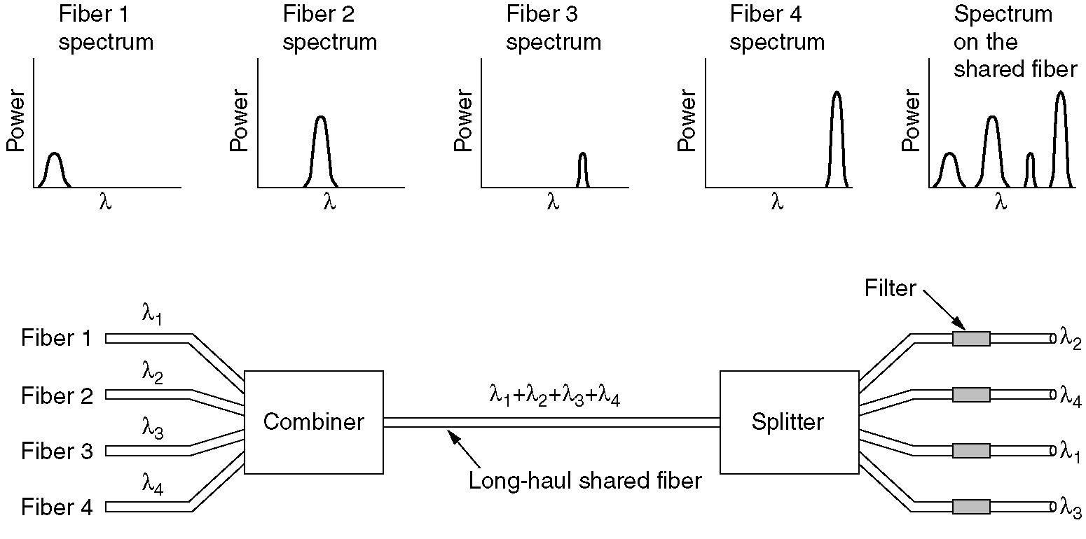
Wavelength Division Multiplexing
Wavelength division multiplexing.
Figure 2-32.
Tanenbaum

Slide 37
Optical Fiber
Three techniques:
Multimode step-index
Multimode graded-index
Single-mode step-index
Presence of multiple paths ➔ differences in delay ➔ optical rays interfere with each other.
A narrow core can create a single direct path which yields higher speeds.
WDM (Wavelength Division Multiplexing) yields more available capacity.

Slide 38
Optical Fiber Transmission Modes
DCC 8th Ed.
Stallings

Slide 39
Frequency Utilization for Fiber Applications
DCC 8th Ed.
Stallings
Notes:
In optical fiber, based on the attenuation characteristics of the medium and on properties of light sources and receivers, four transmission windows are appropriate, as shown in Stallings DCC8e Table 4.5. Note the tremendous bandwidths available. For the four windows, the respective bandwidths are 33 THz, 12 THz, 4 THz, and 7 THz. This is several orders of magnitude greater than the bandwidth available in the radio-frequency spectrum.
The four transmission windows are in the infrared portion of the frequency spectrum, below the visible-light portion, which is 400 to 700 nm. The loss is lower at higher wavelengths, allowing greater data rates over longer distances. Many local applications today use 850-nm LED light sources. Although this combination is relatively inexpensive, it is generally limited to data rates under 100 Mbps and distances of a few kilometers. To achieve higher data rates and longer distances, a 1300-nm LED or laser source is needed. The highest data rates and longest distances require 1500-nm laser sources. nb. WDM = wavelength division multiplexing (see Chapter 8).

Slide 40
Fiber to the Home (FIOS)
ONT
Internet
optical fibers
optical fiber
ONT
OLT
optical
splitter
central office
ONT
Optical links from central office to the home
Two competing optical technologies:
Passive Optical network (PON)
Active Optical Network (PAN)
Much higher Internet rates. Fiber also carries television and phone services
K & R

Slide 41
Wireless Communications (briefly)
An application of omni-directional wireless communications to provide high-speed communications among a number of computers located in close proximity.
In 1996 FCC in US announced its intentions to make 350 MHz of spectrum in the 5.15 to 5.35 GHz and 5.725 to 5.825 GHz bands available for unlicensed use in LAN applications.

Slide 42
Telecommunications Spectrum
DCC 8th Ed.
Stallings

Slide 43
Wireless Access Networks
shared wireless access network connects end system to router
via base station aka “access point”
Wireless LANs:
802.11b/g /n(WiFi): 11, 54, 100’s Mbps, Bluetooth, Zigbee (802.15.4)
Wide Area Wireless Access:
provided by telco operator
~1Mbps over cellular system (EVDO, HSDPA)
next up (?): WiMAX (10’s Mbps) over wide area
router
base
station
mobile
hosts
K & R

Slide 44
Wireless Multipath Interference
DCC 8th Ed.
Stallings

Slide 45
Residential Networks
Typical Residential network components:
DSL or cable modem
Router/firewall/NAT
Ethernet
Wireless access point (AP)
wireless
laptops
to/from
cable
headend
cable
modem
router/
firewall
wireless
access
point
Ethernet
K & R

Slide 46
Transmission Media Summary
Twisted pair
Noise, interference and attenuation are issues.
Cat5e modern required minimum (Fast Ethernet)
Dial-Up and DSL (ADSL) Connections
Coaxial cable
Baseband versus Broadband
Cable is HFC (Hybrid Fiber-Coax)
FDM and asymmetric channel capacities

Slide 47
Transmission Media Summary
Optical Fiber
Wavelength Division Multiplexing of light
Very High Capacities
Three standard wavelengths
Three standard techniques
Fiber to the home
Wireless Communications
‘crowded’ frequency spectrum
WLAN and Wide Area wireless
Common Residential ‘Last Hop’ to the Internet involves wireless AP (router, firewall, NAT).

