Slide 1
Physical Layer (Part 1)
Advanced Computer Networks

Slide 2
Physical Layer Outline (Part 1)
Definitions
Nyquist Theorem - noiseless
Shannon’s Result – with noise
Analog versus Digital
Amplifier versus Repeater
Advantages/Disadvantages of Analog vs Digital Transmissions

Slide 3
A Very Simple Abstraction
Transmitter
Receiver
Communication channel
Leon-Garcia & Widjaja:
Communication Networks

Slide 4
Physical Layer Definitions
The time required to transmit a character depends on both the encoding method and the signaling speed (i.e., the modulation rate - the number of times/sec the signal changes its voltage).
baud (D) - the number of changes per second.
bandwidth (H) - the range of frequencies that is passed by a channel. The transmitted signal is constrained by the transmitter and the nature of the transmission medium in cycles/sec (hertz).
channel capacity (C) – the rate at which data can be transmitted over a given channel under given conditions.{This is also referred to as data rate (R) .}

Slide 5
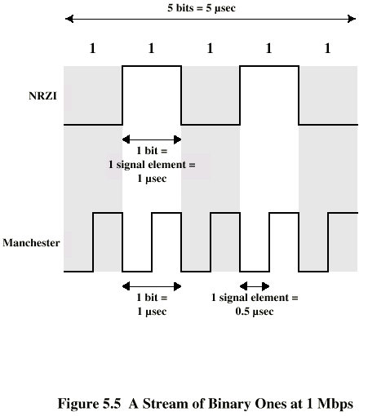
Modulation Rate
modulation rate
is doubled
DCC 6th Ed.
Stallings

Slide 6
Nyquist Theorem {assume a noiseless channel}
If an arbitrary signal is run through a low-pass filter of bandwidth H, the filtered signal can be completely reconstructed by making 2H samples/sec.
This implies for a signal of V discrete levels,
Note – a higher sampling rate is pointless because higher frequency signals have been filtered out.
Max. data rate :: C = 2H log ₂ (V) bits/sec.

Slide 7
Physical Transmission Issues
A(f)
A(f)
1
f
f
0
H
0
H
(b) Maximum pulse transmission rate is 2H pulses/second
Channel
t
t
Leon-Garcia & Widjaja:
Communication Networks

Slide 8
Voice-grade Phone Line
Example 1. {sampling rate}
H = 4000 Hz
2H = 8000 samples/sec.
➔ sample every 125 microseconds!!
Example 2. {noiseless capacity}
D = 2400 baud {note D = 2H}
V = each pulse encodes 16 levels
C = 2H log ₂ (V) = D x log ₂ (V)
= 2400 x 4 = 9600 bps.

Slide 9
Signal Constellations
B_{k}
B_{k}
A_{k}
A_{k}
4 “levels”/ pulse
2 bits / pulse
2D bits per second
16 “levels”/ pulse
4 bits / pulse
4D bits per second
Leon-Garcia & Widjaja:
Communication Networks

Slide 10
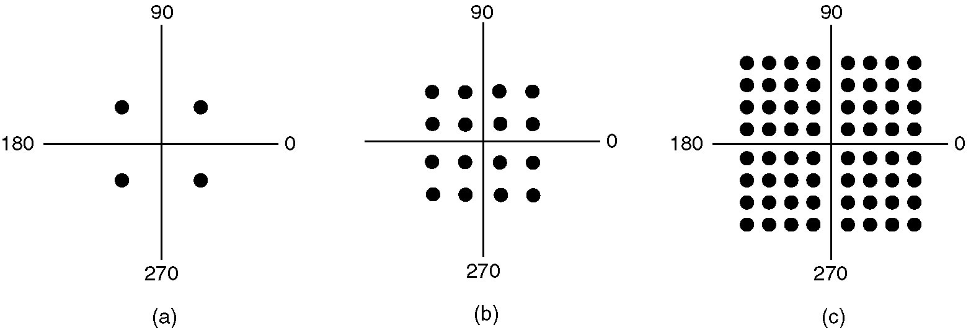
Constellation Diagrams
(a) QPSK. (b) QAM-16. (c) QAM-64.
Figure 2-25.
Tanenbaum

Slide 11
Signal to Noise Ratio (SNR)
signal
noise
signal + noise
High
SNR
t
t
t
signal
noise
signal + noise
Low
SNR
t
t
t
Average Signal Power
SNR =
Average Noise Power
SNR (dB) = 10 log₁₀ SNR
Leon-Garcia & Widjaja:
Communication Networks

Slide 12
Shannon’s Channel Capacity Result {assuming only thermal noise}
For a noisy channel of bandwidth H Hz. and a signal-to-noise ratio SNR, the max. data rate::
Regardless of the number of signal levels used and the frequency of the sampling.
C = H log ₂ (1 + SNR)

Slide 13
Shannon Example – Noisy Channel
Telephone channel (3400 Hz) at 40 dB SNR
C = H log ₂ (1+SNR) b/s
SNR (dB) = 40 dB
40 =10 log ₁₀ (SNR)
4 = log ₁₀ (SNR)
SNR =10,000
C = 3400 log ₂ (10001) = 44.8 kbps
Leon-Garcia & Widjaja:
Communication Networks

Slide 14
Data Communications Concepts
Analog and Digital correspond roughly to continuous and discrete , respectively.
These two terms can be used in three contexts: data, signals, transmissions.
1. data:: entities that convey meaning.
analog – voice and video are continuously
varying patterns of intensity.
digital - take on discrete values (e.g., integers, ASCII text).
Data are propagated from one point to another by means of electrical signals.
DCC 6th Ed.
Stallings

Slide 15
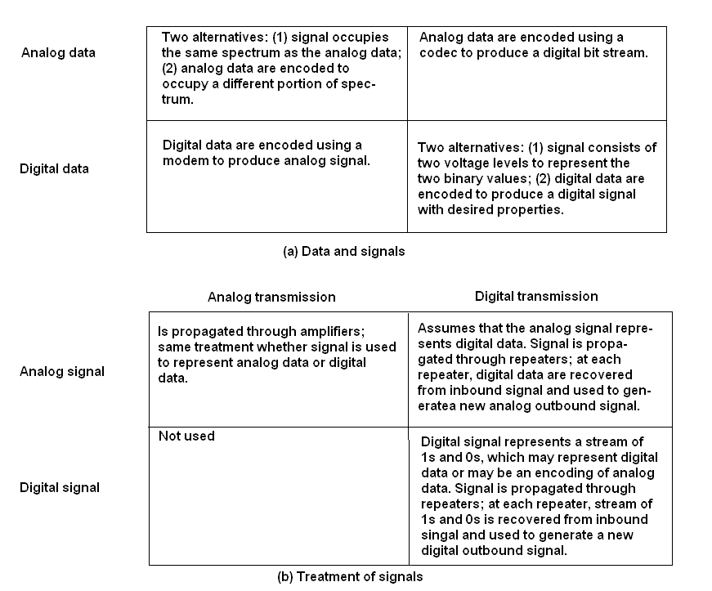
Analog vs Digital (three contexts)
DCC 6th Ed.
Stallings

Slide 16
Analog and Digital Signaling
signals:: electric or electromagnetic encoding of data.
2. signaling :: is the act of propagating the signal along a suitable medium.
Analog signal – a continuously varying electromagnetic wave that may be propagated over a variety of medium depending on the spectrum (e.g., wire, twisted pair, coaxial cable, fiber optic cable and atmosphere or space propagation).

Slide 17
Analog and Digital Signaling
digital signal – a sequence of voltage pulses that may be transmitted over a wire medium.
Note – analog signals to represent analog data and digital signals to represent digital data are not the only possibilities.

Slide 18
Signals Details
Means by which data are propagated.
Analog Signals
Continuously variable
Various media
wire, fiber optic, space
Speech bandwidth 100Hz to 7kHz
Telephone bandwidth 300Hz to 3400Hz
Video bandwidth 4MHz
Digital Signals
Use two DC components
DCC 6th Ed.
Stallings

Slide 19
Analog and Digital Signaling
Digital data can be represented by analog signals using a modem (modulator/demodulator).
The digital data is encoded on a carrier frequency.
Analog data can be represented by digital signals using a codec (coder-decoder).

Slide 20
Analog Signals Carrying Analog and Digital Data
DCC 6th Ed.
Stallings

Slide 21
Digital Signals Carrying Analog and Digital Data
DCC 6th Ed.
Stallings

Slide 22
Analog vs Digital Signaling
Digital signaling is:
Cheaper
Less susceptible to noise interference
Suffers more attenuation.

Slide 23
Attenuation
Attenuation of a signal::
the reduction or loss of signal strength (power) as it is transferred across a system.
Attenuation is an increasing function of frequency.
The strength of the received signal must be strong enough for detection and must be higher than the noise to be received without error.

Slide 24
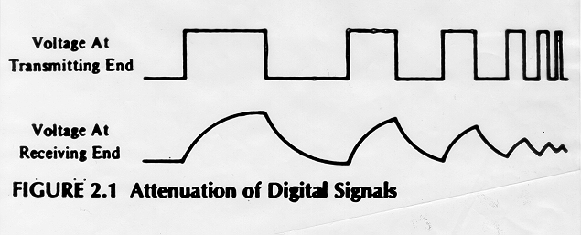
Attenuation

Slide 25
Attenuation vs Frequency
30
26 gauge
24 gauge
27
24
22 gauge
21
18
Attenuation (dB/mi)
15
19 gauge
12
9
6
3
f (kHz)
1
10
100
1000
Leon-Garcia & Widjaja:
Communication Networks

Slide 26
Analog and Digital Transmissions
{Stalling’s third context}
3. Transmissions :: communication of data by the propagation and processing of signals.
Both analog and digital signals may be transmitted on suitable transmission media.
[Stalling’s argument] The way the signals are “treated” is a function of the transmission system and here lies the crux of the distinction between transmission types.

Slide 27
Analog vs Digital Transmission
(a) Analog transmission: all details must be reproduced accurately
Sent
Received
e.g. AM, FM, TV transmission
(b) Digital transmission: only discrete levels need to be reproduced
Sent
Received
e.g digital telephone, CD Audio
Leon-Garcia & Widjaja:
Communication Networks

Slide 28
Analog vs Digital (three contexts)
DCC 6th Ed.
Stallings

Slide 29
Analog Transmissions
Analog transmission:: a means of transmitting analog signals without regard to their content (i.e., the signals may represent analog data or digital data).
Transmissions are attenuated over distance.
Analog signal – the analog transmission system uses amplifiers to boost the energy in the signal.

Slide 30
Analog Transmissions
Amplifiers boost the energy ➔ this
amplifies the signal and amplifies the noise.
The cascading of amplifiers distorts the signal.
Note – voice (analog data) can tolerate much distortion but with digital data, distortion introduces errors.

Slide 31
Digital Transmissions
Digital transmissions:: are concerned with the content of the signal. Attenuation is overcome without amplifying the noise.
1. Analog signals {assumes digital data}:
With retransmission devices [analog repeater] at appropriate points the device recovers the digital data from the analog signal and generates a new clean analog signal.
the noise is not cumulative!!

Slide 32
Digital Transmissions
2. digital signals - digital repeaters are used to attain greater distances.
The digital repeater receives the digital signal, recovers the patterns of 0’s and 1’s and retransmits a new digital signal.
The treatment is the same for analog and digital data.

Slide 33
Analog vs Digital Transmission
Analog Transmission
Source
Amplifier
Amplifier
Destination
Digital Transmission
Source
Repeater
Repeater
Destination
Leon-Garcia & Widjaja:
Communication Networks

Slide 34
Analog Transmissions
Attenuated &
distorted signal
+
noise
Recovered signal
+
residual noise
Amp.
Equalizer
Amplifier
Leon-Garcia & Widjaja:
Communication Networks

Slide 35
Digital Transmissions
Decision Circuit.
& Signal
Regenerator
Amplifier
Equalizer
Timing
Recovery
Repeater (digital signal)
Leon-Garcia & Widjaja:
Communication Networks

Slide 36
Digital vs Analog Transmissions
Digital transmission advantages
Superior cost of digital technology
Low cost LSI/VLSI technology
Repeaters versus amplifiers costs
Superior quality {Data integrity}
Longer distances over lines with lower error rates
Capacity utilization
Economical to build high bandwidth links
High degree of multiplexing easier with digital techniques
TDM (Time Division Multiplexing) is easier and
cheaper than FDM (Frequency Division Multiplexing).
DCC 6th Ed.
Stallings

Slide 37
Digital vs Analog Transmissions
Digital transmission advantages
Security & Privacy
Encryption techniques readily applied to digitized data.
Integration
Can treat analog and digital data similarly.
Economies of scale from integrating voice, video and data.
Analog transmission advantages
Digital signaling not as versatile or practical (digital impossible for satellite and microwave systems).
LAN star topology reduces the severity of the noise and attenuation problems.
DCC 6th Ed.
Stallings

Slide 38
Physical Layer Summary (Part 1)
Definitions of bandwidth, capacity and modulation rate.
Nyquist Theorem
noiseless channel, sampling rate
Shannon’s Result
Channel with thermal noise, voice-grade line, SNR, constellations

Slide 39
Physical Layer Summary (Part 1)
Analog versus Digital
Data, signals, transmissions
Attenuation of the signal as a function of transmission frequency.
Amplifier versus Repeater
Effect of cascading amplifiers
Analog and digital repeaters
Advantages/Disadvantages of Analog vs Digital Transmissions

