Slide 1
Wireless Sensor Networks (WSNs)
Advanced Computer Networks

Slide 2
WSN Outline
Introduction, Mote Revolution
Wireless Sensor Network (WSN) Applications
WSN Details
Types of Wireless Sensor Networks (WSNs)
Tiered Architectures
Dynamic Cluster Formation
Power-Aware MAC Protocols
SMAC, TMAC, WiseMAC, TRAMA, SCP-MAC, AS-MAC, Crankshaft

Slide 3
Wireless Sensor Networks
A distributed connection of nodes that coordinate to perform a common task.
In many applications, the nodes are battery powered and it is often very difficult to recharge or change the batteries.
Prolonging network lifetime is a critical issue.
Sensors often have long period between transmissions (e.g., in seconds).
Thus, a good WSN MAC protocol needs to be energy efficient.

Slide 4
WSN Outline
Introduction, Mote Revolution
Wireless Sensor Network (WSN) Applications
WSN Details
Types of Wireless Sensor Networks (WSNs)
Tiered Architectures
Dynamic Cluster Formation
Power-Aware MAC Protocols
SMAC, TMAC, WiseMAC, TRAMA, SCP-MAC, AS-MAC, Crankshaft

Slide 5
Camalie Vineyards
Case Study in Crossbow Mote Deployment
Copyright 2006 Camalie Vineyards, Not to be reproduced without written permission

Slide 6
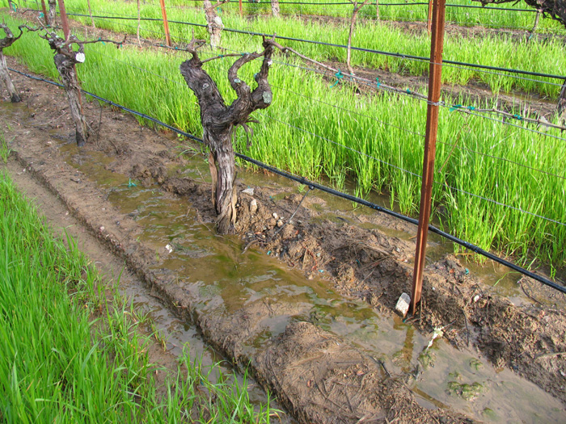
Water in the Vineyard

Slide 7
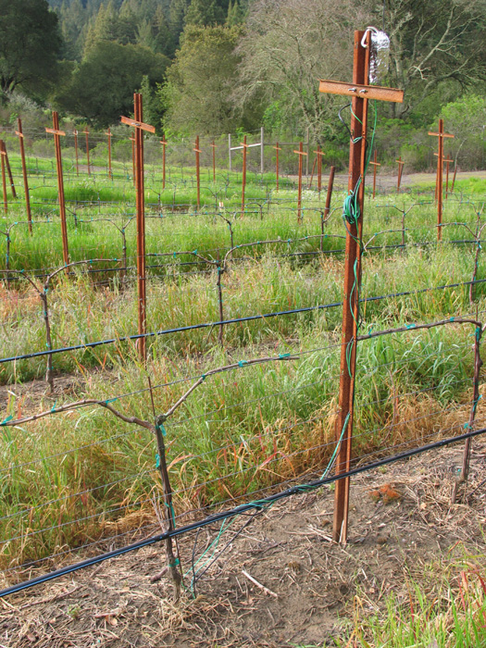
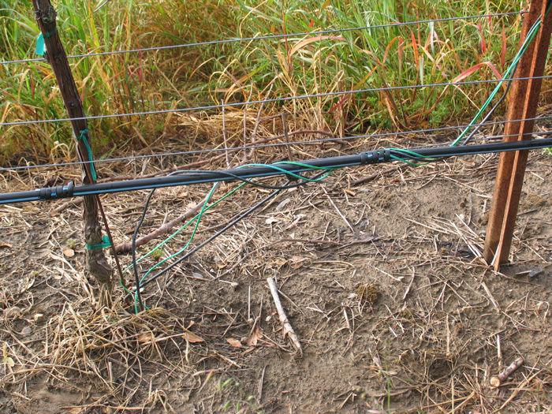
Vineyard Installation
At each Mote location:
2 soil moisture sensors
12” and 24” depth
1 soil temp sensor to calibrate
soil moisture sensors

Slide 8
Power Supply
2 month max battery life now with 10 minute sampling interval
Decided to use solar power, always there when doing irrigation. Solar cell $10 in small quantities and need a $.50 regulator.

Slide 9
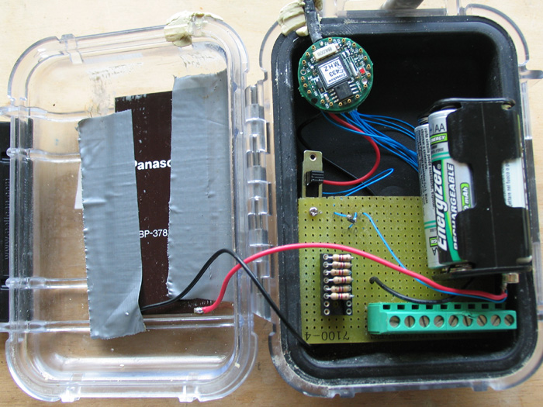
Vineyard Mote Prototype
433MHz Mica2dot
Solar power supply
Up to 6 resistive sensor inputs

Slide 10
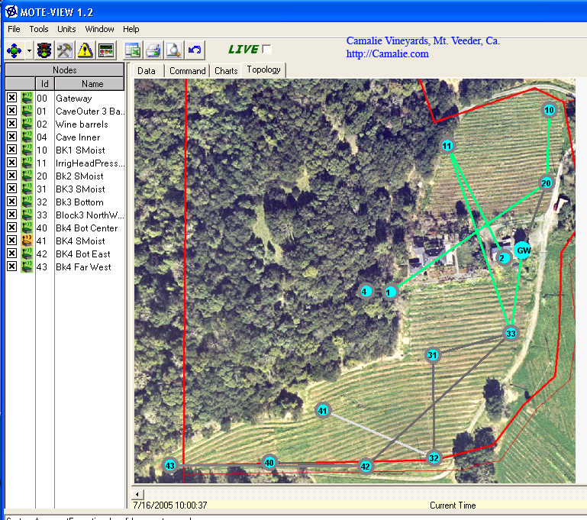
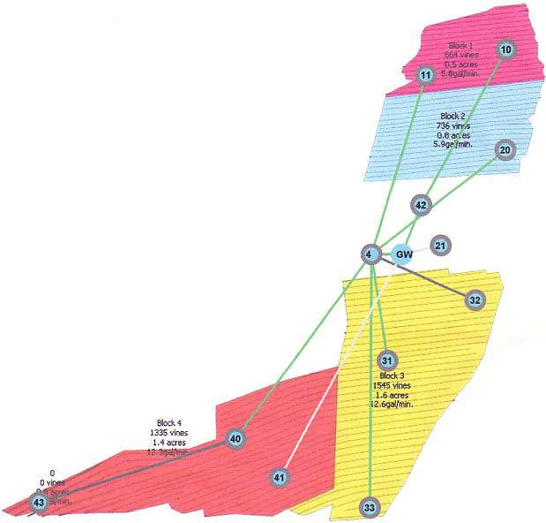
Network Maps
13 nodes late 2005, 18 nodes in 2006
Irrigation Block Map

Slide 11
Soil Moisture Data
Red = 12” depth soil moisture
Green= 24” depth soil moisture
Note delay deeper
More frequent, shorter watering keeps water shallow

Slide 12
WSNs for Assisted Living
Alarm-Net
University of Virginia
Berkeley Fall Detection System

Slide 13
WSNs for Assisted Living

Slide 14
WSNs for Assisted Living
Two-Tiered
WSN
Architecture

Slide 15
Berkeley Fall Detection System

Slide 16
Berkeley Fall Detection System

Slide 17
Outline
Introduction, Definition, Pictures
Wireless Sensor Network (WSN) Applications
WSN Details
Types of Wireless Sensor Networks (WSNs)
Tiered Architectures
Dynamic Cluster Formation
Power-Aware MAC Protocols
SMAC, TMAC, WiseMAC, TRAMA, SCP-MAC, AS-MAC, Crankshaft

Slide 18
Wireless Sensor Networks
Another attribute is scalability and adaptability to change in network size, node density and topology.
In general, nodes can die, join later or be mobile.
Often high bandwidth is not important.
Nodes can take advantage of short-range, multi-hop communication to conserve energy.

Slide 19
Wireless Sensor Networks
Sources of energy waste:
Idle listening, collisions, overhearing and control overhead and overmitting.
Idle listening dominates (measurements show idle listening consumes between 50-100% of the energy required for receiving.)
Idle listening:: listen to receive possible traffic that is not sent.
Overmitting:: transmission of message when receiver is not ready.

Slide 20
Power Measurements

Slide 21
WSN Communication Patterns
Broadcast:: e.g., Base station transmits to all sensor nodes in WSN.
Multicast:: sensor transmit to a subset of sensors (e.g. cluster head to cluster nodes)
Convergecast:: when a group of sensors communicate to one sensor (BS, cluster head, or data fusion center).
Local Gossip:: sensor sends message to neighbor sensors.

Slide 22
Wireless Sensor Networks
Duty cycle:: ratio between listen time and the full listen-sleep cycle.
central approach – lower the duty cycle by turning the radio off part of the time.
Three techniques to reduce the duty cycle:
TDMA
Schedule contention periods
LPL (Low Power Listening)

Slide 23
Techniques to Reduce Idle Listening
TDMA requires cluster-based or centralized control.
Scheduling – ensures short listen period when transmitters and listeners can rendezvous and other periods where nodes sleep (turn off their radios).
LPL – nodes wake up briefly to check for channel activity without receiving data.
If channel is idle, node goes back to sleep.
If channel is busy, node stays awake to receive data.
A long preamble (longer than poll period) is used to assure than preamble intersects with polls.

Slide 24
Outline
Introduction, Definition, Pictures
Wireless Sensor Network (WSN) Applications
WSN Details
Types of Wireless Sensor Networks (WSNs)
Tiered Architectures
Dynamic Cluster Formation
Power-Aware MAC Protocols
SMAC, TMAC, WiseMAC, TRAMA, SCP-MAC, AS-MAC, Crankshaft

Slide 25
Tiered WSN Architectures
[ Stathopoulos]

Slide 26
Dynamic Cluster Formation
Wireless Sensor Networks

Slide 27
Choosing Cluster Heads/ Forming Clusters
Two-tier scheme:
A fixed number of cluster heads that communicate with BS (base station).
Nodes in cluster communicate with head (normally TDMA).
TDMA allows fixed schedule of slots for
sensor to send to cluster head and receive head transmissions.
BS

Slide 28
Choosing Cluster Heads/ Forming Clusters
Periodically select new cluster heads to minimize power consumption and maximize WSN lifetime.
More complex problem when size of cluster changes dynamically.
As time goes by, some sensor nodes die!
Not worried about coverage issues!
X
X
X
BS
X
X

Slide 29
Dynamic Cluster Formation
TDMA cluster algorithms:
LEACH, Bluetooth, …
Rick Skowyra’s MS thesis:
‘Energy Efficient Dynamic Reclustering Strategy for WSNs’
‘Leach-like’ with a fitness function and periodic reclustering.
He designed a distributed genetic algorithm to speed the recluster time.

Slide 30
Power-Aware MAC Protocols
Wireless Sensor Networks

Slide 31
Power Aware MAC Protocols
1997
1998 PAMAS
1999
2000
2001 SMAC
2002 LPL NPSM
2003 TMAC TinyOS EMACs TRAMA Sift
2004 BMAC DMAC DSMAC LMAC WiseMAC
2005 PMAC ZMAC SP
2006 SCP-MAC
2007 Crankshaft
2008 AS-MAC

Slide 32
Power Aware MAC Protocols
Three approaches to saving power:
1. TDMA: TRAMA, EMACs, LMAC
2. Schedule: PAMAS, SMAC, TMAC, DMAC, PMAC, SCP-MAC, Crankshaft, AS-MAC
3. Low Power Listening: LPL, BMAC, WiseMAC
Cross-Layering: SP, BSD

Slide 33
Sensor-MAC (S-MAC)
All nodes periodically listen, sleep and wakeup. Nodes listen and send during the active period and turn off their radios during the sleep period.
The beginning of the active period is a SYNC period used to accomplish periodic synchronization and remedy clock drift {nodes broadcast SYNC frames}.
Following the SYNC period, data may be transferred for the remainder of the fixed-length active period using RTS/CTS for unicast transmissions.
Long frames are fragmented and transmitted as a burst.
SMAC controls the duty cycle to tradeoff energy for delay.
However, as density of WSN grows, SMAC incurs additional overhead in maintaining neighbors’ schedules.

Slide 34
S-MAC

Slide 35
Timeout-MAC (TMAC)
TMAC employs an adaptive duty cycle by using a very short listening window at the beginning of each active period.
After the SYNC portion of the active period, RTS/CTS is used in a listening window. If no activity occurs within a timeout interval (15 ms), the node goes to sleep.
TMAC saves power at the cost of reduced throughput and additional delay.

Slide 36
T-MAC

Slide 37
Scheduled Channel Polling (SCP-MAC)
With channel polling (the LPL scheme), receiver efficiency is gained through cost to sender.
LPLs are very sensitive to tuning for neighborhood size and traffic rate.
By synchronizing channel polling times of all neighbors, long preambles are eliminated and ultra-low duty cycles (below the LPL 1-2% limits) are possible.

Slide 38
Scheduled Channel Polling (SCP-MAC)
The issue is knowing my neighbors’ schedule information.
SCP piggybacks schedule info on data packets when possible or a node broadcasts its schedule in a SYNC packet in synch period (as in SMAC)
Knowing schedules ➔ short wakeup tone.
Optimal synchronization reduces overhearing.

Slide 39
SCP-MAC

Slide 40
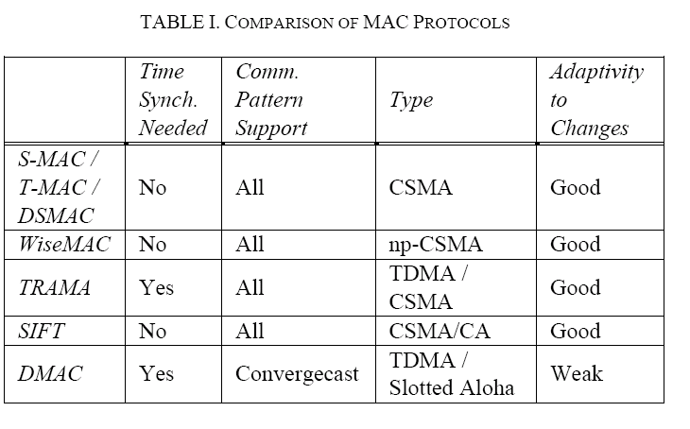
Table I from WSN Survey Paper

Slide 41
WSN Summary
Introduction, Mote Revolution
Wireless Sensor Network (WSN) Applications
WSN Details
Types Wireless Sensor Networks (WSNs)
Tiered Architectures
Dynamic Cluster Formation
Power-Aware MAC Protocols
SMAC, TMAC, SCP-MAC

