Slide 1
Asynchronous Transfer Mode (ATM)
Advanced Computer Networks

Slide 2
ATM Outline
ATM Introduction
Motivation for ATM Architecture
Design Assumptions
ATM Adaptation Layers
Old ATM Design
Revised ATM Design
AAL Details
MPLS

Slide 3
ATM Introduction
ITU-T lead the standards development.
ATM Forum ensures interoperability among private and public ATM implementations.
commonly used to implement WANs.
DSL uses ATM for multiplexing and switching.
used as a backbone in IP networks and Internet.
DCC 9th Ed.
Stallings
Notes:
The International Telecommunication Union Telecommunication Standardization Sector (ITU-T) is the lead organization in developing ATM standards. In addition, the ATM Forum (now part of the Broadband Forum) was founded to ensure interoperability among public and private ATM implementations.
ATM was intended to be a universal networking technology, with much of the switching and routing capability implemented in hardware, and with the ability to support IP-based networks and circuit-switched networks. It was also anticipated that ATM would be used to implement local area networks (LANs). ATM never achieved this comprehensive deployment. However, ATM remains an important technology. ATM is commonly used telecommunications providers to implement wide-area networks. Many DSL implementations use ATM over the basic DSL hardware for multiplexing and switching, and ATM is used as a backbone network technology in numerous IP networks and portions of the Internet.
A number of factors have led to this lesser role for ATM. IP, with its many associated protocols provides an integrative technology that is more scalable and less complex than ATM. In addition, the need to use small fixed-sized cells to reduce jitter has disappeared as transport speeds have increased. The development of voice and video over IP protocols have provided an integration capability at the IP level.
Perhaps the most significant development related to the reduced role for ATM is the widespread acceptance of Multiprotocol Label Switching (MPLS). MPLS is a layer 2 connection-oriented packet-switching protocol that, as the name suggests, can provide a switching service for a variety of protocols and applications, including IP, voice, and video. We introduce MPLS in Chapter 21.
It remains worthwhile to study ATM for two reasons. First, ATM is still commonly deployed in wide-area networks and DSL broadband access configurations. Second, many of the concepts in ATM have been adopted in the MPLS standards.

Slide 4
Issues Driving LAN Changes
Traffic Integration
Voice, video and data traffic
Multimedia became the ‘buzz word’
One-way batch Web traffic
Two-way batch voice messages
One-way interactive Mbone broadcasts
Two-way interactive video conferencing
Quality of Service guarantees (e.g. limited jitter, non-blocking streams)
LAN Interoperability
Mobile and Wireless nodes

Slide 5
Stallings’ “High-Speed Networks”
Backbone

Slide 6
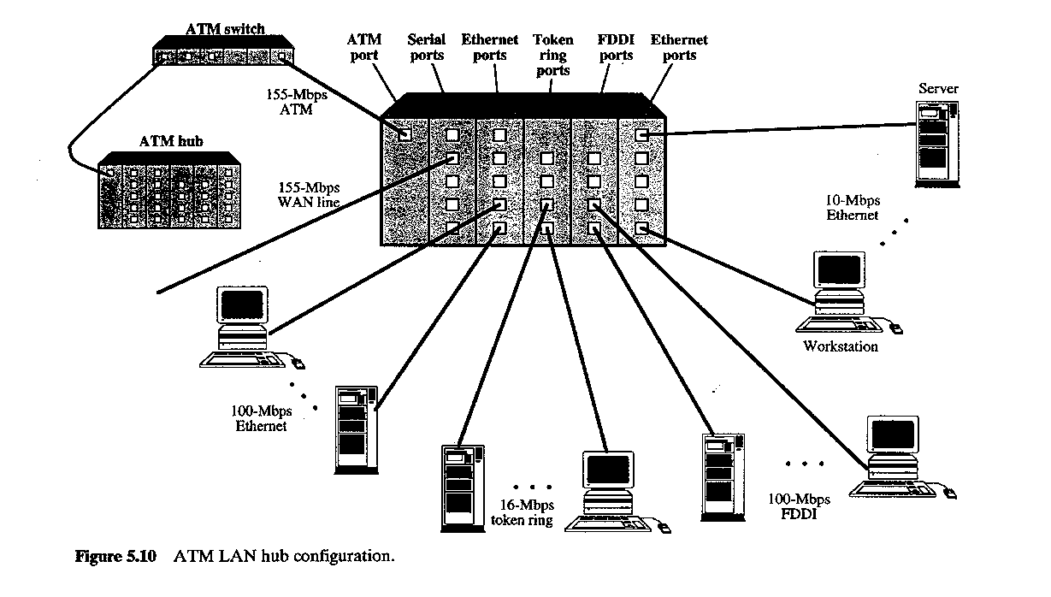
Stallings’ “High Speed Networks”

Slide 7
ATM Adaptation Layers
Voice
A/D
AAL
s_{1 ,} s₂ …
cells
Digital voice samples
Video
A/D
…
Compression
AAL
cells
picture frames
compressed frames
Data
AAL
Bursty variable-length packets
cells
Leon-Garcia & Widjaja:
Communication Networks

Slide 8
Asynchronous Transfer Mode (ATM)
Voice
Data packets
MUX
Wasted bandwidth
Images
TDM
4 3 2 1 4 3 2 1 4 3 2 1
ATM
4 3 1 3 2 2 1
Leon-Garcia & Widjaja:
Communication Networks

Slide 9
ATM
ATM standard (defined by CCITT) was widely accepted by common carriers as mode of operation for communication (particularly BISDN).
ATM is a form of cell switching using small fixed-sized packets.
Basic ATM Cell Format
5 Bytes
48 Bytes
Header
Payload

Slide 10
ATM Conceptual Model Four Design Assumptions
1. ATM network will be organized as a hierarchy.
User’s equipment connects to networks via a UNI (User-Network Interface).
Connections between provided networks are made through NNI (Network-Network Interface).
2. ATM will be connection-oriented.
A connection (an ATM channel) must be established before any cells are sent.

Slide 11
ATM Interfaces
DCC 9th Ed.
Stallings
Notes:
As shown in Stallings DCC9e Figure 11.3, the UNI connects and end system to an ATM switch. An end system can be an end user device, such as a telephone, workstation, video camera or display, and server. An end system can also be a network device, such as an IP router, a local area network (LAN) switch, or a telephone switch. Note that the UNI specification is used between a public ATM network and a private ATM network. In this case, the ATM switch in the private network that has a direct link to an ATM switch in the public network is considered an end system by the public ATM network.
The NNI connects two ATM switches in the same network. An additional specification, the broadband intercarrier interface (B-ICI), connects two public switches from different service providers. These interfaces include definition of routing and quality of service functionality.

Slide 12
ATM Connections
two levels of ATM connections:
virtual path connections (VPC)
virtual channel connections (VCC)
indicated by two fields in the cell header:
virtual path identifier VPI
virtual channel identifier VCI

Slide 13
ATM Virtual Connections
Virtual Path Connection (VPC)
bundle of Virtual Channel Connections (VCC) with same end points.
DCC 9th Ed.
Stallings
Notes:
For ATM, a second sublayer of processing has been introduced that deals with the concept of virtual path (Stallings DCC9e Figure 11.4). A virtual path connection (VPC) is a bundle of VCCs that have the same endpoints. Thus, all of the cells flowing over all of the VCCs in a single VPC are switched together. The virtual path concept was developed in response to a trend in high-speed networking in which the control cost of the network is becoming an increasingly higher proportion of the overall network cost. The virtual path technique helps contain the control cost by grouping connections sharing common paths through the network into a single unit. Network management actions can then be applied to a small number of groups of connections instead of a large number of individual connections.

Slide 14
ATM Conceptual Model Assumptions (cont.)
3. Vast majority of ATM networks will run on optical fiber networks with extremely low error rates.
4. ATM must support low cost attachments.
This decision lead to a significant decision: to prohibit cell reordering in ATM networks.
➔ ATM switch design is more difficult.

Slide 15
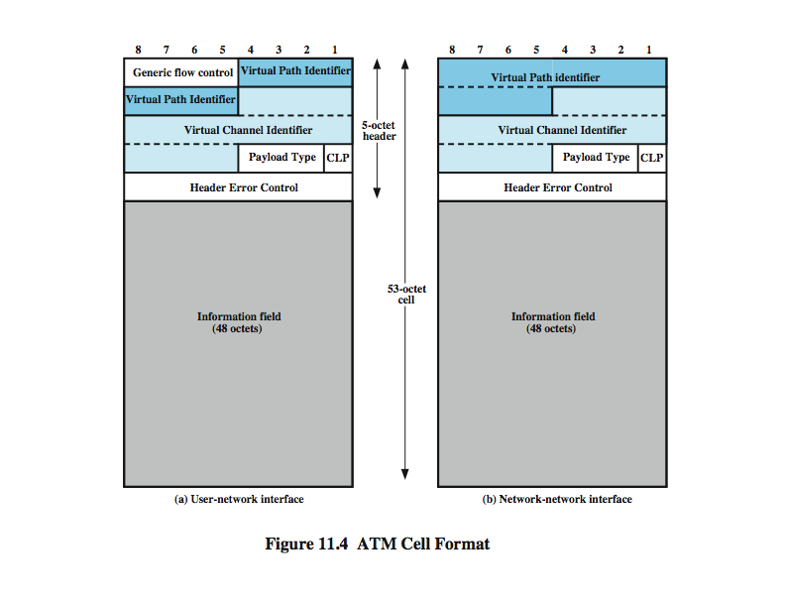
ATM Cell Formats
DCC 9th Ed.
Stallings
Notes:
The asynchronous transfer mode makes use of fixed-size cells, consisting of a 5-octet header and a 48-octet information field. There are several advantages to the use of small, fixed-size cells. First, the use of small cells may reduce queuing delay for a high-priority cell, because it waits less if it arrives slightly behind a lower-priority cell that has gained access to a resource (e.g., the transmitter). Second, it appears that fixed-size cells can be switched more efficiently, which is important for the very high data rates of ATM [PARE88]. With fixed-size cells, it is easier to implement the switching mechanism in hardware.
Stallings DCC9e Figure 11.6a shows the cell header format at the user-network interface, & Stallings DCC9e Figure 11.6b shows the cell header format internal to the network.

Slide 16
Payload Type (PT) Field Coding
DCC 9th Ed.
Stallings
Notes:
Stallings DCC 9e Table 11.2 shows the interpretation of the PT bits

Slide 17
ATM Cell Switching
1
Switch
voice
67
1
…
video
67
2
5
video
25
voice
32
25
N
75
32
1
67
data
39
3
32
3
39
6
data
32
video
61
61
2
67
…
…
N
video
75
N
Leon-Garcia & Widjaja:
Communication Networks

Slide 18
Two Levels of ATM Switches
VP3
a
VP5
a
b
ATM
Sw
1
ATM
DCC
ATM
Sw
2
b
c
ATM
Sw
3
c
d
e
VP2
VP1
ATM
Sw
4
d
Sw = switch
e
Digital Cross Connect
Only switches virtual paths
Leon-Garcia & Widjaja:
Communication Networks

Slide 19
ATM Protocol Architecture
ATM Adaptation Layers (AAL) – the protocol for packaging data into cells is collectively referred to as AAL.
Must efficiently package higher level data such as voice samples, video frames and datagram packets into a series of cells.
Design Issue: How many adaptation layers should there be?

Slide 20
ATM Protocol Architecture
Management plane
Plane management
Control plane
User plane
Layer management
Higher layers
Higher layers
ATM Adaptation Layer
ATM layer
Physical layer
Leon-Garcia & Widjaja:
Communication Networks

Slide 21
ATM in the Protocol Stack
User information
User information
AAL
AAL
ATM
ATM
ATM
ATM
PHY
PHY
PHY
PHY
…
End system
Network
End system
Leon-Garcia & Widjaja:
Communication Networks

Slide 22
Original ATM Architecture
CCITT envisioned four classes of applications (A-D) requiring four distinct adaptation layers (1-4) which would be optimized for an application class:
Constant bit-rate applications CBR
Variable bit-rate applications VBR
Connection-oriented data applications
Connectionless data application

Slide 23
ATM Architecture
An AAL was further divided into:
Convergence Sublayer (CS)
manages the flow of data to and from SAR sublayer.
Segmentation and Reassembly Sublayer
(SAR)
breaks data into cells at the sender and reassembles
cells into larger data units at the receiver.

Slide 24
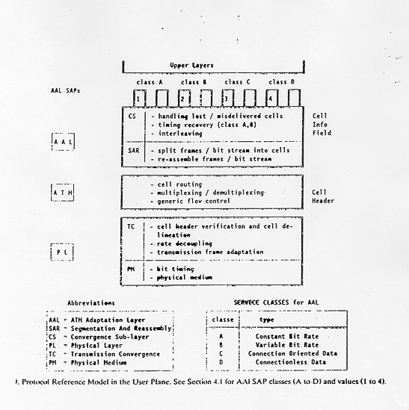
Original ATM Architecture

Slide 25
Physical Layer ATM Adjustments
ATM layer
Transmission convergence sublayer
Physical layer
Physical medium dependent sublayer
Physical medium

Slide 26
Original ATM Architecture
The AAL interface was initially defined as classes A-D with SAP (Service Access Points) for AAL1-4.
AAL3 and AAL4 were so similar that they were merged into AAL3/4.
The data communications community concluded that AAL3/4 was not suitable for data communications applications. They pushed for standardization of AAL5 (also referred to as SEAL – the Simple and Efficient Adaptation Layer).
AAL2 was not initially deployed.

Slide 27
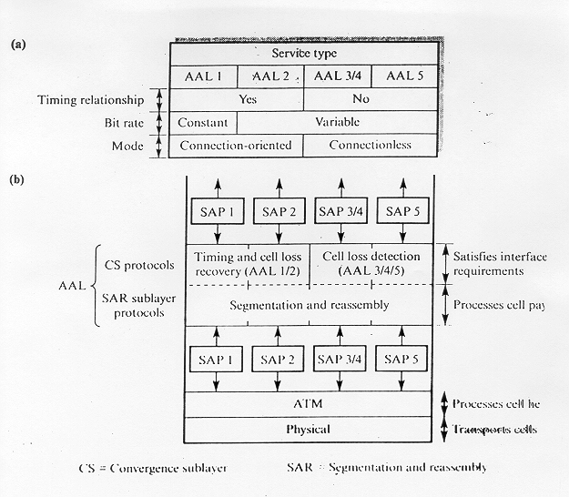
Revised ATM Architecture

Slide 28
Revised ATM Service Categories
Class | Description | Example
CBR | Constant Bit Rate | T1 circuit
RT-VBR | Real Time Variable Bit Rate | Real-time videoconferencing
NRT-VBR | Non-real-time Variable Bit Rate | Multimedia email
ABR | Available Bit Rate | Browsing the Web
UBR | Unspecified Bit Rate | Background file transfer

Slide 29
QoS, PVC, and SVC
Quality of Service (QoS) requirements are handled at connection time and viewed as part of signaling (e.g., RSVP).
ATM provides permanent virtual connections and switched virtual connections.
Permanent Virtual Connections (PVC)
permanent connections set up manually by network manager.
Switched Virtual Connections (SVC)
set up and released on demand by the end user via signaling procedures.

Slide 30
AAL 1
(b) CS PDU with pointer in structured data transfer
47 Bytes
AAL 1 Pointer
1 Byte
46 Bytes
optional
(a) SAR PDU header
CSI
Seq. Count
SNP
1 bit 3 bits 4 bits
Leon-Garcia & Widjaja:
Communication Networks

Slide 31
AAL 1
Higher layer
User data stream
b₁ b₂ b₃
…
Convergence sublayer
CS PDUs
47
47
47
SAR PDUs
SAR sublayer
H
H
H
1 47
1 47
1 47
ATM layer
H
H
ATM Cells
H
5 48
5 48
5 48
Leon-Garcia & Widjaja:
Communication Networks

Slide 32
AAL 3/4 CS and SAR PDUs
(a) CPCS-PDU format
Header
Trailer
CPI Btag BASize
CPCS - PDU Payload
Pad
AL Etag Length
1 1 2 1 - 65,535 0-3 1 1 2 (bytes) (bytes) (bytes)
(b) SAR PDU format
Header (2 bytes)
Trailer (2 bytes)
ST SN MID
SAR - PDU Payload
LI CRC
2 4 10 44 6 10 (bits) (bytes) (bits)
Leon-Garcia & Widjaja:
Communication Networks

Slide 33
AAL 3/4
Higher layer
Information
User message
Service specific convergence sublayer
Assume null
Common part convergence sublayer
Pad message to multiple of 4 bytes. Add header and trailer.
H
Information
PAD
T
4
4
Each SAR-PDU consists of 2-byte header, 2-byte trailer, and 44-byte payload.
SAR sublayer
…
2 44 2
2 44 2
2 44 2
ATM layer
…
Leon-Garcia & Widjaja:
Communication Networks

Slide 34
AAL 5
Convergent Sublayer Format
Information
Pad
UU CPI Length CRC
0 - 65,535 0-47 1 1 2 4 (bytes) (bytes)
SAR Format
ATM
Header
48 bytes of Data
1-bit end-of-datagram field (PTI)
Leon-Garcia & Widjaja:
Communication Networks

Slide 35
AAL 5
Higher layer
Information
Service specific convergence sublayer
Assume null
Common part convergence sublayer
Information
PAD
T
SAR sublayer
…
48 (0)
48 (0)
48 (1)
ATM layer
…
Leon-Garcia & Widjaja:
Communication Networks
PTI = 1
PTI = 0
PTI = 0

Slide 36
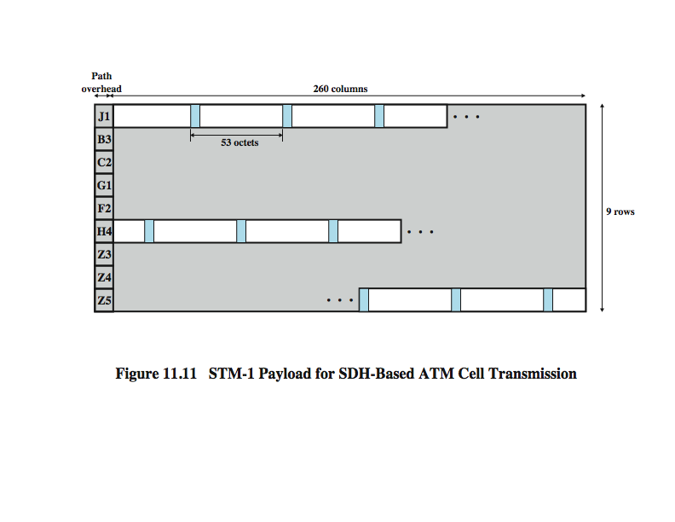
STM-1 (STS-3) Payload for SDH-Based ATM Cell Transmission
Notes:
For the SDH-based physical layer, framing is imposed using the STM-1 (STS-3) frame. Stallings DCC9e Figure 11.13 shows the payload portion of an STM-1 frame (for comparison, see Stallings DCC9e Figure 8.11).
The H4 octet in the path overhead is set at the sending side to indicate the next occurrence of a cell boundary. That is, the value in the H4 field indicates the number of octets to the first cell boundary following the H4 octet. The permissible range of values is 0 to 52.
The advantages of the SDH-based approach include:
It can be used to carry either ATM-based or STM-based (synchronous transfer mode) payloads, making it possible to initially deploy a high-capacity fiber-based transmission infrastructure for a variety of circuit-switched and dedicated applications and then readily migrate to the support of ATM.
Some specific connections can be circuit switched using an SDH channel. For example, a connection carrying constant-bit-rate video traffic can be mapped into its own exclusive payload envelope of the STM-1 signal, which can be circuit switched. This may be more efficient than ATM switching.
Using SDH synchronous multiplexing techniques, several ATM streams can be combined to build interfaces with higher bit rates than those supported by the ATM layer at a particular site. For example, four separate ATM streams, each with a bit rate of 155 Mbps (STM-1), can be combined to build a 622-Mbps (STM-4) interface. This arrangement may be more cost effective than one using a single 622-Mbps ATM stream.

Slide 37
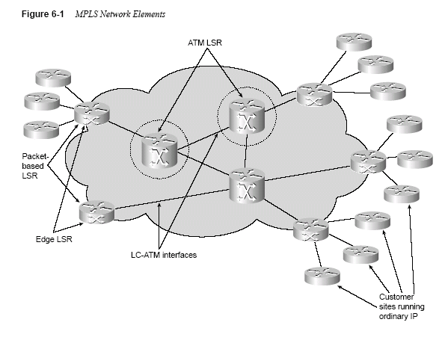
MPLS (Multi Protocol Label Switching)

Slide 38
The Nortel Networks Passport 8600 Routing Switch
designed for high-performance Enterprise, carrier, and service provider networks.
As a chassis based Ethernet switching platform, the Passport 8600 series provides wire speed L2-L7 traffic classification, filtering, forwarding and routing. Hardware based wire speed performance enables fast and efficient traffic classification, policy enforcement and filtering.
Provides wire speed L2- L7 traffic classification.

Slide 39
The Nortel Networks Passport 8600 Routing Switch
Multi-layer redundancy with five 9’s reliability
Integrated intelligent bandwidth connectivity for 10/100/1000 Ethernet, ATM, PoS,10 Gig and WDM
Seamless LAN/MAN/WAN connectivity
Eight policy enabled hardware queues per port
512 Gigabits per second backplane switch capacity.

Slide 40
Nortel Ethernet Routing Switch 8600
Avaya Switch ERS 8600
Configurable as a 1.440 Terabit Switch cluster using SMLT
10 Gigabit Ethernet
Packet Over SONET
6 OC-3 or 3 OC-12 ports
ATM
4 firewall or IDS

Slide 41
ATM Summary
Motivation for ATM Architecture
Four Design Assumptions
ATM Hierarchy
UNI,NNI, VPI, VCI, two switch levels
Old ATM Design
Convergence Sublayer (CS), Segmentation and Reassembly Sublayer (SAR)
ATM Adaptation Layers
AAL1-4

Slide 42
ATM Summary
New ATM Design
PVC, SVC
AAL Details
AAL1, AAL3-4, AAL5
Multi-Protocol Layer Switching (MPLS)
Passport Switch

