Slide 1
Characterization of 802.11 Wireless Networks in the Home
and other associated wireless performance measurements

Slide 2
Outline
Characterization Study
Goals
Design
Outcome
Considerations for Performance

Slide 3
Characterization Study
Enterprise networks
Characterization of home wireless
What interferes with quality?
Construction materials of a house?
802.11a vs 802.11b?
txpower?
txrate?
Node location?
Appliance interference?
Notes:
Enterprise
Mesh networks, self-configuration
Home Network
Small, couple devices, usually just have a single base station in an arbitrary location near internet connection.
Should there be more thought into these networks? Do they need to be designed similarly to enterprise networks?

Slide 4
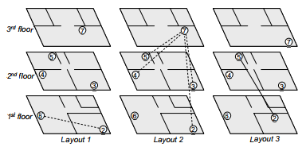
Characterization Study (cont.)
Three Houses (IV)
Six WiFi Nodes (IV)
Antenna Orientation (IV)
Different txpower (IV)
Different txrate (IV)
3 Layouts (IV)
Node distance (IV)
Tested during the night
Packet Loss (DV)
ukhome1 wireless nodes
Notes:
Three houses, two in the US, one in the UK
6 Wireless Nodes (Netgear Ma701, 802.11b cards) for 802.11a (NetGear WAG511 Bardbus)
Put in locations where consumer devices may be found
Each node joins an ad-hoc network which is at least 5 channels away from the next nearest occupied channel
300 probes, 2 per second, for 150 seconds (2.5 minutes. A longer test was done and indicated the 2.5 minute test was a good representation)
Link layer re-transmissions were disabled for this study
**Only small changes in Antenna Orientation and Location
IV = Independent Variable
DV = Dependent Variable
Find the changes in packet loss and measure the quality of a home network

Slide 5
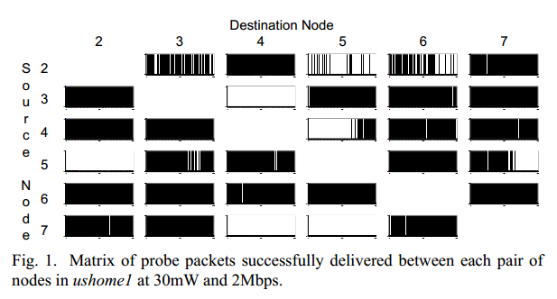
Characterization Study (cont.)
Results
Asymmetry of Loss
Orientation Changes
Notes:
Bars, Black = Good (no loss)
Compare 3->4 and 4->3
As expected in most cases link loss was higher when the bit rate was higher and lower loss when power increased
Results indicate there is some loss to expected in home networks, not all loss can be eliminated by finding the right balance between power and rate
---
-Small changes in orientation and location
-Several reasons why nodes may not be able to communicate.. Multi-path fading and signal attenuation for example
-Interestingly enough however, even the small changes in antenna orientation can make huge differences in loss, exact node placement must be a key contributor to performance
-“randomly” selecting the location of a node will not ensure its connectivity

Slide 6
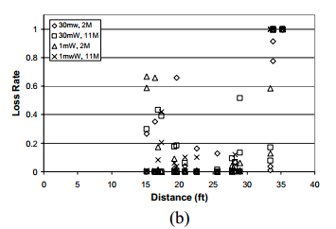
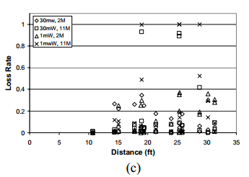
Characterization Study (cont.)
Results
Asymmetry of Loss
Orientation Changes
Distance not a factor*
Notes:
Within reason.. If you are really far away from a node, then yes, there will be no signal and lots of loss.
Not too much of an effect
More importantly, the physical obstacles that fall between nodes as a result of their placement tend to determine performance

Slide 7
Characterization Study (cont.)
Results
Asymmetry of Loss
Orientation Changes
Distance not a factor*
txpower & txrate
Notes:
Point out that while there is a difference in loss rate, that is basically to be expected. What is interesting is the continuation of asymmetric loss rates at any rate/power.
Mention the same thing happens with 802.11a

Slide 8
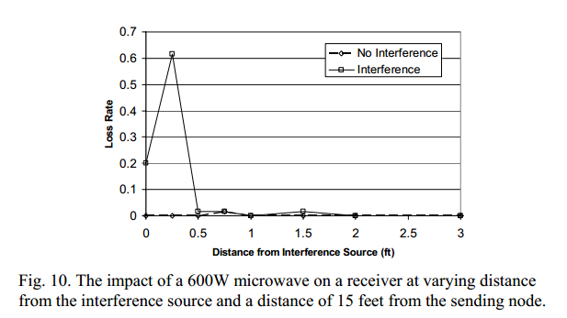
Characterization Study (cont.)
Results
Asymmetry of Loss
Orientation Changes
Distance not a factor*
txpower & txrate
Appliances
Notes:
Microwave didn’t seem to do all that much.
They did postulate that it could have been a result of the shielding though, another good thing to keep in mind

Slide 9
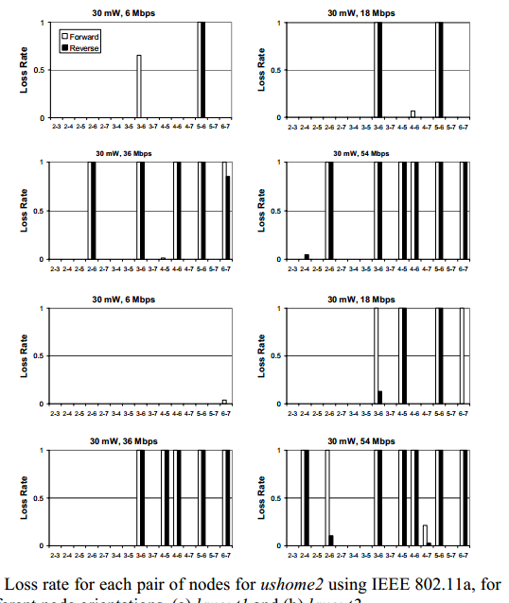
Characterization Study (cont.)
Results
Asymmetry of Loss
Orientation Changes
Distance not a factor*
txpower & txrate
Appliances
802.11a
Notes:
802.11a had basically the same results as 11g, some links lossy, some asymmetrically so.

Slide 10
Performance Considerations
DFC & CSMA/CA
Lowest Machine
Collision Delays
Testing applications (examples)
netperf
tcpperf
udpping
Location
Physical
Antenna Positioning
Notes:
Performance Anomaly of 802.11b paper
Distributed Coordination Function – Carrier Sense Multiple Access with Collision Detection
The slowest host will bog down the entire channel

Slide 11
Performance Considerations
Transmissions
Power
Rate
Other Layers
UDP vs TCP
Applications
Delays in Datalink Layer
Care about:
Packet Loss
“handling” of slow-clients
What happens when many clients join?

