Slide 1
LANs Local Area Networks focused on the Media Access Control (MAC) Sub Layer
Advanced Computer Networks
C13

Slide 2
LANs Outline
Channel Allocation Problem
Relative Propagation Time
LAN Utilization Upper Bound
Multiple Access Protocols
TDMA, FDMA
Aloha, Slotted Aloha
CSMA (non-persistent, 1-persistent,
p-persistent), CSMA/CD
Performance Results

Slide 3
Local Area Networks
Aloha
Slotted Aloha
CSMA
non-persistent
1-persistent
p-persistent
CSMA/CD
Ethernet
Token Ring

Slide 4
Data Link Sub Layers
Network Layer
Network Layer
LLC
802.2 Logical Link Control
Data Link
Layer
802.3
CSMA-CD
802.5
Token Ring
802.11
Wireless
LAN
Other
LANs
MAC
Physical
Layer
Physical
Layer
Various Physical Layers
Leon-Garcia & Widjaja:
Communication Networks
IEEE 802
OSI

Slide 5
Media Access Control (MAC)
Can divide networks into two categories:
Point-to-Point
Using broadcast channels*
*deal here with broadcast channels and their protocols
MAC sub-layer is important in LANs, MANs and wireless networks (both WiFi and cellular)!!

Slide 6
Channel Access Abstraction
2
3
4
1
Shared Multiple
Access Medium
n
5
…
Leon-Garcia & Widjaja:
Communication Networks

Slide 7
Static Channel Allocation Problem
The history of broadcast networks includes satellite and packet radio networks.
Let us view a satellite as a repeater amplifying and rebroadcasting everything that comes in.
To generalize this problem, consider networks where every frame sent is automatically received by every site (node).

Slide 8
Satellite Channel
= f_{in}
= f_{out}
Leon-Garcia & Widjaja:
Communication Networks

Slide 9
Static Channel Allocation Problem
We model this situation as n independent users (one per node), each wanting to communicate with another user and they have no other form of communication.
The Channel Allocation Problem
To manage a single broadcast channel
which must be shared efficiently and fairly
among n uncoordinated users.

Slide 10
Specific LAN Topologies
Ring networks
Multitapped Bus Networks
Leon-Garcia & Widjaja:
Communication Networks

Slide 11
Possible Model Assumptions
0. Listen property :: (applies to satellites)
The sender is able to listen to sent frame one round-trip after sending it.
➔ no need for explicit ACKs.
1. The model consists of n independent stations.
2. A single channel is available for communications.

Slide 12
Possible Model Assumptions
3. Collision Assumption :: If two frames are transmitted simultaneously, they overlap in time and the resulting signal is garbled. This event is a collision.
4a. Continuous Time Assumption :: frame transmissions can begin at any time instant.
4b. Slotted Time Assumption :: time is divided into discrete intervals (slots). Frame transmissions always begin at the start of a time slot.

Slide 13
Possible Model Assumptions
5a. Carrier Sense Assumption (CS) ::
Stations can tell if the channel is busy (in use) before trying to use it. If the channel is busy, no station will attempt to use the channel until it is idle.
5b. No Carrier Sense Assumption ::
Stations are unable to sense channel before attempting to send a frame. They just go ahead and transmit a frame.

Slide 14
a :: Relative Propagation Time
length of the data path (in bits)
a = --------------------------------------------------
length of a standard frame (in bits)
-OR-
propagation time ( in seconds)
a = ------------------------------------------------
transmission time (in seconds)
-OR-
bandwidth-delay product*
a = ----------------------------------------- [ LG&W def p.346]
average frame size
* bandwidth-delay product :: the product of the capacity (bit rate) and the delay.

Slide 15
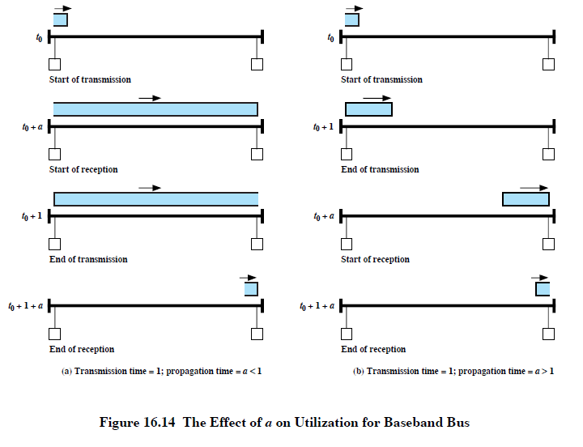
Effect of a on Utilization
DCC 8th Ed.
Stallings

Slide 16
Relative Propagation Time
R = capacity (data rate)
d = maximum distance of communications path
v = propagation velocity (Assume v = 2/3 speed of light 2 x 10⁸ meters/second)
L = frame length
d / v Rd
a = ------- = ------
L/R vL

Slide 17
Upper Bound on Utilization for Shared Media LAN
Assume a perfect, efficient access that allows one transmission at a time where there are no collisions, no retransmissions, no delays between transmissions and no bits wasted on overhead. {These are best-case assumptions!!}
Tput L
Util = ------- = ----------------------------------
Capacity propagation time + transmission time
------------------------------
R

Slide 18
Best Case LAN Utilization
L
------------------
d L L 1
max. Util = ---- + ---- = --------------- = ------------
v R Rd a + 1
--------------- ---- + L
R v
1
max. Util = ---------
1 + a

Slide 19
Worst Case Collision Scenario
Distance d meters
A transmits at t = 0
A
B
B transmits before
t = t_{prop}
and detects collision shortly
thereafter
A
B
A detects
collision at
t = 2 t_{prop}
A
B
t_{prop} = d / ν seconds
Leon-Garcia & Widjaja:
Communication Networks

Slide 20
LAN Design Performance Issues
For broadcast LANs what factors under the designer’s control affect LAN performance?
Capacity {function of media}
Propagation delay {function of media, distance}
Bits /frame (frame size)
MAC protocol
Offered load {depends on retransmission scheme}
Number of stations
Bit error rate {function of media}

Slide 21
Typical Frame Delay versus Throughput Performance
E[T]/E[X]
Transfer Delay
M/M/1
queueing result
1
ρ_{max}
ρ
1
Offered Load
Leon-Garcia & Widjaja:
Communication Networks

Slide 22
Delay-Throughput Performance Dependence on a
E[T]/E[X]
a′ > a
a′
a
Transfer Delay
1
ρ_{max}
ρ
ρ′_{max}
1
Offered Load
Leon-Garcia & Widjaja:
Communication Networks

Slide 23
Multiple Access Protocols

Slide 24
Multiple Access Links and Protocols
Two types of “links”:
point-to-point
PPP for dial-up access
point-to-point link between Ethernet switch and host
broadcast (shared wire or medium)
old-fashioned Ethernet
upstream HFC
802.11 wireless LAN
K & R
humans at a
cocktail party
(shared air, acoustical)
shared wire (e.g.,
cabled Ethernet)
shared RF
(e.g., 802.11 WiFi)
shared RF
(satellite)

Slide 25
Multiple Access Protocols
single shared broadcast channel
two or more simultaneous transmissions by nodes ➔ interference, namely
a collision if any node receives two or more signals at the same time.
Multiple Access Protocol (MA)
distributed algorithm that determines how nodes share channel, i.e., determine when a node can transmit.
communication about channel sharing must use channel itself!
Assumes no out-of-band channel for coordination.

Slide 26
MAC Protocols Taxonomy
Three broad classes:
Channel Partitioning
divide channel into smaller “pieces” (time slots, frequency, code).
allocate piece to node for exclusive use.
Random Access
channel not divided, allow collisions.
“recover” from collisions.
“Taking Turns”
nodes take turns, but nodes with more to send can take longer turns.
K & R

Slide 27
Channel Partitioning MAC Protocols: TDMA
TDMA: Time Division Multiple Access
access to channel in "rounds“.
each station gets fixed length slot (length = pkt transmission time) in each round.
unused slots go idle.
example: 6-station LAN, 1,3,4 have pkt, slots 2,5,6 wasted (idle).
6-slot
frame
1
3
4
1
3
4
K & R

Slide 28
Channel Partitioning MAC Protocols: FDMA
FDMA: Frequency Division Multiple Access
channel spectrum divided into frequency bands.
each station assigned fixed frequency band.
unused transmission time in frequency bands go idle.
example: 6-station LAN, 1,3,4 have pkt, frequency bands 2,5,6 idle.
time
frequency bands
FDM cable
K & R

Slide 29
Random Access Protocols
When node has packet to send
transmit at full channel data rate R.
no a priori coordination among nodes.
two or more transmitting nodes ➜ “collision”,
random access MAC protocol specifies:
how to detect collisions?
how to recover from collisions (e.g., via delayed retransmissions)?
Examples of random access MAC protocols:
ALOHA
slotted ALOHA
CSMA, CSMA/CD, CSMA/CA
K & R

Slide 30
Historic LAN Performance Notation
I :: input load - the total (normalized) rate of data generated by all n stations.
G :: offered load - the total (normalized) data rate presented to the network including retransmissions.
S :: LAN throughput - the total (normalized) data rate transferred between stations.
D :: average frame delay - the time from when a frame is ready for transmission until completion of a successful transmission.

Slide 31
Normalizing Throughput (S) [assuming one packet = one frame]
S is normalized using packets/packet time where
packet time :: the time to transmit a standard fixed-length packet.
i.e.,
packet length
packet time = -----------------
bit rate
NOTE: Since the channel capacity is one packet /packet time, S* can be viewed as throughput as a fraction of capacity.
*Represented in LG&W by in later graphs.
ρ

Slide 32
Historic LAN Performance Notation
retransmissions
1
2
I
G
S
3
X
X
X
n
D

Slide 33
ALOHA
Abramson solved the channel allocation problem for ground radio at University of Hawaii in 1970’s.
Aloha Transmission Strategy
Stations transmit whenever they have data to send.
Collisions will occur and colliding frames are destroyed.
Aloha Retransmission Strategy
Station waits a random amount of time before sending again.

Slide 34
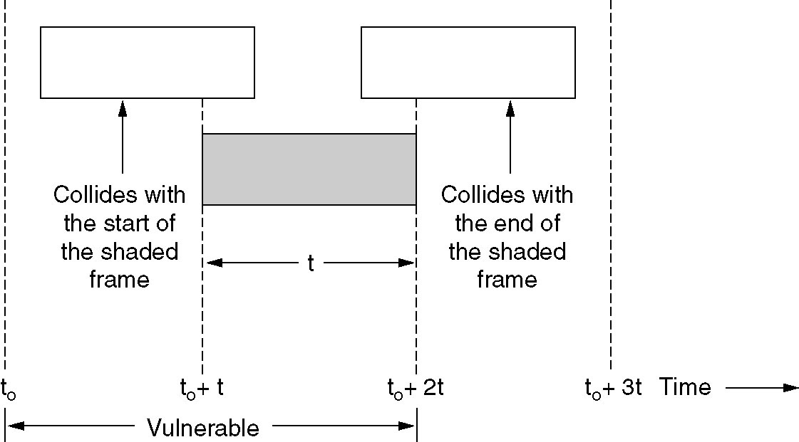
ALOHA
Figure 4-2. Vulnerable period for the shaded frame.
Tanenbaum

Slide 35
ALOHA Retransmissions
First transmission
Retransmission
t
t₀-X
t₀
t₀+X
t₀+X+2t_{prop}
t₀+X+2t_{prop}+Β
Vulnerable
period
Time-out
Backoff
Period B
Retransmission
if necessary
random backoff period B
Leon-Garcia & Widjaja:
Communication Networks

Slide 36
ALOHA
Vulnerable period :: t₀ – X to t₀ + X two frame transmission times
Assume: Poisson Arrivals with average number of arrivals of
2G arrivals/ 2 X
S = G e^{-2 (1+a) G}

Slide 37
Slotted ALOHA (Roberts 1972)
uses discrete time intervals as slots (i.e., slot = one packet transmission time) and synchronize the send time (e.g., use “pip” from a satellite).
Slotted Aloha Strategy
Station transmits ONLY at the beginning of a time slot.
Collisions will occur and colliding frames are destroyed.
Slotted Aloha Retransmission Strategy
Station waits a random amount of time before sending again.

Slide 38
Slotted ALOHA
t
kX
(k+1)X
t₀ +X+2t_{prop}
t₀ +X+2t_{prop}+Β
Vulnerable
period
Time-out
Backoff
Period B
Retransmission
if necessary
random backoff period B slots
Leon-Garcia & Widjaja:
Communication Networks

Slide 39
Slotted ALOHA
Vulnerable period :: t₀ – X to t₀ one frame transmission time
Assume: Poisson Arrivals with average number of arrivals of
G arrivals/ X
P₀ = P[k=0, t=1] = e ^{–G}
S = G P₀
S = G e ^{–G}
and an adjustment for a yields:
S = G e^{- (1+a) G}

Slide 40
ALOHA and Slotted AlOHA
Throughput versus Load
0.368
S
Ge^{-G}
Slotted Aloha
0.184
Ge^{-2G}
Aloha
G
Leon-Garcia & Widjaja:
Communication Networks

Slide 41
Carrier Sense with Multiple Access (CSMA)

Slide 42
1-persistent CSMA Transmission Strategy
‘the greedy algorithm’
Sense the channel.
IF the channel is idle, THEN transmit.
IF the channel is busy, THEN continue to listen until channel is idle and transmit immediately.

Slide 43
nonpersistent CSMA Transmission Strategy
‘’the less-greedy algorithm’
Sense the channel.
IF the channel is idle, THEN transmit.
IF the channel is busy, THEN wait a random amount of time and repeat the algorithm.

Slide 44
p - persistent CSMA Transmission Strategy
’a slotted approximation’
Sense the channel.
IF the channel is idle, THEN with probability p transmit and with probability (1-p) delay one time slot and repeat the algorithm.
3. IF the channel is busy, THEN delay one time slot and repeat the algorithm.

Slide 45
P – Persistent CSMA details
the time slot is usually set to the maximum propagation delay.
as p decreases, stations wait longer to transmit but the number of collisions decreases.
Consideration for the choice of p
(n x p) must be < 1 for stability, where n is maximum number of stations, i.e.,
p < 1/n

Slide 46
CSMA Collisions
In all three strategies, a collision is possible.
CSMA determines collisions by the lack of an ACK which results in a TIMEOUT. {This is extremely expensive with respect to performance!!}
If a collision occurs, THEN wait a random amount of time and retransmit.

Slide 47
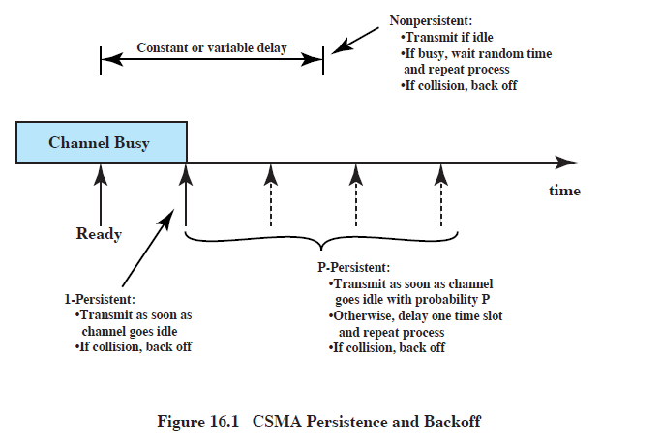
CSMA Persistence Summary

Slide 48
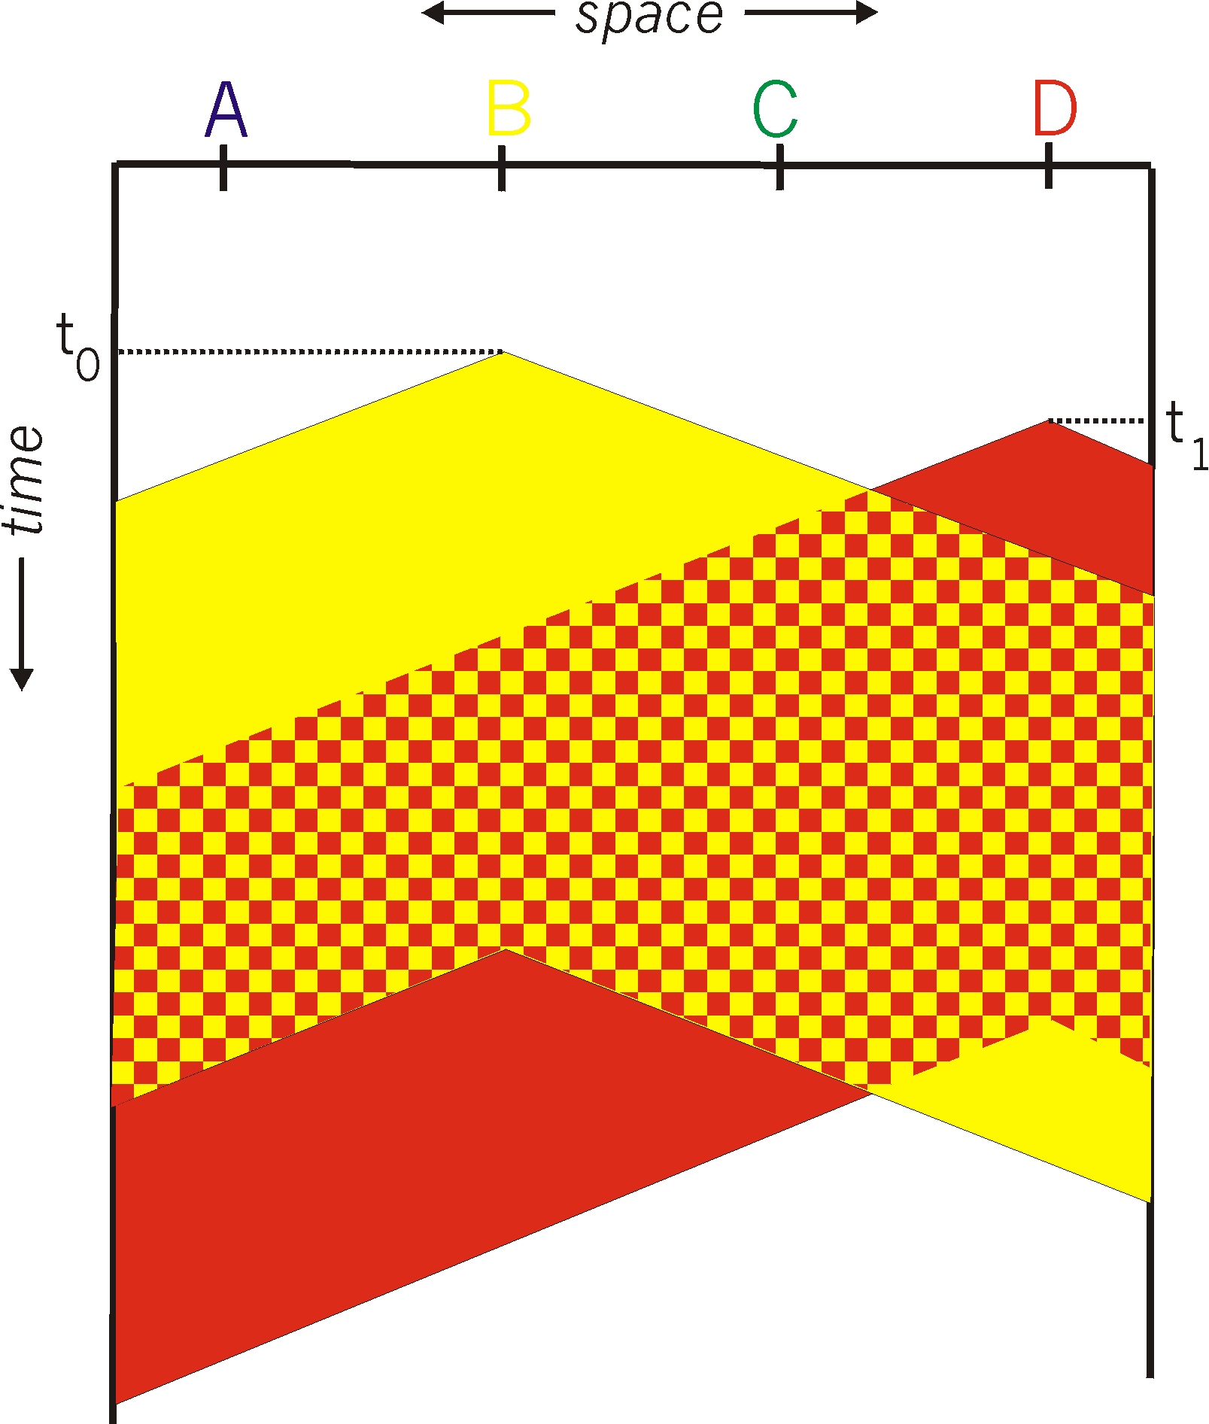
CSMA Collisions
spatial layout of nodes
Collisions can still occur:
propagation delay means
two nodes may not hear
each other’s transmission.
Collision:
entire packet transmission
time wasted.
Note:
The role of distance & propagation delay in determining collision probability
K & R

Slide 49
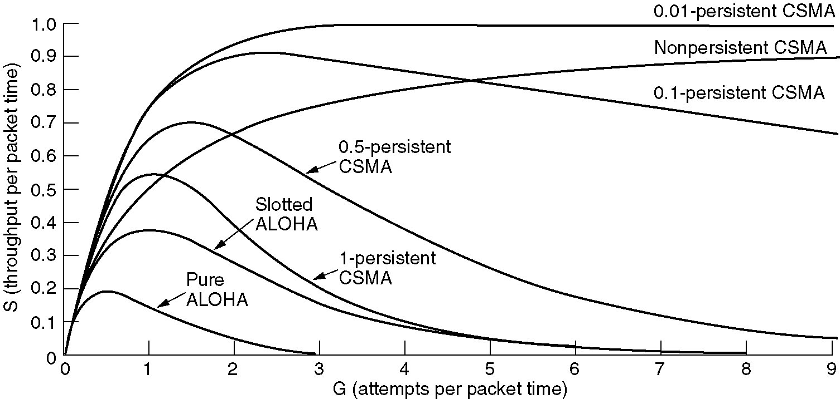
Persistent and Non-persistent CSMA
Figure 4-4. Comparison of the channel utilization versus load for various random access protocols.
Tanenbaum

Slide 50
Throughput versus Load
with varying a
0.53
S
0.45
1-Persistent
CSMA
a = 0.01
0.16
a = 0.1
a = 1
G
Leon-Garcia & Widjaja:
Communication Networks

Slide 51
Throughput versus Load
with varying a
S
0.81
0.51
a = 0.01
Non-Persistent
CSMA
0.14
a = 0.1
G
a = 1
Leon-Garcia & Widjaja:
Communication Networks

Slide 52
CSMA/CD (Collision Detection)
CSMA/CD:
collisions detected within short time.
colliding transmissions aborted, reducing channel wastage.
Collision Detection:
easy in wired LANs: measure signal strengths, compare transmitted, received signals
difficult in wireless LANs: received signal strength overwhelmed by local transmission strength.

Slide 53
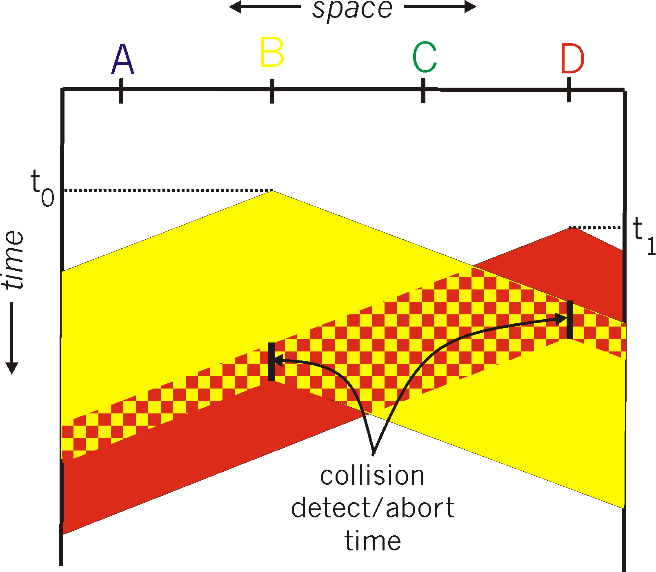
CSMA/Collision Detection
K & R

Slide 54
CSMA/CD CSMA with Collision Detection
If a collision is detected during transmission, then immediately cease transmitting the frame.
The first station to detect a collision sends a jam signal to all stations to indicate that there has been a collision.
After receiving a jam signal, a station that was attempting to transmit waits a random amount of time before attempting to retransmit.
The maximum time needed to detect a collision is 2 x propagation delay.

Slide 55
CSMA vs CSMA/CD
CSMA is essentially a historic technology until we include Wireless LANs.
If propagation time is short compared to transmission time, station can be listening before sending with CSMA.
Collision detection (CD) is accomplished by detecting voltage levels outside acceptable range. Thus attenuation limits distance without a repeater.
If the collision time is short compared to packet time (i.e., small a), performance will increase due to CD.

Slide 56
CSMA/CD
frame
frame
contention
Probability of 1 successful transmission:
P^{max}
P_{success} is maximized at p =1/n :
n
Tanenbaum

Slide 57
Maximum Achievable Throughputs
CSMA/CD
1-P CSMA
Non-P CSMA
ρ_{max}
Slotted Aloha
Aloha
a
Leon-Garcia & Widjaja:
Communication Networks

Slide 58
Frame Delay with varying a
a = 0.01
a = 0.2
a = 0.1
Leon-Garcia & Widjaja:
Communication Networks

Slide 59
“Taking Turns” MAC protocols
Channel Partitioning MAC protocols:
share channel efficiently and fairly at high load.
inefficient at low load: delay in channel access, 1/N bandwidth allocated even if only 1 active node!
Random Access MAC protocols:
efficient at low load: single node can fully utilize channel.
high load: collision overhead
“Taking Turns” protocols:
look for best of both worlds!
K & R

Slide 60
“Taking Turns” MAC protocols
Polling:
master node “invites” slave nodes to transmit in turn
typically used with “dumb” slave devices
concerns:
polling overhead
latency
single point of failure (master)
data
poll
master
data
slaves
K & R

Slide 61
“Taking Turns” MAC protocols
Token passing:
control token passed from one node to next sequentially.
token message
concerns:
token overhead
latency
single point of failure (token)
T
(nothing
to send)
T
data
K & R

Slide 62
LANS Summary
Channel Allocation Problem
Relative Propagation Time
LAN Utilization Upper Bound
Multiple Access Protocols
TDMA, FDMA
Aloha, Slotted Aloha
CSMA (non-persistent, 1-persistent,
p-persistent), CSMA/CD
Token Passing
Performance Results

