Slide 1
Physical Layer (part 3) Transmission Media
Advanced Computer Networks

Slide 2
Transmission Media Choices
Twisted Pair
Coaxial Cable
Optical Fiber
Wireless Communications

Slide 3
Transmission Media
Transmission medium:: the physical path between transmitter and receiver.
Repeaters or amplifiers may be used to extend the length of the medium.
Communication of electromagnetic waves is guided or unguided.
Guided media:: waves are guided along a physical path (e.g., twisted pair, coaxial cable and optical fiber).
Unguided media:: means for transmitting but not guiding electromagnetic waves (e.g., the atmosphere and outer space).

Slide 4
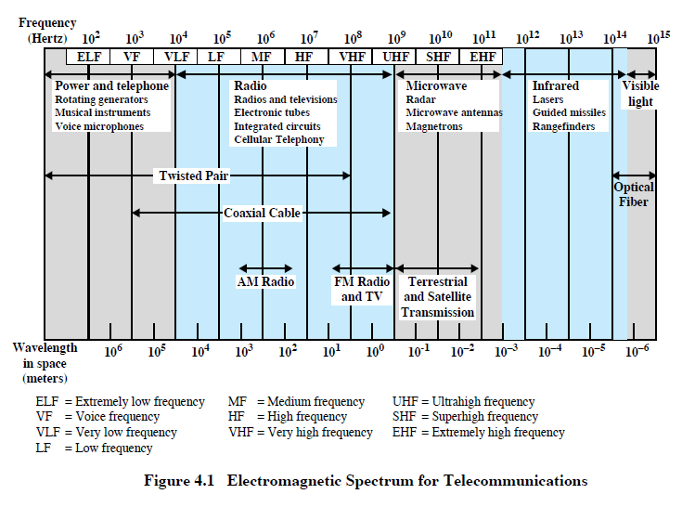
Telecommunications Spectrum
DCC 9th Ed.
Stallings

Slide 5
Guided Media Characteristics
DCC 9th Ed.
Stallings

Slide 6
Twisted Pair
Two insulated wires arranged in a spiral pattern.
Copper or steel coated with copper.
The signal is transmitted through one wire and a ground reference is transmitted in the other wire.
Typically twisted pair is installed in building telephone wiring.
Local loop connection to central telephone exchange is twisted pair.

Slide 7
Twisted Pair
Limited in distance, bandwidth and data rate due to problems with attenuation, interference and noise.
Issue: cross-talk due to interference from other signals.
“shielding” wire (shielded twisted pair (STP)) with metallic braid or sheathing reduces interference.
“twisting” reduces low-frequency interference and crosstalk.

Slide 8
Twisted Pair - Transmission Characteristics
analog
needs amplifiers every 5km to 6km
digital
can use either analog or digital signals
needs a repeater every 2km to 3km
limited:
distance
bandwidth (1MHz)
data rate (100MHz)
susceptible to interference and noise
DCC 9th Ed.
Stallings
Notes:
Transmission Characteristics
Twisted pair may be used to transmit both analog and digital transmission. For analog signals, amplifiers are required about every 5 to 6 km. For digital transmission (using either analog or digital signals), repeaters are required every 2 or 3 km.
Compared to other commonly used guided transmission media (coaxial cable, optical fiber), twisted pair is limited in distance, bandwidth, and data rate. As Stallings DCC9e Figure 4.3a shows, the attenuation for twisted pair is a very strong function of frequency. Twisted-pair cabling is also susceptible to signal reflections, or return loss, caused by impedance mismatches along the length of the transmission line and crosstalk from adjacent twisted-pairs or twisted-pair cables. Due to the well-controlled geometry of the twisted-pair itself (pairs are manufactured with a unique and precise twist rate that varies from pair to pair within a cable) and the media’s differential mode transmission scheme (discussed in Chapter 5), twisted-pair cabling used for data transmission is highly immune to interference from low frequency (i.e., 60 Hz) disturbers. Note that twisted-pair cabling is usually run separately from cables transmitting ac power in order to comply with local safety codes, which protect low voltage telecommunications installers from high voltage applications. The possibility of electromagnetic interference from high frequency (i.e., greater than 30 MHz) disturbers such as walkie-talkies and other wireless transmitters can be alleviated by using shielded twisted-pair cabling.
For point-to-point analog signaling, a bandwidth of up to about 1 MHz is possible. This accommodates a number of voice channels. For long-distance digital point-to-point signaling, data rates of up to a few Mbps are possible. Ethernet data rates of up to 10Gbps can be achieved over 100 meters of twisted-pair cabling.

Slide 9
Twisted Pair
‘the good
old days’
Fig 2-3. (a) Category 3 UTP.
(b) Category 5 UTP.
Tanenbaum

Slide 10
10-BASE -T
10 Mbps baseband transmission over twisted pair.
Two Cat 3 cables, Manchester encoding,
Maximum distance - 100 meters
Ethernet Hub
●     
‘the good
old days’
Leon-Garcia & Widjaja:
Communication Networks

Slide 11
Twisted Pair Categories and Classes
DCC 9th Ed.
Stallings
Notes:
Categories of Twisted Pair for Data Transmission
In 1991, the Electronic Industries Association published standard ANSI/EIA/TIA-568, Commercial Building Telecommunications Cabling Standard, which specifies the use of voice- and data-grade UTP and F/UTP cabling for in-building data applications. At that time, the specification was felt to be adequate for the range of frequencies and data rates found in office environments. With continuing advances in cable and connector design and test methods, this standard has undergone a number of iterations to provide support for higher data rates using higher-quality cable and connectors. The current version is the responsibility of the Telecommunications Industry Association, and was issued in 2009 as four American National Standards Institute (ANSI) standards:
ANSI/TIA-568-C.0 Generic Telecommunications Cabling for Customer Premises: Enables the planning and installation of a structured cabling system for all types of customer premises.
ANSI/TIA-568-C.1 Commercial Building Telecommunications Cabling Standard: Enables the planning and installation of a structured cabling system for commercial buildings.
ANSI/TIA-568-C.2 Balanced Twisted-Pair Telecommunications Cabling and Components Standards: Specifies minimum requirements for balanced twisted-pair telecommunications cabling (e.g. channels and permanent links) and components (e.g. cable, connectors, connecting hardware, patch cords, equipment cords, work area cords, and jumpers) that are used up to and including the telecommunications outlet/connector and between buildings in a campus environment. This Standard also specifies field test procedures and applicable laboratory reference measurement procedures for all transmission parameters.
ANSI/TIA-568-C.3 Optical Fiber Cabling Components Standard: Specifies cable and component transmission performance requirements for premises optical fiber cabling.
The 568-C standards identify a number of categories of cabling and associated components that can be used for premises and campus-wide data distribution. An overlapping standard, jointly issued by the International Standards Organization and the International Electrotechnical Commission (IEC), known as ISO/IEC 11801, second edition, identifies a number of classes of cabling and associated components, which correspond to the 568-C categories.
The categories listed in the table are the following:
Category 5e/Class D: This specification was first published in 2000 in order to address the transmission performance characterization required by applications such as 1-Gbps Ethernet that utilize bi-directional and full four-pair transmission schemes (described in Chapter 16).
Category 6/Class E: In recent years, the majority of structured cabling specified for new buildings has been category 6/class E. This category provides a greater performance margin (also called performance headroom) than category 5e to ensure that the cabling plant could withstand the rigors of the cabling environment and still support 1-Gbps Ethernet when it was time for an application upgrade from 100-Mbps Ethernet. This category was published in 2002, with a targeted lifetime of 10 years, so its use is likely to decline rapidly in new installations.
Category 6A/Class EA: This specification is targeted at 10-Gbps Ethernet applications.
Category 7/Class F: This specification uses fully-shielded twisted pair (i.e., cabling with an overall shield and individually shielded pairs). The advantage of this category over lower grades of cabling is that the use of both an overall shield and a foil shield around individual pairs dramatically decreases internal pair-to-pair crosstalk and external alien crosstalk. This class is targeted for support of next generation applications beyond 10-Gbps Ethernet.
Category 7A/Class FA: The requirements for this class are based on class F cabling requirements. The main enhancement is to extend the frequency bandwidth to 1 GHz. This enhancement enables support of all channels of broadband video (e.g. CATV) that operate up to 862 MHz. It is likely that all fully-shielded cabling solutions specified in the near future will be class FA.
Stallings DCC9e Table 4.2 summarizes key characteristics of the various categories and classes recognized in the current standards. The table includes three key performance parameters. Insertion loss in this context refers to the amount of attenuation across the link from the transmitting system to the receiving system. Thus, lower dB values are better. The table shows the amount of attenuation at a frequency of 100 MHz. This is the standard frequency used in tables comparing various classes of twisted pair. However, attenuation is an increasing function of frequency, and the 568 standards specify that attenuation at various frequencies. In accordance with ANSI/TIA-568-C.2 and ISO/IEC 11801 2nd edition, all transmission characteristics are specified as a worst case value for a 100m length. While cabling lengths may be less than 100m, no provisions are provided in the Standards for the scaling of the specified limits. Attenuation in decibels is a linear function of distance, so attenuation for shorter or longer distances is easily calculated. In practice, as is shown in Chapter 16, distances much less than 100 m are typical for Ethernet at data rates of 1 GB and above.

Slide 12
EIA/TIA 568 and ISO/IEC 11801 Wiring Grades
Grade 1 - Unshielded Untwisted wiring.
Commonly called inside wire by the Telco community.
Grade 2 - Unshielded twisted pair (UTP) derived from IBM Type 3 spec.
Category 3 - Unshielded twisted pair with 100 ohm impedance and electrical
characteristics supporting transmission at frequencies up to 16 MHz. May
be used with 10Base-T, 100Base-T4, and 100Base-T2 Ethernet. (Obsolete)
Category 4 - Unshielded twisted pair with 100 ohm impedance and electrical
characteristics supporting transmission at frequencies up to 20 MHz.
May be used with 10Base-T, 100Base-T4, and 100Base-T2 Ethernet. (Obsolete)
Category 5 - Unshielded twisted pair with 100 ohm impedance and electrical
characteristics supporting transmission at frequencies up to 100 MHz.
May be used with 10Base-T, 100Base-T4, 100Base-T2, and 100Base-TX Ethernet.
May support 1000Base-T, but cable should be tested. (Superceded by Cat5e)

Slide 13
EIA/TIA 568 and ISO/IEC 11801 Wiring Grades
*Category 5e - "Enhanced Cat 5" exceeds Cat 5 performance. Very similar to Cat 5, it has improved specifications for NEXT (Near End Cross Talk), PSELFEXT (Power Sum Equal Level Far End Cross Talk), and Attenuation. May be used for 10Base-T, 100Base-T4, 100Base-T2, 100BaseTX and 1000Base-T Ethernet. (Minimum acceptable wiring grade)
Category 6 - In June 2002 TIA approved specification for Cat 6 doubling Cat 5 bandwidth to 250 MHz. Cat 6 is backward compatible with lower Category grades and supports the same Ethernet standards as Cat 5e. A Cat 6 whitepaper is available from TIA. Currently there are no Ethernet standards that take advantage of Cat 6. ANSI/TIA854 is working on 1000Base-TX. When complete this standard will use two pair in each direction as opposed to all four for 1000Base-T over Cat 5e. This is expected to reduce the cost of Gigabit Ethernet implementations. 1000Base-TX will only operate over Cat6.
Category 7 - Proposed standard to support transmission at frequencies up to 600 MHz over 100 ohm twisted pair.

Slide 14
EIA/TIA 568 and ISO/IEC 11801 Wiring Grades
NOTES:
1) EIA 568 limits UTP copper cabling to maximum distance of 100 meters (328 feet). 90 meters of cable plus 10 meters of patch cord split between both ends.
2) The FCC recently changed the requirement for telephone inside wiring to minimum of Cat 3 due to crosstalk problems with nontwisted quad-four. Cat 3 is no longer recognized by TIA. The minimum wiring grade for structured wiring is Cat 5e.
3) For installation to meet specific Category requirements all components must meet or exceed the designated Category. Using a Cat 3 receptacle (or patch cord) on Cat 6 reduces performance to Cat 3.

Slide 15
Dial-up Modem
central office
telephone
network
Internet
home
PC
home dial-up
modem
ISP modem
(e.g., AOL)
Uses existing telephony infrastructure
Home is connected to central office.
up to 56Kbps direct access to router (often less).
Can’t surf and phone at same time: not “always on”.
K & R

Slide 16
Digital Subscriber Line
Telephone companies originally transmitted within the 0 to 4K HZ range to reduce crosstalk. Loading coils were added within the subscriber loop to provide a flatter transfer function to further improve voice transmission within the 3K HZ band while increasing attenuation at the higher frequencies.
ADSL (Asymmetric Digital Subscriber Line)
Uses existing twisted pair lines to provide higher bit rates that are possible with unloaded twisted pairs (i.e., there are no loading coils on the subscriber loop.)

Slide 17
ADSL
the network transmits downstream at speeds
ranging from 1.536 Mbps to 6.144Mbps
asymmetric
bidirectional
digital transmissions
users transmit upstream at speeds
[higher frequencies] ranging from 64 kbps to 640 kbps
0 to 4K HZ used for conventional analog telephone signals

Slide 18
Digital Subscriber Lines
Figure 2-28. Operation of ADSL using discrete multitone modulation.
Tanenbaum

Slide 19
ADSL
ITU-T G992.1 ADSL standard uses Discrete Multitone (DMT) that divides the bandwidth into a large number of small subchannels.
A splitter is required to separate voice signals from the data signal.
The binary information is distributed among the subchannels. Each subchannel uses QAM.
DMT adapts to line conditions by avoiding subchannels with poor SNR.

Slide 20
Digital Subscriber Lines
Figure 2-29. A typical ADSL equipment configuration.
Tanenbaum

Slide 21
Digital Subscriber Line (DSL)
Existing phone line: 0-4KHz phone; 4-50KHz upstream data; 50KHz-1MHz downstream data
Internet
home
phone
DSLAM
telephone
network
splitter
DSL
modem
central
office
home
PC
Also uses existing telephone infrastructure.
up to 1 Mbps upstream (today typically < 256 kbps)
up to 8 Mbps downstream (today typically < 1 Mbps)
dedicated physical line to telephone central office.
K & R

Slide 22
Coaxial Cable
Center
conductor
Dielectric
material
Braided
outer
conductor
Outer
cover
Leon-Garcia & Widjaja:
Communication Networks

Slide 23
Coaxial Cable
Discussion divided into two basic categories for coax used in LANs:
50-ohm cable [baseband]
75-ohm cable [broadband or single channel baseband]
In general, coaxial cable has better noise immunity for higher frequencies than twisted pair.
Coaxial cable provides much higher bandwidth than twisted pair.
However, the cable is ‘bulky’.
digital
transmissions

Slide 24
Baseband Coax
50-ohm cable is used exclusively for digital transmissions.
Uses Manchester encoding, geographical limit is a few kilometers.
10Base5 Thick Ethernet :: thick (10 mm) coax
10 Mbps, 500 m. max segment length, 100 devices/segment, awkward to handle and install.
10Base2 Thin Ethernet :: thin (5 mm) coax
10 Mbps, 185 m. max segment length, 30 devices/segment, easier to handle, uses T-shaped connectors.

Slide 25
Broadband Coax
75-ohm cable (CATV system standard).
Used for both analog and digital signaling.
Analog signaling – frequencies up to 500 MHZ are possible.
When FDM used, referred to as broadband.
For long-distance transmission of analog signals, amplifiers are needed every few kilometers.

Slide 26
Hybrid Fiber-Coaxial System
Upstream fiber
Fiber
Fiber
Head
end
Fiber
node
Fiber
node
Downstream fiber
Coaxial
distribution
plant
Bidirectional
Split-Band
Amplifier
Leon-Garcia & Widjaja:
Communication Networks

Slide 27
Residential Access: Cable Modems
Does not use telephone infrastructure.
Instead uses cable TV infrastructure.
HFC: Hybrid Fiber Coax
asymmetric: up to 30Mbps downstream, 2 Mbps upstream
A network of cable and fiber attaches homes to ISP router [at the ‘head end’].
homes share access to router.
unlike DSL, which provides dedicated access.
K & R

Slide 28
Residential Access: Cable Modems
K & R
Diagram: http://www.cabledatacomnews.com/cmic/diagram.html

Slide 29
Cable Network Architecture: Overview
Typically 500 to 5,000 homes
cable headend
cable distribution
network (simplified)
home
K & R

Slide 30
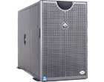
Cable Network Architecture: Overview
server(s)
cable headend
cable distribution
network
home
K & R

Slide 31
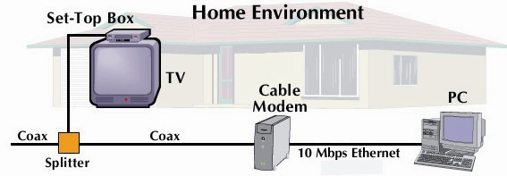
Cable Network Architecture: Overview
cable headend
cable distribution
network (simplified)
home
K & R

Slide 32
Cable Network Architecture: Overview
FDM (more shortly):
C
O
N
T
R
O
L
V
I
D
E
O
V
I
D
E
O
V
I
D
E
O
V
I
D
E
O
V
I
D
E
O
V
I
D
E
O
D
A
T
A
D
A
T
A
1
2
3
4
5
6
7
8
9
Channels
cable headend
cable distribution
network
home
K & R

Slide 33
Optical Fiber
Optical fiber:: a thin flexible medium capable of conducting optical rays. Optical fiber consists of a very fine cylinder of glass (core) surrounded by concentric layers of glass (cladding).
a signal-encoded beam of light (a fluctuating beam) is transmitted by total internal reflection.
Total internal reflection occurs in the core because it has a higher optical density (index of refraction) than the cladding.
Attenuation in the fiber can be kept low by controlling the impurities in the glass.

Slide 34
Optical Fiber
(a) Geometry of optical fiber
light
cladding
jacket
core
(b) Reflection in optical fiber
θ_{c}
Leon-Garcia & Widjaja:
Communication Networks

Slide 35
Optical Fiber
Lowest signal losses are for ultrapure fused silica – but this is hard to manufacture.
Optical fiber acts as a wavelength guide for frequencies in the range 10 ¹⁴ to 10 ¹⁵ HZ which covers the visible and part of the infrared spectrum.
Three standard wavelengths : 850 nanometers (nm), 1300 nm, 1500 nm.
First-generation optical fiber :: 850 nm, 10’s Mbps using LED (light-emitting diode) sources.
Second and third generation optical fiber :: 1300 and 1500 nm using ILD (injection laser diode) sources, gigabits/sec.

Slide 36
Optical Fiber
Attenuation loss is lower at higher wavelengths.
There were two types of detectors used at the receiving end to convert light into electrical energy (photo diodes):
PIN (three layers) detectors – less expensive, less sensitive
APD (Avalanche Photo Detectors) – superior sensitivity for long-haul fiber optics.
ASK is commonly used to transmit digital data over optical fiber {referred to as intensity modulation}.

Slide 37
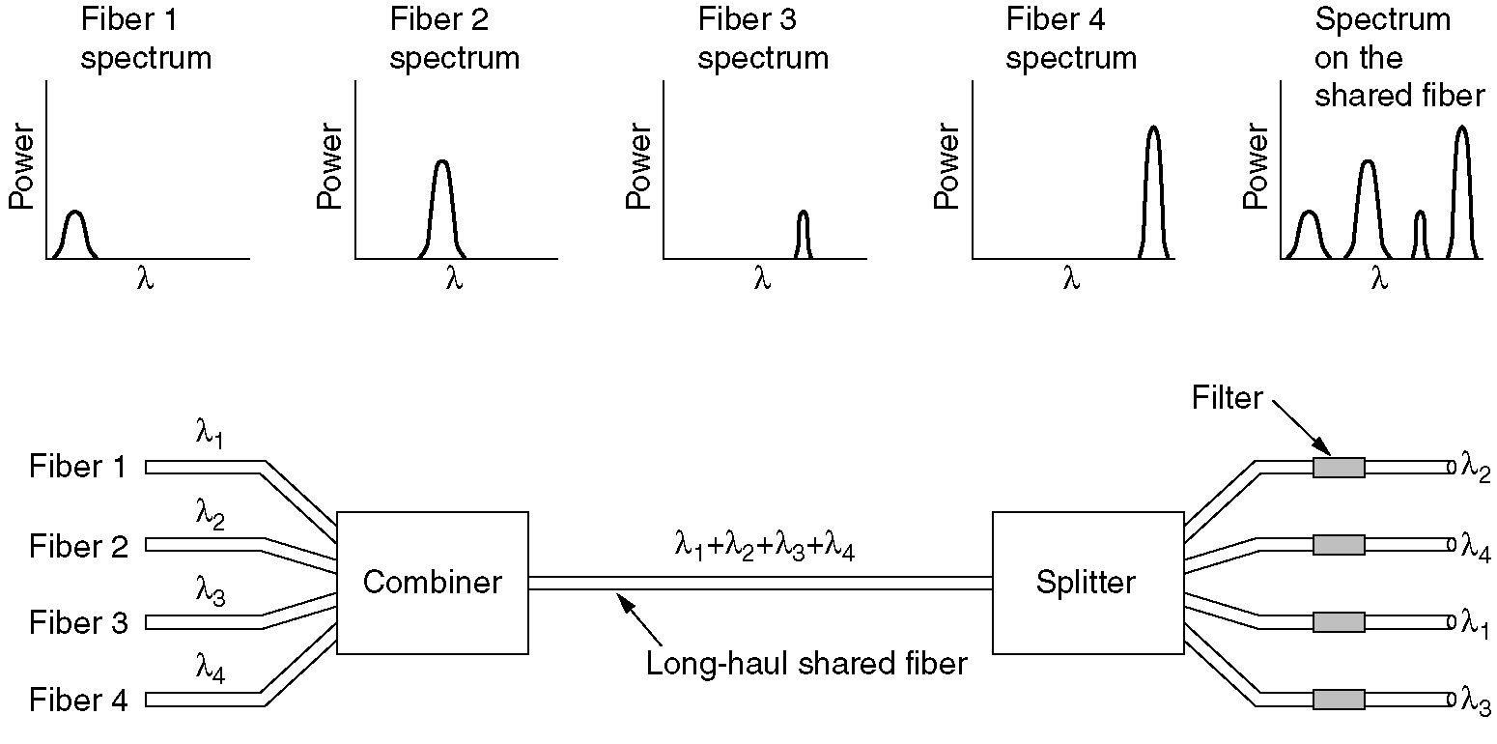
Wavelength Division Multiplexing
Wavelength division multiplexing.
Figure 2-32.
Tanenbaum

Slide 38
Optical Fiber
Three techniques:
Multimode step-index
Multimode graded-index
Single-mode step-index
Presence of multiple paths ➔ differences in delay ➔ optical rays interfere with each other.
A narrow core can create a single direct path which yields higher speeds.
WDM (Wavelength Division Multiplexing) yields more available capacity.

Slide 39
Optical Fiber Transmission Modes
DCC 8th Ed.
Stallings

Slide 40
Frequency Utilization for Fiber Applications
DCC 8th Ed.
Stallings
Notes:
In optical fiber, based on the attenuation characteristics of the medium and on properties of light sources and receivers, four transmission windows are appropriate, as shown in Stallings DCC8e Table 4.5. Note the tremendous bandwidths available. For the four windows, the respective bandwidths are 33 THz, 12 THz, 4 THz, and 7 THz. This is several orders of magnitude greater than the bandwidth available in the radio-frequency spectrum.
The four transmission windows are in the infrared portion of the frequency spectrum, below the visible-light portion, which is 400 to 700 nm. The loss is lower at higher wavelengths, allowing greater data rates over longer distances. Many local applications today use 850-nm LED light sources. Although this combination is relatively inexpensive, it is generally limited to data rates under 100 Mbps and distances of a few kilometers. To achieve higher data rates and longer distances, a 1300-nm LED or laser source is needed. The highest data rates and longest distances require 1500-nm laser sources. nb. WDM = wavelength division multiplexing (see Chapter 8).

Slide 41
Fiber to the Home (FIOS)
ONT
Internet
optical fibers
optical fiber
ONT
OLT
optical
splitter
central office
ONT
Optical links from central office to the home
Two competing optical technologies:
Passive Optical network (PON)
Active Optical Network (PAN)
Much higher Internet rates. Fiber also carries television and phone services
K & R

Slide 42
Wireless Communications (briefly)
An application of omni-directional wireless communications to provide high-speed communications among a number of computers located in close proximity.
In 1996 FCC in US announced its intentions to make 350 MHz of spectrum in the 5.15 to 5.35 GHz and 5.725 to 5.825 GHz bands available for unlicensed use in LAN applications.

Slide 43
Telecommunications Spectrum
DCC 9th Ed.
Stallings

Slide 44
Wireless Access Networks
shared wireless access network connects end system to router
via base station aka “access point”
Wireless LANs:
802.11b/g /n(WiFi): 11, 54, 100’s Mbps, Bluetooth, Zigbee (802.15.4)
Wide Area Wireless Access:
provided by telco operator
~1Mbps over cellular system (EVDO, HSDPA)
next up (?): WiMAX (10’s Mbps) over wide area
router
base
station
mobile
hosts
K & R

Slide 45
Wireless Multipath Interference
DCC 8th Ed.
Stallings

Slide 46
Residential Networks
Typical Residential network components:
DSL or cable modem
Router/firewall/NAT
Ethernet
Wireless access point (AP)
wireless
laptops
to/from
cable
headend
cable
modem
router/
firewall
wireless
access
point
Ethernet
K & R

Slide 47
Transmission Media Summary
Twisted pair
Noise, interference and attenuation are issues.
Cat5e modern required minimum (Fast Ethernet)
Dial-Up and DSL (ADSL) Connections
Coaxial cable
Baseband versus Broadband
Cable is HFC (Hybrid Fiber-Coax)
FDM and asymmetric channel capacities

Slide 48
Transmission Media Summary
Optical Fiber
Wavelength Division Multiplexing of light
Very High Capacities
Three standard wavelengths
Three standard techniques
Fiber to the home
Wireless Communications
‘crowded’ frequency spectrum
WLAN and Wide Area wireless
Common Residential ‘Last Hop’ to the Internet involves wireless AP (router, firewall, NAT).

