Slide 1
Synchronous Optical Networks (SONET)
Advanced Computer Networks
D12

Slide 2
SONET Outline
Brief History
SONET Overview
SONET Rates
SONET Ring Architecture
Add/Drop Multiplexor (ADM)
Section, Line and Path
Virtual Tributaries
Synchronous Payload Envelope (SPE)
Connection to ATM

Slide 3
Telephone Networks {Brief History}
Digital carrier systems
The hierarchy of digital signals that the telephone network uses.
Trunks and access links organized in DS (digital signal) hierarchy
Problem: rates are not multiples of each other.
In the 1980’s Bellcore developed the Synchronous Optical Network (SONET) standard.
Previous efforts include: ISDN and BISDN.

Slide 4
North American Digital Hierarchy
Primary
Multiplex
Eg. Digital
Switch
24 chan PCM
M12
Multiplex
x4
M23
Multiplex
x7
DS1 1.544 Mbps
DS2 6.312 Mbps
DS3 44.736 Mbps
1
M13
Multiplex
DS3 44.736 Mbps
●
●
●
28
Leon-Garcia & Widjaja:
Communication Networks
European Digital Hierarchy
Primary
Multiplex
Eg. Digital
Switch
30 chan PCM
CEPT 1
3rd order
Multiplex
x4
2.048 Mbps
2nd order
Multiplex
x4
8.448 Mbps
34.368 Mbps
4th order
Multiplex
x4
CEPT 4
139.264 Mbps

Slide 5
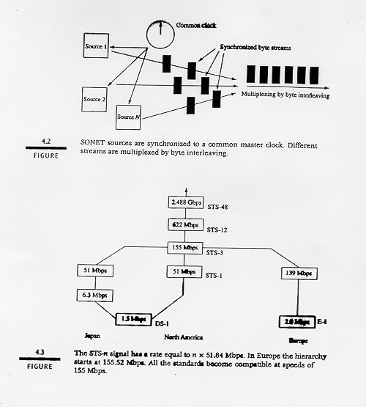

Slide 6
SONET
SONET:: encodes bit streams into optical signals propagated over optical fiber. SONET defines a technology for carrying many signals of different capacities through a synchronous, flexible, optical hierarchy.
A bit-way implementation providing end-to-end transport of bit streams.
All clocks in the network are locked to a common master clock so that simple TDM can be used.
Multiplexing done by byte interleaving.
SONET is backward compatible to DS-1 and E-1 and forward compatible to ATM cells.
Demultiplexing is easy.

Slide 7
SONET
Transmission links of the telephone network have been changing to SONET where rates are arranged in STS (Synchronous Transfer Signal) hierarchy.
The hierarchy is called SDH (Synchronous Digital Hierarchy) defined by CCITT.
It is an ITU standard.

Slide 8
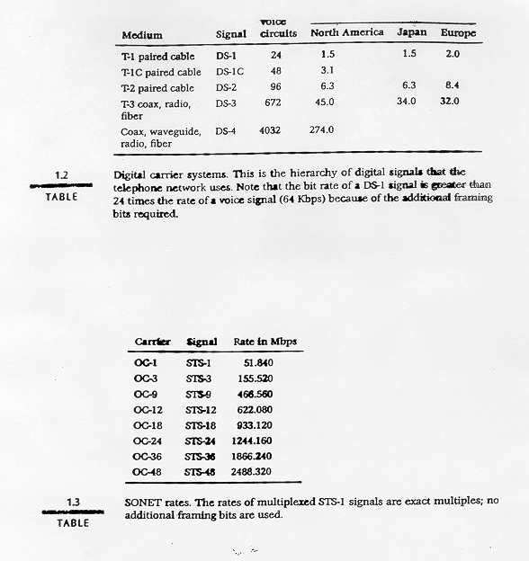

Slide 9
SONET Rates
10 Gbps
Figure 2-37. SONET and SDH Multiplex Rates
Tanenbaum

Slide 10
SONET Multipexing
DS1
Low-Speed
Mapping
Function
DS2
STS-1
CEPT-1
51.84 Mbps
DS3
Medium
Speed
Mapping
Function
STS-1
44.736
●
●
●
●
●
●
STS-n
OC-n
STS-3c
CEPT-4
High-
Speed
Mapping
Function
STS-1
Mux
Scrambler
E/O
STS-1
139.264
STS-1
STS-1
STS-3c
High-
Speed
Mapping
Function
STS-1
ATM
STS-1
150 Mbps
Leon-Garcia & Widjaja:
Communication Networks

Slide 11
SONET Synchronous Multiplexing
STS-1
STS-1
Map
STS-1
STS-1
STS-1
STS-1
STS-1
STS-1
Byte
Interleave
STS-3
Map
STS-1
STS-1
Map
STS-1
STS-1
Incoming
STS-1 Frames
Synchronized New
STS-1 Frames
Leon-Garcia & Widjaja:
Communication Networks

Slide 12
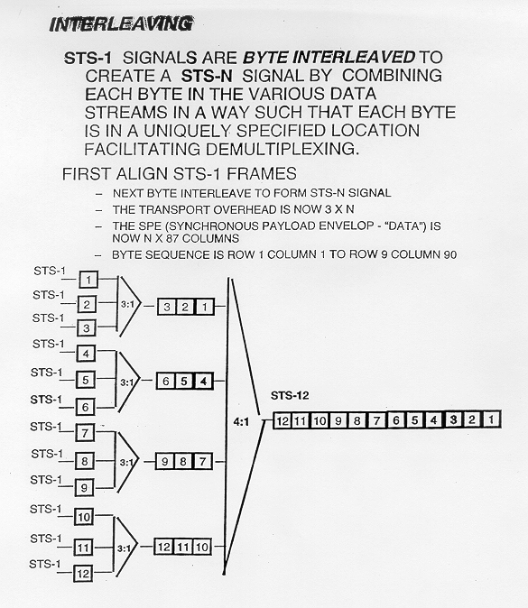

Slide 13
SONET Architecture
SONET topology can be a mesh, but most often it is a dual ring.
Standard component of SONET ring is an ADM (Add/Drop Multiplexer)
Drop one incoming multiplexed stream and replace it with another stream.
Used to make up bi-directional line switching rings.

Slide 14
SONET Ring
a
a
ADM
d
ADM
ADM
b
d
b
ADM
c
c
(a) Dual ring
(b) Loop-around
in response to fault
Leon-Garcia & Widjaja:
Communication Networks

Slide 15
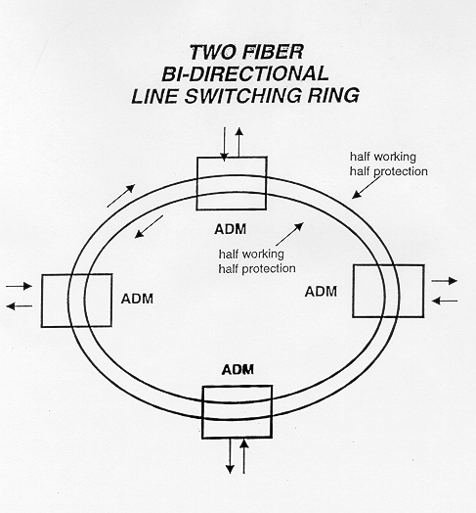
SONET Ring
Changed from
FDDI

Slide 16
ADM
(a) pre-SONET multiplexing
MUX
MUX
DEMUX
MUX
DEMUX
remove
tributary
insert
tributary
(b) SONET Add-Drop multiplexing
MUX
ADM
DEMUX
remove
tributary
insert
tributary
Leon-Garcia & Widjaja:
Communication Networks

Slide 17
SONET Ring
Regional
Ring
Metro
Ring
Inter-Office
Rings
Leon-Garcia & Widjaja:
Communication Networks

Slide 18
Gigabit ATM Over 10 Gb/s SONET Ring
Washington U. St Louis 1995

Slide 19
SONET Architecture
(a)
STS
PTE
STS
PTE
SONET
Terminal
LTE
LTE
SONET
Terminal
STE
STE
STE
Mux
Mux
reg
reg
reg
Section
Section
STS Line
STS-1 Path
STE: Section Terminating Equipment, e.g. a repeater
LTE: Line Terminating Equipment, e.g. a STS-1 to STS-3 multiplexer
PTE: Path Terminating Equipment, e.g. an STS-1 multiplexer
Leon-Garcia & Widjaja:
Communication Networks
(b)
path
path
line
line
line
line
section
section
section
section
section
section
section
optical
optical
optical
optical
optical
optical
optical

Slide 20
SONET Architecture
SONET
MPX
OC-1
BIM
OC-3
REG
OC-3
ADM
OC-3
REG
OC-3
BIM
OC-1
SONET
MPX
Sections
Lines
Path
The main SONET elements

Slide 21
SONET Architecture
BIM
= BIM (Byte Interleaved Multiplexer)
REG
= Regenerator
Boosts power of optical signal
Optical signal is converted to electrical signal.
Amplify electrical signal.
Amplified electrical signal converted back to optical signal.

Slide 22
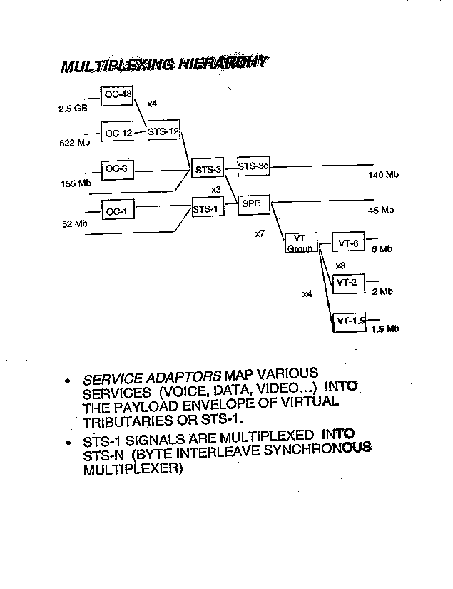
Virtual
Tributaries

Slide 23
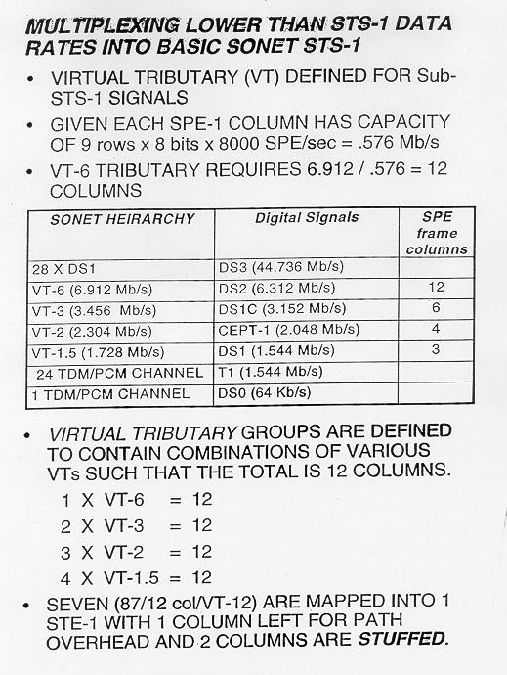

Slide 24
SONET Frame
90 bytes
B
B
B
87B
Section
Overhead
3 rows
Information
Payload
9 Rows
Line
Overhead
6 rows
Transport
overhead
125 μs
SPE Synchronous Payload Envelope
Leon-Garcia & Widjaja:
Communication Networks

Slide 25
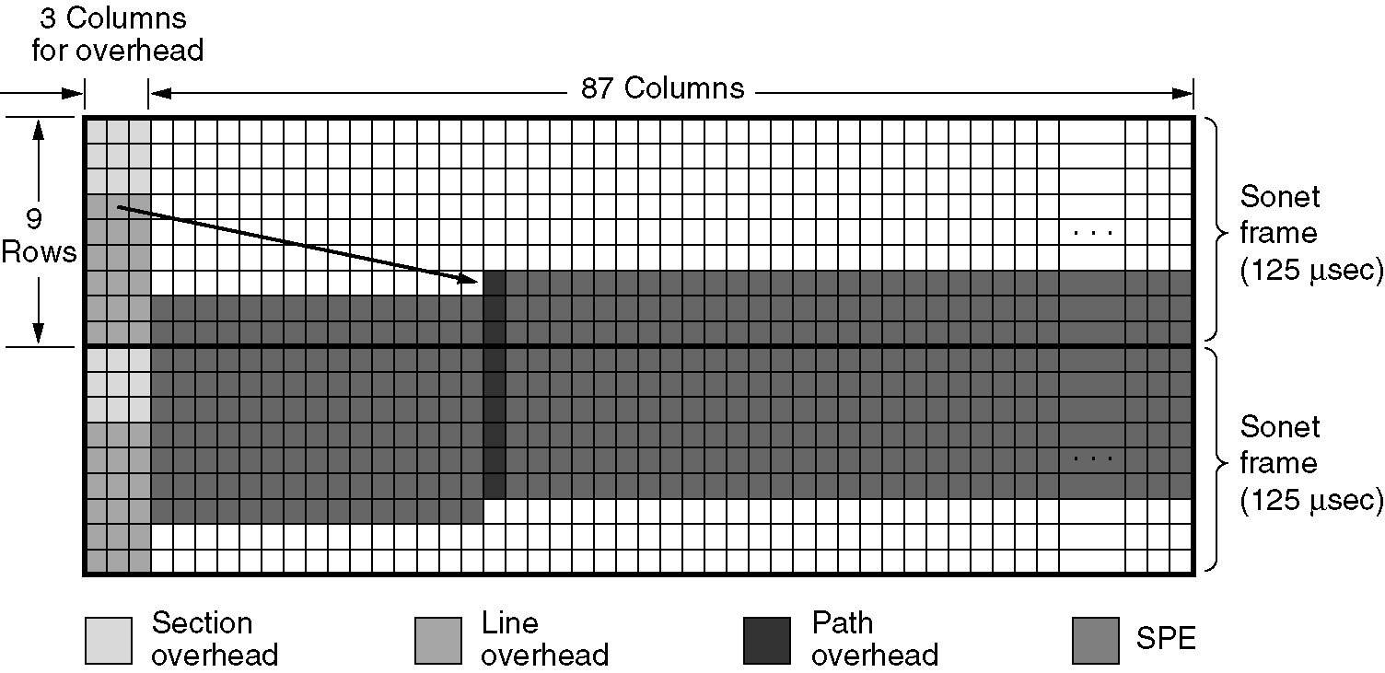
Figure 2-36. Two Back-to-Back SONET Frames
SONET Frame
Tanenbaum

Slide 26
SPE straddling SONET Frame
Pointer
first octet
frame
k
87 columns
Synchronous
Payload
Envelope
9
rows
Pointer
last octet
frame
k+1
first column is path overhead
Leon-Garcia & Widjaja:
Communication Networks

Slide 27
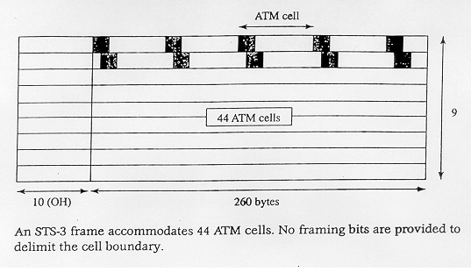
ATM Cells in an STS-3 Frame
ATM Cell Format
Header
5 Bytes
Payload
48 Bytes

Slide 28
SONET Summary
Brief History
SONET Definition and Overview
SONET Rates (STS and OC’s)
SONET Ring Architecture
Add/Drop Multiplexor (ADM)
Section, Line and Path
Virtual Tributaries
Synchronous Payload Envelope (SPE)
Connection to ATM

