Slide 1
Observing Home Wireless Experience through WiFi APs
MobiCom ‘13 September 2013
Patro, S. Govindan, S. Banerjee
University of Wisconsin Madison
Presented by Bob Kinicki
PEDS Seminar
18 November 2013

Slide 2
Motivation
Generally, while home WiFi users get reasonably good performance most of the time, there remain instances when home network performance remains frustratingly slow.
Most researchers over the last decade have deployed passive sniffers to understand and evaluate specific wireless characteristics.

Slide 3
Research Goals
1. To perform a more systematic study of WiFi experience in home environments and provide a detailed characterization.
2. To evaluate the community’s collective intuition of WiFi network performance.

Slide 4
Objectives
To answer these questions:
How often does home WiFi provide good, mediocre or bad performance?
When performance is bad –what are the causes and how long does it persist?
How much interference do we see and what sources provide the interference?
How do users configure their WiFi networks?

Slide 5
Research Approach
Define a wireless performance metric that captures overall network goodness.
This metric should consider ONLY wireless part of user’s end-to-end path.
Metric is “application-agnostic” while focusing on TCP elasticity.
Witt :: WiFi-based TCP throughput
Evaluate and use Witt as a key metric in wireless measurement study.

Slide 6
Outline
Introduction
WiSe Infrastructure and Framework
How was Witt constructed?
Use Witt to Classify WiFi Experience
Analyze detailed Results from Measurement Study
To answer the posed questions.
Summary and Critique

Slide 7
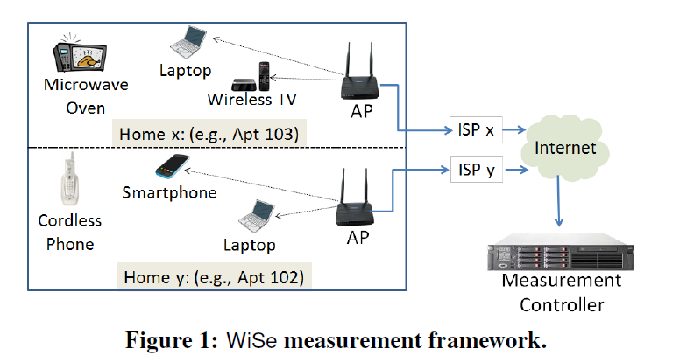
WiSe Measurement Framework
Give away 30 Open
Wrt-based WiFi APs
with dual WiFi NICs
Uses open API to
remotely manage
and configure APs

Slide 8
Open API High Level Description
(Every 10 secs.)
10-byte per packet summaries including AP’s own links
and overheard data packets on the same channel

Slide 9
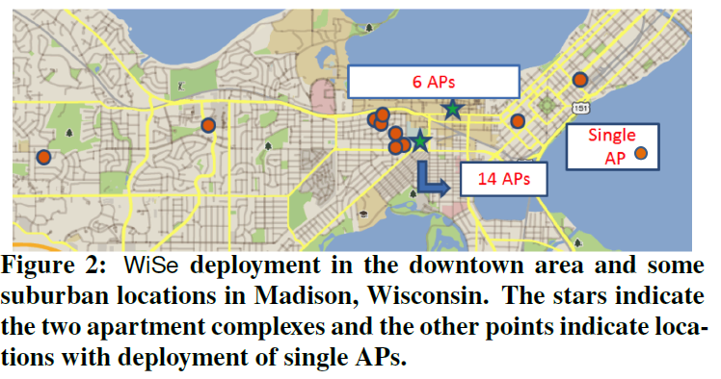

Slide 10
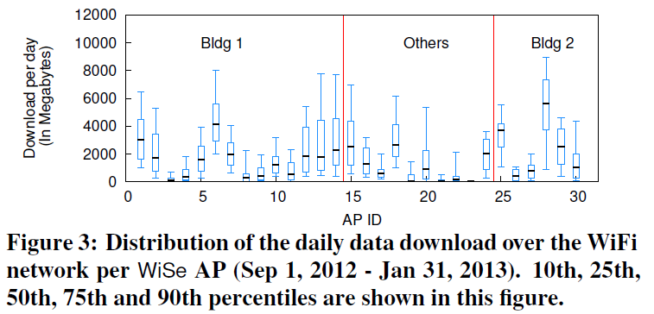
Wide-Ranging Daily WiFi Usage
8-9 GB per day
(90th percentile usage)

Slide 11
Outline
Introduction
WiSe Infrastructure and Framework
How was Witt constructed?
Use Witt to Classify WiFi Experience
Analyze detailed Results from Measurement Study
To answer the posed questions.
Summary and Critique

Slide 12
Witt: WiFi-based TCP Throughput
Metric idea – measure (passively at the AP) the likely TCP throughput between a client and its AP given the existing wireless conditions.
Consider also the average value for all active clients* as a single aggregate for the entire AP.
*To be considered active, a client has to send at least 500 packets in the last 10-second window.

Slide 13
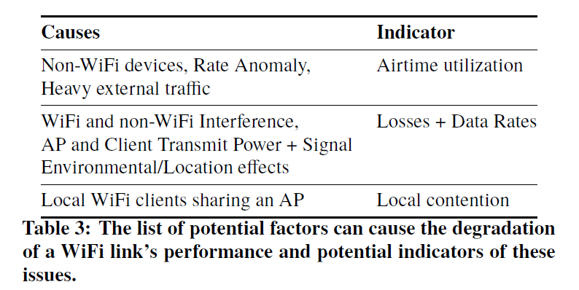
Degradation Factors and Indicators
More details wrt factors: low signal strength, increased delay due to reduced
PHYrates or multiple retransmissions, high airtime reduces ability to send

Slide 14
How to measure Witt?
Collect ‘ground truth’ measurements under a variety of conditions.
Four of their own clients (laptops) co-existed with WiSe APs at eight different deployment locations in the apartment buildings.
Iperf TCP download run between WiSE APs and clients for 20 seconds.
Clients ran throughput measurements in intervals of 5 to 10 minutes over the course of a week.

Slide 15
How to measure Witt?
Clients were connected to different APs to emulate different link conditions.
Experiments automatically conducted at different times of the day.
Collected hundreds of measurements (see Table 6).
Based on the key factors from the measurements build a model of Witt.
Use benchmarks to evaluate Witt.

Slide 16
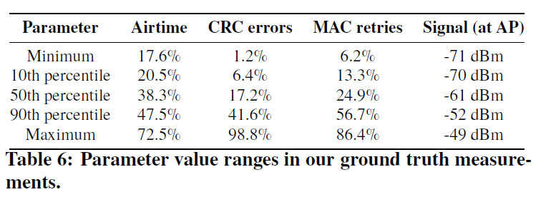
Ground Truth Measurements

Slide 17
Feature Definitions
Airtime utilization :: aggregate busy statistic that includes time when transmitting, receiving and overhearing {fraction of time occupied by only external WiFi and non-Wifi transmissions}.
Local contention (c) :: the relative amount of other client traffic through an AP as a fraction of the total traffic passing through this AP.
Effective rate (r) :: captures the net effect of packet losses and choice of PHY rate used on an AP-client link. (see equation 1)
Link experience (link_exp) :: (see equation 2)

Slide 18
Effective Rate and Link Experience
where*
s_{i} is the number of successful packet transmissions
and p_{i} is the total number of packet transmissions at each PHY rate (r₁, …, r_{n} ) used by an AP-client pair.
a is the airtime utliization from external sources.
*Note – all features are based on aggregate stats per link (collected over 10 second intervals).

Slide 19
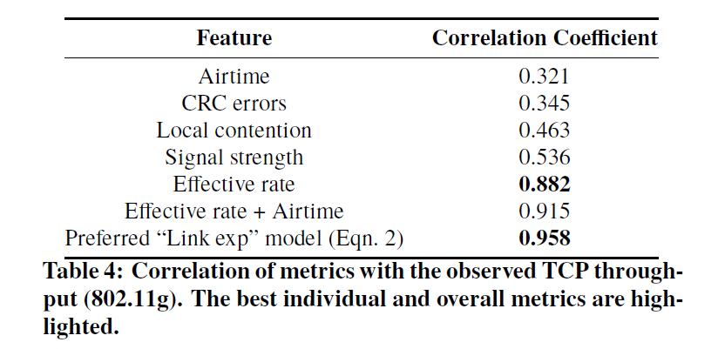
How to Create Witt ?
To create Witt, wireless statistics recorded by WiSe APs in 10-sec intervals were evaluated via correlations as potential important features to used to predict Witt.

Slide 20
Build a linear model of Witt
Link experience is mapped to Witt using a linear model (equation 3).
By dividing ground truth data into training and testing data sets, authors test fidelity of linear model and develop 95% confidence intervals that show model is a reasonable estimate for predicting throughput.

Slide 21
Benchmarks to Evaluate Witt
Ground truth TCP throughput measurements are compared against predicted TCP throughputs using linear regression of effective rate and link experience (see Figure 4).
CDF of errors between actual vs predicted TCP throughputs using different metrics (see Figure 5).

Slide 22
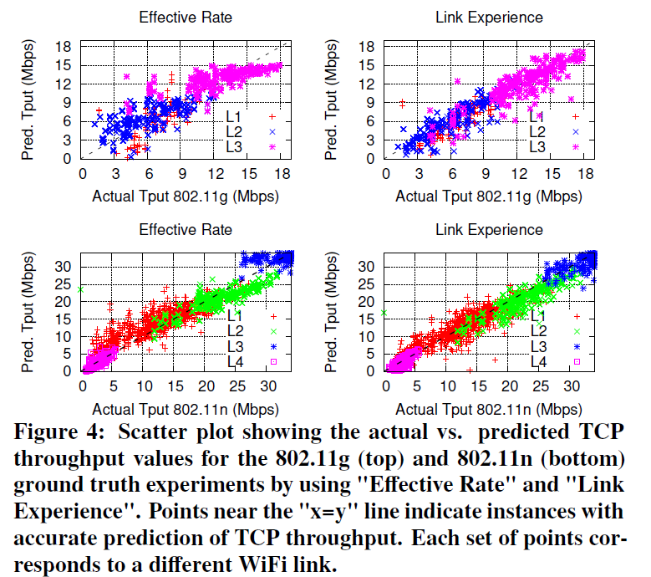

Slide 23
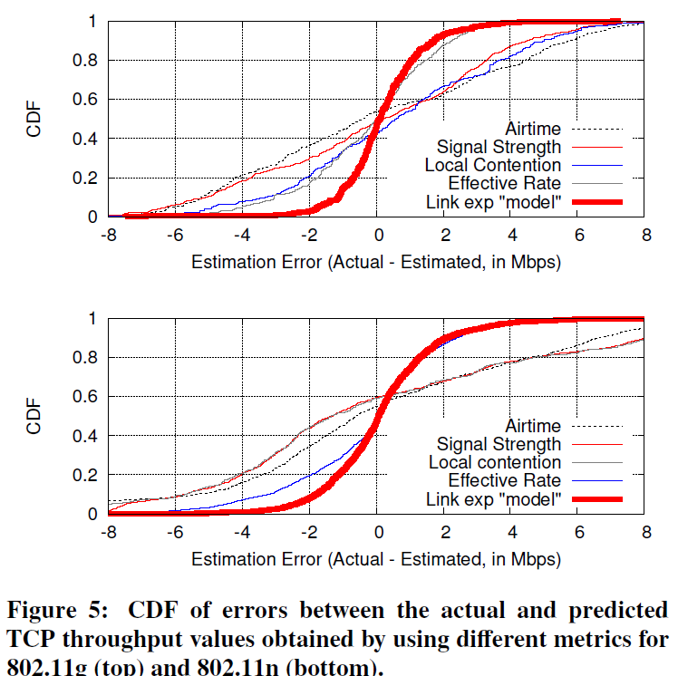
CDF of Errors for Various Metrics

Slide 24
Outline
Introduction
WiSe Infrastructure and Framework
How was Witt constructed?
Use Witt to Classify WiFi Experience
Analyze detailed Results from Measurement Study
To answer the posed questions.
Summary and Critique

Slide 25
Use Witt to Classify Wireless Experience
Focus on periods when WiSe AP has at least one active client.
How did link performance vary across APs over time?
A diverse set of clients associated with WiSe APs.
Measured Witt values during active periods and group results bases on Witt values.
In Figure 6 – AP clients are active for at least 20 days.

Slide 26
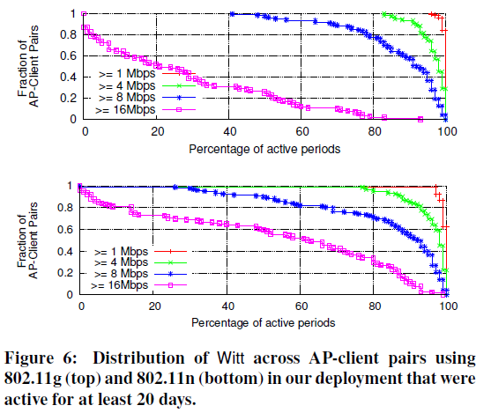
Figure 6

Slide 27
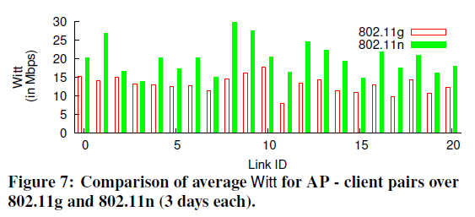
Table 7 & Figure 7
11n higher Witt due to higher PHY rates
and frame aggregation.

Slide 28
Causes for Poor Wireless Experience
Over 80 days (Nov 2012 – Jan 2013) detected 186 and 2031 minutes of “Very Poor” and “Poor” instances across all 30 WiSe APs (2.1% of the active periods).
Very poor periods rare; Poor periods occur intermittently depending on link and location.
Aggregated instances of poor performance across WiSe APs in each apartment.

Slide 29
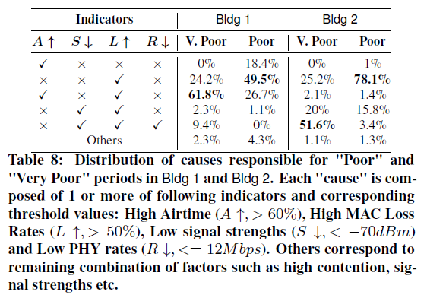
Causes of Poor Experience
High density produces
higher airtime and losses.
High frame losses
cause poor results.
Low signal strength
yields low performance.

Slide 30
Impact of Other Factors
Impact of other factors (including local contention from other clients) was low (<= 4.3%).
Prevalence of low local contention at wireless hop is due to it is uncommon for multiple clients to generate high traffic during the same interval.
In cases where there were multiple active clients at AP, bottleneck at the wired link led to lower contention.

Slide 31
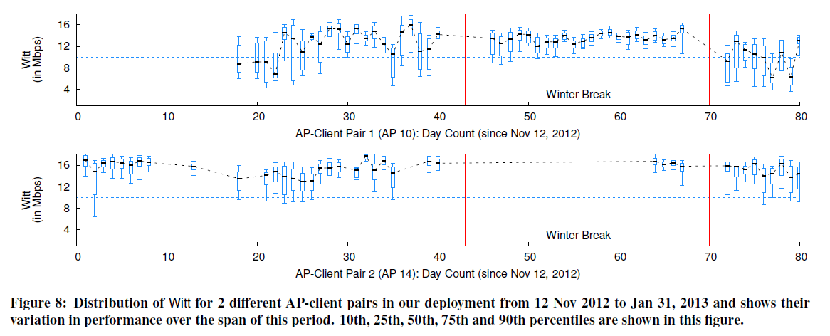
Variability in Wireless Experience
Less airtime and congestion from neighbors
Higher performance variability
Consistently good performance
Both APs are in Building 1

Slide 32
Outline
Introduction
WiSe Infrastructure and Framework
How was Witt constructed?
Use Witt to Classify WiFi Experience
Analyze detailed Results from Measurement Study
To answer the posed questions.
Summary and Critique

Slide 33
Detailed View
Analyze impact of external factors on wireless clients in the wild:
Contention from low data rate senders
Packet loss due to hidden terminals
Non-WiFi interference activity

Slide 34
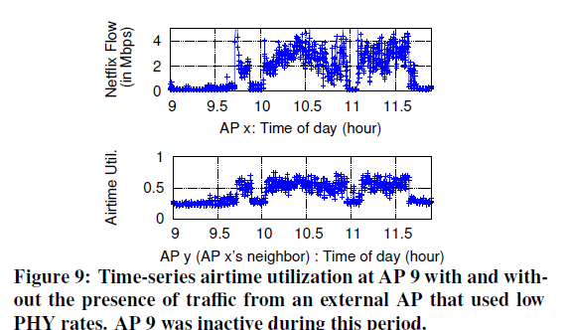
Contention from low data rate senders
Due to performance anomaly (aka rate anomaly) transmitters using low PHY rates can cause their Witt to suffer.
Low PHY at AP x causes
AP 9’s airtime to increase.

Slide 35
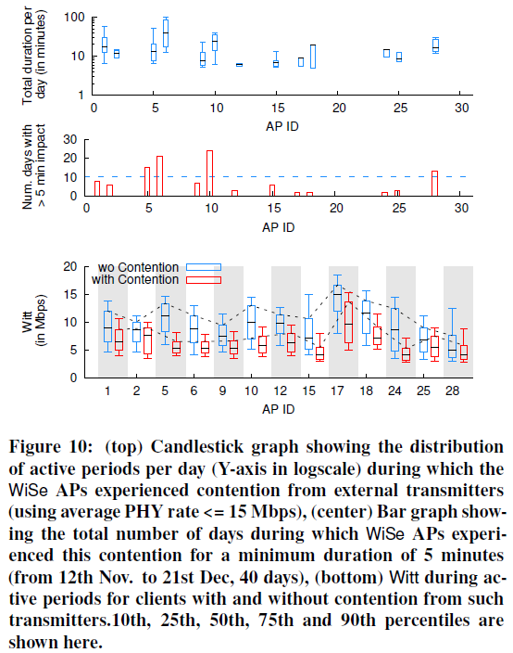
Figure 10
Impact of low PHY from
external APs
AP 6 had highest
activity in Figure 3
Impact of contention

Slide 36
Packet Loss due to Hidden Terminals
High packet loss was a major cause for “Poor” cases.
Hidden Terminals (HT) are an external factor that can reduce link’s Witt by increasing packet loss.
Used synchronized and merged packet summaries from multiple APs in Bldg 1 to compute HT events in 15-second epochs.
Packet loss at a receiver due to overlapping packet transmissions from the interferer is the main cause for a hidden terminal event.

Slide 37
Packet Loss due to Hidden Terminals
For 15 second “epochs”, epoch is marked as HT event for WiSe AP when one of its link’s loss rates is 40% higher for packets overlapped in time by the interferer compared to packets not overlapped by any other transmitter.
Required constraint of 1000 packet minimum for a link and minimum of 100 packet overlaps from potential interferer per epoch to check for HT conflict (makes this a conservative estimate of interference experienced).

Slide 38
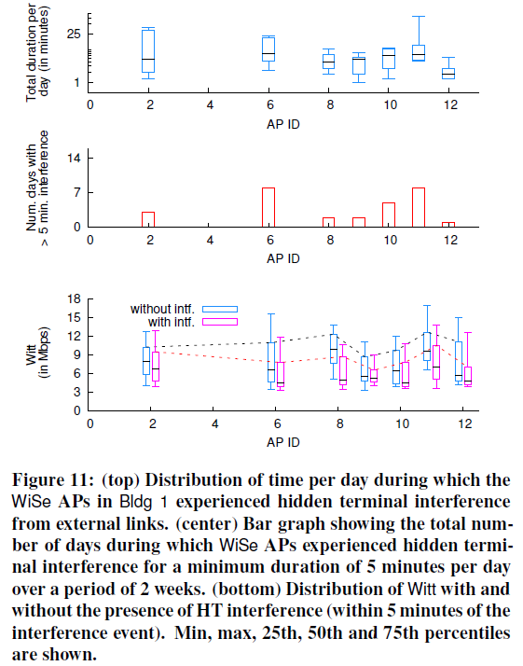
NF
NF
HT interference
for seven APs
6, 10, 11 repeatedly
impacted by HTs
High variability in
HT impact due high
burstiness of WiFi
links

Slide 39
High Burstiness of Traffic
Only about 10% of total periods of continuous activity at the WiSe APs
lasted more than three minutes.
{explains small periods of interference in homes}
Example – Netflix video streaming
APs 6 and 11 (NF in Figure 11) periods of highest interference coincided with usage of Netflix. APs are more sensitive to HT interference issues during periods of high activity.

Slide 40
Non-WiFi Interference Activity
Interference by commonly available non-WiFi devices can degrade WiFi link performance (e.g,. Microwaves).
These devices do NOT have carrier sense before transmitting.
Authors use Airshark to detect presense of non-WiFi devices.
Since microwaves impact channels 8-11, conducted 30 day experiment with APs using channel 11.

Slide 41
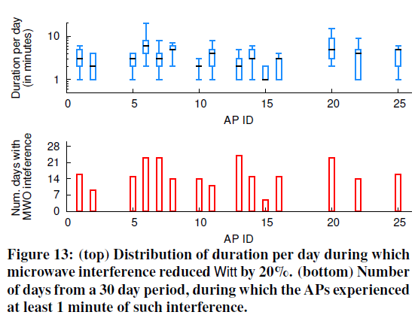
Figure 13 Microwave Interference

Slide 42
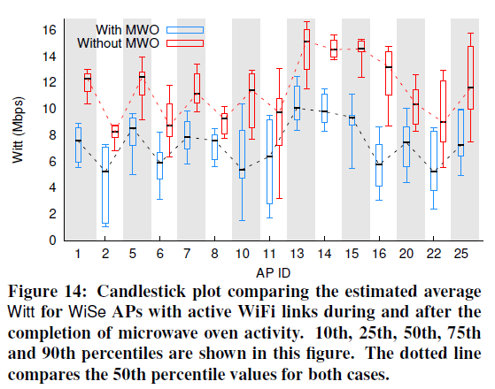
Figure 14 Impact of Microwave Activity on Witt

Slide 43
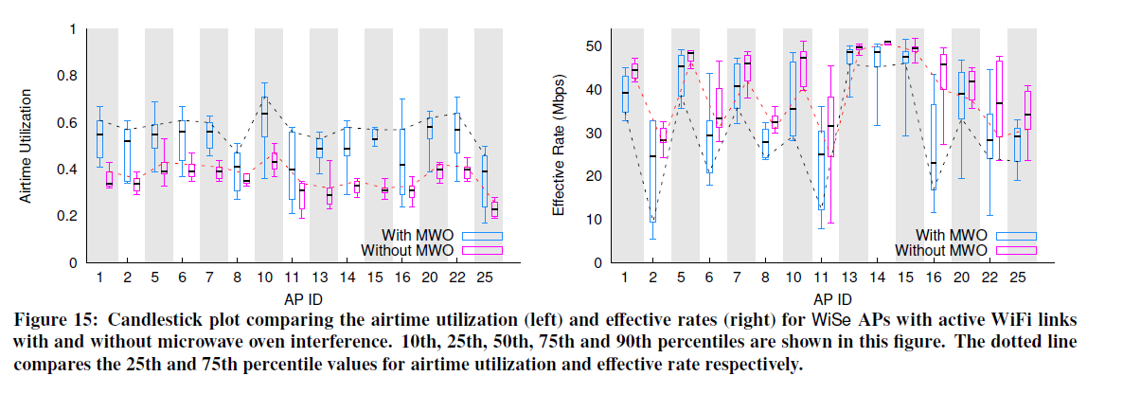
Impact of Microwave Activity on Airtime and Effective Rate

Slide 44
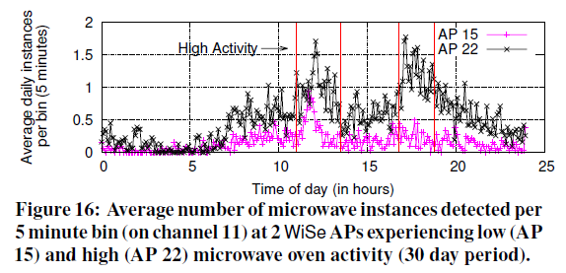
Figure 16 Microwave Instances
Figure 16 demonstrates differences over APs
and over time of day.

Slide 45
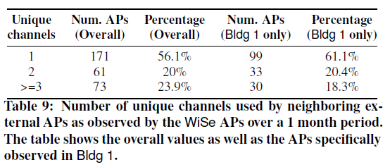
Channel Usage Patterns
Done by periodically scanning all channels to overhear
beacons from neighboring APs (including external APs).

Slide 46
Section 5 Summary
Impact of interference (WiFi and non-WiFi) depends on the traffic of both link and interferer. Majority of interference durations are short.
Some interferers had high impact on the APs (e.g., microwave ovens severely degraded performance of some APs).

Slide 47
Section 5 Summary (cont)
Learning the context about interference activity (e.g., time of day) can enable APs to avoid interference.
Majority of APs observed use static channel configurations.

Slide 48
Conclusions
WiSe APs are used to measurement wireless properties in homes.
Simple metric, Witt , is developed, tested and used in this investigation.
Paper provides detailed results about causes of poor performance, contention from low data rate senders, packet loss caused by hidden terminals, and interference due to non-WiFi devices.

Slide 49
Critique
Did authors
answer these questions:
How often does home WiFi provide good, mediocre or bad performance? Y
When performance is bad –what are the causes and how long does it persist? Y
How much interference do we see and what sources provide the interference? Y
How do users configure their WiFi networks? N

Slide 50
Critique/Questions
Top Level comments:
Paper is structured well.
Scientific methodology (factors and features) was strong.
Used very thorough experimentation with unusual set up.
Several graphs/experiments were not well-explained
Is Witt the only important metric?

Slide 51
Critique/Questions
More detailed comments:
Provide little analysis of non-apartment performance.
There were a number of small grammar mistakes.
Figures/Tables and descriptive prose not always close together.
While many good, detailed results are given, this does not inform well my intuition on wireless behavior.

Slide 52
Observing Home Wireless Experience through WiFi APs
Questions?
Thank you!

