Slide 1
Brief History of C and Unix
Systems Programming Concepts

Slide 2
C and Unix History
C
Unix
Bell Labs
Berkeley
Others
Linux

Slide 3
1.6 The C Programming Language
C evolved from two previous languages, BCPL and B.
BCPL was developed in 1967 by Martin Richards as a language for writing operating-systems software and compilers.
Ken Thompson modeled many features in his B language after their counterparts in BCPL, and in 1970 he used B to create early versions of the UNIX operating system at Bell Laboratories.
Copyright © Pearson, Inc. 2013. All Rights Reserved.

Slide 4
1.6 The C Programming Language
The C language was evolved from B by Dennis Ritchie at Bell Laboratories and was originally implemented in 1972.
C initially became widely known as the development language of the UNIX operating system.
Many of today’s leading operating systems are written in C and/or C++.
C is mostly hardware independent.
With careful design, it is possible to write C programs that are portable to most computers.
Copyright © Pearson, Inc. 2013. All Rights Reserved.

Slide 5
1.6 The C Programming Language
Built for Performance
C is widely used to develop systems that demand performance, such as operating systems, embedded systems, real-time systems and communications systems (Figure 1.5).
Copyright © Pearson, Inc. 2013. All Rights Reserved.

Slide 6
C Applications
Copyright © Pearson, Inc. 2013. All Rights Reserved.

Slide 7
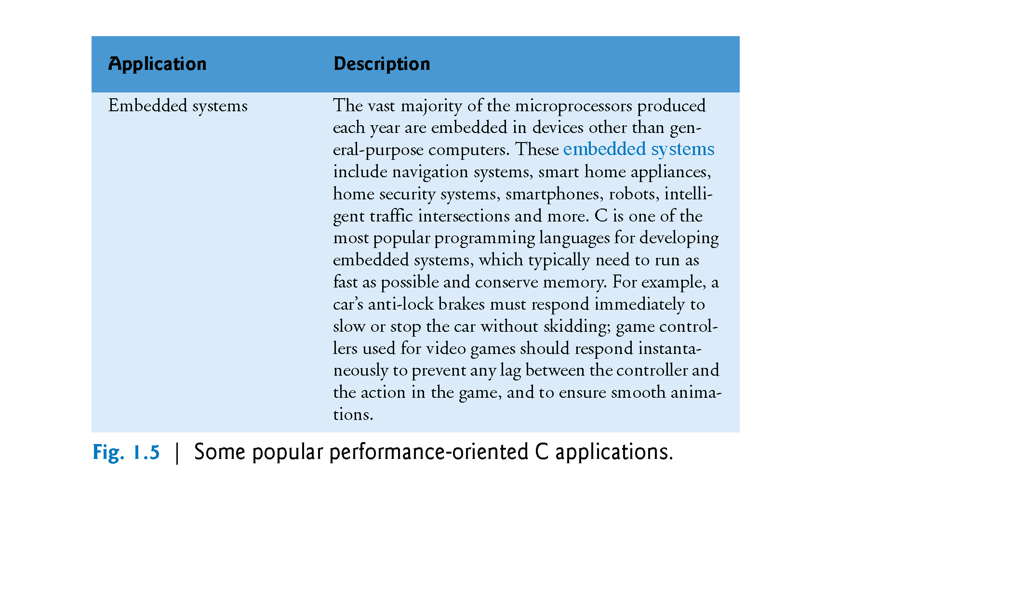
C Applications
Copyright © Pearson, Inc. 2013. All Rights Reserved.

Slide 8
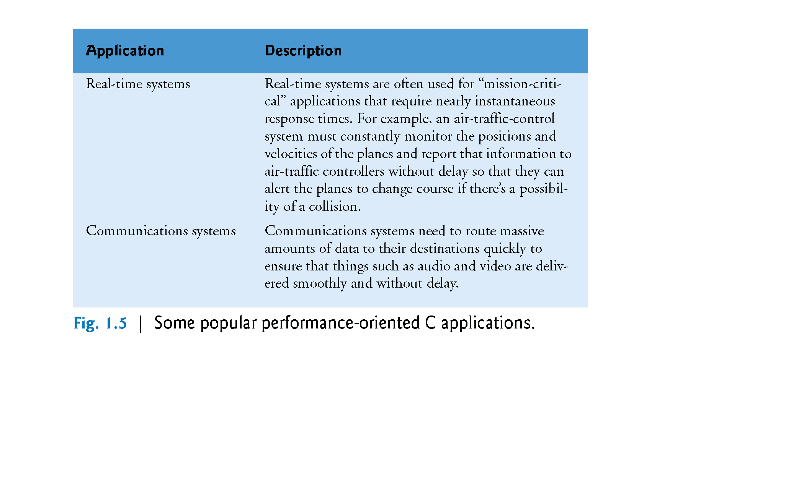
C Applications
Copyright © Pearson, Inc. 2013. All Rights Reserved.

Slide 9
1.6 The C Programming Language
By the late 1970s, C had evolved into what is now referred to as “traditional C.” The publication in 1978 of Kernighan and Ritchie’s book, The C Programming Language, drew wide attention to the language.
Standardization
The rapid expansion of C over various types of computers (sometimes called hardware platforms) led to many variations that were similar but often incompatible.
In 1989, the C standard was approved; this standard was updated in 1999 and is often referred to as C99.
Copyright © Pearson, Inc. 2013. All Rights Reserved.

Slide 10
1.6 The C Programming Language
The New C Standard
The new C standard (referred to as C11) refines and expands the capabilities of C.
Not all popular C compilers support the new features. Of those that do, most implement only a subset of the new features.
Copyright © Pearson, Inc. 2013. All Rights Reserved.

Slide 11
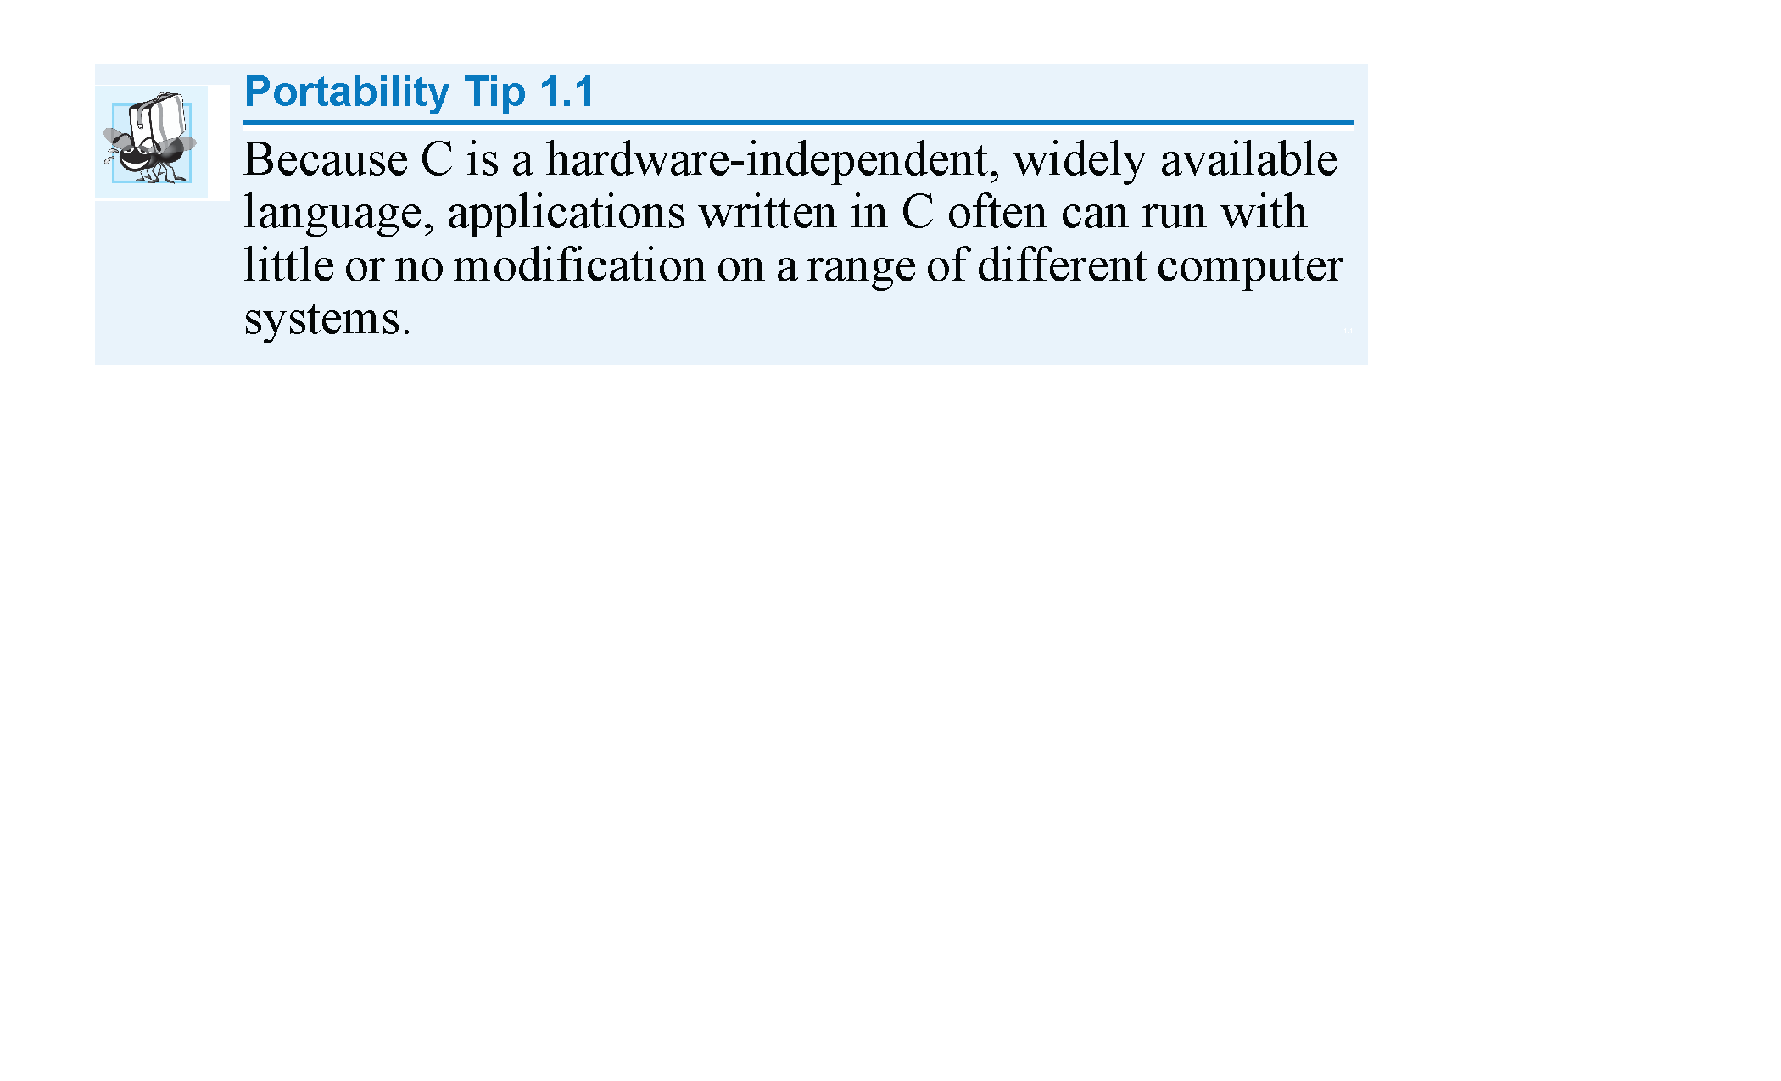
Why Learn C ?
Copyright © Pearson, Inc. 2013. All Rights Reserved.

Slide 12
Early Unix
In 1970’s Unix development continued between Bell Labs and the academic community with V7 important version in 1979.
Beginning in 1975 BSD (Berkeley Software Distribution) Unix competed with AT&T version (particularly System V Unix).

Slide 13
Unix to Linux
Resulted in ‘80s-’90s period of OS Wars included DEC, HP, SUN and OSF versions.
In 1991 Linus Torvalds developed Linux kernel as part of Unix-like OS developed on the philosophy of free software which makes Linux a variant of GNU version of Unix.
Ubuntu is a Debian*-based Linux OS.
* Free software carrying GNU licensing

Slide 14
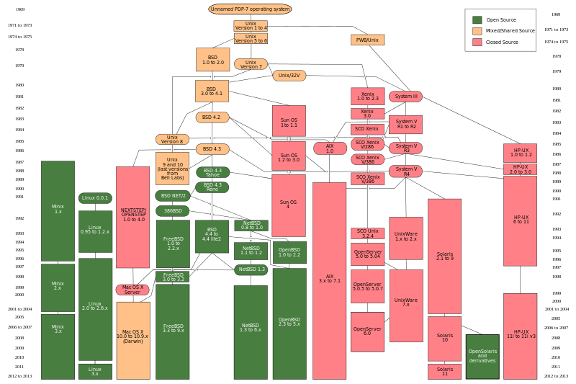
UNIX Evolution [Wikipedia]

