Slide 1
Classes and
Objects
Systems Programming

Slide 2
Classes and Objects
Class Definitions and Objects
Member Functions
Data Members
  Get and Set functions
  Constructors
Placing Classes in Separate Files
Separating Interface from Implementation
Data Validation
  Ensures that data in an object is in a particular format or range.

Slide 3

C++ Program Structure
Typically C++ Programs will consist of:
  A function main
  One or more classes
    Each containing data members and member functions.

Slide 4
16.2 Defining a Class
With a Member Function
Class definition
  Tells the compiler what member functions and data members belong to the class.
  Keyword class followed by the class’s name.
  Class body is enclosed in braces ({})
    Specifies data members and member functions
    Access-specifier public:
      Indicates that a member function or data member is accessible to other functions and member functions of other classes.

Slide 5
C++ Gradebook Example
Beginning of class definition for class GradeBook
Beginning of class body
Access specifier public; makes members available to the public
Member function displayMessage returns nothing.
End of class body
Use dot operator to call GradeBook’s member function

Slide 6
Member Function Takes a Parameter
Include string class definition
Member function parameter
Use the function parameter as a variable

Slide 7
Member function takes a parameter
getline is a library fcn
Passing an argument to the member function

Slide 8
Member Function Takes a Parameter
A string
  Represents a string of characters.
  An object of C++ Standard Library class std::string
    Defined in header file <string>.
Library function getline
  Used to retrieve input until a newline is encountered.
  Example
    getline( cin, nameOfCourse );
      Inputs a line from standard input into string object nameOfCourse.

Slide 9
16.4 Data Members, set Functions and get Functions
Local variables
  Variables declared in a function definition’s body cannot be used outside of that function body.
  When a function terminates the values of its local variables are lost.
Attributes
  Exist throughout the life of the object.
  Are represented as data members.
    Namely, associated with variables in a class definition.
    Are declared inside a class definition but outside the bodies of the class’s member-function definitions.
  Each object of a class maintains its own copy of its attributes in memory.

Slide 10
16.4 Data Members, set Functions and get Functions
Access-specifier private
  Makes a data member or member function accessible only to member functions of the class.
  private is the default access for class members.
  “information hiding” is an object-oriented tenet.
Returning a value from a function
  A function that specifies a return type other than void
    Returns a value to its calling function.

Slide 11
16.4 Data Members, set Functions and get Functions
set function modifies private data
get function accesses private data

Slide 12
16.4 Data Members, set Functions and get Functions
Use set and get functions, even within the class
private members accessible only to member functions of the class
default constructor
Accessing private data outside class definition

Slide 13
16.4 Data Members, set Functions and get Functions
Modifying private data outside class definition
default setting from constructor
is an empty string!!

Slide 14
Software Engineering Observation 16.1
As a rule of thumb, data members should be declared private and member functions should be declared public. (We will see that it is appropriate to declare certain member functions private, if they are to be accessed only by other member functions of the class.)

Slide 15
Data Members, set Functions and get Functions
Software engineering with set and get functions:
  public member functions that allow clients of a class to set or get the values of private data members.
  set functions are sometimes called mutators and get functions are sometimes called accessors.
  Allows the creator of the class to control how clients access private data.
  Should also be used by other member functions of the same class.

Slide 16
Initializing Objects with Constructors
Constructors
  Functions used to initialize an object’s data when it is created.
    The call is made implicitly by the compiler when the object is created.
    Must be defined with the same name as the class.
    Cannot return values.
      Not even void !!
  A default constructor has no parameters.
    The compiler will provide one when a class does not explicitly include a constructor.
    A compiler’s default constructor only calls constructors of data members that are objects of classes.

Slide 17
16.5 Initializing Objects with Constructors
Any constructor that takes no arguments is called a default constructor.
A class gets a default constructor in one of two ways:
  The compiler implicitly creates a default constructor in a class that does not define a constructor. Such a constructor does not initialize the class’s data members, but does call the default constructor for each data member that is an object of another class. An uninitialized variable typically contains a “garbage” value.
  You explicitly define a constructor that takes no arguments. Such a default constructor will call the default constructor for each data member that is an object of another class and will perform additional initialization specified by you.
If you define a constructor with arguments, C++ will not implicitly create a default constructor for that class.
Copyright © Pearson, Inc. 2013. All Rights Reserved.

Slide 18
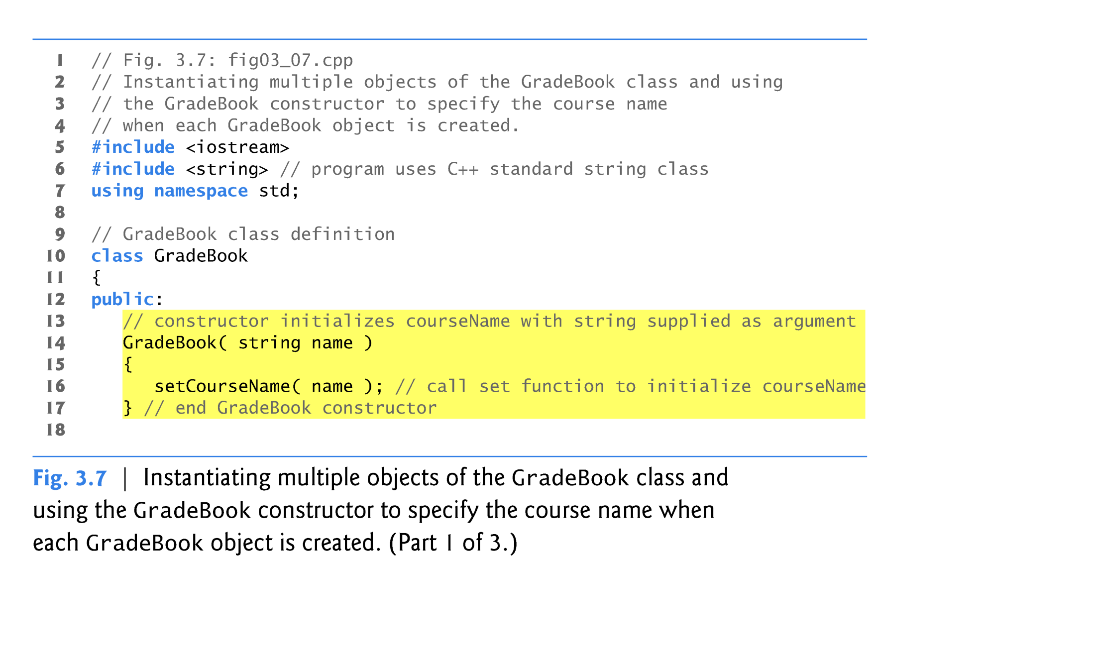
Constructor Example
Constructor has same name as class and no return type
Initialize data member
Copyright © Pearson, Inc. 2013. All Rights Reserved.

Slide 19
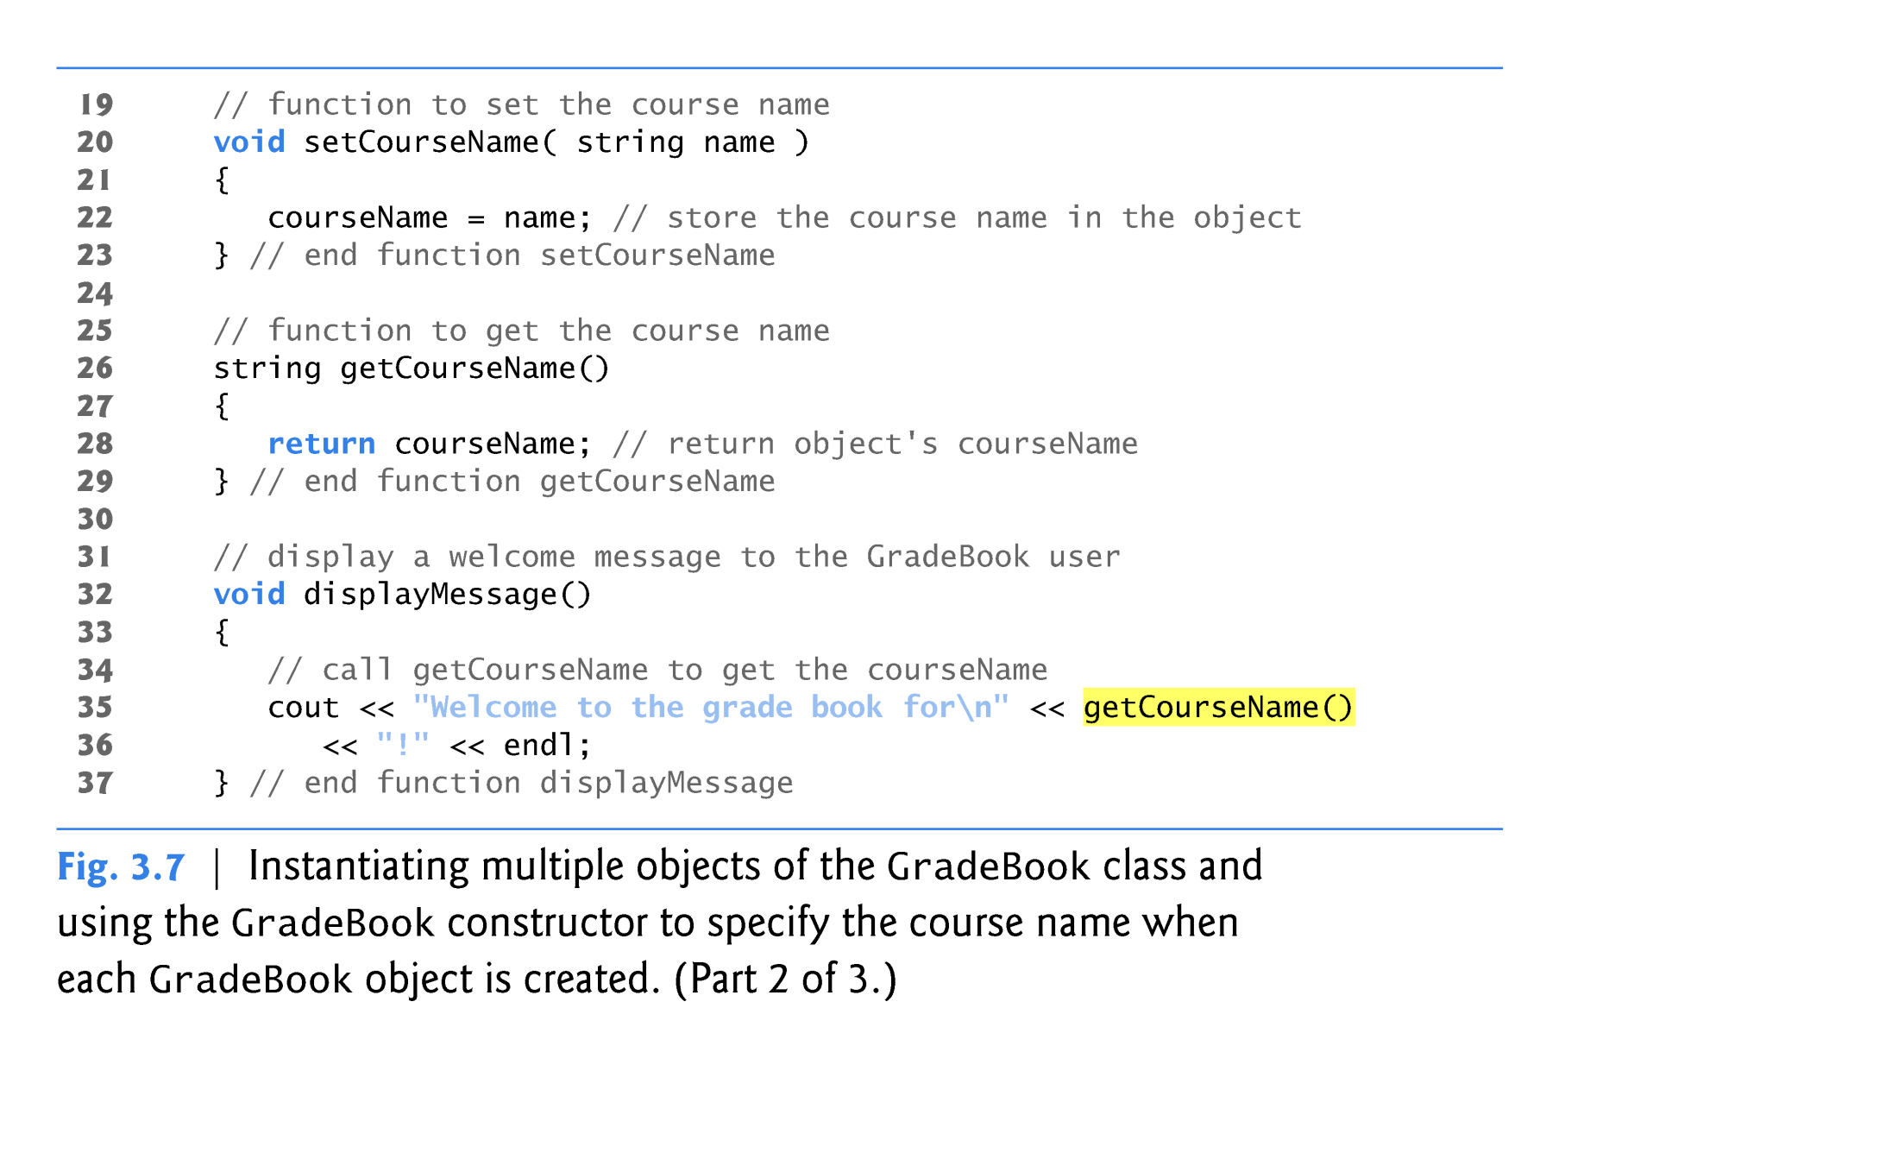
Constructor Example
Copyright © Pearson, Inc. 2013. All Rights Reserved.

Slide 20
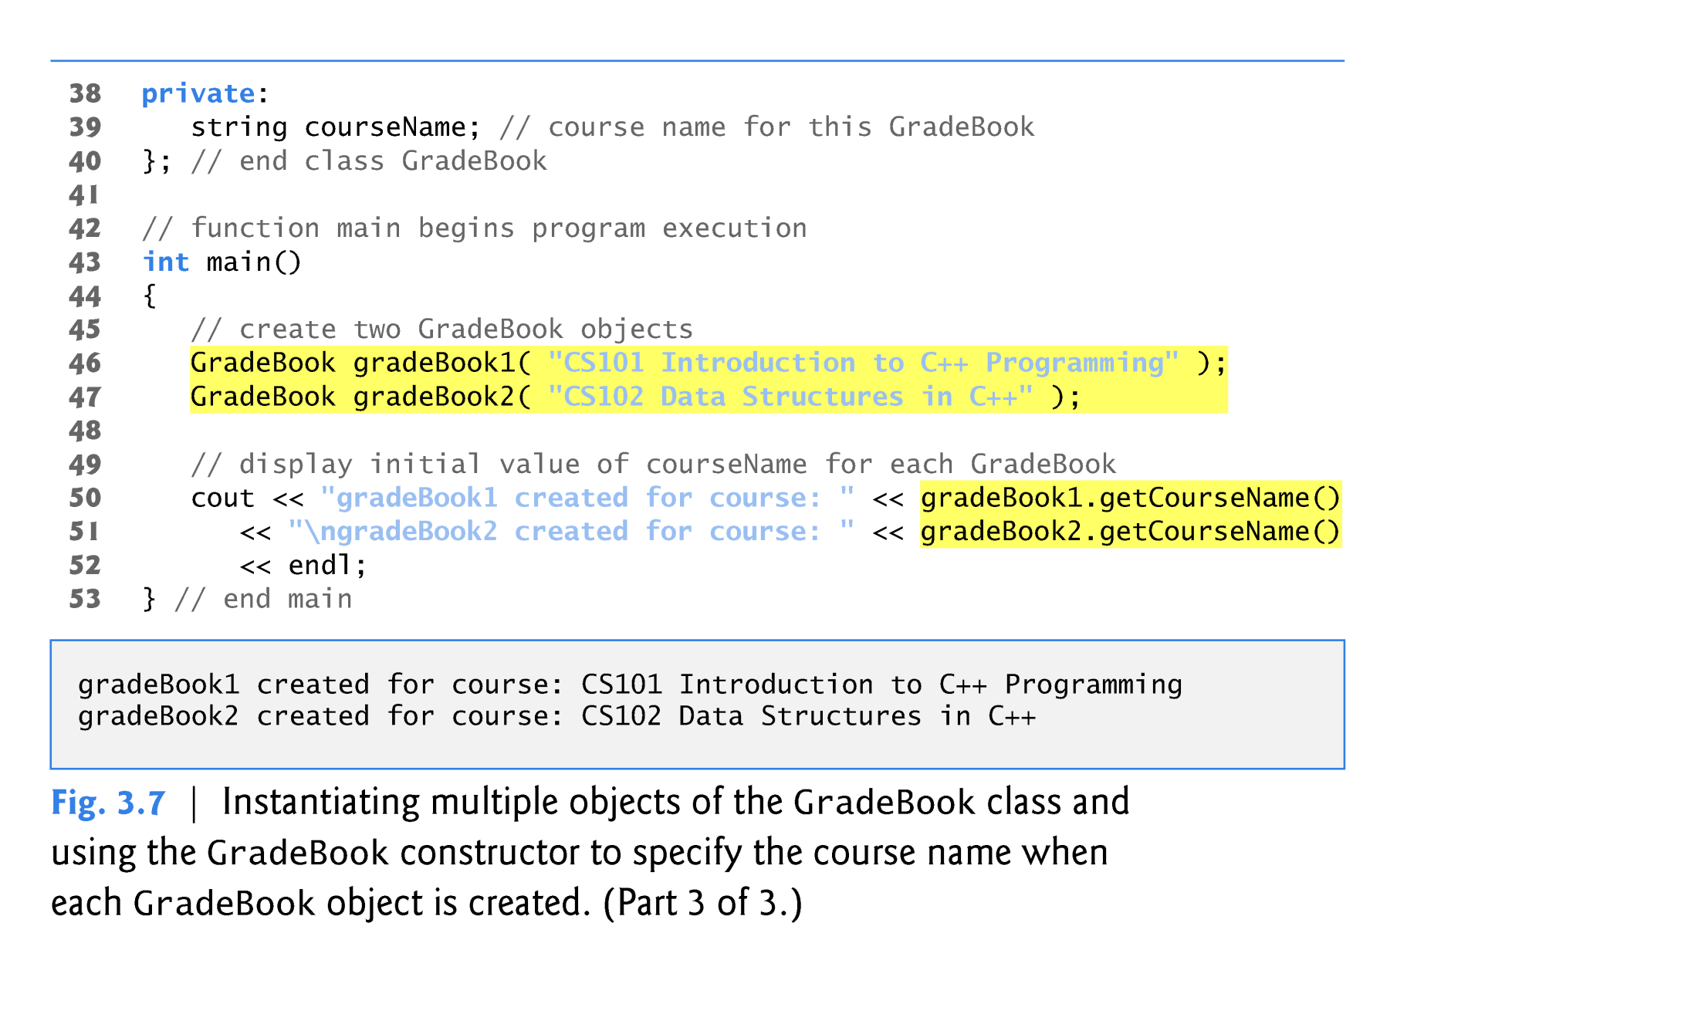
Constructor Example
Creating objects implicitly calls the constructor
Copyright © Pearson, Inc. 2013. All Rights Reserved.

Slide 21
Placing a Class in a Separate File for Reusability
.cpp file is known as a source-code file.
Header files
  Separate files in which class definitions are placed.
  Allows compiler to recognize the classes when used elsewhere.
  Generally have .h filename extensions
Driver files
  A program used to test software (such as classes).
  Contains a main function so it can be executed.

Slide 22
16.7 Separating Interface from Implementation
Interface
  Describes what services a class’s clients can use and how to request those services.
    without revealing how the class carries out the services.
    a class definition that lists only member function names, return types and parameter types.
      e.g., function prototypes
  A class’s interface consists of the class’s public member functions (services).
Separating interface from implementation:
  Client code should not break if implementation changes, as long as the interface stays the same.

Slide 23
Separating Interface from Implementation
Define the member functions outside the class definition, in a separate source-code file.
  In a source-code file for a class
    Use binary scope resolution operator (::) to tie each member function to the class definition.
  Implementation details are hidden.
    Client code does not need to know the implementation.
In a header file for a class
  The function prototypes describe the class’s public interface.

Slide 24
Separating Interface from Implementation
Interface contains data members and member function prototypes

Slide 25
Separating Interface from Implementation
GradeBook implementation is placed in a separate source-code file
Include the header file to access the class name GradeBook
Binary scope resolution operator ties a function to its class

Slide 26
Separating Interface from Implementation

Slide 27
Separating Interface from Implementation
Note - This is a separate .cpp file that holds only main.

Slide 28
19.10 Validating Data with set Functions
set functions can validate data.
  Known as validity checking.
  Keeps object in a consistent state.
    The data member contains a valid value.
  Can return values indicating that attempts were made to assign invalid data.
string member functions
  length returns the number of characters in the string.
  substr returns specified substring within the string.

Slide 29
Validating Data with set Functions
Constructor calls set function to perform validity checking
set functions perform validity checking to keep courseName in a consistent state

Slide 30
Validating Data with set Functions

Slide 31
Review of Classes and Objects
Introduced class definitions and objects
  Public versus private access into class.
Syntax for member functions
Syntax data members
  Get and Set functions
  Constructors
Placing classes in separate files
Separating interface from implementation
Data validation in set functions.

