Slide 1
Command Line Arguments plus Variable-Length Arrays
Systems Programming Concepts

Slide 2
Command Line Arguments
A C program must always have a function named main. This function is directly invoked by the Linux/Unix system.
main has two arguments conventionally named argc and argv.
The argc argument is of type int and corresponds to the number of arguments provided on the command line (including the program name as the first argument).

Slide 3
Command Line Arguments
The second argument to main, argv, is an array of pointers to strings.
Each string contains the ASCII string representation of what is typed on the program command line.

Slide 4
Command Line Arguments
For example, if the command line typed is:
./prog3 file1 200
argc will have the value 3
and
argv[0] points to string “./prog3”
argv[1] points to string “file1”
argv[2] points to string “200”.

Slide 5
Command Line Arguments
It is standard and safe programming practice for main to immediately check to see if it has received the correct number of arguments from the Linux command line.
If there is a mismatch, main prints out a proper usage statement and immediately ends the program.

Slide 6
Command Line Arguments
Command line arguments intended as integer program parameters requires converting the ASCII string representation to an integer using the standard library function atoi {ascii-to-integer}.
Example atoi
#include <stdio.h>
#include <stdlib.h>
int main (void)
{
int i; // variable to hold converted string
i = atoi (“2593”);
printf( “%s%d\n”, “The string \”2593\” converts to int “ , i);
return 0;
}
The string “2593” convert to int 2593

Slide 7
A Command Line Argument Sample Program
/* An Example of the Use of Command Line Arguments */
#include <stdio.h>
#include <stdlib.h>
#define SIZE 100
int main (int argc, char *argv[])
{
int i, samples, table[SIZE];
char *samstring, *timestring; /* strings are needed */
char *progstring;
if(argc != 3)
printf("Proper Usage is: com_arg samples time\n");
Note: main function arguments
Check for number of arguments

Slide 8
A Command Line Argument Sample Program
else
{
progstring = argv[0];
samstring = argv[1];
timestring = argv[2];
printf("Program = %s\n", progstring);
/* convert to integer */
samples = atoi(samstring);
printf("Please enter %d samples\n", samples);
for (i=0; i < samples; i++)
scanf("%d", &table[i]);
for (i=0; i < samples; i++)
printf("sample[%d] = %d\n", i+1, table[i]);
printf("Time = %d\n", atoi(timestring));
}
return;
}
./com_arg 3 500
Program = ./com_arg
Please enter 3 samples
745
1023495
2
sample[1] = 745
sample[2] = 1023495
sample[3] = 2
Time = 500

Slide 9
Command Line Arguments
Using command line arguments to specify variable size for input parameters is a preferred technique.
Remember C treats the arguments as ASCII strings.
Use atoi to convert the strings to integers.

Slide 10
6.10 Variable-Length Arrays
A variable-length array is an array whose length, or size, is defined in terms of an expression evaluated at execution time.
The program of Fig. 6.23 declares and prints several VLAs.
[Note: This feature is not supported in Microsoft Visual C++.]
Copyright © Pearson, Inc. 2013. All Rights Reserved.

Slide 11
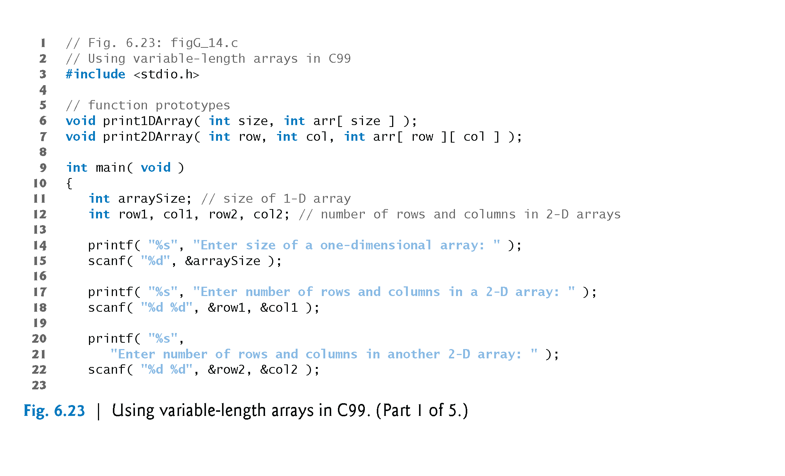
6.10 Variable-Length Arrays (Cont.)
Copyright © Pearson, Inc. 2013. All Rights Reserved.

Slide 12
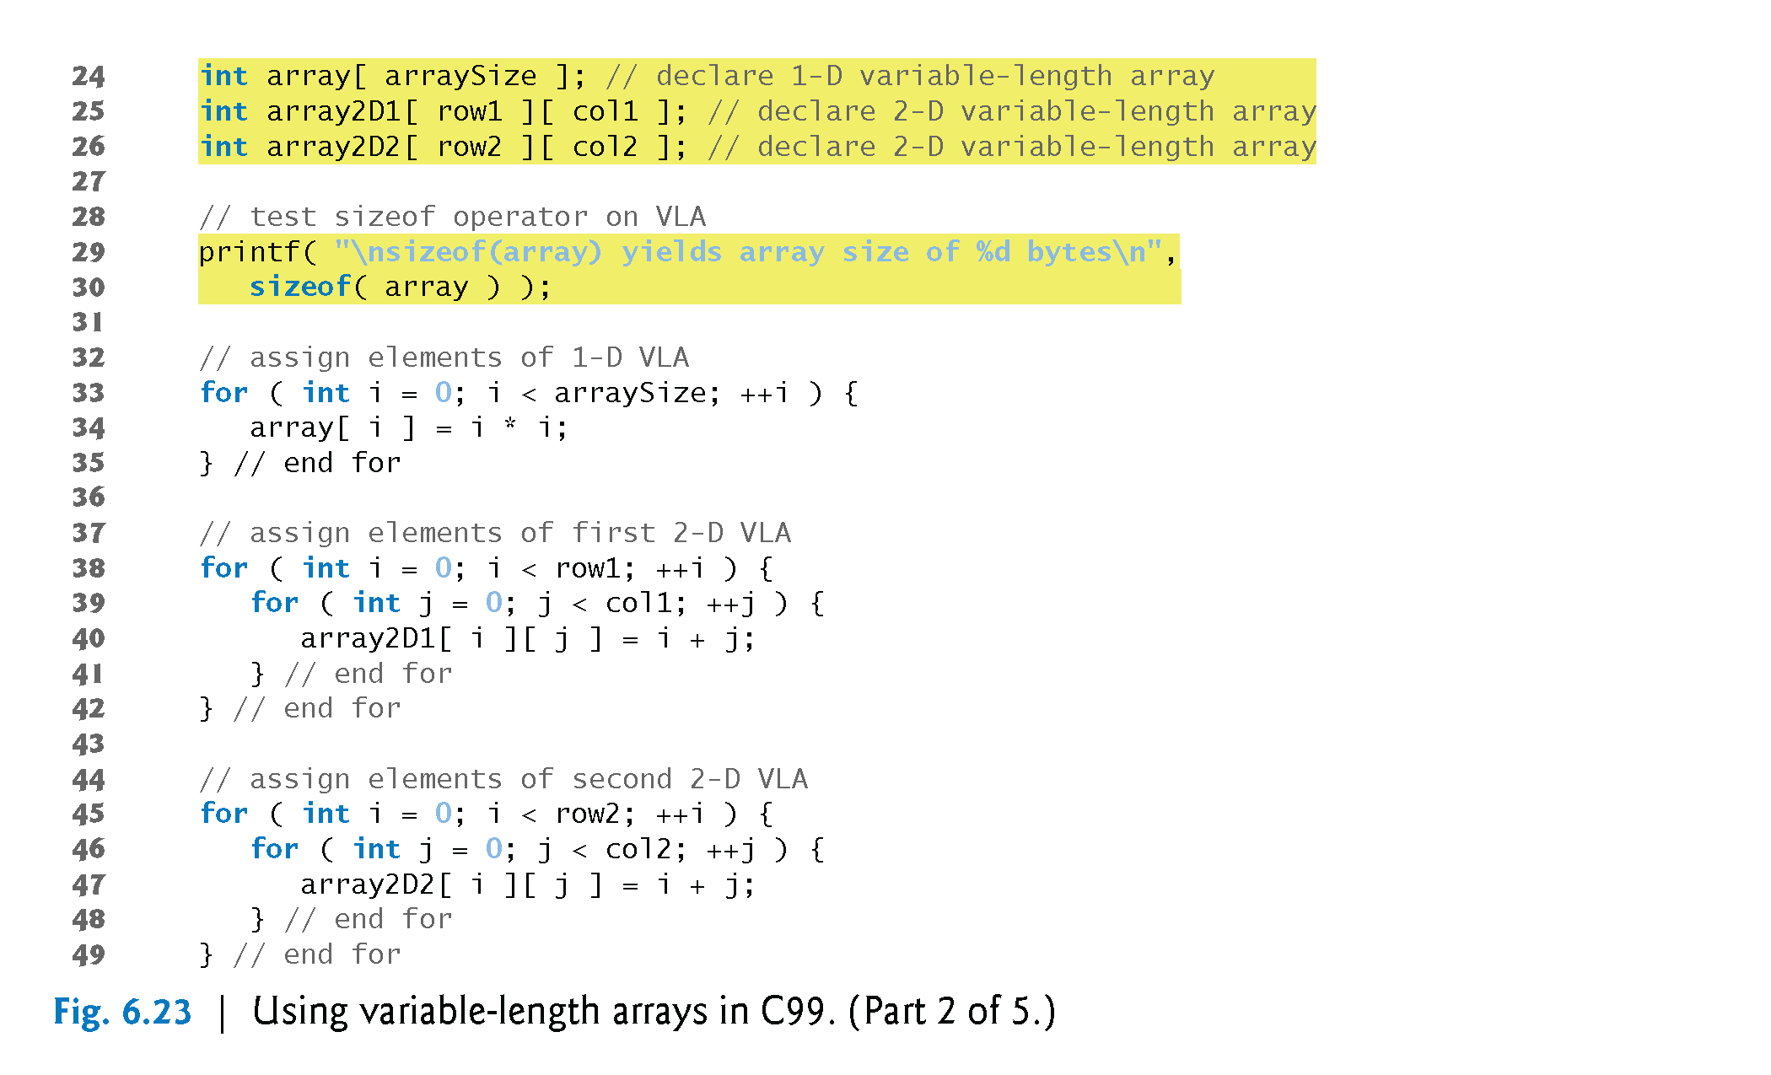
6.10 Variable-Length Arrays (Cont.)
Note: declarations
deliberately come later!
Copyright © Pearson, Inc. 2013. All Rights Reserved.

Slide 13
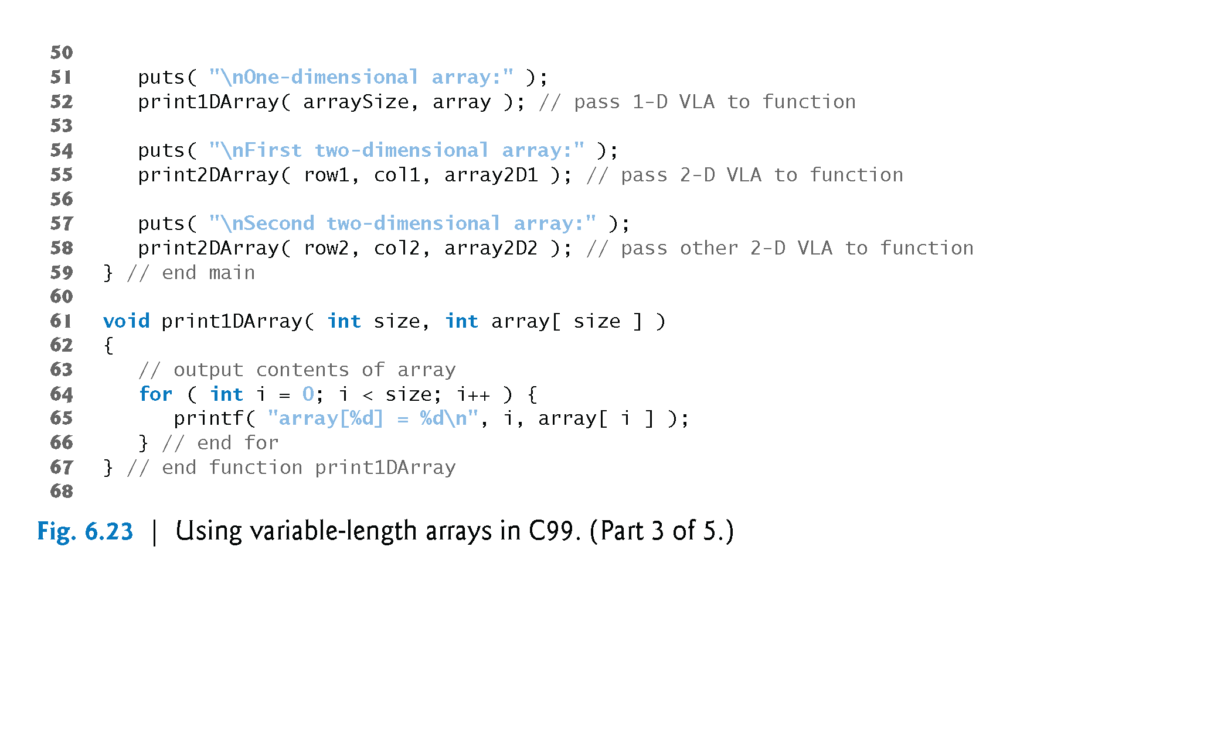
6.10 Variable-Length Arrays (Cont.)
Copyright © Pearson, Inc. 2013. All Rights Reserved.

Slide 14
6.10 Variable-Length Arrays (Cont.)
Copyright © Pearson, Inc. 2013. All Rights Reserved.

Slide 15
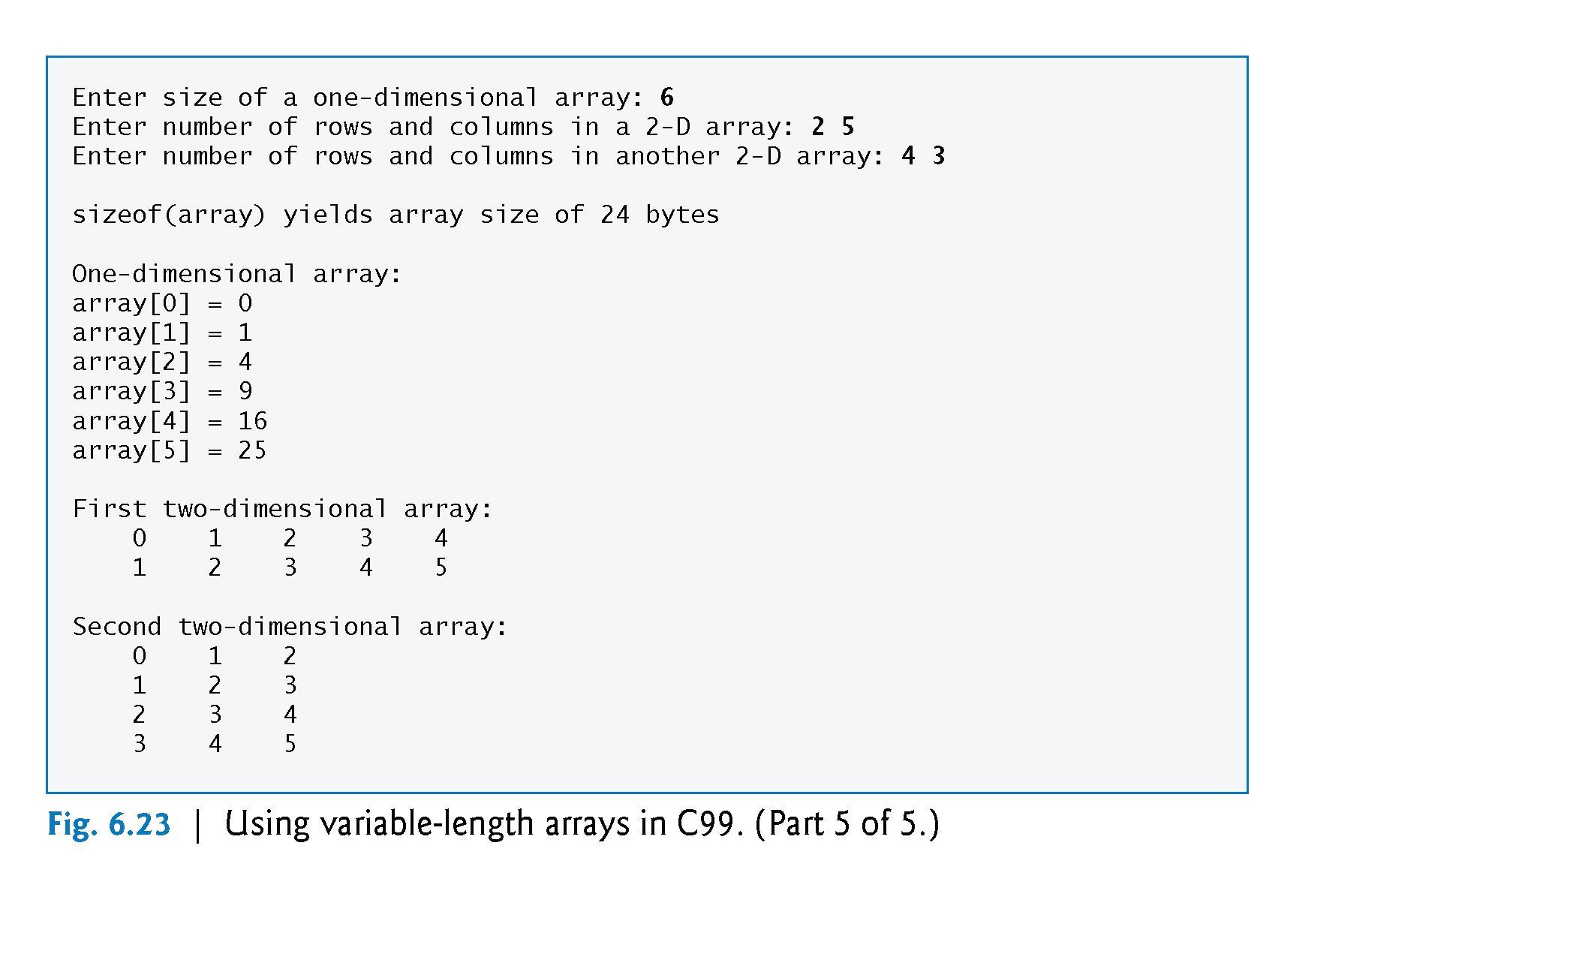
6.10 Variable-Length Arrays (Cont.)
Copyright © Pearson, Inc. 2013. All Rights Reserved.

Slide 16
Review of Command Line Arguments
main arguments
argc and argv
atoi function
Variable-length arrays
Array declarations comes after variable-length inputs
Length defined at execution time

