Slide 1
Data Structures
Systems Programming

Slide 2
Data Structures
Queues
Queuing System Models
Queue Data Structures
A Queue Example
Trees
Binary Trees
Tree Traversals
Inorder, preorder, postorder
Stacks
A Stack Example
Hashing
Static Hashing
Linear probing
Chaining
2
2

Slide 3
12.6 Queues
Queues
Are very common structures in operating systems and computer networks.
The abstraction in system queues is of customers queued with one customer in service.
Customers are placed in the queue First-In, first-Out (FIFO). {also First-Come-First-Served (FCFS) }
Customers are removed from the head of the queue structure. When modeling a server, the customer at the head of the queue is in service.
Customers are inserted at the back (or tail) of the queue.
Queues can model either finite of infinite buffer space.
3

Slide 4
Simple Queuing Model
Arrivals
Queue
Server

Slide 5
12.6 Queues (Cont.)
Information packets also wait in queues in computer networks.
Each time a packet arrives at a network node, it must be routed to the next node on the network along the path to its final destination.
The routing node routes one packet at a time, so additional packets are enqueued until the router can route them.
Copyright © Pearson, Inc. 2013. All Rights Reserved.

Slide 6
Router Node
15
packet
packet
17
Outgoing Link
Server
Router Buffer
6

Slide 7
Performance Metrics (General Definitions)
Utilization :: the percentage of time a device is busy servicing a “customer”.
Throughput :: the number of jobs processed by the “system” per unit time.
Response time :: the time required to receive a response to a request (round-trip time).
Delay :: the time to traverse from one end to the other in a system.
7

Slide 8
Round Robin Queuing

Slide 9
12.6 Queues
Queues
When modeling a finite buffer, when the buffer is full, an arriving customer is dropped (normally from the tail). This is known as a drop-tail queue.
Queue data structure operations:
Insert or enqueue
Remove or dequeue
9

Slide 10
Fig. 12.12 Queue Graphical Representation
Pointers go from head towards the tail
© 2007 Pearson Ed -All rights reserved.
10

Slide 11
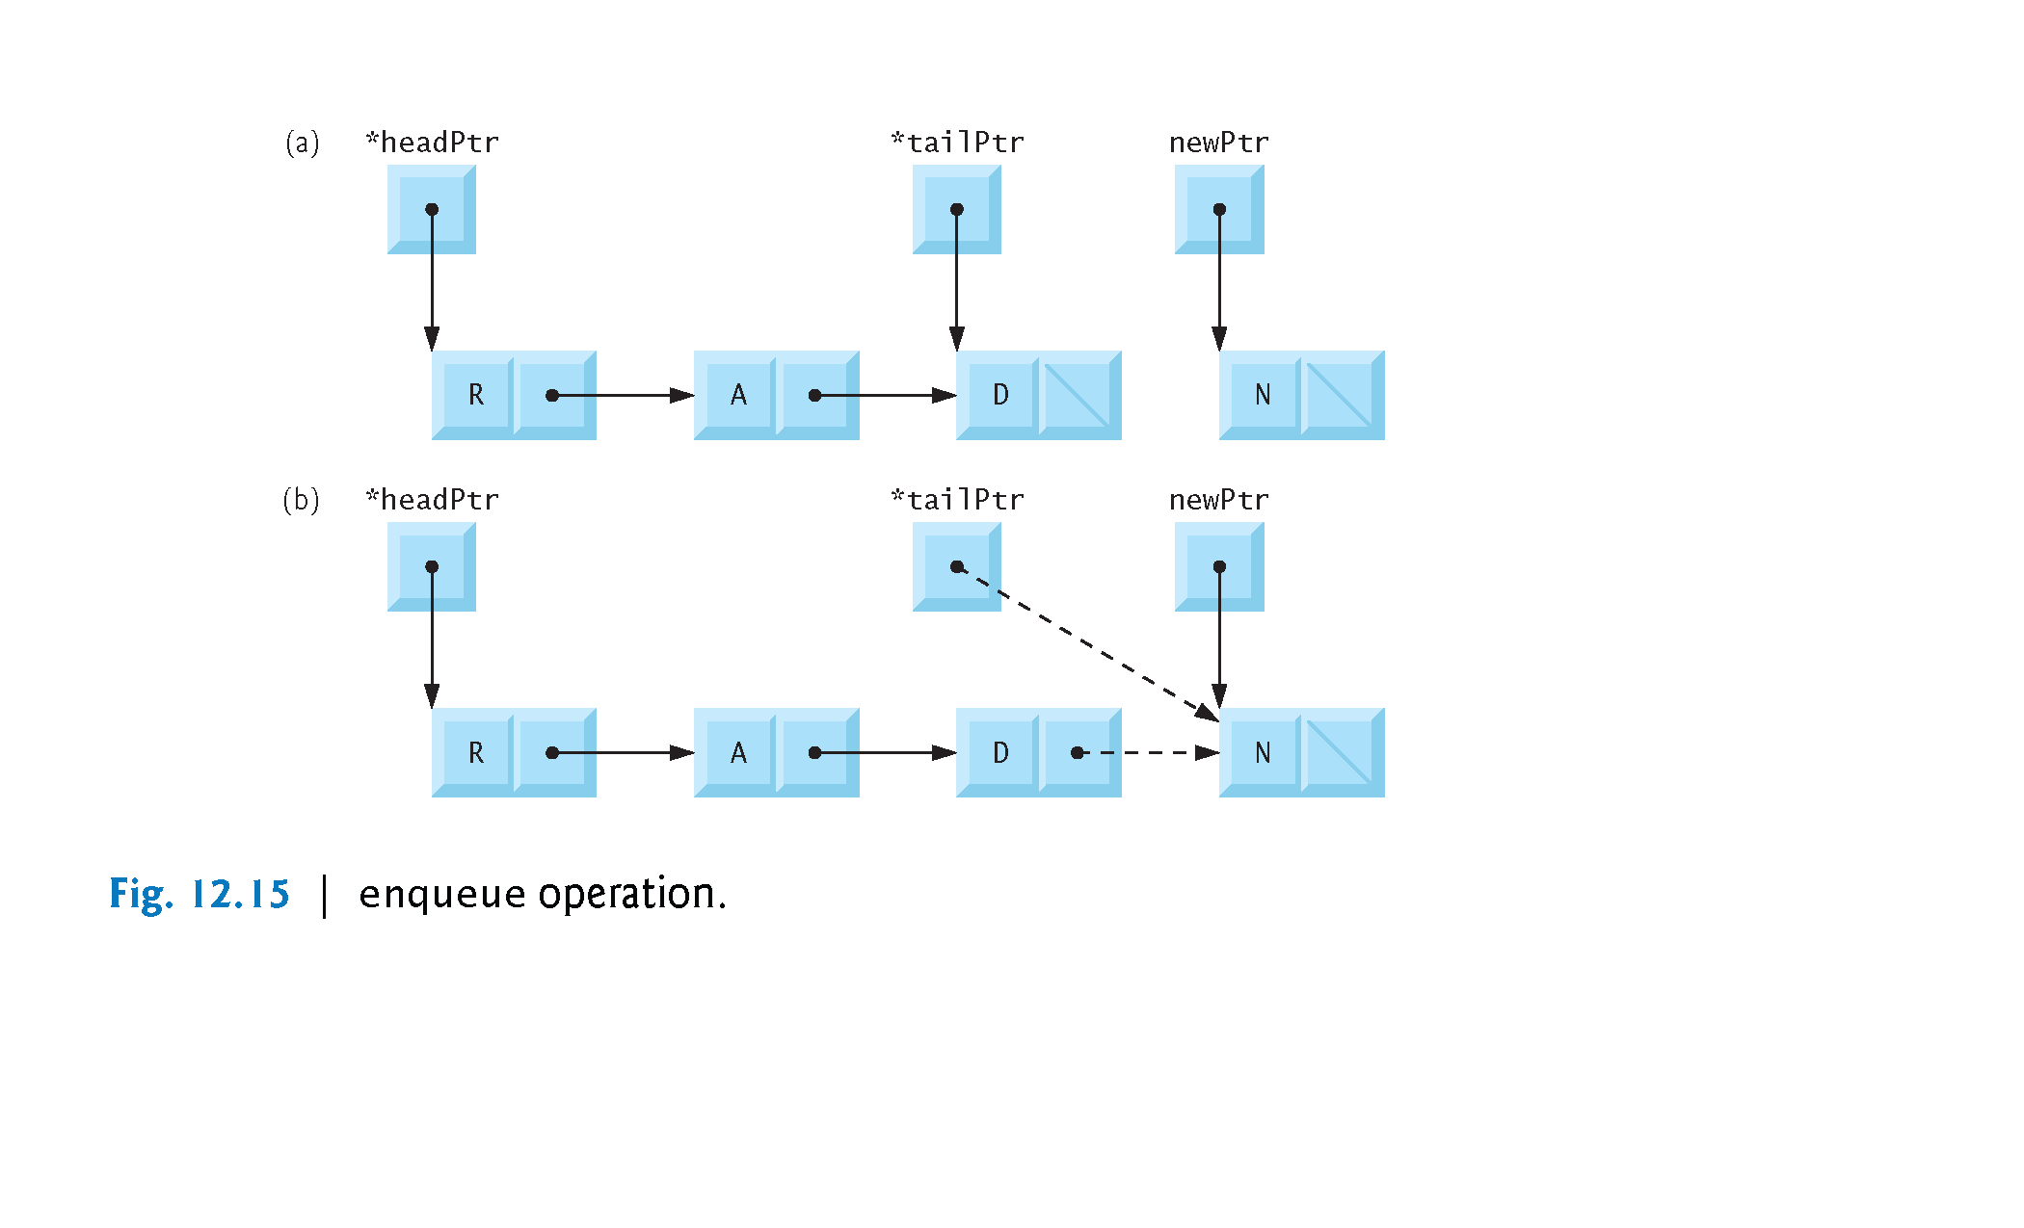
Fig. 12.15 Enqueue Operation
Copyright © Pearson, Inc. 2013. All Rights Reserved.

Slide 12
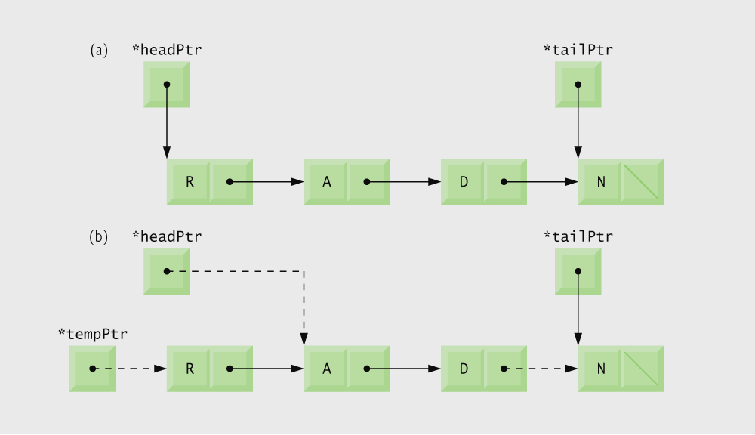
Fig. 12.16 Dequeue Operation
© 2007 Pearson Ed -All rights reserved.
12

Slide 13
Fig 12.13 Processing a Queue
Each node in the queue contains a data element and a pointer to the next node
Note that unlike linked lists and stacks, queues keep track of the tail node as well as the head
© 2007 Pearson Ed -All rights reserved.
13

Slide 14
Fig 12.13 Processing a Queue
© 2007 Pearson Ed -All rights reserved.
14

Slide 15
Fig 12.13 Processing a Queue
© 2007 Pearson Ed -All rights reserved.
15

Slide 16
Fig 12.13 Processing a Queue
To insert a node into the queue, memory must first be allocated for that node
Queue nodes are always inserted at the tail, so there is no need to search for the node’s place
If the queue is empty, the inserted node becomes the new head in addition to the new tail
Inserted node becomes the new tail
© 2007 Pearson Ed -All rights reserved.
16

Slide 17
Fig 12.13 Processing a Queue
Queue nodes are always removed from the head, so there is no need to search for the node’s place
Second node becomes the new head
If the removed node is the only node in the queue, it is the tail as well as the head of the queue, so tailPtr must be set to NULL
Free the memory of the removed node
© 2007 Pearson Ed -All rights reserved.

Slide 18
Fig 12.13 Processing a Queue
© 2007 Pearson Ed -All rights reserved.
18

Slide 19
Fig 12.13 Processing a Queue
© 2007 Pearson Ed -All rights reserved.

Slide 20
Fig 12.13 Processing a Queue
© 2007 Pearson Ed -All rights reserved.
20

Slide 21
12.7 Trees
Tree nodes contain two or more links.
All other data structures considered thus far have only contained one link.
Binary trees
All nodes contain two links.
None, one, or both of which may be NULL
The root node is the first node in a tree.
Each link in the root node refers to a child.
A node with no children is called a leaf node.
A node can only be inserted as a leaf node in a binary search tree (i.e., a tree without duplicates.)
© 2007 Pearson Ed -All rights reserved.

Slide 22
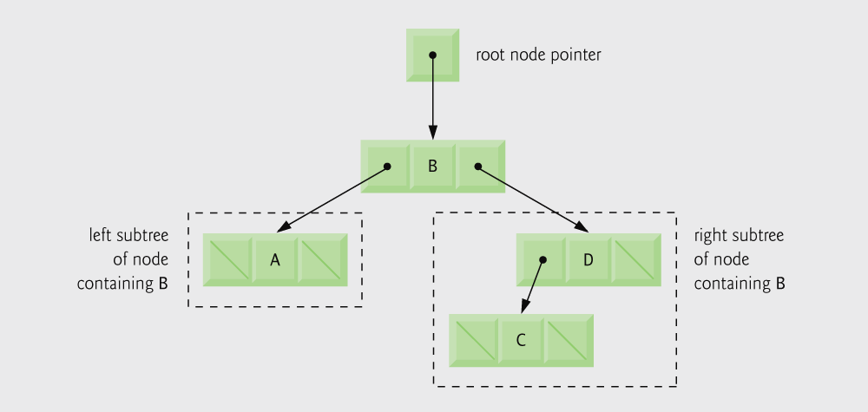
Fig. 12.17 Binary Tree Representation
© 2007 Pearson Ed -All rights reserved.

Slide 23
Common Programming Error 12.8
Not setting to NULL the links in leaf nodes of a tree can lead to runtime errors.
Remember, since tree traversals are normally recursive, this error can be ‘deeply embedded’.
© 2007 Pearson Ed -All rights reserved.

Slide 24
12.7 Trees
Binary trees
The key value for nodes in the left subtree are less than the key value in the parent.
The key value for nodes in the right subtree are greater than the key value in the parent.
This data structure facilitates duplicate elimination!
Fast searches - for a balanced tree, maximum of log₂n comparisons.
© 2007 Pearson Ed -All rights reserved.

Slide 25
Fig. 12.18 Binary search tree
© 2007 Pearson Ed -All rights reserved.

Slide 26
The Three Standard Tree Traversals
1. Inorder traversal:
visit the nodes in ascending order by key value.
1.1 Traverse the left subtree with an inorder traversal
1.2 Visit the node (process the value in the node,i.e., print the node value).
1.3 Traverse the right subtree with an inorder traversal.

Slide 27
The Three Standard Tree Traversals
2. Preorder traversal:
2.1 Visit the node (process the value in the node, i.e., print the node value).
2.2 Traverse the left subtree with a preorder traversal.
2.3 Traverse the right subtree with a preorder traversal.

Slide 28
The Three Standard Tree Traversals
3. Postorder traversal:
3.1 Traverse the left subtree with a postorder traversal.
3.2 Traverse the right subtree with a postorder traversal.
3.3 Visit the node (process the value in the node, i.e., print the node value).

Slide 29
Tree Example
Each node in the tree contains a data element and a pointer to the left and right child nodes
data
© 2007 Pearson Ed -All rights reserved.

Slide 30
Tree Example
© 2007 Pearson Ed -All rights reserved.

Slide 31
Tree Example
To insert a node into the tree, memory must first be allocated for that node
If the inserted node’s data is less than the current node’s, the program will attempt to insert the node at the current node’s left child.
© 2007 Pearson Ed -All rights reserved.

Slide 32
Tree Example
If the inserted node’s data is greater than the current node’s, the program will attempt to insert the node at the current node’s right child.
The inorder traversal calls an inorder traversal on the node’s left child, then prints the node itself, then calls an inorder traversal on the right child.
© 2007 Pearson Ed -All rights reserved.

Slide 33
Tree Example
The preorder traversal prints the node itself, then calls a preorder traversal on the node’s left child, then calls a preorder traversal on the right child.
The postorder traversal calls an postorder traversal on the node’s left child, then calls an postorder traversal on the right child, then prints the node itself.
© 2007 Pearson Ed -All rights reserved.

Slide 34
12.5 Stacks
Stack
New nodes are added and removed only at the top of the stack.
The classical analogy is a dishes stacker found in restaurants.
Last-in, first-out (LIFO) devices.
The bottom of stack is indicated by a link member to NULL.
Essentially, a constrained version of a linked list.
Stacks are important in computer languages because it is the data structure for calling and returning from function or subroutine calls.
© 2007 Pearson Ed -All rights reserved.
34

Slide 35
12.5 Stacks
Stack operations
push
Add a new node to the top of the stack.
pop
Remove a node from the top of the stack.
Store the popped value.
Return true if pop was successful.
© 2007 Pearson Ed -All rights reserved.
35

Slide 36
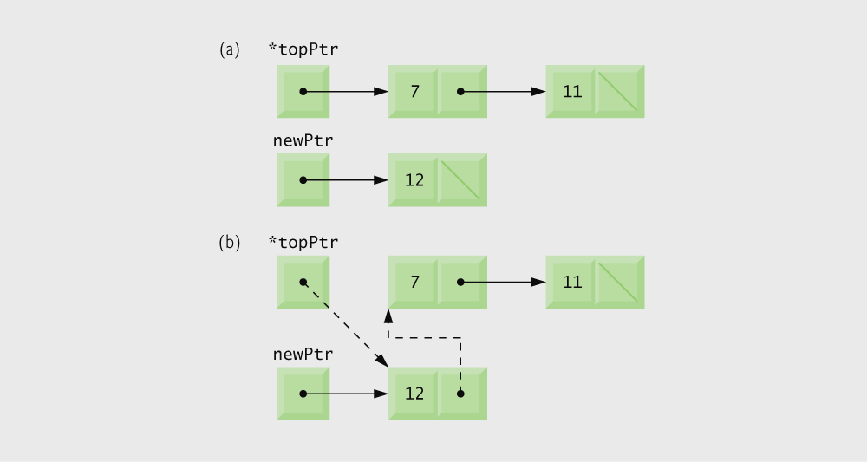
Fig. 12.10 Push Operation
© 2007 Pearson Ed -All rights reserved.
36

Slide 37
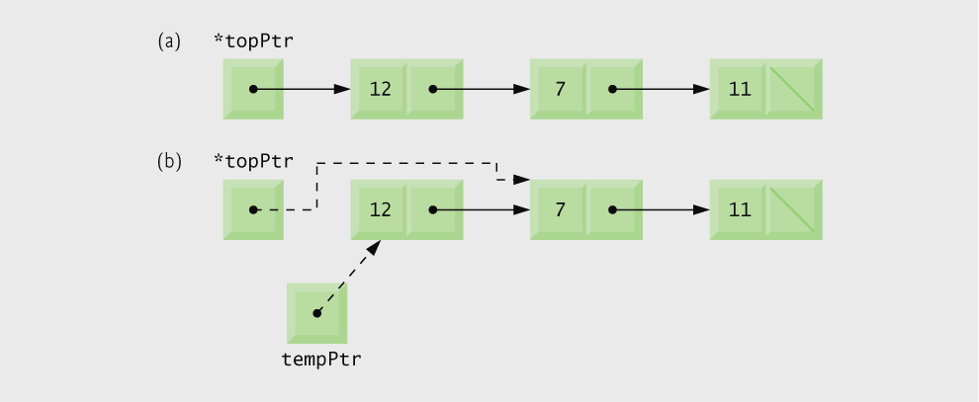
Fig. 12.10 Pop Operation
© 2007 Pearson Ed -All rights reserved.
37

Slide 38
A Stack Example
Each node in the stack contains a data element and a pointer to the next node
© 2007 Pearson Ed -All rights reserved.
38

Slide 39
A Stack Example
© 2007 Pearson Ed -All rights reserved.
39

Slide 40
A Stack Example
To insert a node into the stack, memory must first be allocated for that node
© 2007 Pearson Ed -All rights reserved.
40

Slide 41
A Stack Example
Stack nodes are always inserted at the top, so there is no need to search for the node’s place
Inserted node becomes the new top
Stack nodes are always removed from the top, so there is no need to search for the node’s place
Second node becomes the new top
Free the memory of the popped node
© 2007 Pearson Ed -All rights reserved.
41

Slide 42
A Stack Example
© 2007 Pearson Ed -All rights reserved.
42

Slide 43
A Stack Example
© 2007 Pearson Ed -All rights reserved.
43

Slide 44
A Stack Example
© 2007 Pearson Ed -All rights reserved.
44

Slide 45
Hashing
Two classic examples of the use of hashing are:
{old example}
Building a symbol table for a compiler, whereby a symbol table is similar to a dictionary, but with a set of name-attribute pairs.
Standard operations on any symbol table are:
Determine if the name is in the table.
Retrieve the attributes of that name.
Modify the attributes of that name.
Insert a new name and its attributes in the table.
45

Slide 46
Tracking Flows in a Router Node
15
packet
packet
17
Outgoing Link
Server
Router Buffer
{new example}
46

Slide 47
Static Hashing
In static hashing, identifiers (names)
are stored in a fixed size table called a hash table.
A hash function f(x) is used to determine the location of an identifier x in the table.
The hash table is stored into sequential memory locations that are partitioned into b buckets. Each bucket has s slots.

Slide 48
Hash Table

Slide 49
Hash Function
A good hash function is easy to compute and minimizes bucket collisions (i.e., it should be unbiased).
A good hash function hashes x such that x has an equal chance of hashing into any of the b buckets. Namely, the hash function should uniformly distribute the symbols into the b buckets.
Examples of hash function are: mid-square, division f(x) = x % M, and folding.
{Note – M and b are the same here!!}

Slide 50
Hash Table Details
We need to initialize table where all slots are empty.
void init_table (element ht[])
{
int i;
for (i =0; i < TABLE_SIZE; i++)
ht[i].key[0] = NULL;
}

Slide 51
Hash Table with Linear Probing
There are four possibilities after hashing x into a table bucket:
The bucket contains x. {x is in the table already}
The bucket is empty.
The bucket contains a nonempty entry other than x {a bucket collision}. Here we either examine next slot or the next bucket.
We have exhausted all table memory and have wrapped around to the ‘home bucket’.

Slide 52
Hash Table with Linear Probing
After running for awhile identifiers will tend to cluster and coalesce. Note, now the search time is likely to grow with each new addition to the symbol table.
Result = Bad Performance.
This is the motivation for implementing hash buckets using chaining ( each bucket is implemented as a linked list with a header node).

Slide 53
Example of Chain insert into a hash table with a BAD hash function
[0] -> add -> asp -> attitude
[1] -> NULL
[2] -> cat -> char -> cosine -> czar
…
[9] -> jack -> jumbo
[10] -> king -> kinicki
…
[25] -> zac -> zebro -zits

Slide 54
More Advanced Hashing
Dynamic Hashing
Double Hashing
Circular Linked Lists

Slide 55
Review of Data Structures
55
55
Connected queuing computer systems with queuing data structures. Basic operations: enqueue and dequeue.
Introduced tree terminology and structures
Binary Trees
Tree Traversals
Inorder, preorder, postorder
Stacks
A Stack Example
A quick look at Hashing including:
Static Hashing
Hash functions
Linear probing
Chaining (linked lists)

