Slide 1
Classes: A Deeper Look
Systems Programming

Slide 2
Deeper into C++ Classes
const objects and const member functions
Composition
Friendship
this pointer
Dynamic memory management
new and delete operators
static class members and member functions

Slide 3
18.2 const (Constant) Objects and const Member Functions
Principle of least privilege
“allowing access to data only when it is absolutely needed.”
Is one of the most fundamental principles of good software engineering.
Applies to objects, too.
const objects
Keyword const
Specifies that an object is not modifiable.
Attempts to modify the object will result in compilation errors.
Example
const Time noon (12, 0, 0);

Slide 4
const (Constant) Objects and const Member Functions
const member functions
Only const member function can be called for const objects.
Member functions declared const are not allowed to modify the object.
A function is specified as const both in its prototype and in its definition.
const declarations are not allowed for constructors and destructors.

Slide 5
Software Engineering Observation 18.2
A const member function can be overloaded with a non-const version. The compiler chooses which overloaded member function to use based on the object on which the function is invoked. If the object is const, the compiler uses the const version. If the object is not const, the compiler uses the non-const version.

Slide 6
const Example

Slide 7
const Example

Slide 8
const Example

Slide 9
const Example
const keyword in function definition, as well as in function prototype

Slide 10
const Example

Slide 11
const Example
Cannot invoke non-const member functions on a const object

Slide 12
const Example

Slide 13
Member Initializer
Required for initializing:
const data members
data members that are references.
Can be used for any data member.
Member initializer list
Appears between a constructor’s parameter list and the left brace that begins the constructor’s body.
Separated from the parameter list with a colon (:).
Each member initializer consists of the data member name followed by parentheses containing the member’s initial value.
Multiple member initializers are separated by commas.
Executes before the body of the constructor executes.

Slide 14
Member Initializer
const data member that must be initialized using a member initializer

Slide 15
Member Initializer
Colon (:) marks the start of a member initializer list
Member initializer for non-const member count
Required member initializer for const member increment
print being const member function not required, but safer

Slide 16
Member Initializer

Slide 17
Software Engineering Observation 18.3
A const object cannot be modified by assignment, so it must be initialized. When a data member of a class is declared const, a member initializer must be used to provide the constructor with the initial value of the data member for an object of the class. The same is true for references.
Copyright © Pearson, Inc. 2013. All Rights Reserved.

Slide 18
Common Programming Error 18.5
Not providing a member initializer for a const data member is a compilation error.
Copyright © Pearson, Inc. 2013. All Rights Reserved.

Slide 19
Error-Prevention Tip 18.1
Copyright © Pearson, Inc. 2013. All Rights Reserved.

Slide 20
18.3 Composition: Objects as Members of Classes
Composition
Sometimes referred to as a has-a relationship.
A class can have objects of other classes as members.
Example
AlarmClock object with a Time object as a member.

Slide 21
Composition: Objects as Members of Classes
Initializing member objects
Member initializers pass arguments from the object’s constructor to member-object constructors.
Member objects are constructed in the order in which they are declared in the class definition.
Not in the order that they are listed in the constructor’s member initializer list.
Before the enclosing class object (host object) is constructed.
If a member initializer is not provided
The member object’s default constructor will be called implicitly.

Slide 22
Software Engineering Observation 18.4
A common form of software reusability is composition, in which a class has objects of other classes as members.
Copyright © Pearson, Inc. 2013. All Rights Reserved.

Slide 23
18.8 Composition Example
First example of static data member in C++
Copyright © Pearson, Inc. 2013. All Rights Reserved.

Slide 24
18.9 Composition Example
Copyright © Pearson, Inc. 2013. All Rights Reserved.

Slide 25
18.9 Composition Example
Copyright © Pearson, Inc. 2013. All Rights Reserved.

Slide 26
18.9 Composition Example
Standard C trick
Copyright © Pearson, Inc. 2013. All Rights Reserved.

Slide 27
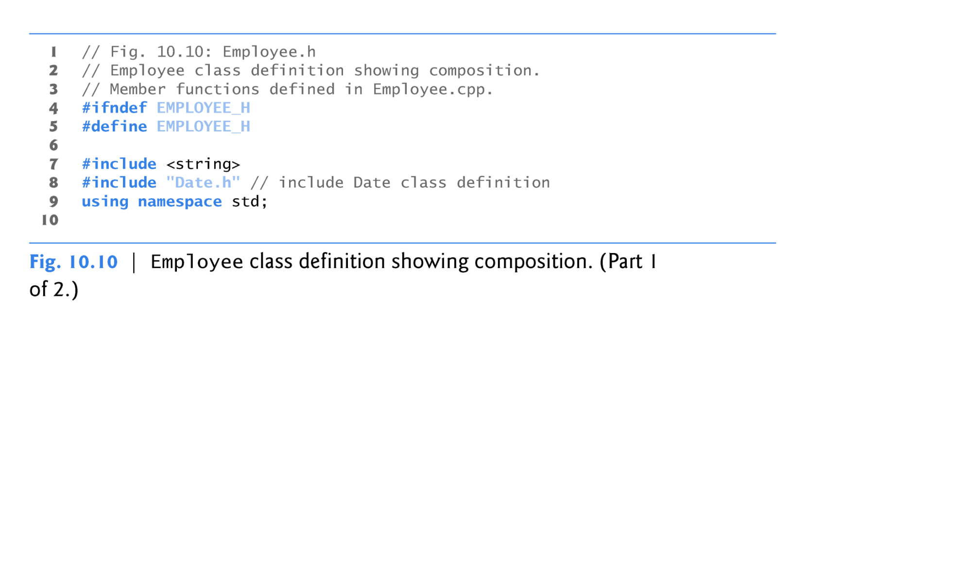
18.10 Composition Example
Copyright © Pearson, Inc. 2013. All Rights Reserved.

Slide 28
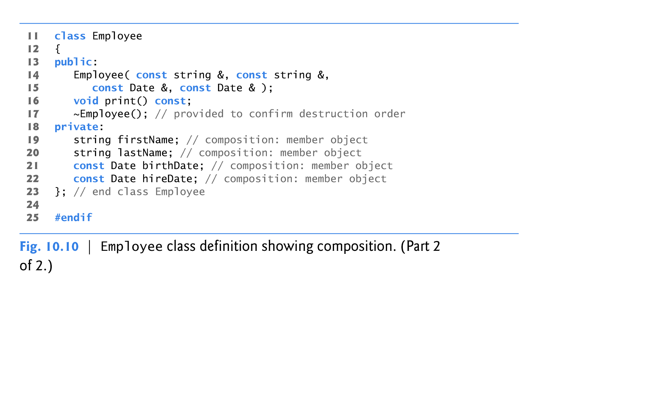
18.10 Composition Example
Parameters to be passed via member initializers to the constructor for class Date
const objects of class Date as members
utilizes a default copy constructor
Copyright © Pearson, Inc. 2013. All Rights Reserved.

Slide 29
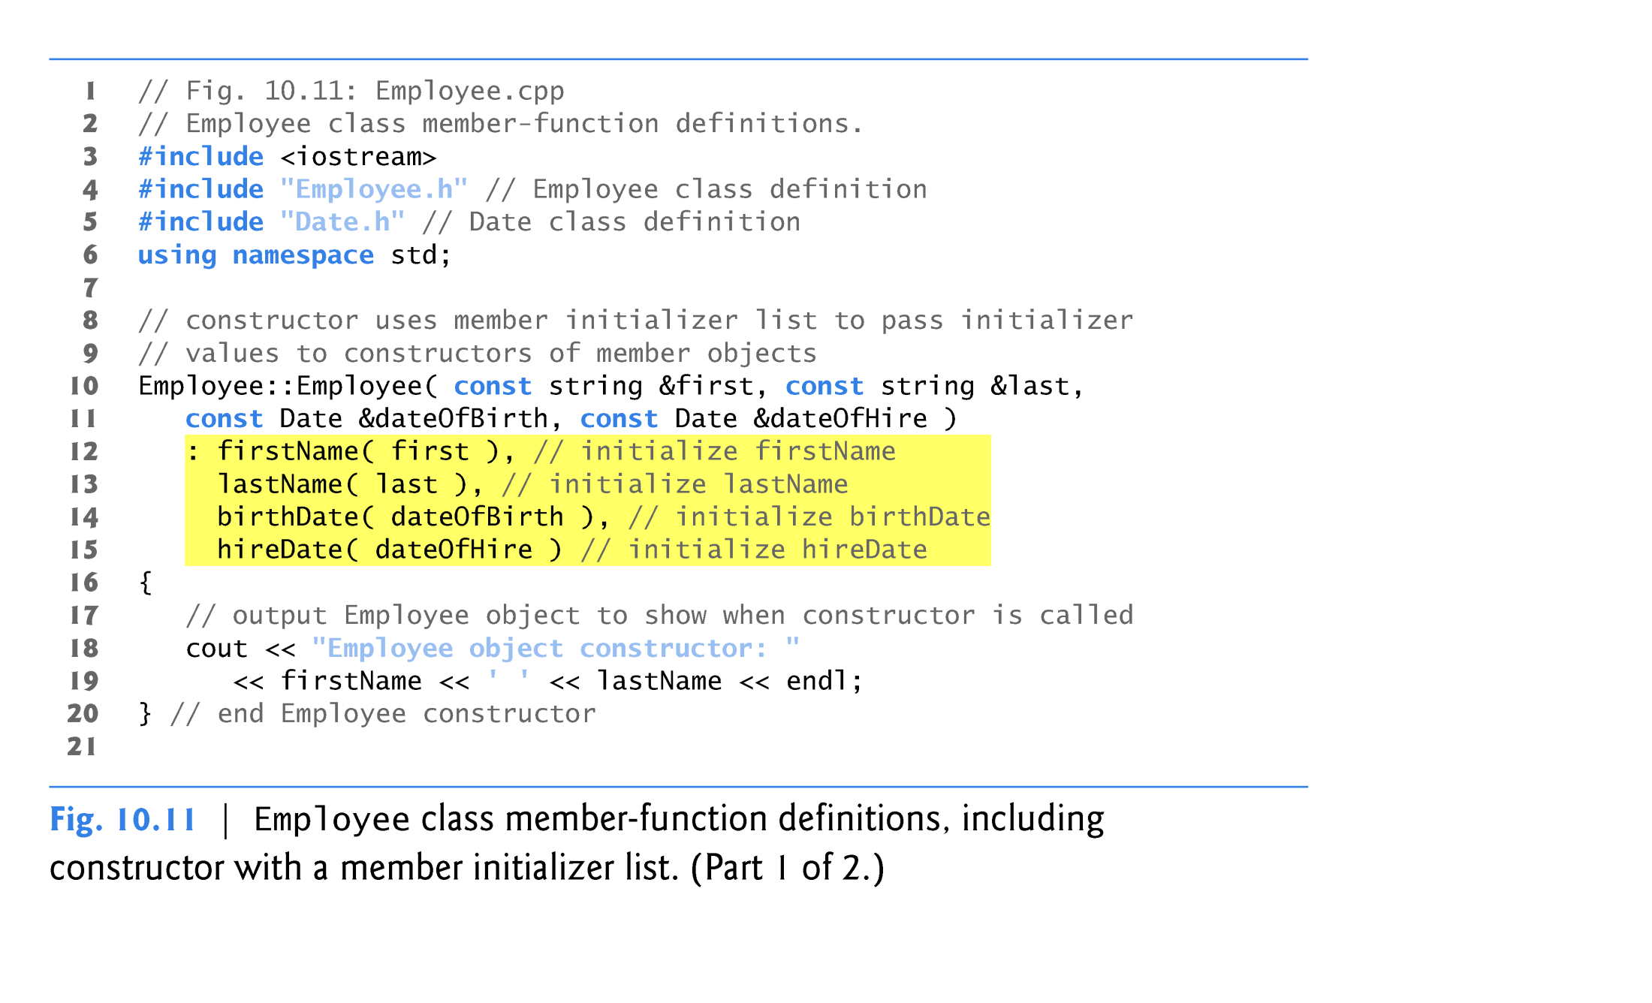
18. 11 Composition Example
Member initializers that pass arguments to Date’s implicit default copy constructor
Copyright © Pearson, Inc. 2013. All Rights Reserved.

Slide 30
18.11 Composition Example
Copyright © Pearson, Inc. 2013. All Rights Reserved.

Slide 31
18.3 Composition: Objects as Members of Classes (cont.)
As you study class Date (in Fig. 18.8), notice that the class does not provide a constructor that receives a parameter of type Date.
Why can the Employee constructor’s member initializer list initialize the birthDate and hireDate objects by passing Date object’s to their Date constructors?
Answer:: The compiler provides each class with a default copy constructor that copies each data member of the constructor’s argument object into the corresponding member of the object being initialized.
Copyright © Pearson, Inc. 2013. All Rights Reserved.

Slide 32
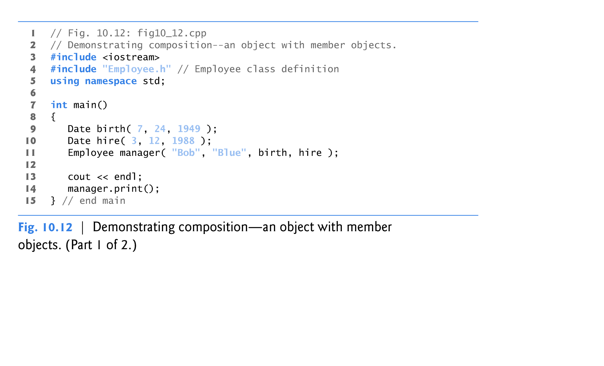
18.12 Composition Example
Passing objects arguments to a host object constructor.
Copyright © Pearson, Inc. 2013. All Rights Reserved.

Slide 33
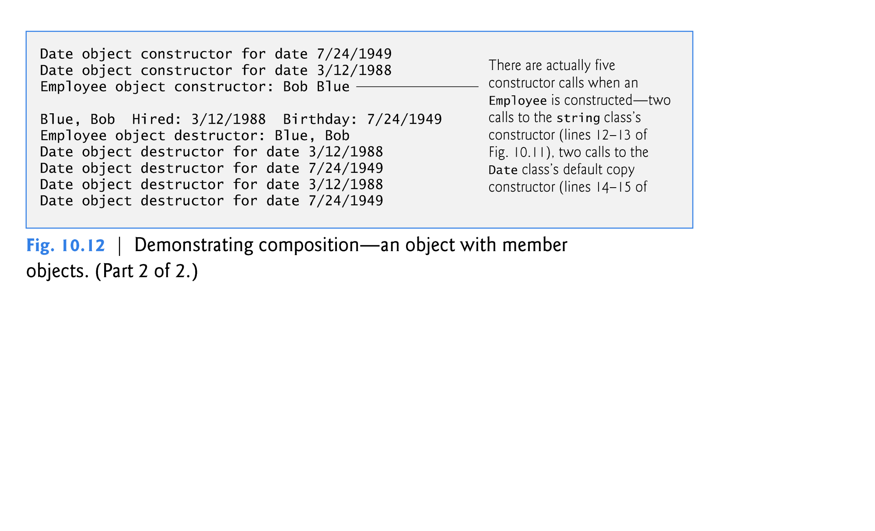
18.12 Composition Example
Note – As the call to default copy constructor is made implicitly by compiler, no output statements appear to indicate this has happened!
Copyright © Pearson, Inc. 2013. All Rights Reserved.

Slide 34
Common Programming Error 18.6
A compilation error occurs if a member object is not initialized with a member initializer and the member object’s class does not provide a default constructor (i.e., the member object’s class defines one or more constructors, but none is a default constructor).
Copyright © Pearson, Inc. 2013. All Rights Reserved.

Slide 35
18.3 Composition: Objects as Members of Classes (cont.)
If a member object is not initialized through a member initializer, the member object’s default constructor will be called implicitly.
Values, if any, established by the default constructor can be overridden by set functions.
However, for complex initialization, this approach may require significant additional work and time.
Copyright © Pearson, Inc. 2013. All Rights Reserved.

Slide 36
18.4 friend Functions and friend Classes
friend function of a class
Defined outside that class’s scope.
Not a member function of that class.
has the right to access the non-public and public members of that class.
Standalone functions, entire classes or member functions of other classes may be declared to be friends of a class.
Using friend functions can enhance performance.
Often appropriate when a member function cannot be used for certain operations.
Copyright © Pearson, Inc. 2013. All Rights Reserved.

Slide 37
friend Functions and friend Classes
To declare a function as a friend of a class:
Provide the function prototype in the class definition preceded by keyword friend.
To declare a class as a friend of another class:
Place a declaration of the form
friend class ClassTwo; in the definition of class ClassOne
All member functions of class ClassTwo are friends of class ClassOne.

Slide 38
friend Functions and friend Classes
Friendship is granted, not taken.
For class B to be a friend of class A, class A must explicitly declare that class B is its friend.
Friendship relation is neither symmetric nor transitive
If class A is a friend of class B, and class B is a friend of class C, you cannot infer that class B is a friend of class A, that class C is a friend of class B, or that class A is a friend of class C.

Slide 39
friend Functions and friend Classes
It is possible to specify overloaded functions as friends of a class.
Each overloaded function intended to be a friend must be explicitly declared as a friend
of the class.

Slide 40
Fig 18.13 friend Function Example
friend function declaration (can appear anywhere in the class)

Slide 41
Fig 18.13 friend Function Example
friend function can modify Count’s private data
Calling a friend function; note that we pass the Count object to the function.

Slide 42
non-friend Function Example

Slide 43
non-friend Function Example
Non-friend function cannot access the class’s private data

Slide 44
non-friend Function Example

Slide 45
18.5 Using the this Pointer
Member functions know which object’s data members to manipulate.
Every object has access to its own address through a pointer called this (a C++ keyword).
An object’s this pointer is not part of the object itself.
The this pointer is passed (by the compiler) as an implicit argument to each of the object’s non-static member functions.
Copyright © Pearson, Inc. 2013. All Rights Reserved.

Slide 46
18.5 Using the this Pointer
Objects use the this pointer implicitly or explicitly.
this is used implicitly when accessing members directly.
It is used explicitly when using keyword this.
The type of the this pointer depends on the type of the object and whether the executing member function is declared const.
Copyright © Pearson, Inc. 2013. All Rights Reserved.

Slide 47
Fig 18.14 this Example

Slide 48
Fig 18.14 this Example
Implicitly using the this pointer to access member x
Explicitly using the this pointer to access member x
Using the dereferenced this pointer and the dot operator

Slide 49
Common Programming Error 18.7
Attempting to use the member selection operator (.) with a pointer to an object is a compilation error—the dot member selection operator may be used only with an lvalue such as an object’s name, a reference to an object or a dereferenced pointer to an object.
Copyright © Pearson, Inc. 2013. All Rights Reserved.

Slide 50
Using the this Pointer
Cascaded member-function calls
Multiple functions are invoked in the same statement.
Enabled by member functions returning a reference to an object via the this pointer.
Example
t.setMinute( 30 ).setSecond( 22 );
Calls t.setMinute( 30 );
Then calls t.setSecond( 22 );

Slide 51
Cascading Function Calls using the this Pointer
set functions return Time & (a reference) to enable cascading

Slide 52
Cascading Function Calls using the this Pointer

Slide 53
Cascading Function Calls using the this Pointer
Returning *this pointer enables cascading

Slide 54
Cascading Function Calls using the this Pointer

Slide 55
Cascading Function Calls using the this Pointer

Slide 56
Cascading Function Calls using the this Pointer
Cascaded function calls using the reference returned by one function call to invoke the next
Note that these calls must appear in the order shown, because printStandard does not return a reference to t

Slide 57
Cascading Function Calls using the this Pointer

Slide 58
19.9 Dynamic Memory Management: Operators new and delete
Dynamic memory management in C++
Enables programmers to allocate and deallocate memory for objects, arrays or any built-in or user-defined type.
Performed by operators new and delete.
For example, dynamically allocating memory for an array instead of using a fixed-size array.
Copyright © Pearson, Inc. 2013. All Rights Reserved.

Slide 59
19.9 Operators new and delete
Operator new
Allocates (i.e., reserves) storage of the exact for an object from the free store at execution time.
Calls a default constructor to initialize the object.
Returns a pointer of the type specified to the right of new (e.g., Time * below).
Can be used to dynamically allocate any fundamental type (such as int or double) or any class type.
The free store (referred to as the heap)
Is a region of memory assigned to each program for storing objects created at execution time.
Example:
Time *timePtr
timePtr = new Time;
Copyright © Pearson, Inc. 2013. All Rights Reserved.

Slide 60
19.9 Operators new and delete
Operator delete
Destroys a dynamically allocated object.
Calls the destructor for the object (e.g. to which timePtr points below).
Deallocates (i.e., releases) memory from the free store.
The memory can then be reused by the system to allocate other objects.
Example:
delete timePtr;

Slide 61
19.9 Operators new and delete
Initializing an object allocated by new
Initializer for a newly created fundamental-type variable.
Example
double *ptr = new double( 3.14159 );
Specify a comma-separated list of arguments to the constructor of an object.
Example
Time *timePtr = new Time( 12, 45, 0 );

Slide 62
19.9 Operators new and delete
new operator can be used to allocate arrays dynamically.
Dynamically allocate a 10-element integer array:
int *gradesArray = new int[ 10 ];
Size of a dynamically allocated array
Specified using any integral expression that can be evaluated at execution time.
Queue * queuePtr = new Queue[stores];

Slide 63
19.9 Operators new and delete
Delete a dynamically allocated array:
delete [] gradesArray;
This deallocates the array to which gradesArray points.
If the pointer points to an array of objects,
It first calls the destructor for every object in the array.
Then it deallocates the memory.
If the statement did not include the square brackets ([]) and gradesArray pointed to an array of objects : result is undefined!!
Some compilers would call destructor for only the first object in the array.

Slide 64
18.6 static Class Members
static data member
When only one copy of a variable is shared by all objects of a class.
The member is “class-wide” information.
A property of the class shared by all instances, not a property of a specific object of the class.
Static data members can save storage.
Declaration begins with keyword static.
Copyright © Pearson, Inc. 2013. All Rights Reserved.

Slide 65
18.6 static Class Members
IMGD Example
Video game with Martians and other space creatures
Each Martian needs to know the martianCount.
martianCount should be static class-wide data.
Every Martian can access martianCount as if it were a data member of that Martian
Only one copy of martianCount exists.
May seem like global variables but static data members have class scope.
Can be declared public, private or protected.

Slide 66
18.6 static Class Members
Fundamental-type static data members
Initialized by default to 0.
If you want a different initial value, a static data member can be initialized once (and only once).
Static const data member of int or enum type
Can be initialized in its declaration in the class definition.
All other static data members
Must be defined at file scope (i.e., outside the body of the class definition).
Can be initialized only in those definitions.
static data members of class types (i.e., static member objects) that have default constructors
Need not be initialized because their default constructors will be called.
Copyright © Pearson, Inc. 2013. All Rights Reserved.

Slide 67
18.6 static Class Members
Exists even when no objects of the class exist.
To access a public static class member when no objects of the class exist.
Prefix the class name and the binary scope resolution operator (::) to the name of the data member.
Example
Martian::martianCount
Also accessible through any object of that class
Use the object’s name, the dot operator and the name of the member.
Example
myMartian.martianCount

Slide 68
18.6 static Class Members
static member function
Is a service of the class, not of a specific object of the class.
static is applied to an item at file scope.
That item becomes known only in that file.
The static members of the class need to be available from any client code that accesses the file.
So we cannot declare them static in the .cpp file—we declare them static only in the .h file.

Slide 69
Presentation Note
The following example is older and from the 5th Edition of the Deitel textbook.
This example is more complicated (but useful) because it provides an example of pointers to member functions and explicit new and delete memory allocation and deallocation calls .
For an easier example of static data and member functions, see Figures 18.18 to 18.20 in the 7th Edition of Deitel & Deitel.

Slide 70
static class member Example
Function prototype for static member function
static data member keeps track of number of Employee objects that currently exist

Slide 71
static class member Example
static data member is defined and initialized at global scope in the .cpp file. (NO static keyword here!)
static member function can access only static data, because the function might be called when no objects exist.

Slide 72
static class member Example
Dynamically allocating char arrays
Non-static member function (i.e., constructor) can modify the class’s static data members
Deallocating memory reserved for arrays

Slide 73
static class member Example

Slide 74
static class member Example
Calling static member function using class name and binary scope resolution operator
Dynamically creating Employees with new
Calling a static member function through a pointer to an object of the class

Slide 75
static class member Example
Releasing memory to which a pointer points
Disconnecting a pointer from any space in memory

Slide 76
static Class Members
Declare a member function static
If it does not access non-static data members or non-static member functions of the class.
A static member function does not have a this pointer.
static data members and static member functions exist independently of any objects of a class.
When a static member function is called, there might not be any objects of its class in memory!!

Slide 77
Review of Deeper into C++ Classes
const objects and const member functions
Member Composition Example
friend function Example
this pointer Example
Dynamic memory management
new and delete operators
static class members

