Slide 1
Introduction to C++
Systems Programming

Slide 2
Introduction to C++
Syntax differences between C and C++
A Simple C++ Example
  C++ Input/Output
C++ Libraries
  C++ Header Files
Another Simple C++ Example
  Inline Functions
Call by Reference in C++
References and Reference Parameters
2

Slide 3
Introduction to C++
3
Default Arguments
Unary Scope Resolution Operator
Function Overloading
Function Templates

Slide 4

Introduction to C++
4
C++ was developed by Bjarne Stroustrup at Bell Laboratories
  Originally called “C with classes”
  The name C++ includes C’s increment operator (++)
    Indicate that C++ is an enhanced version of C
C++ programs
  Built from pieces called classes and functions.
C++ Standard Library
  Rich collections of existing classes and functions

Slide 5
Why use C++
Many claim it is a better C because it is all of C with additions:
Objects {and object-oriented philisophy}
Inheritance
Polymorphism
Exception handling
Templates

Slide 6
A Simple C++ Example
// C++ simple example
#include <iostream> //for C++ Input and Output
int main ()
{
int number3;
std::cout << "Enter a number:";
std::cin >> number3;
int number2, sum;
std::cout << "Enter another number:";
std::cin >> number2;
sum = number2 + number3;
std::cout << "Sum is: " << sum <<std::endl;
return 0;
}
C++ style comments
standard output stream object
stream insertion operator
stream extraction operator
standard input stream object
stream manipulator
Concatenating insertion operators

Slide 7
A Simple C++ Program
C++ file names can have one of several extensions
  Such as: .cpp, .cxx or .C (uppercase)
Commenting
  A // comment is a maximum of one line long.
  A /*…*/ C-style comments can be more than one line long.
iostream
  Must be included for any program that outputs data to the screen or inputs data from the keyboard using C++ style stream input/output.
C++ requires you to specify the return type, possibly void, for all functions.
  Specifying a parameter list with empty parentheses is equivalent to specifying a void parameter list in C.

Slide 8
A Simple C++ Program
Stream manipulator std::endl
  Outputs a newline.
  Flushes the output buffer.
The notation std::cout specifies that we are using a name (cout ) that belongs to a “namespace” (std).

Slide 9
15.5 Header Files
C++ Standard Library Header Files
  Each contains a portion of the Standard Library.
    Function prototypes for the related functions
    Definitions of various class types and functions
    Constants needed by those functions
  “Instruct” the compiler on how to interface with library and user-written components.
  Header file names ending in .h
    Are “old-style” header files
    Superseded by the C++ Standard Library header files
  Use #include directive to include a class in a program.

Slide 10
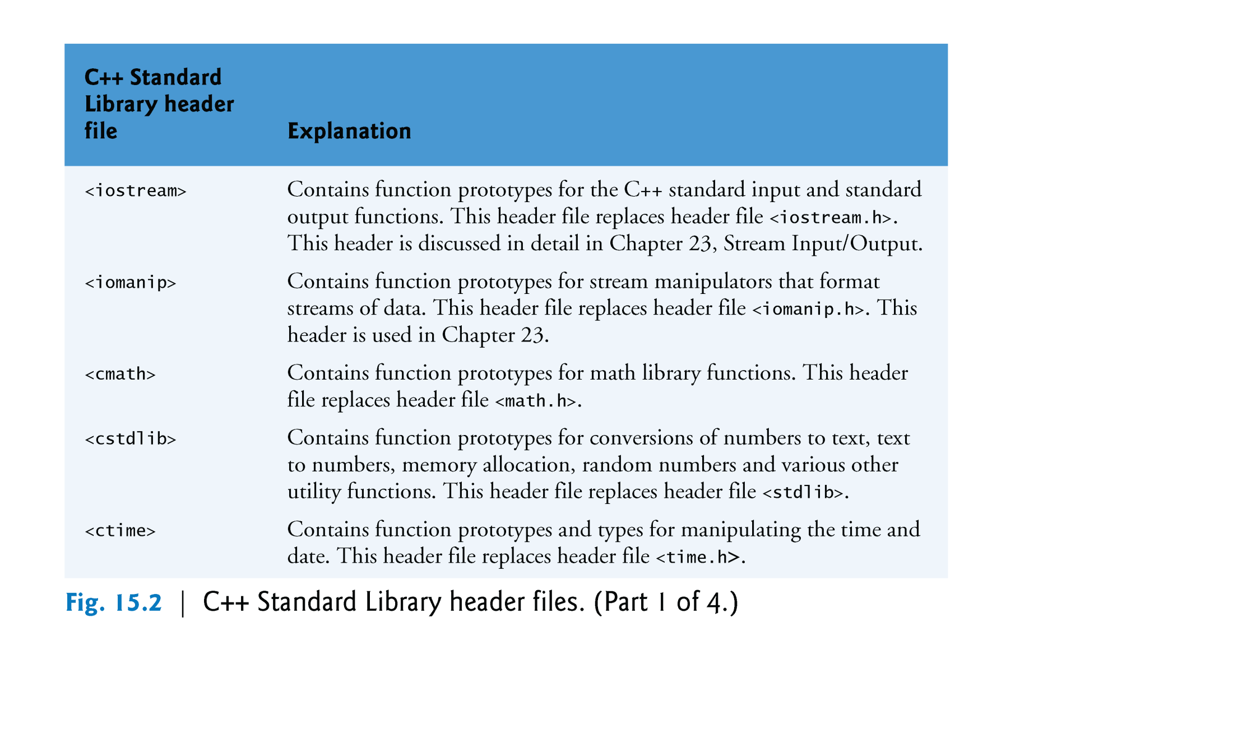
Fig. 15.2 C++ Standard
Library Header Files
Copyright © Pearson, Inc. 2013. All Rights Reserved.

Slide 11
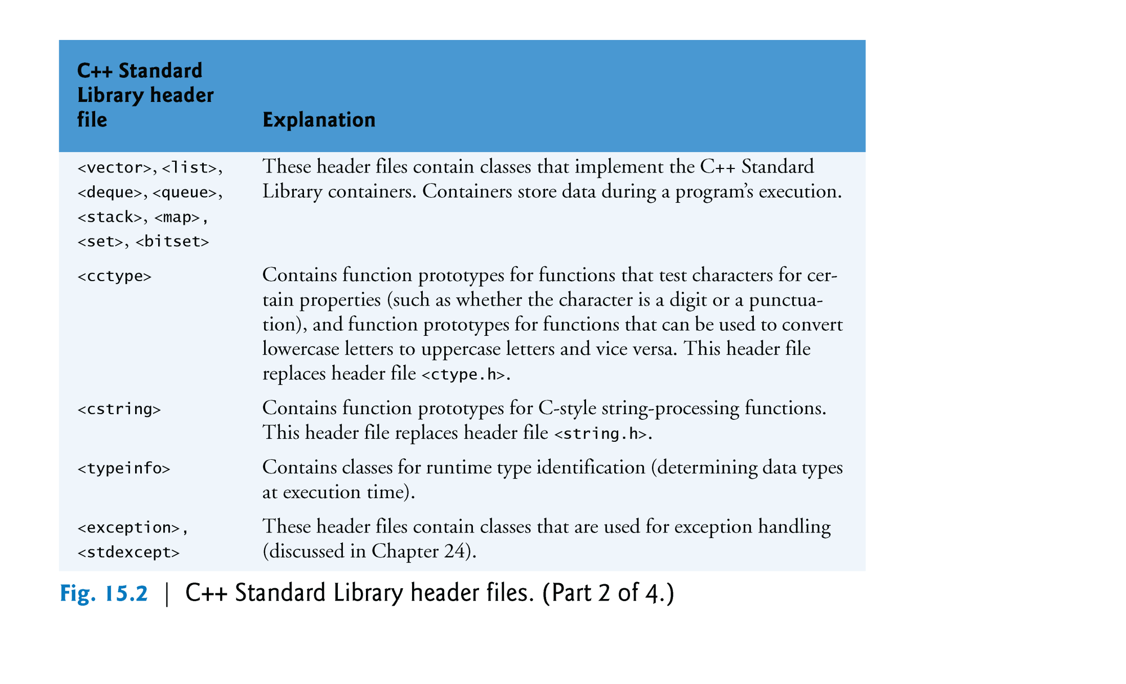
Fig. 15.2 C++ Standard
Library Header Files
Copyright © Pearson, Inc. 2013. All Rights Reserved.

Slide 12
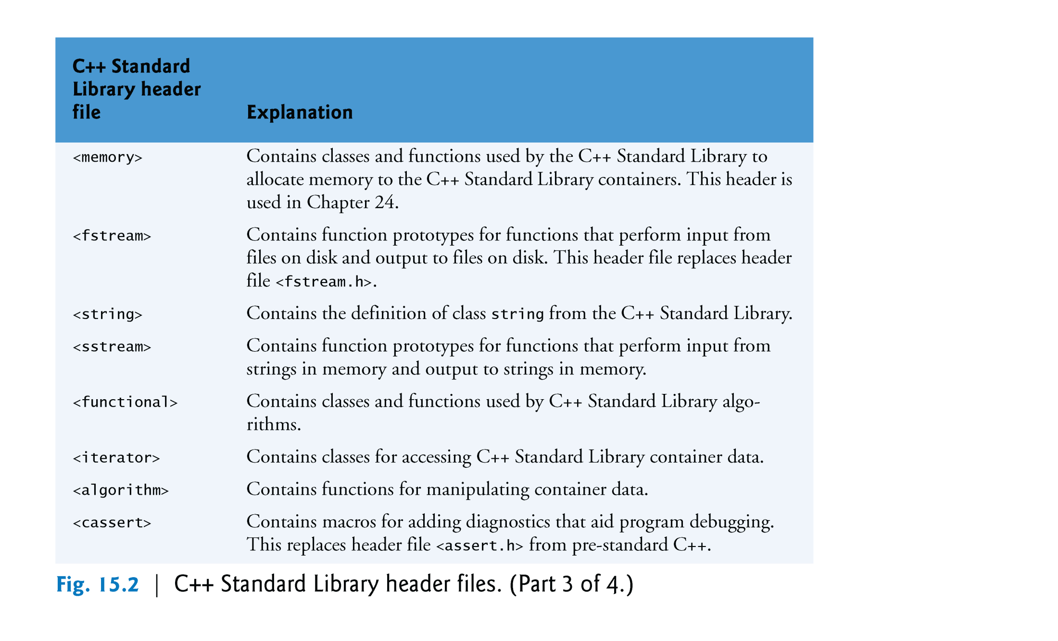
Fig. 15.2 C++ Standard
Library Header Files
Copyright © Pearson, Inc. 2013. All Rights Reserved.

Slide 13
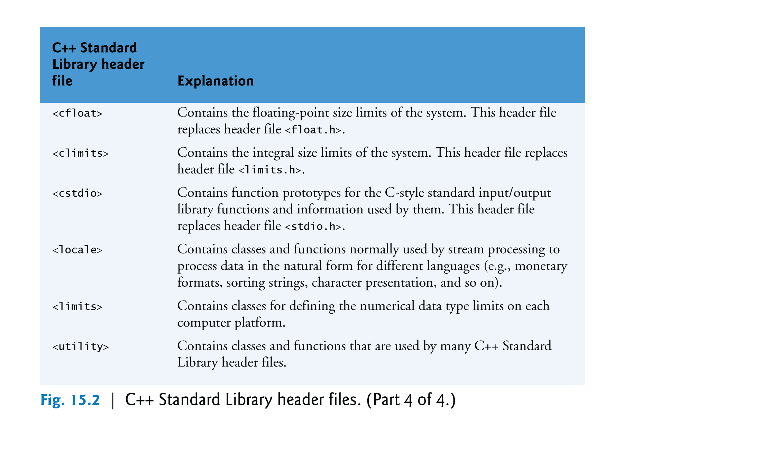
Fig. 15.2 C++ Standard
Library Header Files
Copyright © Pearson, Inc. 2013. All Rights Reserved.

Slide 14
15.6 Inline Functions
Inline functions
  Reduce function call overhead—especially for small functions.
  Qualifier inline before a function’s return type in the function definition
    “Advises” the compiler to generate a copy of the function’s code in place (when appropriate) to avoid a function call.
  Trade-off of inline functions
    Multiple copies of the function code are inserted in the program (often making the program larger).
  The compiler can ignore the inline qualifier and typically does so for all but the smallest functions.

Slide 15
Another Simple C++ Program
using avoids repeating std::
inline qualifier
Complete function definition so the compiler knows how to expand a cube function call into its inlined code.

Slide 16
Another Simple C++ Program
cube function call that could be inlined

Slide 17
Fig. 18.4 C++ keywords

Slide 18
Fig. 18.4 C++ keywords

Slide 19
15.6 Inline Functions (Cont.)
using statements help eliminate the need to repeat the namespace prefix
  Ex: std::
for statement’s condition evaluates to either 0 (false) or nonzero (true)
  Type bool represents boolean (true/false) values.
    The two possible values of a bool are the keywords true and false.
      When true and false are converted to integers, they become the values 1 and 0, respectively.
      When non-boolean values are converted to type bool, non-zero values become true, and zero or null pointer values become false.

Slide 20
15.7 References and Reference Parameters
Reference Parameter
  An alias for its corresponding argument in a function call.
  & placed after the parameter type in the function prototype and function header
  Example
    int &count in a function header
      Pronounced as “count is a reference to an int”
  Parameter name in the called function body actually refers to the original variable in the calling function.

Slide 21
Call by Reference and Call by Value in C++
Function illustrating pass-by-value
Function illustrating pass-by-reference
Variable is simply mentioned by name in both function calls

Slide 22
Call by Reference and Call by Value in C++
Receives copy of argument in main
Receives reference to argument in main
Modifies variable in main

Slide 23
15.7 References and Reference Parameters
References
  are used as aliases for other variables within a function.
    All operations supposedly performed on the alias (i.e., the reference) are actually performed on the original variable.
    An alias is simply another name for the original variable.
    Must be initialized in their declarations.
      It cannot be reassigned afterward.
  Example
    int count = 1;
    int &cRef = count;
    cRef++;
      Increments count through alias cRef.

Slide 24
References and Reference Parameters
Creating a reference as an alias to another variable in the function
Assign 7 to x through alias y

Slide 25
References and Reference Parameters
Uninitialized reference

Slide 26
References
// Three ways in C++
#include <stdio.h>
int main ()
{
int y = 8;
int &yref = y;
int *yptr = &y;
printf(" y = %d\n using ref y = %d\n using pointer y = %d\n",
y, yref, *yptr);
return 0;
}
yptr
y
8
yref
$ g++ -o ref ref.cpp
$ ./ref
y = 8
using ref y = 8
using pointer y = 8

Slide 27
References and Reference Parameters
Returning a reference from a function
  Functions can return references to variables.
    Should only be used when the variable is static.
  A Dangling reference
    Returning a reference to an automatic variable
      That variable no longer exists after the function ends.

Slide 28
15.9 Default Arguments
Default argument
  A default value to be passed to a parameter.
    Used when the function call does not specify an argument for that parameter.
  Must be the rightmost argument(s) in a function’s parameter list.
  Should be specified with the first occurrence of the function name.
    Typically in the function prototype.

Slide 29
Default Arguments
Default arguments
Calling function with no arguments
Calling function with one argument
Calling function with two arguments
Calling function with three arguments

Slide 30
Default Arguments
Note that default arguments were specified in the function prototype, so they are not specified in the function header.

Slide 31
15.10 Unary Scope Resolution Operator
Unary scope resolution operator (::)
  Used to access a global variable when a local variable of the same name is in scope.
  Cannot be used to access a local variable of the same name in an outer block.

Slide 32
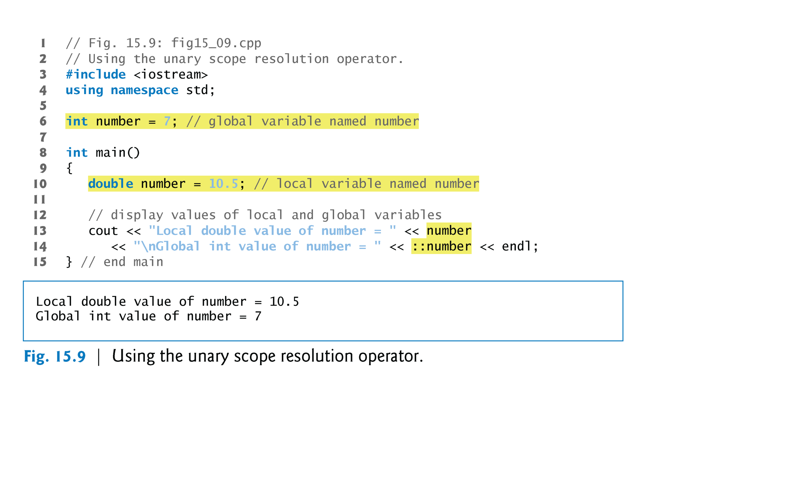
15.10 Unary Scope Resolution Operator
Unary scope resolution operator used to access global variable number
Copyright © Pearson, Inc. 2013. All Rights Reserved.

Slide 33
15.11 Function Overloading
Overloaded functions
  Overloaded functions have
    The same name
    But different sets of parameters
  Compiler selects proper function to execute based on number, types and order of arguments in the function call.
  Commonly used to create several functions of the same name that perform similar tasks, but on different data types.

Slide 34
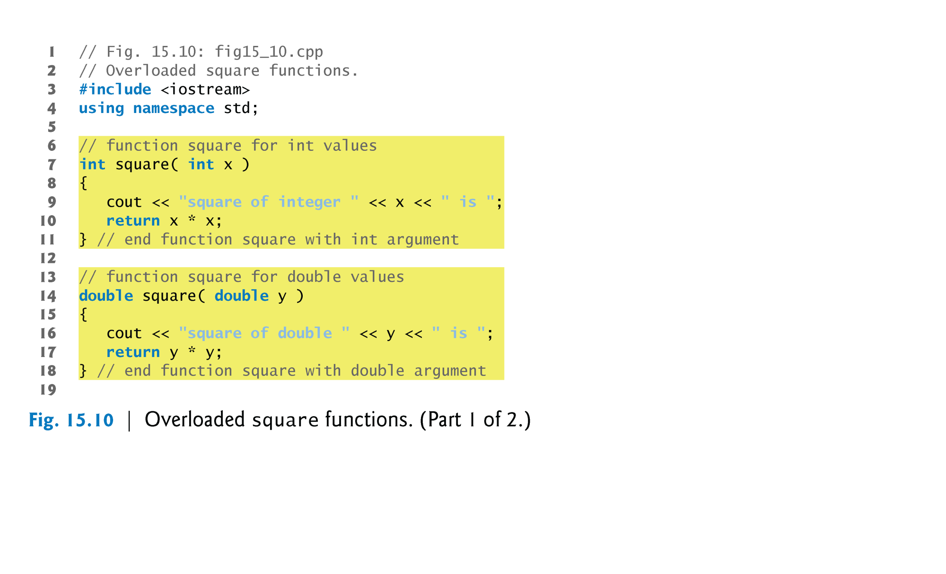
Function Overloading
Defining a square function for ints
Defining a square function for doubles

Slide 35
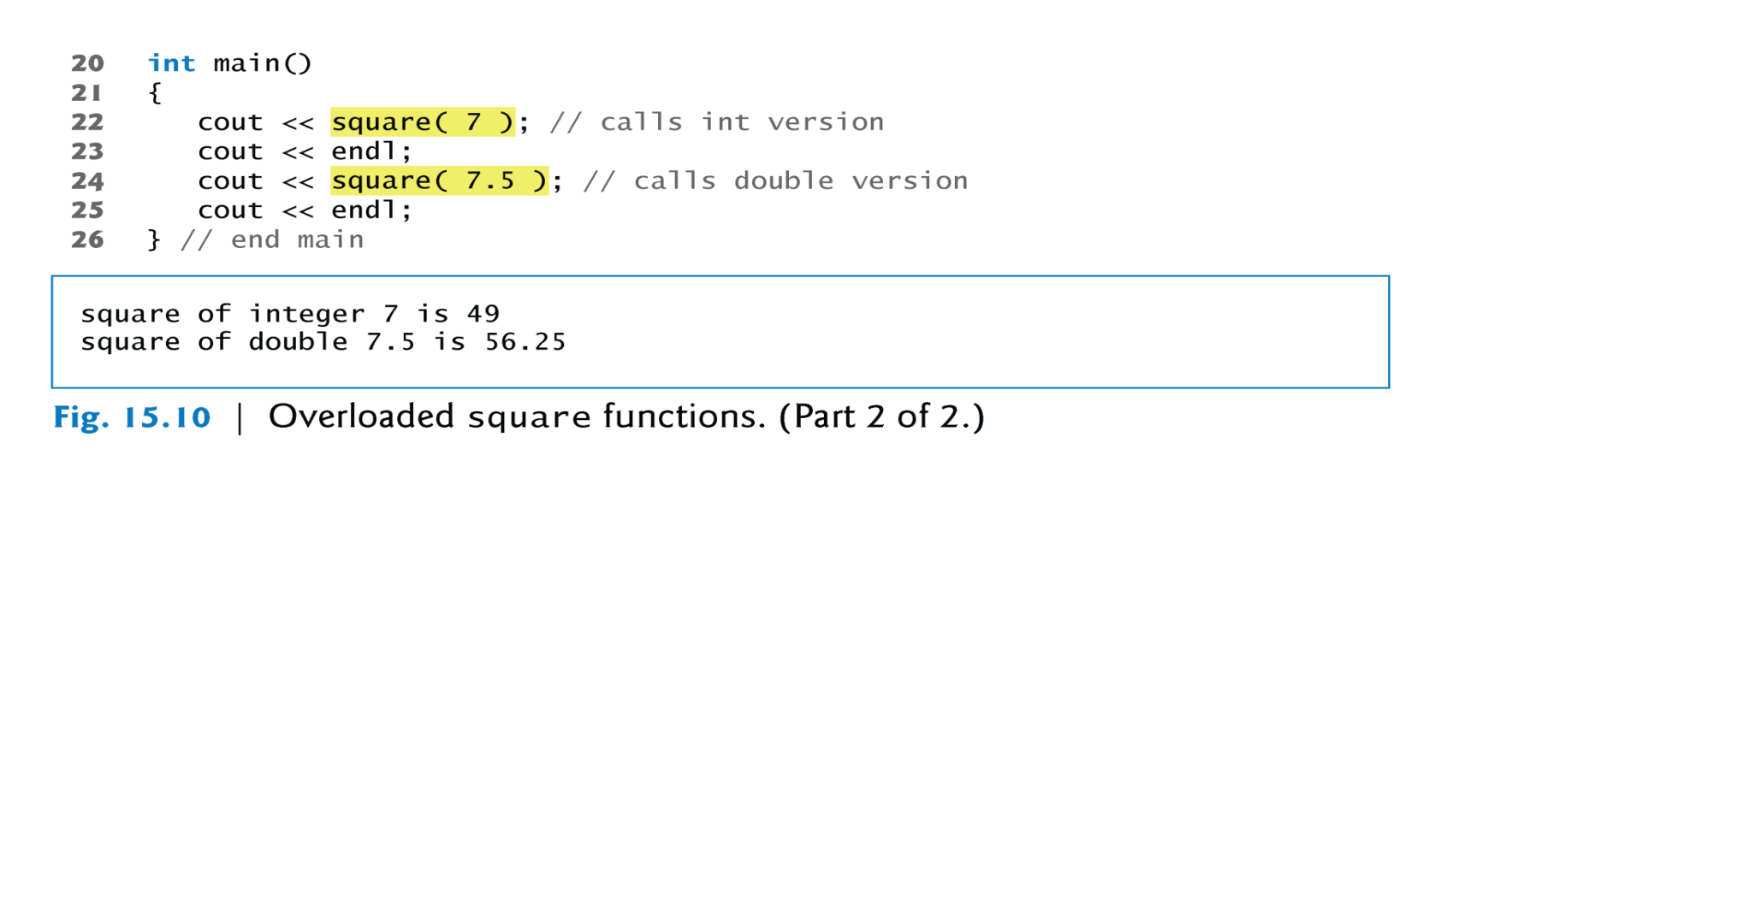
Function Overloading
Output confirms that the proper function was called in each case.

Slide 36
Constructor overload
class Listnode
{
Listnode ()
{
link = NULL;
}
Listnode( string word)
{
link = NULL;
lword = word;
}
…
Private:
Listnode* link;
string lword;
};
Provides more than
one choice

Slide 37
15.12 Function Templates
A more compact and convenient form of overloading.
  Identical program logic and operations for each data type.
Function template definition
  Written by programmer once.
  Essentially defines a whole family of overloaded functions.
  Begins with the template keyword.
  Contains a template parameter list of formal type and the parameters for the function template are enclosed in angle brackets (<>).
  Formal type parameters
    Preceded by keyword typename or keyword class.
    Placeholders for fundamental types or user-defined types.

Slide 38
15.12 Function Templates
Function-template specializations
  Generated automatically by the compiler to handle each type of call to the function template.
  Example for function template max with type parameter T called with int arguments
    Compiler detects a max invocation in the program code.
    int is substituted for T throughout the template definition.
    This produces function-template specialization max< int >.

Slide 39
Function Template Example
Note: This begins C++ style of using headers different from C
Using formal type parameter T
in place of data type

Slide 40
Common Programming Error 15.11
Not placing keyword class or keyword typename before every formal type parameter of a function template (e.g., writing < class S, T > instead of < class S, class T > ) is a syntax error.

Slide 41
Function Template Example
Invoking maximum with int arguments

Slide 42
Function Template Example
Invoking maximum with double arguments
Invoking maximum with char arguments

Slide 43
Review of Introduction to C++
Syntax differences between C and C++
A Simple C++ Example
  C++ Input/Output
C++ Libraries
  C++ Header Files
Another Simple C++ Example
  Inline Functions
Call by Reference in C++
References and Reference Parameters
43

Slide 44
Review of Introduction to C++
Default Arguments
Unary Scope Resolution Operator
Function Overloading
Function Templates
Note – I skipped Class template vector! (Read if interested and okay to use vectors in your programs).
44

