Slide 1
More
C++ Classes
Systems Programming

Slide 2
C++ Classes
Preprocessor Wrapper
Time Class Case Study
  Two versions (old and new)
Class Scope and Assessing Class Members
  Using handles to access class members
Access and Utility Functions
Destructors
Calling Constructors and Destructors

Slide 3

20.2 Preprocesor Wrappers
Prevent code from being included more than once.
  #ifndef – “if not defined”
    Skip this code if it has been included already
  #define
    Define a name so this code will not be included again
  #endif
If the header has been included previously
  Name is defined already and the header file is not included again.
Prevents multiple-definition errors
Example
  #ifndef TIME_H
  #define TIME_H
  … // code
  #endif

Slide 4
Time.h with Preprocessor Wrapper
Preprocessor directive #ifndef determines whether a name is defined
Preprocessor directive #define defines a name (e.g., TIME_H )
Preprocessor directive #endif marks the end of the code that should not be included multiple times

Slide 5
Time Class Case Study
Ensure that hour, minute and second values remain valid

Slide 6
Time Class Case Study
Using setfill stream manipulator to specify a fill character

Slide 7
Time Class Case Study

Slide 8
Time Class Case Study

Slide 9
Common Programming Error 20.1
Attempting to initialize a non-static data member of a class explicitly in the class definition is a syntax error.

Slide 10
20.2 Time Class Case Study
Parameterized stream manipulator setfill
  Specifies the fill character
    Which is displayed when an output field wider than the number of digits in the output value.
    By default, fill characters appear to the left of the digits in the number.
  setfill is a “sticky” setting
    Applies for all subsequent values that are displayed in fields wider than the value being displayed.

Slide 11
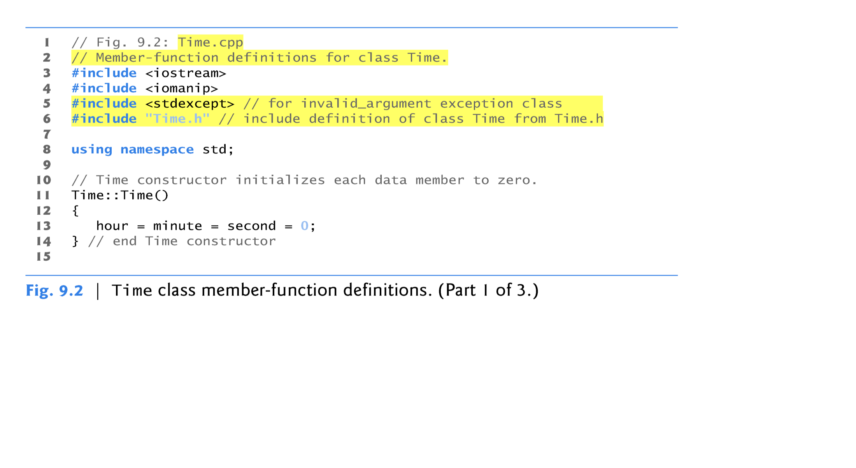
Time Class Case Study v2
Header for
handling
exceptions
Copyright © Pearson, Inc. 2013. All Rights Reserved.

Slide 12
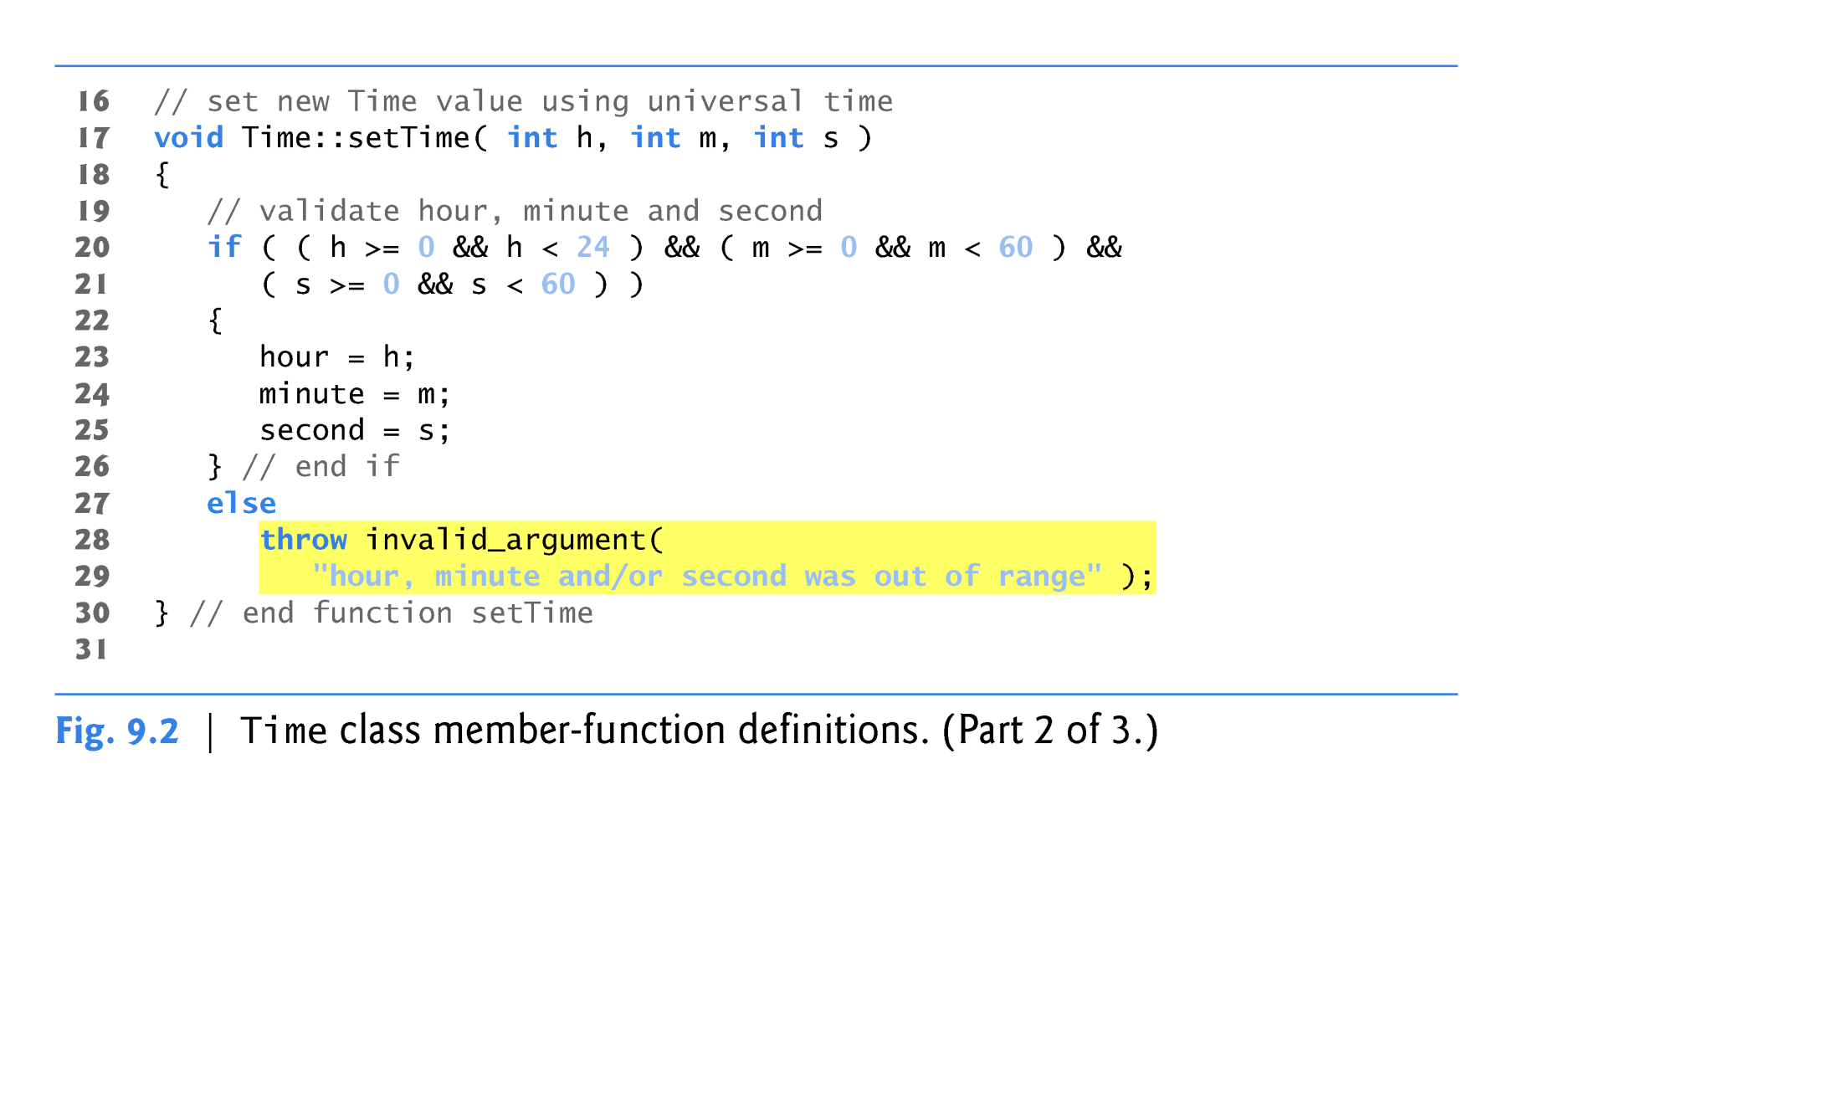
Time Class Case Study v2
throw
exception
Copyright © Pearson, Inc. 2013. All Rights Reserved.

Slide 13
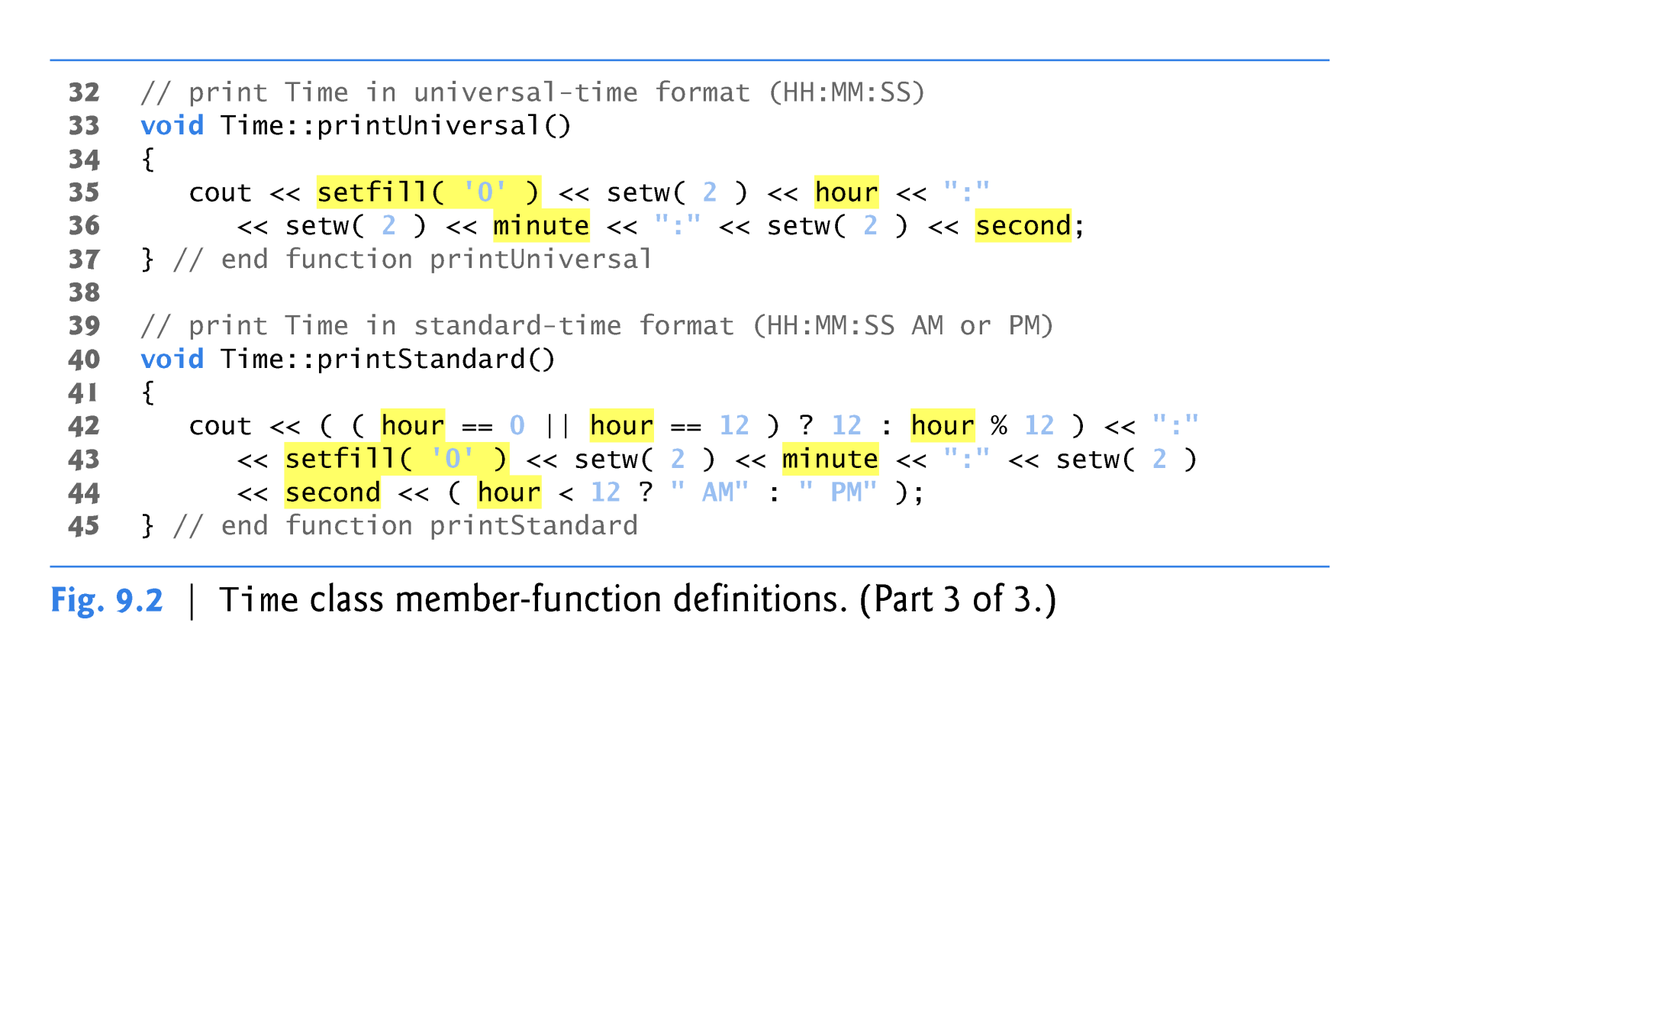
Time Class Case Study v2
Copyright © Pearson, Inc. 2013. All Rights Reserved.

Slide 14
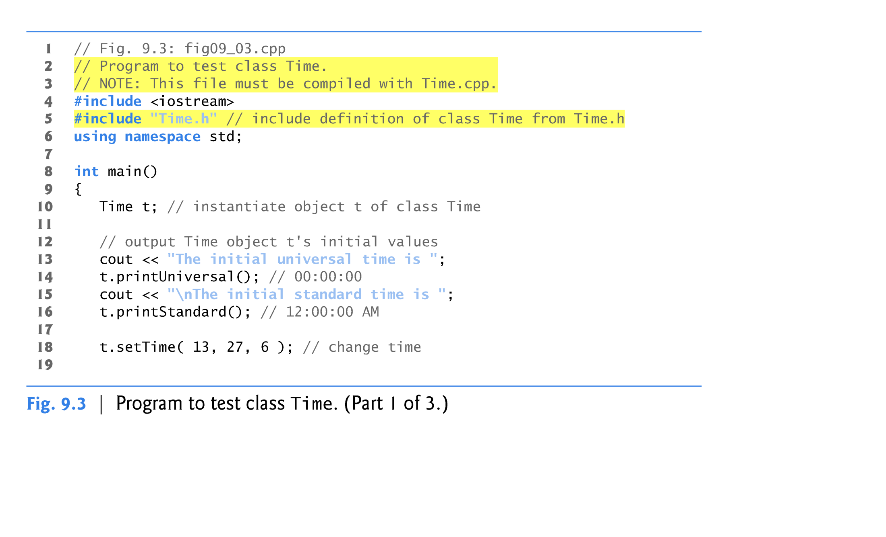
Time Class Case Study v2
Copyright © Pearson, Inc. 2013. All Rights Reserved.

Slide 15
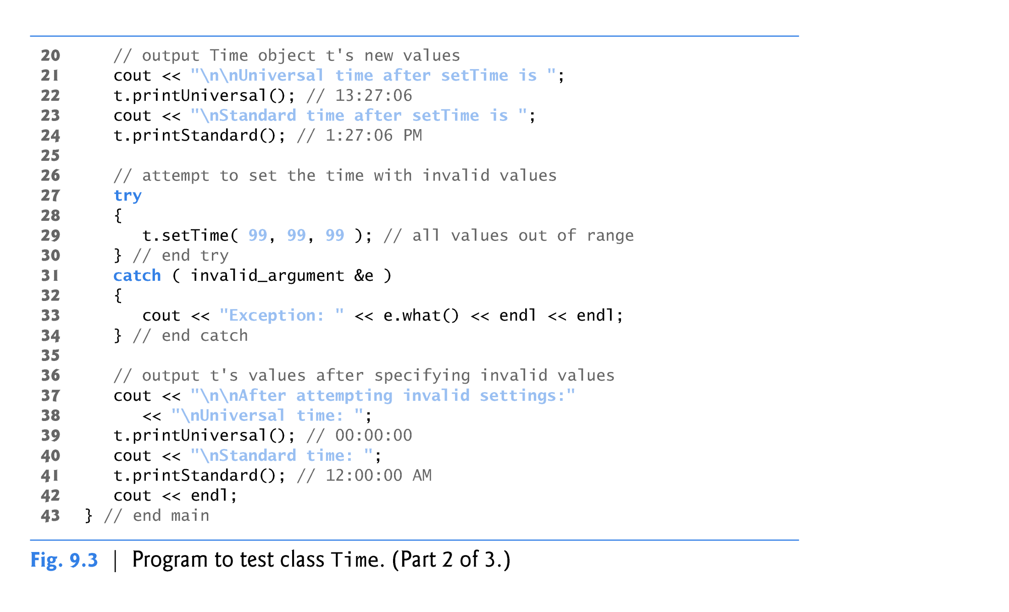
Time Class Case Study v2
Copyright © Pearson, Inc. 2013. All Rights Reserved.

Slide 16
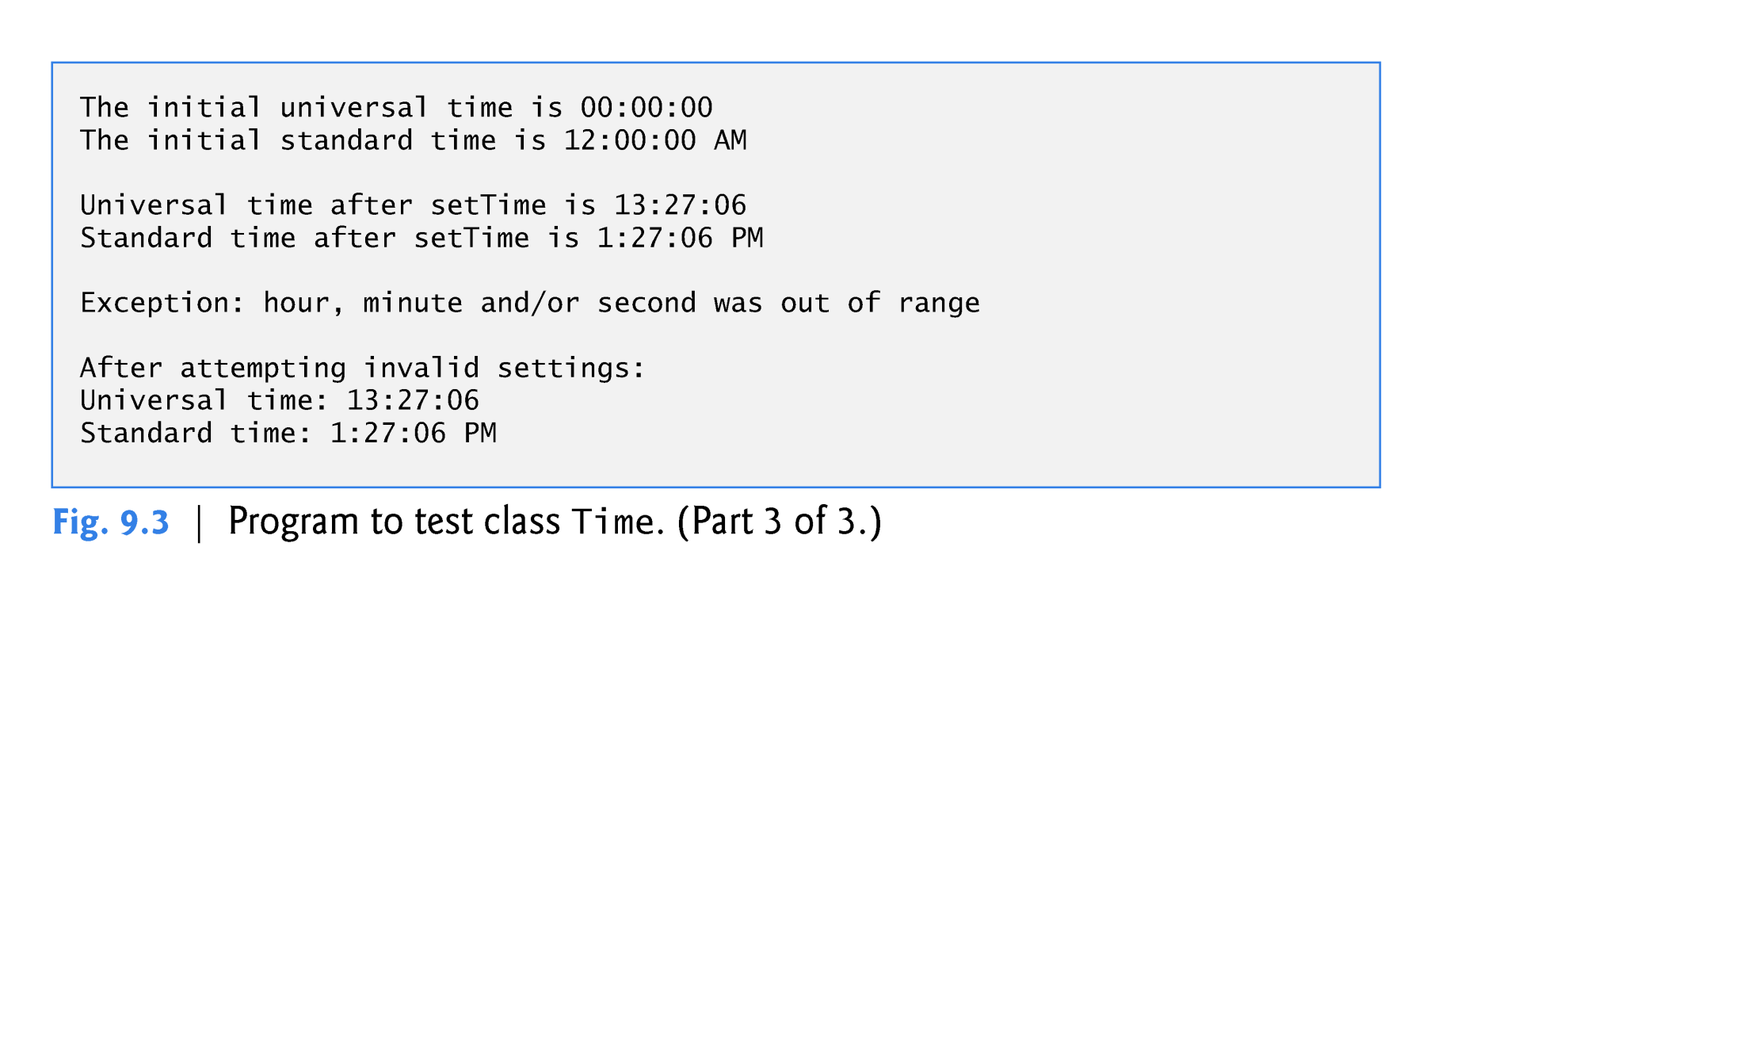
Time Class Case Study v2
Copyright © Pearson, Inc. 2013. All Rights Reserved.

Slide 17
Time Class Case Study
Member functions declared in a class definition but defined outside that class definition
  Are still within the class’s scope.
  Are known only to other members of the class unless referred to via:
    Object of the class
    Reference to an object of the class
    Pointer to an object of the class
    Binary scope resolution operator
Member function defined in the body of a class definition
  C++ compiler attempts to inline calls to the member function.

Slide 18
Time Class Case Study
Using class Time
  Once class Time has been defined, it can be used in declarations:
    Time sunset;
    Time arrayOfTimes[ 5 ];
    Time &dinnerTime = sunset;
    Time *timePtr = &dinnerTime;

Slide 19
Performance Tip 17.2
Objects contain only data, so objects are much smaller than if they also contained member functions. Applying operator sizeof to a class name or to an object of that class will report only the size of the class’s data members. The compiler creates one copy (only) of the member functions separate from all objects of the class. All objects of the class share this one copy. Each object, of course, needs its own copy of the class’s data, because the data can vary among the objects. The function code is nonmodifiable (also called reentrant code or pure procedure) and, hence, can be shared among all objects of one class.

Slide 20
17.3 Class Scope and
Accessing Class Members
Class scope contains
  Data members
    Variables declared in the class definition.
  Member functions
    Functions declared in the class definition.
Nonmember functions are defined at file scope.

Slide 21
Class Scope and Accessing Class Members
Within a class’s scope
  Class members are accessible by all member functions.
Outside a class’s scope
  public class members are referenced through a handle:
    An object name
    A reference to an object
    A pointer to an object.

Slide 22
Class Scope and Accessing Class Members
Variables declared in a member function
  Have block scope.
  Are known only to that function.
Hiding a class-scope variable
  In a member function, define a variable with the same name as a variable with class scope.
  Such a hidden variable can be accessed by preceding the name with the class name followed by the scope resolution operator (::)

Slide 23
Class Scope and Accessing Class Members
Dot member selection operator (.)
  Accesses the object’s members.
  Used with an object’s name or with a reference to an object.
Arrow member selection operator (->)
  Accesses the object’s members.
  Used with a pointer to an object.

Slide 24
Using Handles to Access Class Members

Slide 25
Using Handles to Access Class Members
Using the dot member selection operator with an object
Using the dot member selection operator with a reference
Using the arrow member selection operator with a pointer

Slide 26
17.5 Access and Utility Functions
Access functions
  Can read or display data.
  Can test the truth or falsity of conditions.
    Such functions are often called predicate functions.
    For example, isEmpty function for a class capable of holding many objects.
    Namely, a container class holding many objects such as a linked list, stack or queue.
Utility functions (also called helper functions)
  private member functions that support the operation of the class’s public member functions.
  Not part of a class’s public interface
    Not intended to be used by clients of a class.

Slide 27
Access and Utility Functions Example
Prototype for a private utility function

Slide 28
Access and Utility Functions Example

Slide 29
Access and Utility Functions Example

Slide 30
Access and Utility Functions Example
Calling a private utility function
Definition of a private utility function

Slide 31
Access and Utility Functions Example

Slide 32
17.7 Destructors
A special member function
The destructor name is the tilde character (~) followed by the class name, e.g., ~Time.
Is called implicitly when an object is destroyed.
  For example, this occurs as an automatic object is destroyed when program execution leaves the scope in which that object was instantiated.
A destructor does not release the object’s memory.
  It performs termination housekeeping.
  The system reclaims the object’s memory.
    So the memory may be reused to hold new objects.

Slide 33
Destructors
Destructor
  Receives no parameters and returns no value.
    Cannot specify a return type—not even void!
  A class may have only one destructor.
    Destructor overloading is not allowed.
  If the programmer does not explicitly provide a destructor, the compiler creates an “empty” destructor.

Slide 34
17.8 Calling Constructors and Destructors
Constructors and destructors
  Are called implicitly by the compiler.
    The order of these function calls depends on the order in which execution enters and leaves the scopes where the objects are instantiated.
  Generally,
    Destructor calls are made in the reverse order of the corresponding constructor calls.
  However,
    Storage classes of objects can alter the order in which destructors are called.

Slide 35
Calling Constructors and Destructors
For objects defined in global scope, constructors are called before any other function (including main) in that file begins execution.
The corresponding destructors are called when main terminates.
The function exit
  Forces a program to terminate immediately.
  Does not execute the destructors of automatic objects.
  Is often used to terminate a program when an error is detected.
The function abort
  Performs similarly to function exit.
  But it forces the program to terminate immediately without allowing the destructors of any objects to be called.
  Usually used to indicate an abnormal termination of the program.

Slide 36
Calling Constructors and Destructors
For an automatic local object
  A constructor is called when that object is defined.
  The corresponding destructor is called when execution leaves the object’s scope.
For automatic objects
  Constructors and destructors are called each time execution enters and leaves the scope of the object.
  Automatic object destructors are not called if the program terminates with an exit or abort function.

Slide 37
Calling Constructors and Destructors
For a static local object
  The constructor is called only once -
    When execution first reaches where the object is defined.
  The destructor is called when main terminates or the program calls function exit.
  Destructors for static objects are not called if the program terminates with a call to function abort.
Global and static objects are destroyed in the reverse order of their creation.

Slide 38
Destructor Example
Prototype for destructor

Slide 39
Destructor Example
Defining the class’s destructor

Slide 40
Destructor Example
Object created outside of main
Local automatic object created in main
Local static object created in main
Local automatic object created in main

Slide 41
Destructor Example
Local automatic object created in create
Local static object created in create
Local automatic object created in create

Slide 42
Destructor Example

Slide 43
17.10 Default Memberwise Assignment
Default memberwise assignment
  Assignment operator (=)
    Can be used to assign an object to another object of the same type.
      Each data member of the right object is assigned to the same data member in the left object.
    Can cause serious problems when data members contain pointers to dynamically allocated memory !!

Slide 44
17.10 Default Memberwise Assignment
Default initialization of data members

Slide 45
17.10 Default Memberwise Assignment

Slide 46
17.10 Default Memberwise Assignment
memberwise assignment assigns data members of date1 to date2
date2 now stores the same date as date1

Slide 47
17.10 Default Memberwise Assignment
Copy constructor
  Enables pass-by-value for objects
    Used to copy original object’s values into new object to be passed to a function or returned from a function
  Compiler provides a default copy constructor
    Copies each member of the original object into the corresponding member of the new object (i.e., memberwise assignment).
  Can cause serious problems when data members contain pointers to dynamically allocated memory!!

Slide 48
Review of More C++
Preprocessor Wrapper Example
Time Class Case Study
  Setfill, setw, conditional
Class Scope and Assessing Class
  Handles
  Members
  Using handles to access class members
  Dot and arrow member selection operators.
Access and Utility Functions
  Predicates, container classes and helpers
Destructors
  Restrictions, default, order of execution
  Functions exit and abort
Calling Constructors and Destructors
  Differences between static and automatic objects
  Destructor Example
Default Memberwise Assignment
  Default Copy Constructor

